Slide 1
Univariate EDA
Purpose – describe the distribution
Distribution is concerned with what values a variable takes and how often it takes each value
Four characteristics
Shape
Outliers
Center
Dispersion

Slide 2
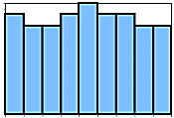
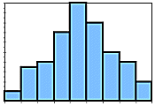
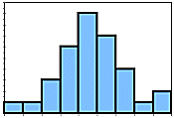
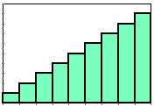
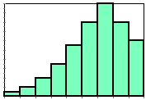
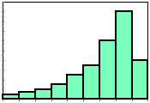
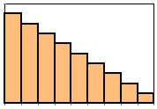
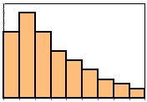
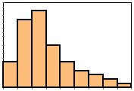
Quantitative Univariate EDA
Shape
Symmetric
Left-skewed
Right-skewed

Slide 3
Quantitative Univariate EDA
Outlier
Individual(s) that is/are distinctly separate* from the main cluster of individuals
*at least one or two bars removed
*only one or two individuals
*on the margins of the distribution

Slide 4
Quantitative Univariate EDA
Center
Mean (arithmetic average)
Median (value in the middle of ordered data)
μ = population mean
‾x = sample mean
Μ = sample median

Slide 5
Quantitative Univariate EDA
Dispersion -- variability among individuals
Range (minimum, maximum)
Inter-Quartile Range (IQR; Q1, Q3)
Standard Deviation (average difference from mean)
σ = population standard deviation
s = sample standard deviation

Slide 6
Overall Numerical Summaries
If outliers exist then use the Median and IQR
If outliers do not exist, but distribution is strongly skewed then use the Median and IQR
If outliers do not exist and the distribution is symmetric or only slightly skewed then use the Mean and standard deviation

Slide 7
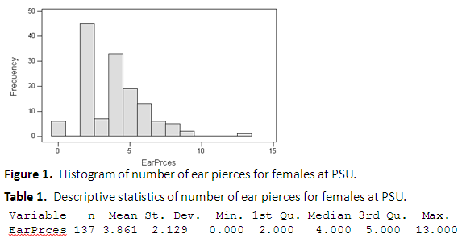
Describe a univariate EDA for the data in Figure 1 and Table 1.
The distribution of number of ear pierces is right-skewed and bimodal with an obvious outlier at 13, centered on a median of 4, with an IQR from 2 to 5 (Figure 1; Table 1). I used the median and IQR as measures of center and dispersion because of the outlier and skew of the distribution.

Slide 8
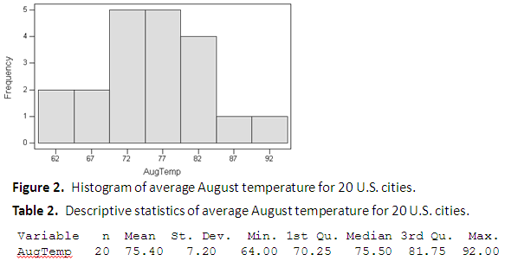
Describe a univariate EDA for the data in Figure 2 and Table 2.
The distribution of average August temperatures is approximately symmetric with no obvious outliers, centered on a mean of 75.4, with a standard deviation of 7.2 (Figure 2; Table 2). I used the mean and standard deviation as measures of center and dispersion because no outliers were present and the distribution was not strongly skewed.

Slide 9
Describe a univariate EDA for the data in Figure 3.
Figure 3. Histogram of 1996 tuition for 30 public and 50 private colleges and universities.

Slide 10
Table 3. Summary statistics of 1996 tuition for 30 public and 50 private colleges and universities.
Statistic Public Private
Mean 14370 24150
Std. Dev. 2755 3556
Min. 11050 16740
1st Qu. 12660 21260
Median 13590 25430
3rd Qu. 15420 26910
Max. 23460 29910
Figure 4. Boxplot of 1996 tuition for 30 public and 50 private colleges and universities.
The distribution of tuition for private schools is left-skewed with no obvious outliers, centered on a median of 25430, with an IQR from 21260 to 26910 (Figure 4; Table 3). The distribution of tuition for public schools is right-skewed with one outlier at a tuition of 23460, centered on a median of 13590, with an IQR from 12660 to 15420 (Figure 4; Table 3). I chose to use the median and IQR as measures of center and dispersion because of the outlier and the skewness of the distributions.

