Slide 1
2-Sample t-test -- Examples
Do test scores differ between sections of a class?
Is the average number of yew per m² different between areas exposed to and areas protected from moose browsing?
Does the time from ingesting a pill until a subject claims no more headache pain less for subjects given an experimental drug as compared to those given a placebo?

Slide 2
2-sample t-test
H_{o}: μ₁ = μ₂ (where the subscript is a sample index)
Statistic:
because μ₁=μ₂ same as μ₁-μ₂=0
- 0
Test Statistic:
where s_{p}² is the pooled sample variance
df = n₁ + n₂ - 2

Slide 3
2-sample t-test
Assume:
n₁ + n₂ is large (to use a t-distribution)
n₁ + n₂ > 40, OR
n₁ + n₂ > 15 and both histograms are not strongly skewed, OR
both histograms are approximately normal
the two samples are independent
σ₁² = σ₂²
Are σ₁² & σ₂² parameters or statistics?
Hypothesis Test -- Levene’s Test
H_{o}: σ₁² = σ₂² vs H_{a}: σ₁² ≠ σ₂²
What do you do with the p-value?

Slide 4
Levene’s Test Summary
A hypothesis test within a hypothesis test.
Small p-values mean the variances are unequal.
If Levene’s test is a reject, can not continue with the 2-sample t-test (as presented here).

Slide 5
2-sample t-test
When: samples from two populations, samples are independent, quantitative variable

Slide 6
A Full Example
A study of the effect of caffeine on muscle metabolism used 36 male volunteers who each underwent arm exercise tests. Eighteen of the men were randomly selected to take a capsule containing pure caffeine one hour before the test. The other men received a placebo capsule. During each exercise the subject's respiratory exchange ratio (RER) was measured. [RER is the ratio of CO₂ produced to O₂ consumed and is an indicator of whether energy is being obtained from carbohydrates or fats]. The question of interest to the experimenter was whether, on average and at the 5% level, caffeine changed mean RER.

Slide 7
A Full Example
Group n Mean StDev Min 1st Qu Median 3rd Qu Max
Caffeine 18 94.22 4.870 84.0 93.00 94.00 96.75 105.0
Placebo 18 100.10 5.795 89.0 96.25 100.50 103.00 109.0
Levene’s Test p-value = 0.1993
Caffeine
Placebo
6
6
4
4
Frequency
Frequency
2
2
0
0
80
85
90
95
100
105
85
90
95
100
105
110
RER
RER

Slide 8
Recipe for any Hypothesis Test
1) State the rejection criterion (α)
α=0.05
2) State the null & alternative hypotheses, define the parameter(s)
H_{o}: μ_{c}−μ_{p} = 0
H_{a}: μ_{c}−μ_{p} ≠ 0
where μ_{c} is mean RER for all males given the caffeine pill
μ_{p} is mean RER for all males given the placebo

Slide 9
Recipe for any Hypothesis Test
3) Determine which test to perform – Explain!
2-sample t-test … because …
(a) two populations were considered (caffeine and placebo groups),
(b) the populations are independent (there is no connection between males in the two groups), and
(c) a quantitative variable (RER) was recorded.
4) Collect the data (address type of study and randomization)
(i) Experiment (pill was controlled by experimenter to form treatments)
(ii) Random allocation of individuals to treatments, but not random selection from population for inclusion in the experiment

Slide 10
Recipe for any Hypothesis Test
5) Check all necessary assumption(s)
n_{c}+n_{p} = 18+18 = 36 >15 and histograms not strongly skewed
(ii) Two samples are independent
Caffeine
Placebo
6
6
4
4
Frequency
Frequency
2
2
0
0
80
85
90
95
100
105
85
90
95
100
105
110
RER
RER

Slide 11
Recipe for any Hypothesis Test
5) Check all necessary assumption(s)
(iii) Variances are equal
2. H_{o}: Variances are equal H_{a}: Variances are not equal
3. Levene’s Test
8. p-value = 0.1993
9. p-value > α (0.05) … DNR H_{o}
10. Variances appear to be equal

Slide 12
Group n Mean StDev Min 1st Qu Median 3rd Qu Max
Caffeine 18 94.22 4.870 84.0 93.00 94.00 96.75 105.0
Placebo 18 100.10 5.795 89.0 96.25 100.50 103.00 109.0
6) Calculate the appropriate statistic(s)
‾x_{c} -‾x_{p} = 94.22-100.10 = -5.88
7) Calculate the appropriate test statistic
df = 18 + 18 – 2 = 34

Slide 13
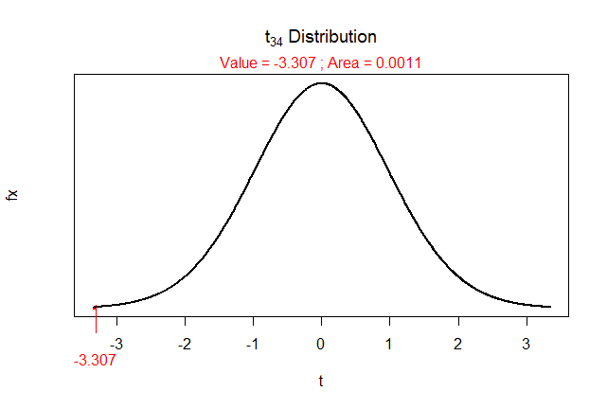
Recipe for any Hypothesis Test
8) Calculate the p-value
9) State your rejection decision
p-value (0.0022) < α (0.05) …. Reject H_{o}
10) Summarize your findings in terms of the problem
The mean RER appears to differ between the males that received the caffeine pill and those that received the placebo.
> 2*distrib(-3.307,distrib="t",df=34)
[1] 0.002233631

Slide 14
Recipe for any Hypothesis Test
11) If rejected H₀, compute a 100(1-α)% confidence region for parameter
(i) 100(1-0.05)% = 95%
(ii) Interval … because H_{a} was not equals
(iii) t* = ±2.032 … from
(iv) -5.88 ± 2.032*1.778
-5.88 ± 3.61
(-9.49, -2.27)
(v) I am 95% confident that the mean RER for those that received the caffeine pill is between 2.27 and 9.49 units lower than for those that received the placebo.
> ( distrib(0.025,distrib="t",df=34,type="q") )
[1] -2.032245

