Slide 1
Univariate EDA
Purpose – describe the distribution
Distribution is concerned with what values a variable takes and how often it takes each value
Quantitative vs. Categorical
Do NOT describe shape, center, dispersion, or outliers with CATEGORICAL data.
Identify the most outstanding characteristics.

Slide 2
Numerical Summaries
Frequency Table
Percentages Table
Red
Blonde
Blonde
Brunette
Blonde
Red
Blonde
Red
Hair Color | Freq
Blonde
Brunette
Red
Hair Color | Perc
Blonde
Brunette
Red
4
50.0
1
12.5
3
37.5

Slide 3
Graphical Summaries
Bar chart
Bars over category label
Height is frequency of individuals in that category
Hair Color | Freq
Blonde | 4
Brunette | 1
Red | 3

Slide 4
Overall Summary
Identify most outstanding characteristic(s)
Most student were blondes and very few were brunettes.
Hair Color | Freq
Blonde | 4
Brunette | 1
Red | 3

Slide 5
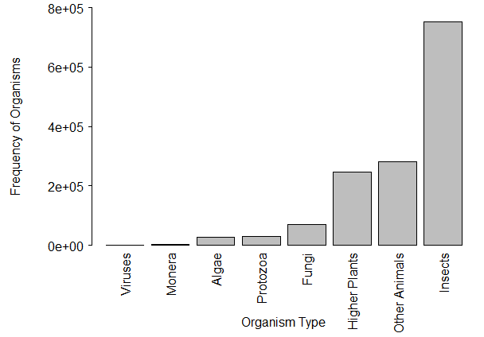
Figure 4. Bar chart of the number of KNOWN species by organism type.
Insects are by far the type of organism with the most known species, followed by “other animals” and “higher plants.”

Slide 6
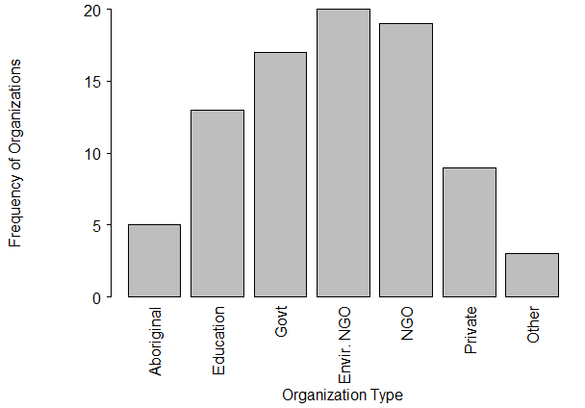
Figure 5. Bar chart of the types of organizations that received funding by the Invasive Alien Species Partnership Program (Canada), 2005-2010.
There is fairly even distribution of funding to the government, environmental NGOs, and non-environmental NGOs. Lesser amounts are awarded to educational and private organizations. Aboriginal groups received the least funding.

Slide 7
Pie Charts
Pie chart
Circle with pieces proportional to category frequencies
Hair Color | Freq
Blonde | 4
Brunette | 1
Red | 3

Slide 8
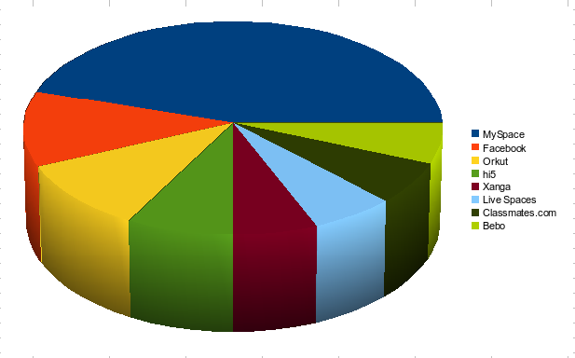
no, No, NO!!!

Slide 9
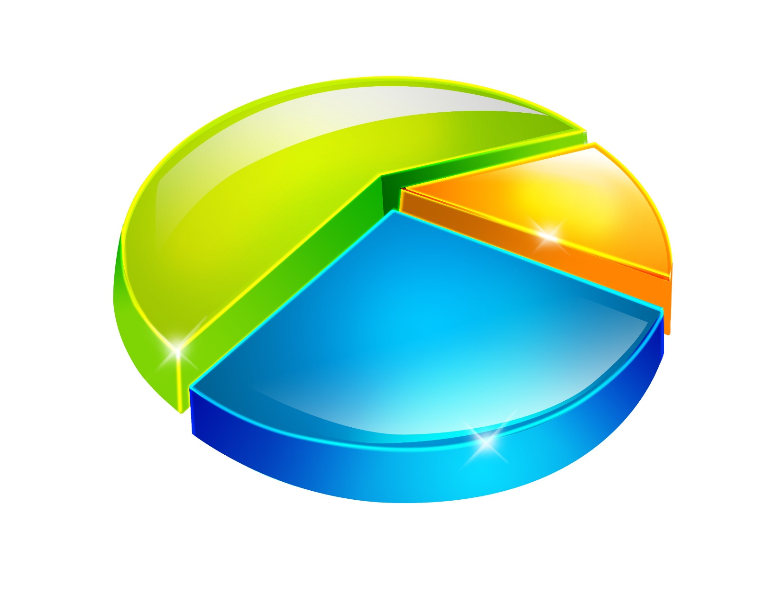
no, No, NO!!!

Slide 10
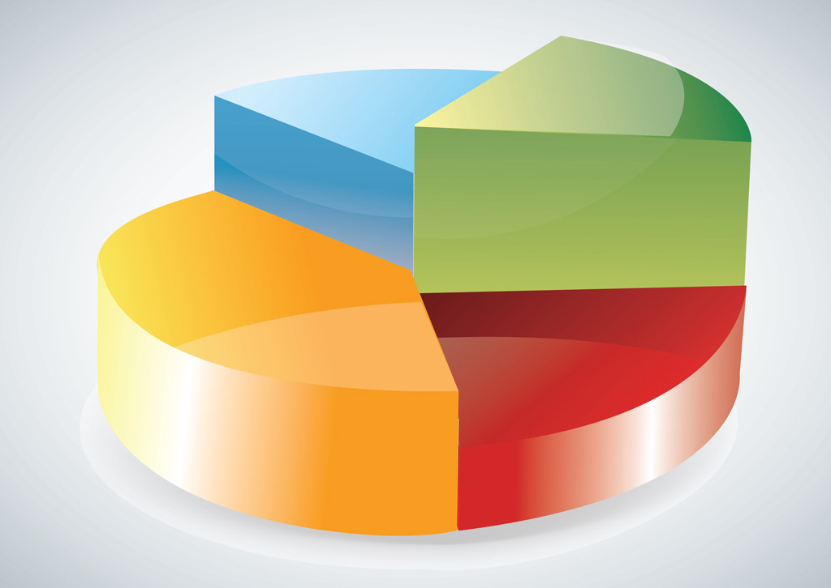
no, No, NO!!!

Slide 11

no, No, NO!!!

