Slide 1
Univariate EDA

Slide 2
Exploratory Data Analysis
Univariate EDA – Describe the distribution
Distribution is concerned with what values a variable takes and how often it takes each value
Univariate EDA (for quantitative data)
Graphically
Numerically
Model

Slide 3
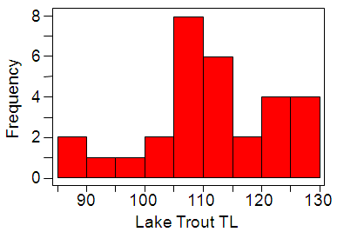
What is this graph called?
How many lake trout were in the 100-105 mm bin?
What is the most common range of lengths?
Which range of lengths has the fewest lake trout?
How many lake trout were exactly 108 mm?

Slide 4
Quantitative Univariate EDA
What four things are described?
Shape
Outliers
Center
Dispersion

Slide 5
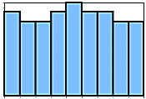
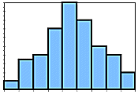
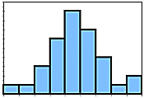
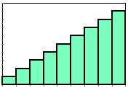
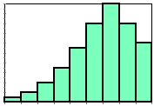
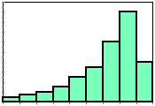
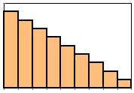
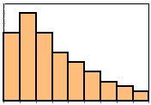
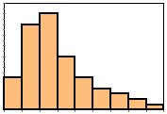
Quantitative Univariate EDA
Shape – what are these three shapes?
Symmetric
Left-skewed
Right-skewed

Slide 6
Quantitative Univariate EDA
Outliers – what is an outlier?
Individual(s) that is/are distinctly separate* from the main cluster of individuals
*at least one or two bars removed
*only one or two individuals
*on the margins of the distribution

Slide 7
Quantitative Univariate EDA
Center – what are the two measures of center?
Mean (arithmetic average)
Median (value in the middle of ordered data)
μ = population mean
‾x = sample mean
Μ = sample median

Slide 8
Compute the‾x and M of values (faculty salaries) below with and without the red value.
38, 46, 42, 44, 44, 43, 45, 45, 46, 44, 139
Examine meanMedian() graphic
Notes:
library(NCStats)
meanMedian(c(1,15:35))
meanMedian(c(1:7,35))
meanMedian()

Slide 9
Adequacy of Mean?
18, 19, 20, 21, 22 ➔ ‾x = 20
5, 15, 20, 25, 35 ➔ ‾x = 20
Does the mean adequately relate all pertinent information for these samples?
If not, what is missing?

Slide 10
Quantitative Univariate EDA
Dispersion -- variability among individuals
What are the three measures of dispersion?
Range (minimum, maximum)
Inter-Quartile Range (IQR; Q1, Q3)
Standard Deviation (average difference from mean)
σ = population standard deviation
s = sample standard deviation

Slide 11
Standard Deviation
Calculation Steps
1) Find the sample mean
2) Find each difference from the mean
3) Square each difference
4) Sum squared differences
5) Divide by n-1
6) Square root

Slide 12
Compute s from the values below (use table 3.4 in the book as a model).
5, 8, 9, 11, 12
Compute the IQR of values (faculty salaries) below with and without the red value.
38, 46, 42, 44, 44, 43, 45, 45, 46, 44, 139

Slide 13
Quantitative Univariate EDA in R
Examine Handout
hist()
Summarize()

Slide 14
Overall Numerical Summaries
If outliers exist then use the Median and IQR
If outliers do not exist, but distribution is strongly skewed then use the Median and IQR
If outliers do not exist and the distribution is symmetric or only slightly skewed then use the Mean and standard deviation

Slide 15
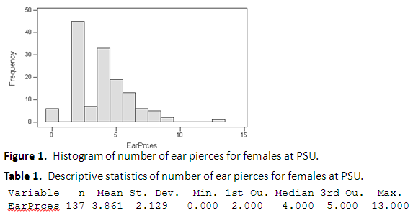
What four items are described in a univariate EDA for quantitative data?
Describe a univariate EDA for the data in Figure 1 and Table 1.

Slide 16
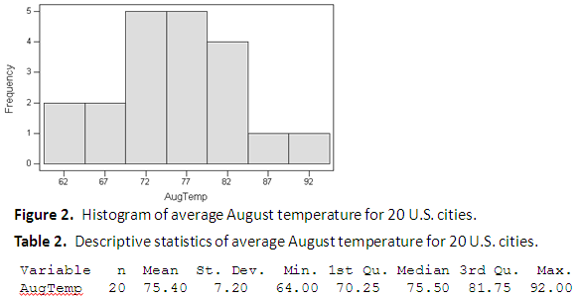
Describe a univariate EDA for the data in Figure 2 and Table 2.

Slide 17
Figure 3. Histogram of 1996 tuition for 30 public and 50 private colleges and universities.
Describe a univariate EDA for the data in Figure 3.

Slide 18
Table 3. Summary statistics of 1996 tuition for 30 public and 50 private colleges and universities.
Statistic Public Private
Mean 14370 24150
Std. Dev. 2755 3556
Min. 11050 16740
1st Qu. 12660 21260
Median 13590 25430
3rd Qu. 15420 26910
Max. 23460 29910
Figure 4. Boxplot of 1996 tuition for 30 public and 50 private colleges and universities.
The distribution of tuition for private schools is left-skewed with no obvious outliers, centered on a median of 25430, with an IQR from 21260 to 26910 (Figure 4; Table 3). The distribution of tuition for public schools is right-skewed with one outlier at a tuition of 23460, centered on a median of 13590, with an IQR from 12660 to 15420 (Figure 4; Table 3). I chose to use the median and IQR as measures of center and dispersion because of the outlier and the skewness of the distributions.

Slide 19
Quantitative vs. Categorical
Do NOT describe shape, center, dispersion, or outliers with CATEGORICAL data.
Identify the most outstanding characteristics.

Slide 20
Numerical Summaries
Frequency Table
Percentages Table
Red
Blonde
Blonde
Brunette
Blonde
Red
Blonde
Red
Hair Color | Freq
Blonde
Brunette
Red
Hair Color | Perc
Blonde
Brunette
Red
4
50.0
1
12.5
3
37.5

Slide 21
Graphical Summaries
Bar chart
Bars over category label
Height is frequency of individuals in that category
Hair Color | Freq
Blonde | 4
Brunette | 1
Red | 3

Slide 22
Graphical Summaries
Bar chart
Pie chart
Circle with pieces proportional to category frequencies
Hair Color | Freq
Blonde | 4
Brunette | 1
Red | 3

Slide 23
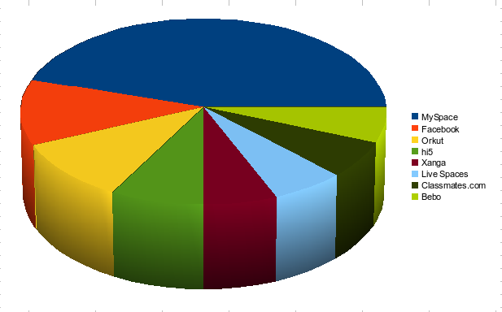
no, No, NO!!!

Slide 24

no, No, NO!!!

Slide 25
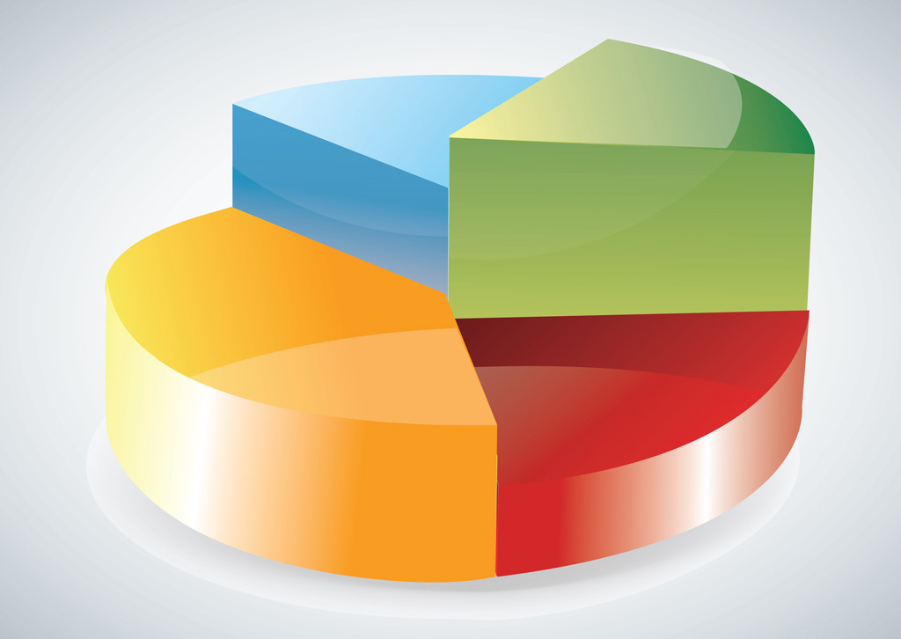
no, No, NO!!!

Slide 26

no, No, NO!!!

Slide 27
Overall Summary
Identify most outstanding characteristic(s)
Most student were blondes and very few were brunettes.
Hair Color | Freq
Blonde | 4
Brunette | 1
Red | 3

Slide 28
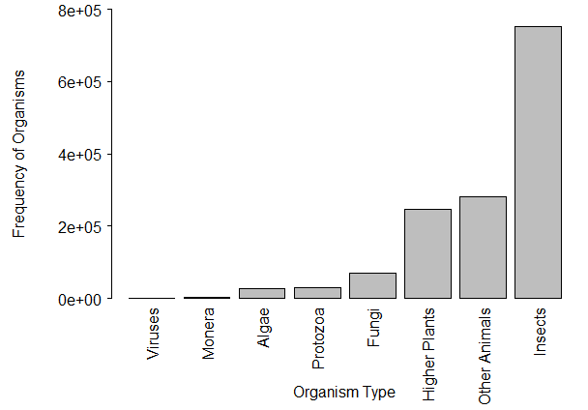
Figure 4. Bar chart of the number of KNOWN species by organism type.
Describe a univariate EDA for the data in Figure 4.

Slide 29
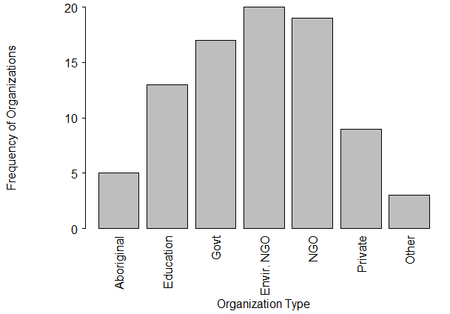
Figure 5. Bar chart of the types of organizations that received funding by the Invasive Alien Species Partnership Program (Canada), 2005-2010.
Describe a univariate EDA for the data in Figure 5.

Slide 30
Categorical Univariate EDA in R
Examine Handout
xtabs()
percTable()
barplot()

