Slide 1
Bivariate EDA
Describe the relationship between pairs of variables
Four characteristics to describe
Association (Direction)
Form
Outliers
Strength

Slide 2
Bivariate EDA - Description
Association (Direction)
Positive
Negative
None
130
+
120
110
Y
100
-
90
80
70
70
80
-
90
100
110
+
120
130
X

Slide 3
Bivariate EDA - Description
Form
Linear Non-linear

Slide 4
Bivariate EDA - Description
Outliers
130
120
110
Y
100
90
80
70
70
80
90
100
110
120
130
X

Slide 5
Bivariate EDA - Description
Strength -- how closely the points cluster to the form

Slide 6
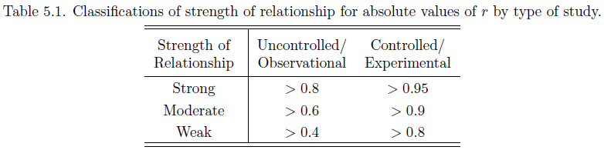
Correlation Coefficient
A measure of association and strength
-1
0
+1
Strongest
Weakest
Strongest

Slide 7
Correlation Coefficient
A measure of association and strength of a linear relationship with no outliers
Moral … PLOT YOUR DATA!!
r = 0.817
r = 0.817
r = 0.817
r = 0.817

Slide 8
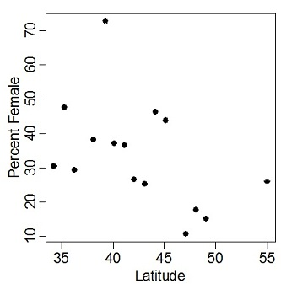
Perform a bivariate EDA from Figure 1.
r = -0.673
Figure 1. Plot of the percent female kingfishers observed at different latitudes during the Christmas Bird Count, 1992.

Slide 9
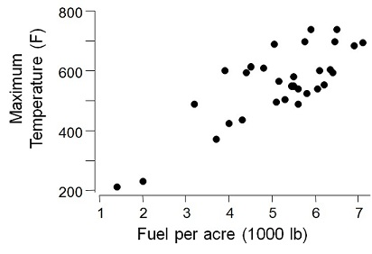
Perform a bivariate EDA from Figure 2.
r=0.798
Figure 2. Plot of the maximum temperature versus herbage yield for grassland headfires in west Texas.

Slide 10
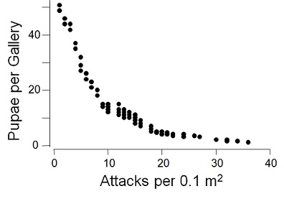
Perform a bivariate EDA from Figure 3.
r=-0.612
Figure 3. Plot of the number of pupae per gallery and the density of attacks for the beetle Ips cembrae

