Slide 1
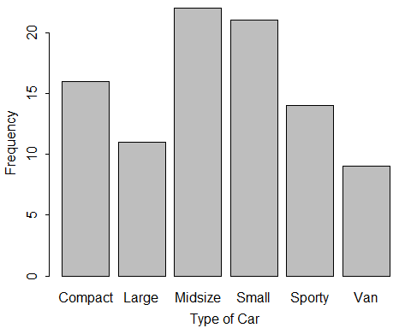
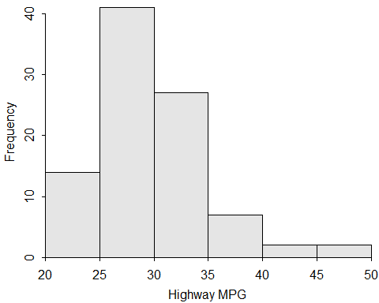
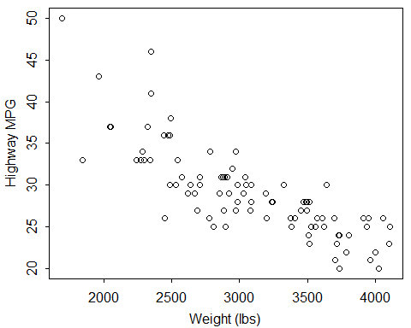
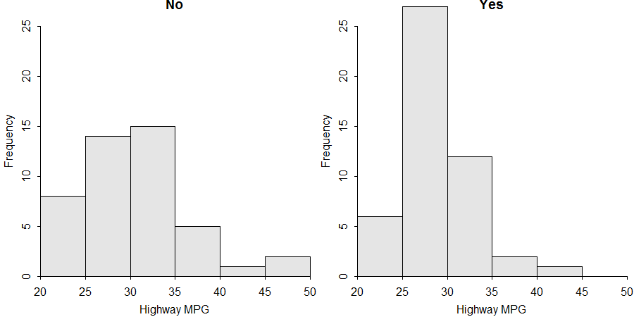
Get and Load Data
Univariate EDA
Bivariate EDA
ENTER RAW DATA:
In Excel, enter variables in columns with variable names in the first row, each individual’s data in rows below that (do not use spaces or special characters).
Save as “Comma Separated Values (*.CSV)” file in your local directory/folder.
DATA PROVIDED BY PROFESSOR:
Goto the MTH107 Resources webpage.
Save “data” link (right-click) to your local directory/folder.
LOAD THE EXTERNAL CSV FILE INTO R:
Start script and save it in the same folder with the CSV file.
Select the Session, Set Working Directory, To Source File Location menus.
Copy resulting setwd() code to your script.
Use read.csv() to load data in filename.csv into dfobj.
Observe the structure of dfobj.
CATEGORICAL – Frequency table, percentage table, and bar chart for the cvar variable.
CATEGORICAL – Frequency and percentage tables for the cvarRow and cvarCol variables.
( freq1 <- xtabs(~cvar,data=dfobj) )
percTable(freq1,digits=1)
barplot(freq1,xlab="better cvar label", ylab="Frequency")
( freq2 <- xtabs(~cvarRow+cvarCol, data=dfobj) )
percTable(freq2,digits=1) # total/table %
percTable(freq2,digits=1,margin=1) # row %
percTable(freq2,digits=1,margin=2) # column %
> ( freq1 <- xtabs(~Type,data=dfcar) )
Compact Large Midsize Small Sporty Van 16 11 22 21 14 9
> percTable(freq1,digits=1) Compact Large Midsize Small Sporty Van Sum 17.2 11.8 23.7 22.6 15.1 9.7 100.1
> barplot(freq1,xlab="Type of Car",ylab="Frequency")
> ( freq2 <- xtabs(~Domestic+Manual,data=dfcar) )
Manual Domestic No Yes No 6 39 Yes 26 22
> percTable(freq2,digits=1)
Manual Domestic No Yes Sum No 6.5 41.9 48.4 Yes 28.0 23.7 51.7 Sum 34.5 65.6 100.1
> percTable(freq2,digits=1,margin=1)
Manual Domestic No Yes Sum No 13.3 86.7 100.0 Yes 54.2 45.8 100.0
> percTable(freq2,digits=1,margin=2)
Manual Domestic No Yes No 18.8 63.9 Yes 81.2 36.1 Sum 100.0 100.0
dfobj <- read.csv("filename.csv")
str(dfobj)
QUANTITATIVE – Histogram and summary statistics (mean, median, SD, IQR, etc.) for the qvar variable.
> library(NCStats)
> setwd("C:/aaaWork/Web/GitHub/NCMTH107") > dfcar <- read.csv("93cars.csv") > str(dfcar)
'data.frame': 93 obs. of 26 variables: $ Type : Factor w/ 6 levels "Compact","Large": 4 3 3 ... $ HMPG : int 31 25 26 26 30 31 28 25 27 25... $ Manual : Factor w/ 2 levels "No","Yes": 2 2 2 2 2 1 1 ... $ Weight : int 2705 3560 3375 3405 3640 2880 3470 ... $ Domestic: Factor w/ 2 levels "No","Yes": 1 1 1 1 1 2 2 ...
hist(~qvar,data=dfobj,xlab="better qvar label")
Summarize(~qvar,data=dfobj,digits=#)
> hist(~HMPG,data=dfcar,xlab="Highway MPG")
> Summarize(~HMPG,data=dfcar,digits=1)
n mean sd min Q1 median Q3 max 93.0 29.1 5.3 20.0 26.0 28.0 31.0 50.0
QUANTITATIVE – Scatterplot and correlation coefficient (r) for the qvarY and qvarX variables.
plot(qvarY~qvarX,data=dfobj, pch=21,by="gray70“,
ylab="better yvar label", xlab="better xvar label")
corr(~qvarY+qvarX,data=dfobj,digits=3)
Filter Individuals
Individuals may be selected from the dfobj data.frame and put in the newdf data.frame according to a condition with
where condition may be as follows
var == value # equal to
var != value # not equal to
var > value # greater than
var >= value # greater than or equal
var %in% c("val", "val", "val") # in the list
cond, cond # both conditions met
with var replaced by a variable name and value replaced by a number or category name (if value is not a number then it must be put in quotes).
> plot(HMPG~Weight,data=dfcar,pch=21,bg="gray70“,
ylab="Highway MPG“, xlab="Weight (lbs)")
> corr(~HMPG+Weight,data=dfcar,digits=3)
[1] -0.811
newdf <- filterD(dfobj,condition)
QUANTITATIVE BY GROUP – Histograms and summary statistics for qvar separated by groups in cvar.
hist(qvar~cvar,data=dfobj,xlab="better qvar label")
Summarize(qvar~cvar,data=dfobj,digits=#)
> hist(HMPG~Domestic,data=dfcar,xlab="Highway MPG")
> Summarize(HMPG~Domestic,data=dfcar,digits=1)
Domestic n mean sd min Q1 median Q3 max 1 No 45 30.1 6.2 21 25 30 33 50 2 Yes 48 28.1 4.2 20 26 28 30 41
QUANTITATIVE (ALL PAIRS) – Scatterplot and correlation coefficient (r) for all pairs of quantitative variables.
> justSporty <- filterD(dfcar,Type=="Sporty") > noDomestic <- filterD(dfcar,Domestic!="Yes") > justHMPGgt30 <- filterD(dfcar,HMPG>30) > Sp_or_Sm <- filterD(dfcar,Type %in% c("Sporty","Small"))
> Spry_n_gt30 <- filterD(dfcar,Type=="Sporty",HMPG>30)
> justWTlteq3000 <- filterD(dfcar,Weight<=3000)
> justNum17 <- dfcar[17,]
> notNum17 <- dfcar[-17,]
pairs(~qvar1+qvar2+qvar3,data=dfobj, pch=21,bg="gray70")
corr(~qvar1+qvar2+qvar3,data=dfobj,digits=3,
use="pairwise.complete.obs")
> pairs(~HMPG+Weight+Cyl,data=dfcar,pch=21,bg="gray70")
> corr(~HMPG+Weight+Cyl,data=dfcar,digits=3,
use="pairwise.complete.obs")

Slide 2
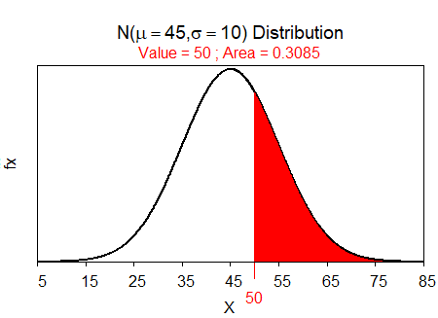
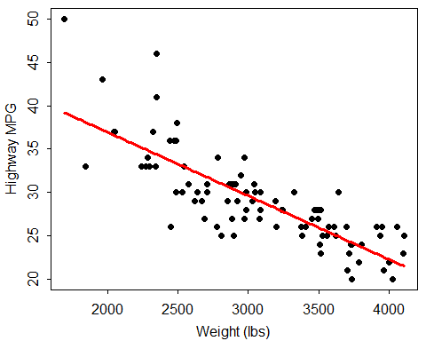
Normal Distributions
Quantitative Hypothesis Tests
Categorical Hypothesis Tests
where
val is a value of the quantitative variable (x) or an area (i.e., a percentage, but entered as a proportion).
mnval is the population mean (μ)
sdval is the standard deviation (σ) or error (SE)
lower.tail=FALSE is included for “right-of” calculations
type="q" is included for reverse calculations
For SE use (where nval=sample size):
ONE SAMPLE Z-TEST AND T-TEST:
qvar is the quantitative response variable in dfobj
mu0 is the population mean in H₀
HA is replaced with "two.sided" for a not equals, "less" for a less than, or "greater" for a greater than H_{A}
cnfval is the confidence level as a proportion (e.g., 0.95)
sdval is the known population standard deviation (σ)
(TWO SAMPLE) CHI-SQUARE TEST:
Chi-square for two-way frequency table in obstbl (with the cvarResp categorical response variable in columns and the populations in cvarPop as rows).
Follow-up Analyses:
Extract expected values.
Percentages of individuals in each level of the response variable for each population.
distrib(val,mean=mnval,sd=sdval,lower.tail=FALSE, type="q")
z.test(dfobj$qvar,mu=mu0,alt=HA, conf.level=cnfval,sd=sdval)
t.test(dfobj$qvar,mu=mu0,alt=HA, conf.level=cnfval)
( obstbl <- xtabs(~cvarPop+cvarResp,data=dfobj) )
( chi <- chisq.test(obstbl,correct=FALSE) )
sd=sdval/sqrt(nval)
chi$expected
> z.test(dfcar$HMPG,mu=26,alt="greater",conf.level=0.95,sd=6) z= 4.9601, n= 93, Std. Dev= 6.000, Std. Dev of the sample mean = 0.622, p-value = 3.523e-07 alternative hypothesis: true mean is greater than 26 95 percent confidence interval: 28.06264 Inf sample estimates: mean of dfcar$HMPG 29.08602
> t.test(dfcar$HMPG,mu=26,alt="two.sided",conf.level=0.99) t = 5.5818, df = 92, p-value = 2.387e-07 alternative hypothesis: true mean is not equal to 26 99 percent confidence interval: 27.63178 30.54026 sample estimates: mean of x 29.08602
> distrib(50,mean=45,sd=10,lower.tail=FALSE) #forward-right
> distrib(50,mean=45,sd=10) #forward-left
> distrib(0.05,mean=45,sd=10,type="q") #rev-left
> distrib(0.2,mean=45,sd=10,type="q",lower.tail=FALSE) #rev-rgt
> distrib(50,mean=45,sd=10/sqrt(30)) #using SE
> distrib(0.95,mean=45,sd=10/sqrt(30),
type="q",lower.tail=FALSE) #using SE
percTable(obstbl,margin=1,digits=1) # row percent table
> ( freq2 <- xtabs(~Domestic+Manual,data=dfcar) )
Manual Domestic No Yes No 6 39 Yes 26 22
> ( chi <- chisq.test(freq2,correct=FALSE) )
Pearson's Chi-squared test with freq2 X-squared = 17.1588, df = 1, p-value = 3.438e-05
> chi$expected
Manual Domestic No Yes No 15.48387 29.51613 Yes 16.51613 31.48387
> percTable(freq2,margin=1,digits=1)
Manual Domestic No Yes Sum No 13.3 86.7 100.0 Yes 54.2 45.8 100.0
Linear Regression
Quantitative Hypothesis Tests
The best-fit line between the qvarResp response and qvarExpl explanatory variables.
A visual of the best-fit line.
The r² value.
TWO SAMPLE T-TEST:
qvar is the quantitative response variable in dfobj
cvar is the categorical variable that identifies the two groups
mu0 is the population mean in H₀
HA is replaced with "two.sided" for a not equals, "less" for a less than, or "greater" for a greater than H_{A}
cnfval is the confidence level as a proportion (e.g., 0.95)
var.equal=TRUE if the popn variances are thought to be equal
( bfl <- lm(qvarResp~qvarExpl,data=dfobj) )
levenesTest(qvar~cvar,data=dfobj)
t.test(qvar~cvar,data=dfobj,alt=HA , conf.level=cnfval,
var.equal=TRUE)
fitPlot(bfl,ylab="better Resp label",xlab="better Expl label")
Categorical Hypothesis Tests
(ONE SAMPLE) GOODNESS-OF-FIT TEST:
Goodness-of-fit for one-way frequency table in obstbl and expected values (or ratios) in exp.p.
Follow-up Analyses:
Extract expected values.
Percentages of individuals in each level of the response variable.
rSquared(bfl)
> ( bfl <- lm(HMPG~Weight,data=dfcar) )
Coefficients: (Intercept) Weight 51.601365 -0.007327
> fitPlot(bfl,ylab="Highway MPG",xlab="Weight (lbs)")
> rSquared(bfl)
[1] 0.6571665
( obstbl <- c(lvl1=##,lvl2=##,lvl3=##) ) # if summarized data
( obstbl <- xtabs(~cvarResp,data=dfobj) ) # if raw data
( exp.p <- c(lvl1=##,lvl2=##,lvl3=## ) )
( gof <- chisq.test(obstbl,p=exp.p,rescale.p=TRUE,
correct=FALSE) )
> levenesTest(HMPG~Manual,data=dfcar)
Df F value Pr(>F) group 1 7.6663 0.006818 91
> t.test(HMPG~Manual,data=dfcar,alt="less",conf.level=0.99,
var.equal=TRUE) t = -4.2183, df = 91, p-value = 2.904e-05 alt. hypothesis: true difference in means is less than 0 99 percent confidence interval: -Inf -1.980103 sample estimates: mean in group No mean in group Yes 26.12500 30.63934
gof$expected
percTable(obstbl,digits=1)
Prepared by Dr. Derek H. Ogle for Northland College’s MTH107 course
Revised Dec-18

