Slide 1
Bivariate EDA

Slide 2
Bivariate EDA
Describe the relationship between pairs of variables
Bivariate EDA
Graphically
Numerically
Model

Slide 3
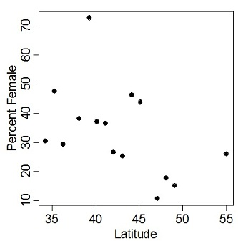
Figure 1. Plot of the percent female kingfishers observed at different latitudes during the Christmas Bird Count, 1992.
What is the name of this plot?
What type of variable is latitude?
Which variable is considered the response variable?
What is the approximate percentage females at a latitude of 55? at 45? at 35?

Slide 4
Variables & Axes
Response (dependent) variable
variability is being explained or values predicted
y-axis
Explanatory (independent, predictor) variable
used to explain variability or to make predictions
x-axis

Slide 5
Bivariate EDA -- Description
What four things are described in a bivariate EDA for quantitative data?
Association/Direction – what words are used?
Positive
Negative
None

Slide 6
What Type of Association?
Negative
130
+
120
110
Y
100
-
90
80
70
70
80
90
100
110
120
130
-
+
X

Slide 7
What Type of Association?
Positive
130
+
120
110
Y
100
-
90
80
70
70
80
90
100
110
120
130
-
+
X

Slide 8
What Type of Association?
None
130
+
120
110
Y
100
-
90
80
70
70
80
90
100
110
120
130
-
+
X

Slide 9
Items to Describe in a Bivariate EDA
Association/Direction
Form – what two forms will we consider?
Linear Non-linear

Slide 10
Items to Describe in a Bivariate EDA
Association/Direction
Form
Outliers
130
120
110
Y
100
90
80
70
70
80
90
100
110
120
130
X

Slide 11
Items to Describe in a Bivariate EDA
Association/Direction
Form
Outliers
Strength -- how closely the points cluster to the form

Slide 12
Strength?
130
120
110
Y
100
90
80
70
70
80
90
100
110
120
130
X

Slide 13
Which is More Strong?

Slide 14
Correlation Coefficient
⎡
⎛
−
⎞
⎛
−
⎞
⎤
n
x
x
y
y
∑
⎜
⎟
⎜
⎟
⎢
i
*
i
⎥
⎜
⎟
⎜
⎟
⎢
⎝
s
⎠
⎝
s
⎠
⎥
i
=
1
⎣
x
y
⎦
r
=
n
−
1
1. Standardize both X and Y
2. Product paired standardized values
3. Sum products
4. Divide by n-1

Slide 15
Correlation Coefficient
A measure of association/direction

Slide 16
r for positive Association?
1. Standardize both X and Y
130
+
120
110
Y
100
-
90
80
70
70
80
-
90
100
110
120
130
+
X

Slide 17
r for positive Association?
2. Product paired standardized values
130
+
+
-
120
110
Y
100
-
90
+
-
80
70
70
80
-
90
100
110
120
130
+
X

Slide 18
r for positive Association?
3. Sum products
Positive
130
+
+
-
120
110
Y
100
-
90
+
-
80
70
70
80
-
90
100
110
120
130
+
X

Slide 19
r for positive Association?
4. Divide by n-1
Positive
130
+
+
-
120
110
Y
100
-
90
+
-
80
70
70
80
-
90
100
110
120
130
+
X

Slide 20
r for Positive Association?
Thus, r is Positive
130
+
+
-
120
110
Y
100
-
90
+
-
80
70
70
80
-
90
100
110
120
130
+
X

Slide 21
r for Negative Association?
Thus, r is Negative
-
130
+
120
+
110
Y
100
+
-
90
-
80
70
70
80
90
100
110
120
130
-
+
X

Slide 22
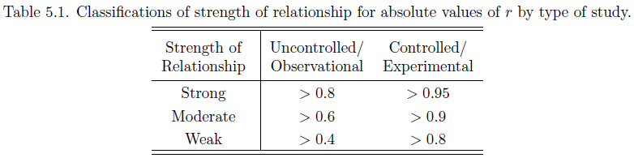
Correlation Coefficient
A measure of association and strength
-1
0
+1
Strongest
Weakest
Strongest

Slide 23
Correlation Coefficient
A measure of association and strength of a linear relationship with no outliers
Moral … PLOT YOUR DATA!!
r = 0.817
r = 0.817
r = 0.817
r = 0.817

Slide 24
Correlation Review
Variables must be quantitative
Form must be linear without outliers -- i.e., PLOT
-1 < r < 1
No distinction between which variable is on x and which is on y (though, response variable should always be y)
r does not depend on units of x and y
Correlation is not causation
We won’t compute r - must interpret and identify strength

Slide 25
Perform a bivariate EDA from Figure 1.
r = -0.673
Figure 1. Plot of the percent female kingfishers observed at different latitudes during the Christmas Bird Count, 1992.

Slide 26
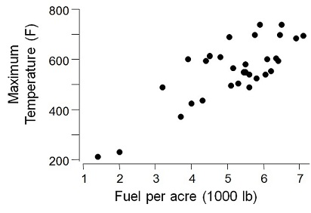
Perform a bivariate EDA from Figure 2.
r=0.798
Figure 2. Plot of the maximum temperature versus herbage yield for grassland headfires in west Texas.

Slide 27
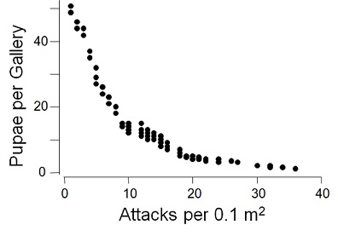
Perform a bivariate EDA from Figure 3.
r=-0.612
Figure 3. Plot of the number of pupae per gallery and the density of attacks for the beetle Ips cembrae

Slide 28
Quantitative Bivariate EDA in R
Examine handout
plot()
cor()

Slide 29
Two-way Frequency Table
A statistic for the relationship between two categorical variables
rows are levels of one variable
columns are levels of the other variable
18
22
Marginal distribution for Y-I-S
11
18
6
18
21
8
16
69
Marginal distribution for Stats Grade
Total Number of Individuals

Slide 30
Row Percentages Table
Each value is divided by the row total (*100).
 | A | B | C | D | F
FR | 3 | 5 | 4 | 2 | 4 | 18
SO | 0 | 4 | 10 | 3 | 5 | 22
JR | 1 | 6 | 3 | 0 | 1 | 11
SR | 2 | 3 | 4 | 3 | 6 | 18
 | 6 | 18 | 21 | 8 | 16 | 69
 | A | B | C | D | F
FR | 17 | 28 | 22 | 11 | 22 | 100
SO | 0 | 18 | 45 | 14 | 23 | 100
JR | 9 | 55 | 27 | 0 | 9 | 100
SR | 11 | 17 | 22 | 17 | 33 | 100
 | 9 | 26 | 30 | 12 | 23
3
3
17 =
*100
27 =
*100
18
11

Slide 31
Column Percentages Table
Each value is divided by the column total (*100).
 | A | B | C | D | F
FR | 3 | 5 | 4 | 2 | 4 | 18
SO | 0 | 4 | 10 | 3 | 5 | 22
JR | 1 | 6 | 3 | 0 | 1 | 11
SR | 2 | 3 | 4 | 3 | 6 | 18
 | 6 | 18 | 21 | 8 | 16 | 69
 | A | B | C | D | F
FR | 50 | 28 | 19 | 25 | 25 | 26
SO | 0 | 22 | 48 | 38 | 31 | 32
JR | 17 | 33 | 14 | 0 | 6 | 16
SR | 33 | 17 | 19 | 38 | 38 | 26
 | 100 | 100 | 100 | 100 | 100
3
3
50 =
*100
14 =
*100
6
21

Slide 32
Table Percentages Table
Each value is divided by the table total (*100).
 | A | B | C | D | F
FR | 3 | 5 | 4 | 2 | 4 | 18
SO | 0 | 4 | 10 | 3 | 5 | 22
JR | 1 | 6 | 3 | 0 | 1 | 11
SR | 2 | 3 | 4 | 3 | 6 | 18
 | 6 | 18 | 21 | 8 | 16 | 69
 | A | B | C | D | F
FR | 4 | 7 | 6 | 3 | 6 | 26
SO | 0 | 6 | 14 | 4 | 7 | 32
JR | 1 | 9 | 4 | 0 | 1 | 16
SR | 3 | 4 | 6 | 4 | 9 | 26
 | 9 | 26 | 30 | 12 | 23 | 100
3
3
18
4 =
*100
4 =
*100
26 =
*100
69
69
69

Slide 33
Which Table?
What percentage of Freshman earned an A?
What percentage of the class was Sophomores and earned a C?
 | A | B | C | D | F
FR | 4 | 7 | 6 | 3 | 6 | 26
SO | 0 | 6 | 14 | 4 | 7 | 32
JR | 1 | 9 | 4 | 0 | 1 | 16
SR | 3 | 4 | 6 | 4 | 9 | 26
 | 9 | 26 | 30 | 12 | 23 | 100
What percentage of the class earned an A?
What percentage of students who earned Fs were Seniors?
 | A | B | C | D | F
FR | 17 | 28 | 22 | 11 | 22 | 100
SO | 0 | 18 | 45 | 14 | 23 | 100
JR | 9 | 55 | 27 | 0 | 9 | 100
SR | 11 | 17 | 22 | 17 | 33 | 100
 | 9 | 26 | 30 | 12 | 23
 | A | B | C | D | F
FR | 50 | 28 | 19 | 25 | 25 | 26
SO | 0 | 22 | 48 | 38 | 31 | 32
JR | 17 | 33 | 14 | 0 | 6 | 16
SR | 33 | 17 | 19 | 38 | 38 | 26
 | 100 | 100 | 100 | 100 | 100

Slide 34
Hints
Decipher to which group the question refers.
e.g., identify if restricted to one group of the row variable.
Identify table type by which margin has 100%.
e.g., a row table rows sum to 100.

Slide 35
Categorical Bivariate EDA in R
Examine handout
table()
percTable()

Slide 36
 | A | B | C | D | F
FR | 3 | 5 | 4 | 2 | 4 | 18
SO | 0 | 4 | 10 | 3 | 5 | 22
JR | 1 | 6 | 3 | 0 | 1 | 11
SR | 2 | 3 | 4 | 3 | 6 | 18
 | 6 | 18 | 21 | 8 | 16 | 69
 | A | B | C | D | F
FR | 4 | 7 | 6 | 3 | 6 | 26
SO | 0 | 6 | 14 | 4 | 7 | 32
JR | 1 | 9 | 4 | 0 | 1 | 16
SR | 3 | 4 | 6 | 4 | 9 | 26
 | 9 | 26 | 30 | 12 | 23 | 100
 | A | B | C | D | F
FR | 17 | 28 | 22 | 11 | 22 | 100
SO | 0 | 18 | 45 | 14 | 23 | 100
JR | 9 | 55 | 27 | 0 | 9 | 100
SR | 11 | 17 | 22 | 17 | 33 | 100
 | 9 | 26 | 30 | 12 | 23
 | A | B | C | D | F
FR | 50 | 28 | 19 | 25 | 25 | 26
SO | 0 | 22 | 48 | 38 | 31 | 32
JR | 17 | 33 | 14 | 0 | 6 | 16
SR | 33 | 17 | 19 | 38 | 38 | 26
 | 100 | 100 | 100 | 100 | 100

Slide 37
 | A | B | C | D | F
FR | 3 | 5 | 4 | 2 | 4 | 18
SO | 0 | 4 | 10 | 3 | 5 | 22
JR | 1 | 6 | 3 | 0 | 1 | 11
SR | 2 | 3 | 4 | 3 | 6 | 18
 | 6 | 18 | 21 | 8 | 16 | 69
 | A | B | C | D | F
FR | 4 | 7 | 6 | 3 | 6 | 26
SO | 0 | 6 | 14 | 4 | 7 | 32
JR | 1 | 9 | 4 | 0 | 1 | 16
SR | 3 | 4 | 6 | 4 | 9 | 26
 | 9 | 26 | 30 | 12 | 23 | 100
 | A | B | C | D | F
FR | 17 | 28 | 22 | 11 | 22 | 100
SO | 0 | 18 | 45 | 14 | 23 | 100
JR | 9 | 55 | 27 | 0 | 9 | 100
SR | 11 | 17 | 22 | 17 | 33 | 100
 | 9 | 26 | 30 | 12 | 23
 | A | B | C | D | F
FR | 50 | 28 | 19 | 25 | 25 | 26
SO | 0 | 22 | 48 | 38 | 31 | 32
JR | 17 | 33 | 14 | 0 | 6 | 16
SR | 33 | 17 | 19 | 38 | 38 | 26
 | 100 | 100 | 100 | 100 | 100

