Slide 1
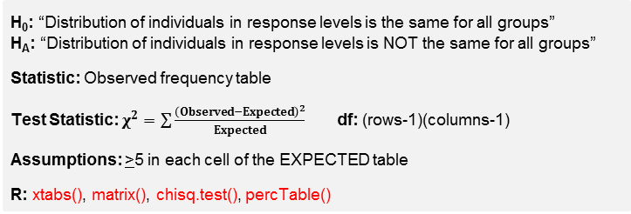
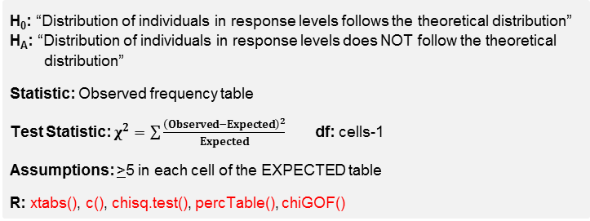
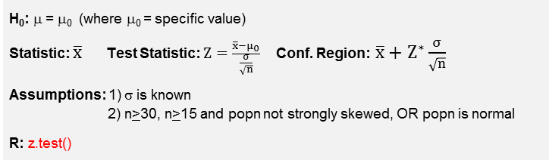
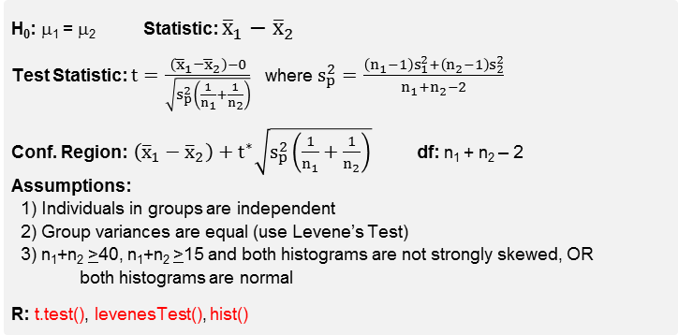
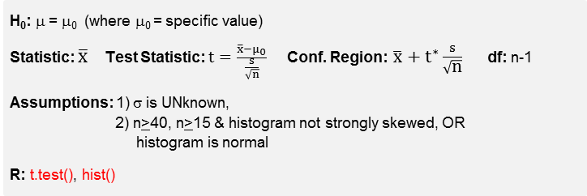
Hypothesis Testing • MTH107
Choosing a Hypothesis Test
1. If response variable is QUANTITATIVE, GOTO 2; if CATEGORICAL, GOTO 5.
Quantitative Response
2. If 1 group, GOTO 3; if 2 or more groups, GOTO 4.
3. If σ is KNOWN, then 1-Sample Z; If σ is UNKNOWN, then 1-Sample t.
4. If individuals are INDEPENDENT between groups, then 2-Sample t;
otherwise, Paired t.
Categorical Response
5. If 1 group, then Goodness-of-Fit; if 2 or more groups, then Chi-Square.
Class R FAQ
by Derek H. Ogle, revised Dec-17
1-Sample Z-Test
H₀: μ = μ₀ (where μ₀ = specific value)
Statistic: $\overline{x}$ Test Statistic: $Z=\frac{\overline{x}−μ_{0}}{\frac{σ}{\sqrt{n}}}$ Conf. Region: $\overline{x}+Z^{∗}\frac{σ}{\sqrt{n}}$
Assumptions: 1) σ is known
2) n>30, n>15 and popn not strongly skewed, OR popn is normal
R: z.test()
Making a Decision about H₀
If p-value < α, then REJECT H₀., otherwise DNR H₀.
1-Sample t-Test
H₀: μ = μ₀ (where μ₀ = specific value)
Statistic: $\overline{x}$ Test Statistic: $t=\frac{\overline{x}−μ_{0}}{\frac{s}{\sqrt{n}}}$ Conf. Region: $\overline{x}+t^{∗}\frac{s}{\sqrt{\text{n}}}$ df: n-1
Assumptions: 1) σ is UNknown,
2) n>40, n>15 & histogram not strongly skewed, OR
histogram is normal
R: t.test(), hist()
Chi-Square Test
H₀: “Distribution of individuals in response levels is the same for all groups”
H_{A}: “Distribution of individuals in response levels is NOT the same for all groups”
Statistic: Observed frequency table
Test Statistic: $χ^{2}=\sum{\frac{{\left(Observed−Expected\right)}^{2}}{Expected}}$ df: (rows-1)(columns-1)
Assumptions: >5 in each cell of the EXPECTED table
R: xtabs(), matrix(), chisq.test(), percTable()
2-Sample t-Test
H₀: μ₁ = μ₂ Statistic: ${\overline{x}}_{1}−{\overline{x}}_{2}$
Test Statistic: $t=\frac{\left({\overline{x}}_{1}−{\overline{x}}_{2}\right)−0}{\sqrt{s_{p}^{2}\left(\frac{1}{n_{1}}+\frac{1}{n_{2}}\right)}}$ where $s_{p}^{2}=\frac{\left(n_{1}−1\right)s_{1}^{2}+\left(n_{2}−1\right)s_{2}^{2}}{n_{1}+n_{2}−2}$
Conf. Region:$\left({\overline{x}}_{1}−{\overline{x}}_{2}\right)+t^{∗}\sqrt{s_{p}^{2}\left(\frac{1}{n_{1}}+\frac{1}{n_{2}}\right)}$ df: n₁ + n₂ – 2
Assumptions:
1) Individuals in groups are independent
2) Group variances are equal (use Levene’s Test)
3) n₁+n₂ >40, n₁+n₂ >15 and both histograms are not strongly skewed, OR
both histograms are normal
R: t.test(), levenesTest(), hist()
Goodness-of-Fit Test
H₀: “Distribution of individuals in response levels follows the theoretical distribution”
H_{A}: “Distribution of individuals in response levels does NOT follow the theoretical
distribution”
Statistic: Observed frequency table
Test Statistic: $χ^{2}=\sum{\frac{{\left(Observed−Expected\right)}^{2}}{Expected}}$ df: cells-1
Assumptions: >5 in each cell of the EXPECTED table
R: xtabs(), c(), chisq.test(), percTable(), chiGOF()

Slide 2
1) State the rejection criterion (α)
2) State the null & alternative hypotheses and define the parameter(s)
3) Determine which test to perform – Explain!
4) Collect the data (address type of study and randomization)
5) Check all necessary assumption(s)
6) Calculate the appropriate statistic(s)
7) Calculate the appropriate test statistic
8) Calculate the p-value
9) State your rejection decision
10) Summarize your findings in terms of the problem
11) If rejected H₀, compute a 100(1-α)% confidence region for parameter
11 Steps for Any Hypothesis Test

