Slide 1
1-sample t-test
H_{o}: μ = μ_{o} (where μ_{o} = specific value)
Statistic:
Test Statistic:
Assume:
σ is UNknown
n is large (so that the test stat follows a t-distribution)
n > 40, OR
n > 15 and histogram is not strongly skewed, OR
Histogram is approximately normal
When: Quantitative variable, one population sampled, σ is UNknown.
df = n-1

Slide 2
A Full Example
In Health magazine reported (March/April 1990) that the average saturated fat in one pound packages of butter was 66%. A food company wants to determine if its brand is significantly less than this overall mean. They analyzed a random sample of 96 one pound packages of its butter. Test the company’s hypothesis at the 1% level.
Variable n Mean St. Dev. Min ...
%SatFat 96 65.6 1.41 60.2 ...

Slide 3
Recipe for any Hypothesis Test
1) State the rejection criterion (α)
α=0.01
2) State the null & alternative hypotheses, define the parameter(s)
H_{o}: μ = 66
H_{a}: μ < 66 …. μ is mean %SatFat for all 1-lb package of butter from this company
3) Determine which test to perform – Explain!
1-sample z-test … because (a) a single population (1-lb packages of butter from this company), (b) quantitative variable (%SatFat), and (c) σ is unknown.

Slide 4
Recipe for any Hypothesis Test
4) Collect the data (address type of study and randomization)
(i) Observational study (no control imparted on packages of butter)
(ii) A random sample (n=96) was taken
5) Check all necessary assumption(s)
(i) σ is unknown
(ii) n>40
6) Calculate the appropriate statistic(s)
‾x = 65.6 (in background)

Slide 5
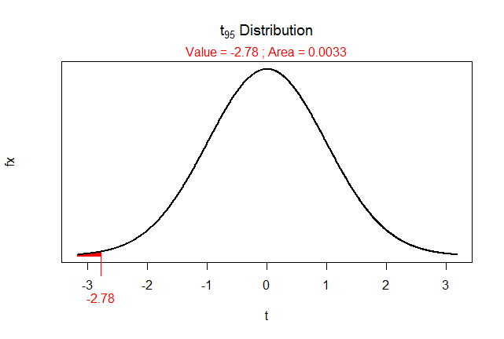
Recipe for any Hypothesis Test
7) Calculate the appropriate test statistic
df = 96-1 = 95
8) Calculate the p-value
> ( distrib(-2.78,distrib="t",df=95) )
[1] 0.003276885

Slide 6
Recipe for any Hypothesis Test
9) State your rejection decision
p-value (0.0033) < α (0.01) …. Reject H_{o}
10) Summarize your findings in terms of the problem
The mean percent saturated fat for all 1-lb packages of butter for this company appears to be less than that (=66) for the industry as a whole.

Slide 7
Recipe for any Hypothesis Test
11) If rejected H₀, compute a 100(1-α)% confidence region for parameter
(i) 100(1-0.01)% = 99%
(ii) Confidence interval … because H_{a} was not equals (two-sided)
(iii) t* = +2.366 … from distrib(0.99,distrib=“t”,df=95,type=“q”)
(iv) 65.6 +2.366*0.144
65.6 + 0.34
65.94
(v) I am 99% confident that the mean percent saturated fat for all 1-lb packages of butter from this company is less than 65.94.

Slide 8
Practical Significance
Is there a real difference between 66% and 65.6% saturated fat?
If the sample size is large enough, any hypothesis can be rejected.

