Slide 1
1-sample Z-test
H_{o}: μ = μ_{o} (where μ_{o} = specific value)
Statistic:
Test Statistic:
Assume:
σ is known
n is “large” (so sampling distribution is Normal)
When: One population, quantitative variable, σ is known.

Slide 2
Full Example
The mean number of close friends for the population of people living in the U.S. is 5.7. The standard deviation in this slightly skewed population is 1.3. An investigator predicts that the mean number of close friends for introverts will be significantly different from the mean of the general population. The mean number of close friends for a random sample of 26 introverts is 6.5. Do these data support, at the 5% level, the investigator's prediction?

Slide 3
Recipe for any Hypothesis Test
1) State the rejection criterion (α)
α=0.05
2) State the null & alternative hypotheses, define the parameter(s)
H_{o}: μ = 5.7
H_{a}: μ ≠ 5.7 …. μ is mean number of close friends for all introverts
3) Determine which test to perform – Explain!
1-sample z-test … because (a) a single population (introverts in U.S.), (b) quantitative variable (number of close friends), and (c) σ is known (=1.3).

Slide 4
Recipe for any Hypothesis Test
4) Collect the data (address type of study and randomization)
(i) Observational study (no control imparted on introverts)
(ii) A random sample (n=26) was taken
5) Check all necessary assumption(s)
(i) σ is known (=1.3)
(ii) n>15 and population is only slightly skewed (in background)
6) Calculate the appropriate statistic(s)
‾x = 6.5 (in background)

Slide 5
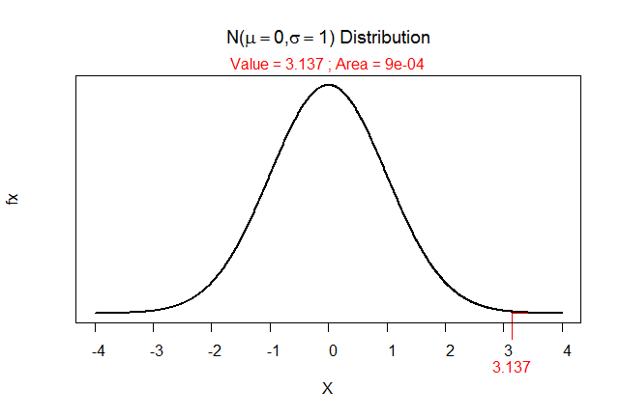
Recipe for any Hypothesis Test
7) Calculate the appropriate test statistic
8) Calculate the p-value
> 2*distrib(3.137,lower.tail=FALSE)
[1] 0.001706861

Slide 6
Recipe for any Hypothesis Test
9) State your rejection decision
p-value (0.0017) < α (0.05) …. Reject H_{o}
10) Summarize your findings in terms of the problem
The mean number of close friends for all introverts appears to be different than that (=5.7) for the population of people living in the U.S.

Slide 7
Recipe for any Hypothesis Test
11) If rejected H₀, compute a 100(1-α)% confidence region for parameter
(i) 100(1-0.05)% = 95%
(ii) Confidence interval … because H_{a} was not equals (two-sided)
(iii) Z* = ±1.96 … from distrib(0.025,type=“q”)
(iv) 6.5 ± 1.96*0.255
6.5 ± 0.50
(6.0, 7.0)
(v) I am 95% confident that the mean number of close friends for all introverts is between 6.0 and 7.0.

