Slide 1
Goodness-of-Fit Test
Examples –
Test whether responses are “random” (e.g., preference)
Test Mendelian genetics (e.g., 3:1 and 9:3:3:1 theories).
Test use of available resources (e.g., compare habitat usage to availability).
When: 1 population sampled, categorical data, comparing observed to theoretical frequencies of individuals in categories

Slide 2
Goodness-of-Fit Test
H_{o}: distribution of individuals into levels follows the theoretical distribution
H_{A}: distribution of individuals into levels does NOT follow the theoretical distribution
Assume: at least 5 in each cell of expected table
Statistic: Observed frequency table
Test Statistic:
df: cells-1

Slide 3
An Illustrative Example
A sample of Northland College students were played representative audio samples of The Chris Duarte Group (CDG), Ronnie Baker Brooks (RBB), and Bernard Allison (BA). Each student was asked to identify which artist they most preferred. Of the students sampled, 24, 38, and 18 preferred CDG, RBB, and BA, respectively. Determine, at the 10% level, if Northland students showed a clear preference for any of these artists.

Slide 4
Recipe for any Hypothesis Test
1) State the rejection criterion (α)
α=0.10
2) State the null & alternative hypotheses, define the parameter(s)
H_{o}: “no preference … same frequency for each artist”
H_{a}: “some preference … different frequency for at least one artist”
3) Determine which test to perform – Explain!
GOF test … because (a) a single population (Northland students), (b) categorical variable (artist preferred), and (c) comparing observed frequencies to theoretical uniform distribution.

Slide 5
Recipe for any Hypothesis Test
4) Collect the data (address type of study and randomization)
(i) Observational study (no control imparted on subjects)
(ii) Not clear that a random sample (n=80) was taken
Check all necessary assumption(s)
Expected frequencies (below) are all > 5
6) Calculate the appropriate statistic(s)
Expected
Table
Artist | CDG | RBB | BA
Freq | 80/3=26.7 | 80/3=26.7 | 80/3=26.7
Observed
Table
Artist | CDG | RBB | BA
Freq | 24 | 38 | 18

Slide 6
Recipe for any Hypothesis Test
7) Calculate the appropriate test statistic
Observed
Table
Artist | CDG | RBB | BA
Freq | 24 | 38 | 18
Expected
Table
Artist | CDG | RBB | BA
Freq | 26.7 | 26.7 | 26.7
χ² =
χ² = 0.27 + 4.78 + 2.83 = 7.88
df = (3-1) = 2

Slide 7
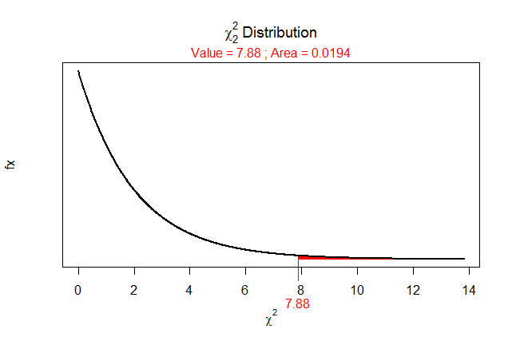
Recipe for any Hypothesis Test
8) Calculate the p-value
> ( distrib(7.88,distrib="chisq",df=2,lower.tail=FALSE) )
[1] 0.01944821
9) State your rejection decision
p-value (0.0194) < α (0.10) …. Reject H_{o}
10) Summarize your findings in terms of the problem
Northland students appear to show a preference among the three artists. Specifically, more students preferred RBB and less preferred BA than would be expected if there had been no preference.

Slide 8
A Full Example
In a randomly selected national sample of 1,007 adults, aged 18 and older, conducted Aug. 22-25, 2005, Gallup polls found that that 403 respondents approved of the way that George W. Bush was handling his presidency. In a previous sample (Aug. 8-11, 2005), 45% of the respondents approved of George W. Bush’s handling of the presidency. Assuming that this earlier value was true for the entire population, determine, at the 5% level, if the approval rating has changed by the Aug. 22-25, 2005 sample.

