Slide 1
Univariate EDA
Purpose – describe the distribution
Distribution is concerned with what values a variable takes and how often it takes each value
Quantitative vs. Categorical
Do NOT describe shape, center, dispersion, or outliers with CATEGORICAL data.
Identify the most outstanding characteristics.

Slide 2
Overall Summary
Identify most outstanding characteristic(s)
Most student were blondes and very few were brunettes.
Hair Color | Freq
Blonde | 4
Brunette | 1
Red | 3

Slide 3
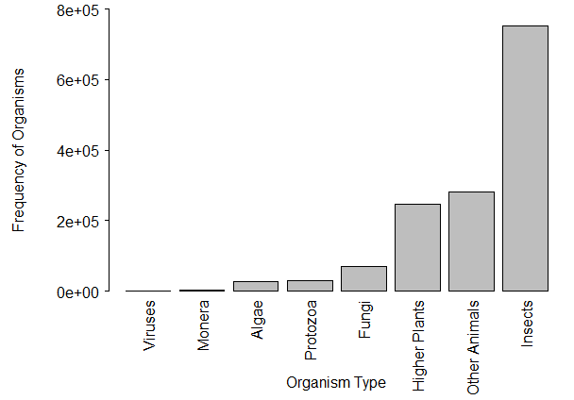
Figure 4. Bar chart of the number of KNOWN species by organism type.
Insects have, by far, the most known species, followed by “other animals” and “higher plants.”

Slide 4
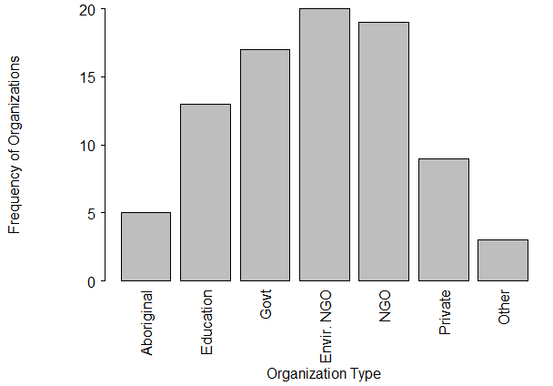
Figure 5. Bar chart of the types of organizations that received funding by the Invasive Alien Species Partnership Program (Canada), 2005-2010.
There is a fairly even distribution of funding to the government, environmental NGOs, and non-environmental NGOs. Lesser amounts are awarded to educational and private organizations. Aboriginal groups received the least funding.

