Slide 1
Univariate EDA

Slide 2
Exploratory Data Analysis
Univariate EDA – Describe the distribution
Distribution is concerned with what values a variable takes and how often it takes each value
Univariate EDA (for quantitative data)
Graphically
Numerically
Model

Slide 3
Quantitative vs. Categorical
Do NOT describe shape, center, dispersion, or outliers with CATEGORICAL data.
Identify the most outstanding characteristics.

Slide 4
Numerical Summaries
Frequency Table
Percentages Table
Red
Blonde
Blonde
Brunette
Blonde
Red
Blonde
Red
Hair Color | Freq
Blonde
Brunette
Red
Hair Color | Perc
Blonde
Brunette
Red
4
50.0
1
12.5
3
37.5

Slide 5
Graphical Summaries
Bar chart
Bars over category label
Height is frequency of individuals in that category
Hair Color | Freq
Blonde | 4
Brunette | 1
Red | 3

Slide 6
Graphical Summaries
Bar chart
Pie chart
Circle with pieces proportional to category frequencies
Hair Color | Freq
Blonde | 4
Brunette | 1
Red | 3

Slide 7
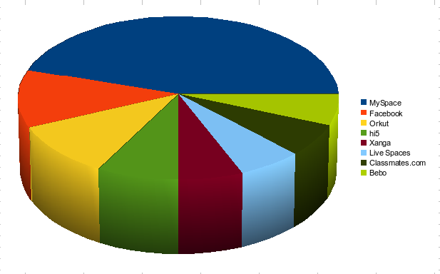
no, No, NO!!!

Slide 8
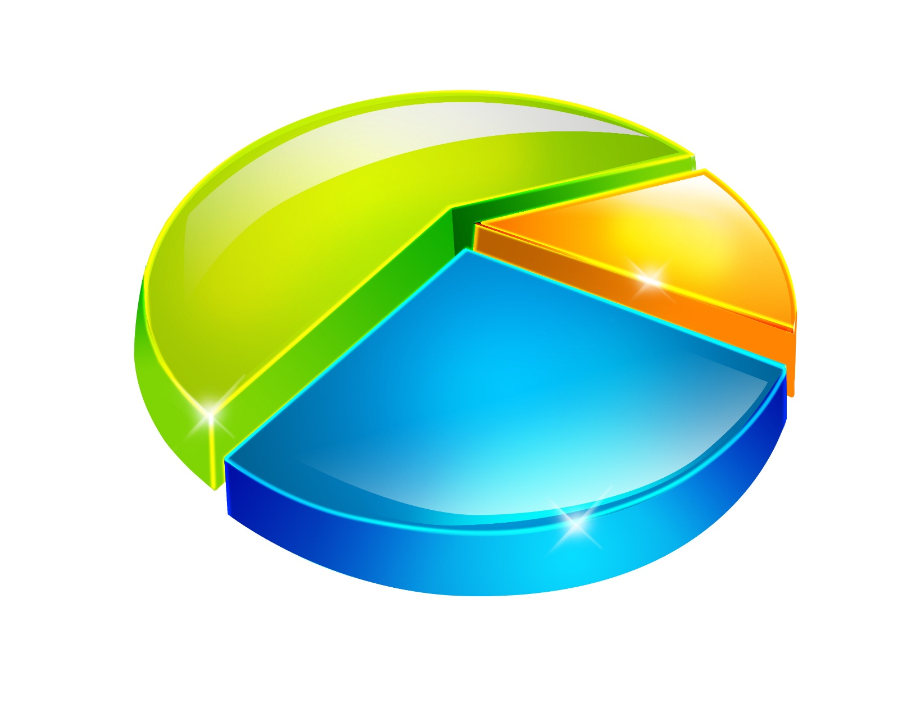
no, No, NO!!!

Slide 9
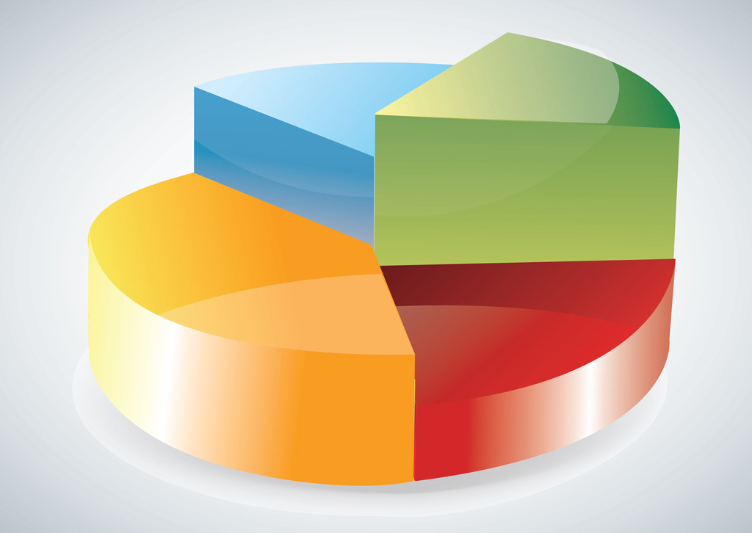
no, No, NO!!!

Slide 10

no, No, NO!!!

Slide 11
Overall Summary
Identify most outstanding characteristic(s)
Most student were blondes and very few were brunettes.
Hair Color | Freq
Blonde | 4
Brunette | 1
Red | 3

Slide 12
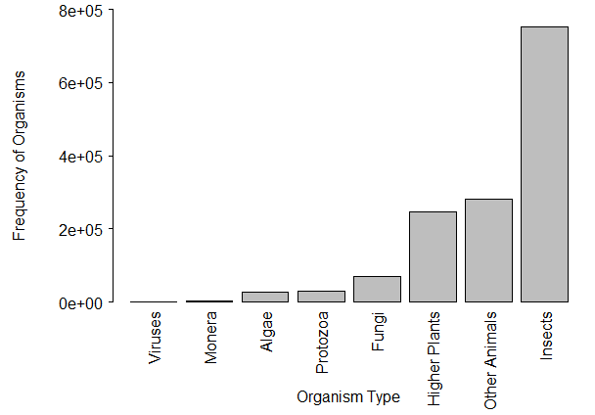
Figure 4. Bar chart of the number of KNOWN species by organism type.
Describe a univariate EDA for the data in Figure 4.

Slide 13
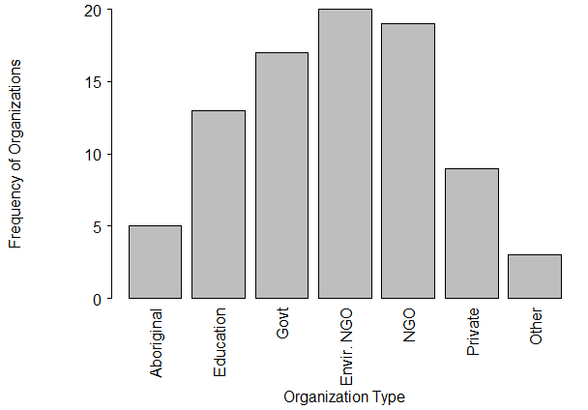
Figure 5. Bar chart of the types of organizations that received funding by the Invasive Alien Species Partnership Program (Canada), 2005-2010.
Describe a univariate EDA for the data in Figure 5.

Slide 14
Categorical Univariate EDA in R
Examine Handout
xtabs()
percTable()
barplot()

