Slide 1
R Cheatsheet • MTH107
Data
Get Data
Filter Individuals
Class R FAQ
by Derek H. Ogle, revised Dec-17
ENTER RAW DATA:
Enter data in Excel (variables in columns, individuals in rows, first row has variable names, no spaces or special characters).
Save as “Comma Separated Values (*.CSV)” file in your local directory/folder.
DATA PROVIDED BY PROFESSOR:
Goto Data Specific to MTH107 on Resources page.
Right-click on “data” link and save to your local directory/folder.
Individuals that meet a certain condition (or conditions) are filtered from the dfobj data.frame with filterD().
where cond may be as follows with var replaced with a variable name and value replaced with a number or category level (if value is text then it must be in quotes):
var == value # equal to
var != value # not equal to
var > value # greater than
var >= value # greater than or equal
var < value # less than
var <= value # less than or equal
var %in% c(“val”,”val”,”val”) # in the list
cond | cond # either condition met
cond, cond # both conditions met
Individual in row rownum is selected with:
Individual in row rownum is excluded with:
Models
newdf <- filterD(dfobj,cond)
Normal Distributions
Linear Regression
where
val is a value of the quantitative variable or area (i.e., percentage as a proportion).
meanval is population mean (μ)
sdval is standard deviation (σ) or error (SE)
type=”q” is included for reverse calculations
lower.tail=FALSE is included for “right-of” calculations
For SE use (where nval=sample size):
The best-fit line between the rspvar response and expvar explanatory variables.
A visual of the best-fit line.
The r² value.
Predict a value of rspvar given a specific expval value of the expvar.
distrib(val,mean=meanval,sd=sdval,
type=“q”,lower.tail=FALSE)
( bfl <- lm(rspvar~expvar,data=dfobj) )
Load CSV
fitPlot(bfl,ylab=“rspvar lbl”,xlab=“expvar lbl”)
Start script and save it in the same folder that contains the CSV file.
Select Session, Set Working Directory, To Source File Location menus.
Copy resulting setwd() code to script.
Use read.csv() to load data into dfobj.
Observe structure of data.frame.
rSquared(bfl)
dfobj[rownum,]
sd=sdval/sqrt(nval)
predict(bfl,data.frame(expvar=expval))
dfobj <- read.csv(“filename.csv”)
Hypothesis Testing
str(dfobj)
dfobj[-rownum,]
Quantitative
Categorical
ONE SAMPLE:
TWO SAMPLE:
qvar is the quant. response variable in dfobj
mu0 is the population mean in H₀
HA is “two.sided” for a not equals, “less” for a less than, or “greater” for a greater than H_{A}
confval is the confidence level (e.g., 0.95)
sdval is the popn. standard deviation (σ)
gvar is a categorical variable in dfobj that identifies the groups
var.equal=TRUE if the population variances are thought to be equal
ONE SAMPLE:
Goodness-of-fit test for observed frequencies in the freq1 table and expected values (or proportions) in exp.p.
TWO SAMPLE:
Chi-square for freq2 two-way observed frequency table (with response variable in columns and groups in rows).
Follow-up Analyses:
Extract the expected values.
Extract the residuals.
Confidence intervals for goodness-of-fit.
Exploratory Data Analysis
z.test(dfobj$qvar,mu=mu0,alt=HA,
conf.level=confval,sd=sdval)
t.test(dfobj$qvar,mu=mu0,alt=HA,
conf.level=confval)
Univariate
Bivariate
QUANTITATIVE – Summary statistics (mean, median, SD, IQR, etc.) and a histogram for the qvar variable.
QUANTITATIVE BY GROUP – Summary statistics and histograms for the qvar variable separated by groups in the gvar variable.
CATEGORICAL – Frequency and percentage tables and bar chart for the cvar variable.
QUANTITATIVE – Correlation (r) and scatterplot for the qvarY and qvarX variables.
CATEGORICAL – Frequency and percentage tables for the cvarRow and cvarCol variables.
( gof <- chisq.test(freq1,p=exp.p,
rescale.p=TRUE,correct=FALSE) )
hist(~qvar,data=dfobj,xlab=“qvar label”)
Summarize(~qvar,data=dfobj,digits=#)
plot(qvarY~qvarX,data=dfobj,
ylab=“yvar label”,xlab=“xvar label”)
corr(~qvarY+qvarX,data=dfobj)
levenesTest(qvar~gvar,data=dfobj)
t.test(qvar~gvar,data=dfobj,alt=HA ,
conf.level=confval,var.equal=TRUE)
( chi <- chisq.test(freq2,correct=FALSE) )
hist(qvar~gvar,data=dfobj,xlab=“qvar label”)
Summarize(qvar~gvar,data=dfobj,digits=#)
( freq2 <- xtabs(~cvarRow+cvarCol,
data=dfobj) )
percTable(freq2) # total/table %
percTable(freq2,margin=1) # row %
percTable(freq2,margin=2) # column %
gof$expected or chi$expected
( freq1 <- xtabs(~cvar,data=dfobj) )
percTable(freq1,digits=#)
barplot(freq1,xlab=“cvar label”,
ylab=“Frequency”)
gof$residuals or chi$expected
gofCI(gof,digits=3)

Slide 2
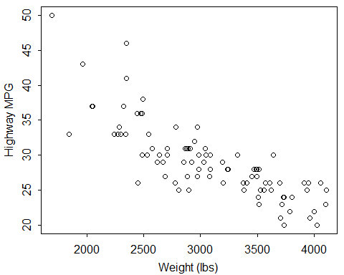
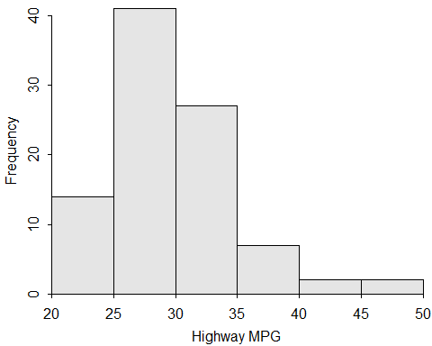
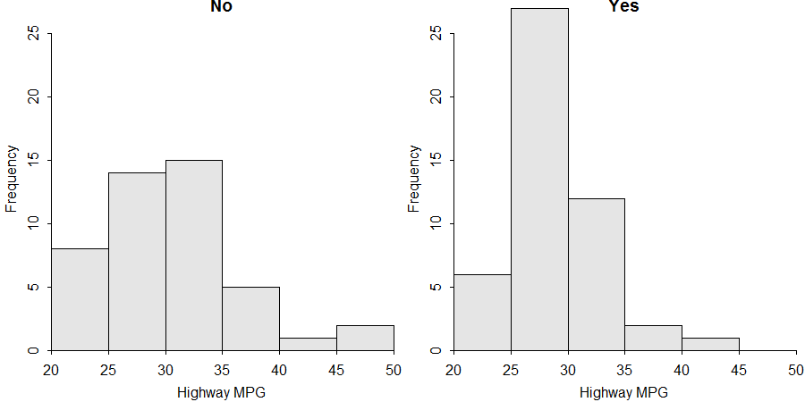
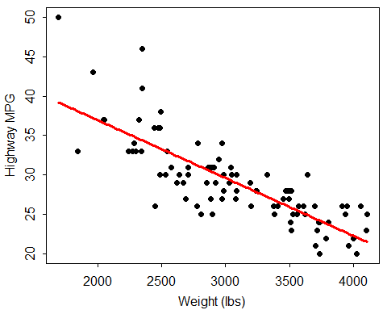
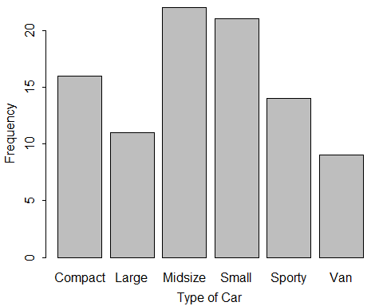
Data
Bivariate EDA
Hypothesis Tests
> library(NCStats)
> setwd("C:/aaaWork/Web/GitHub/NCMTH107") > dfobj <- read.csv("93cars.csv") > str(dfobj)
'data.frame': 93 obs. of 26 variables: $ Type : Factor w/ 6 levels "Compact","Large",..: 4 ... $ HMPG : int 31 25 26 26 30 31 28 25 27 25 ... $ Manual : Factor w/ 2 levels "No","Yes": 2 2 2 2 2 1 ... $ Weight : int 2705 3560 3375 3405 3640 2880 3470 ... $ Domestic: Factor w/ 2 levels "No","Yes": 1 1 1 1 1 2 ...
> justSporty <- filterD(dfobj,Type=="Sporty") > justHMPGgt30 <- filterD(dfobj,HMPG>30) > noDomestics <- filterD(dfobj,Domestic!="Yes") > Sprty_Small <- filterD(dfobj,Type %in% c("Sporty","Small"))
> plot(HMPG~Weight,data=dfobj,ylab="Highway MPG")
xlab="Weight (lbs)“)
> corr(HMPG~Weight,data=dfobj)
[1] -0.8106581
> ( freq2 <- xtabs(~Domestic+Manual,data=dfobj) )
Manual Domestic No Yes No 6 39 Yes 26 22
> percTable(freq2,digits=1)
Manual Domestic No Yes Sum No 6.5 41.9 48.4 Yes 28.0 23.7 51.7 Sum 34.5 65.6 100.1
> percTable(freq2,margin=1,digits=1)
Manual Domestic No Yes Sum No 13.3 86.7 100.0 Yes 54.2 45.8 100.0
> percTable(freq2,margin=2,digits=1)
Manual Domestic No Yes No 18.8 63.9 Yes 81.2 36.1 Sum 100.0 100.0
> z.test(dfobj$HMPG,mu=26,alt="greater",conf.level=0.95,sd=6) z= 4.9601, n= 93, Std. Dev= 6.000, Std. Dev of the sample mean = 0.622, p-value = 3.523e-07 alternative hypothesis: true mean is greater than 26 95 percent confidence interval: 28.06264 Inf sample estimates: mean of dfobj$HMPG 29.08602
> t.test(dfobj$HMPG,mu=26,alt="two.sided",conf.level=0.99) t = 5.5818, df = 92, p-value = 2.387e-07 alternative hypothesis: true mean is not equal to 26 99 percent confidence interval: 27.63178 30.54026 sample estimates: mean of x 29.08602
> levenesTest(HMPG~Domestic,data=dfobj)
Df F value Pr(>F) group 1 5.3595 0.02286 * 91
> t.test(HMPG~Manual,data=dfobj,alt="less",conf.level=0.99,
var.equal=TRUE) t = -4.2183, df = 91, p-value = 2.904e-05 alt. hypothesis: true difference in means is less than 0 99 percent confidence interval: -Inf -1.980103 sample estimates: mean in group No mean in group Yes 26.12500 30.63934
> exp <- c(1,1,1,1,1,1)/6 > (gof<-chisq.test(freq1,p=exp,rescale.p=TRUE,correct=FALSE)) X-squared = 8.871, df = 5, p-value = 0.1143
> gof$expected
Compact Large Midsize Small Sporty Van 15.5 15.5 15.5 15.5 15.5 15.5
> gof$residuals Compact Large Midsize Small Sporty Van 0.12700 -1.14300 1.65100 1.39700 -0.38100 -1.65100
> gofCI(gof,digits=3)
p.obs p.LCI p.UCI p.exp Compact 0.172 0.109 0.261 0.167 Large 0.118 0.067 0.199 0.167 Midsize 0.237 0.162 0.332 0.167 Small 0.226 0.153 0.321 0.167 Sporty 0.151 0.092 0.237 0.167 Van 0.097 0.052 0.174 0.167
> ( chi <- chisq.test(freq2,correct=FALSE) )
Pearson's Chi-squared test with freq2 X-squared = 17.1588, df = 1, p-value = 3.438e-05
> chi$expected
Manual Domestic No Yes No 15.48387 29.51613 Yes 16.51613 31.48387
> chi$residuals
Manual Domestic No Yes No -2.410160 1.745645 Yes 2.333627 -1.690214
Univariate EDA
> Summarize(~HMPG,data=dfobj,digits=1)
n mean sd min Q1 median Q3 max 93.0 29.1 5.3 20.0 26.0 28.0 31.0 50.0
> hist(~HMPG,data=dfobj,xlab="Highway MPG")
> Summarize(HMPG~Domestic,data=dfobj,digits=1)
Domestic n mean sd min Q1 median Q3 max 1 No 45 30.1 6.2 21 25 30 33 50 2 Yes 48 28.1 4.2 20 26 28 30 41
> hist(HMPG~Domestic,data=dfobj,xlab="Highway MPG")
> ( freq1 <- xtabs(~Type,data=dfobj) )
Type Compact Large Midsize Small Sporty Van 16 11 22 21 14 9
> percTable(freq1,digits=1)
Type Compact Large Midsize Small Sporty Van Sum 17.2 11.8 23.7 22.6 15.1 9.7 100.1
> barplot(freq1,xlab="Type of Car",ylab="Frequency")
Linear Regression
> ( bfl <- lm(HMPG~Weight,data=dfobj) )
Coefficients: (Intercept) Weight 51.601365 -0.007327
> fitPlot(bfl,xlab="Weight (lbs)",ylab="Highway MPG")
> rSquared(bfl)
[1] 0.6571665
> predict(bfl,data.frame(Weight=3000)) 29.62019

