Slide 1
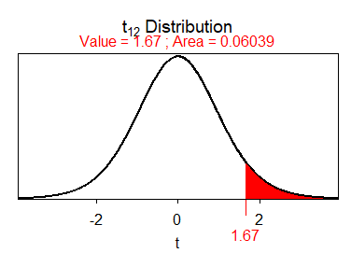
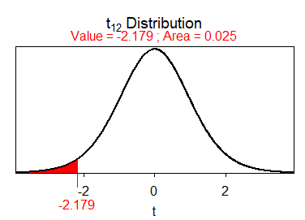
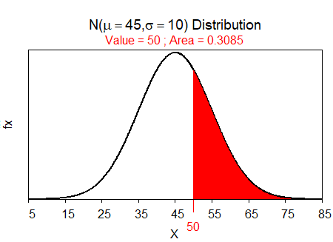
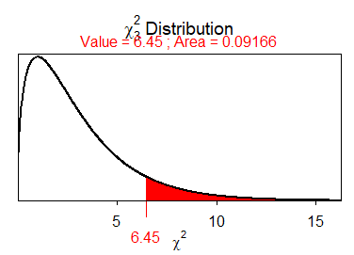
R Function
Hints:
Green code typed exactly as shown
Red code is optional or must be replaced with context-specific name or value
Replace qvar with quantitative variable name
Replace cvar with categorical variable name
Replaced # with numeric value
Get and Load Data
ENTER RAW DATA:
In Excel, enter variables in columns with variable names in the first row, each individual’s data in rows below that (do not use spaces or special characters).
Save as “CSV (comma delimited)” file in your local directory/folder (a “.csv” extension will be automatically added to your filename).
DATA PROVIDED BY PROFESSOR:
Follow “data” link or goto the MTH107 Resources webpage.
Save “data” link (right-click) to your local directory/folder.
LOAD THE EXTERNAL CSV FILE INTO R:
Start script and save it in the same folder with the CSV file.
Select Session, Set Working Directory, To Source File … menus
Copy resulting setwd() code to your script.
Use read.csv() to load data in filename.csv into dfobj.
Observe the structure of dfobj.
Guide
Load Packages
The NCStats and ggplot2 packages should ALWAYS be loaded with library() at the top/beginning of your new script in RStudio.
> library(NCStats)
> library(ggplot2)
t Distributions
Randomize Individuals
val is a value of the t test statistic (for computing the p-value) or an area as a proportion (for computing t* for confidence region)
dfval is the degrees-of-freedom (df)
lower.tail=FALSE is included for “right-of” calculations
type="q" is included for reverse (confidence region) calculations
EXPERIMENT – Randomly order N individuals.
OBSERVATIONAL STUDY – Randomly select n from N individuals.
distrib(val,distrib="t",df=dfval,lower.tail=FALSE,type="q")
sample(N)
dfobj <- read.csv("filename.csv")
sample(N,n)
str(dfobj)
> sample(10) # randomly order 1 to 10
[1] 6 7 9 8 1 2 10 5 3 4
> sample(10,3) # randomly select 3 from 1 to 10
[1] 10 4 5
> distrib(1.67,distrib="t",df=12,lower.tail=FALSE) # p-value
> distrib(0.025,distrib="t",df=12,type="q") # t-star
> setwd("C:/aaaWork/Web/GitHub/NCMTH107") > dfcar <- read.csv("93cars.csv") > str(dfcar)
'data.frame': 93 obs. of 26 variables: $ Type : Factor w/ 6 levels "Compact","Large": 4 3 3 ... $ HMPG : int 31 25 26 26 30 31 28 25 27 25... $ Manual : Factor w/ 2 levels "No","Yes": 2 2 2 2 2 1 1 ... $ Weight : int 2705 3560 3375 3405 3640 2880 3470 ... $ Domestic: Factor w/ 2 levels "No","Yes": 1 1 1 1 1 2 2 ...
Normal Distributions
val is a value of the quantitative variable (x) or an area (i.e., a percentage, but entered as a proportion)
mnval is the population mean (μ)
sdval is the standard deviation (σ) or error (SE)
For SE use (where nval is the sample size):
lower.tail=FALSE is included for “right-of” calculations
type="q" is included for reverse calculations
distrib(val,mean=mnval,sd=sdval,lower.tail=FALSE,type="q")
Filter Individuals
Individuals may be selected from the dfobj data.frame and put in the newdf data.frame according to a condition with
where condition may be as follows
var == value # equal to
var != value # not equal to
var > value # greater than
var >= value # greater than or equal
var %in% c("value", "value", "value") # in the list
cond, cond # both conditions met
with var replaced by a variable name and value replaced by a number or category name (if not a number then must be in quotes).
sd=sdval/sqrt(nval)
newdf <- filterD(dfobj,condition)
χ² Distributions
> distrib(50,mean=45,sd=10,lower.tail=FALSE) #forward-right
> distrib(50,mean=45,sd=10) #forward-left
> distrib(0.05,mean=45,sd=10,type="q") #reverse-left
> distrib(0.2,mean=45,sd=10,type="q",lower.tail=FALSE) #rev-rgt
> distrib(50,mean=45,sd=10/sqrt(30)) #using SE
> distrib(0.95,mean=45,sd=10/sqrt(30),
type="q",lower.tail=FALSE) #using SE
> distrib(.025,type="q") #Z*, not =, alpha=.05
val is a value of the χ² test statistic (for computing the p-value)
dfval is the degrees-of-freedom (df)
lower.tail=FALSE is included for ALL calculations
distrib(val,distrib="chisq",df=dfval,lower.tail=FALSE)
> distrib(6.45,distrib="chisq",df=3,lower.tail=FALSE) # p-value
> justSporty <- filterD(dfcar,Type=="Sporty") > noDomestic <- filterD(dfcar,Domestic!="Yes") > justHMPGgt30 <- filterD(dfcar,HMPG>30) > Sp_or_Sm <- filterD(dfcar,Type %in% c("Sporty","Small"))
> Sprty_n_gt30 <- filterD(dfcar,Type=="Sporty",HMPG>30)
> justWTlteq3000 <- filterD(dfcar,Weight<=3000)
> justNum17 <- dfcar[17,]
> notNum17 <- dfcar[-17,]
Prepared by Dr. Derek H. Ogle for Northland College’s MTH107 course
Page 1 of 3
Revised Oct-20

Slide 2
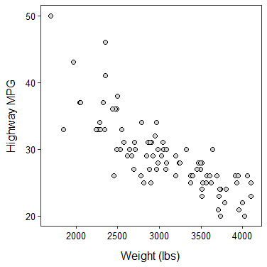
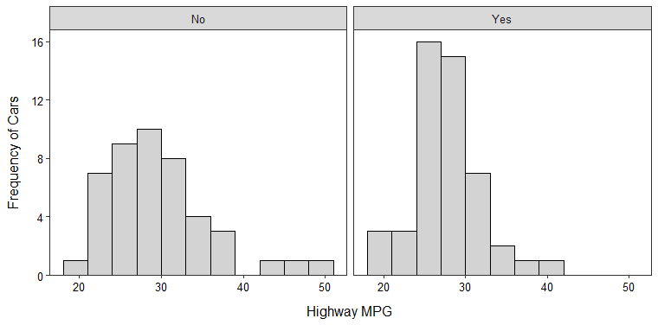
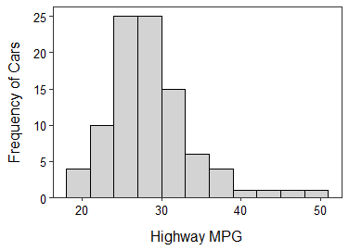
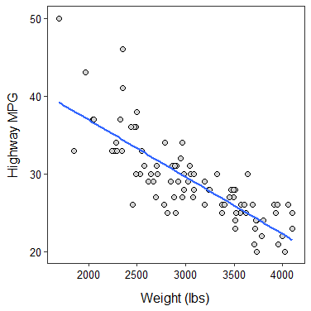
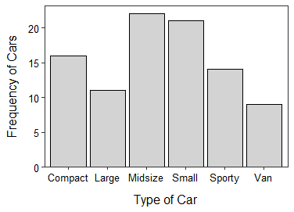
Univariate EDA - Quantitative
Univariate EDA – Quant by Groups
Bivariate EDA - Quantitative
Summary statistics (mean, median, SD, Q1, Q3, etc.) and histogram of qvar quantitative variable in dfobj data.frame.
# in digits= is the desired number of decimal places
# in binwidth= is the desired width of bins/bars
XXX in labs() is a label/description of an individual
Separate summary statistics of qvar by groups in cvar.
Separate histograms by “adding” this to code for a single histogram.
Correlation coefficient (r) and scatterplot for qvar1 and qvar2.
Summarize(~qvar,data=dfobj,digits=#)
ggplot(data=dfobj,mapping=aes(x=qvar)) +
geom_histogram(binwidth=#,boundary=0,
color="black",fill="lightgray") +
labs(x="better qvar label",y="Frequency of XXX") +
scale_y_continuous(expand=expansion(mult=c(0,0.05))) +
theme_NCStats()
Summarize(qvar~cvar,data=dfobj,digits=#)
corr(~qvar1+qvar2,data=dfobj,digits=3)
ggplot(data=dfobj,mapping=aes(x=qvar1,y=qvar2)) +
geom_point(pch=21,color="black",fill="lightgray") +
labs(x="better qvar1 label",y=“better qvar2 label") +
theme_NCStats()
facet_wrap(vars(cvar))
> Summarize(HMPG~Domestic,data=dfcar,digits=1)
Domestic n mean sd min Q1 median Q3 max 1 No 45 30.1 6.2 21 25 30 33 50 2 Yes 48 28.1 4.2 20 26 28 30 41
> ggplot(data=dfcar,mapping=aes(x=HMPG)) +
geom_histogram(binwidth=3,boundary=0,
color="black",fill="lightgray") +
labs(x="Highway MPG",y="Frequency of Cars") +
scale_y_continuous(expand=expansion(mult=c(0,0.05))) +
theme_NCStats() +
facet_wrap(vars(Domestic))
> corr(~HMPG+Weight,data=dfcar,digits=3)
[1] -0.811
> ggplot(data=dfcar,mapping=aes(x=Weight,y=HMPG)) +
geom_point(pch=21,color="black",fill="lightgray") +
labs(x="Weight (lbs)",y="Highway MPG") +
theme_NCStats()
> Summarize(~HMPG,data=dfcar,digits=1)
n mean sd min Q1 median Q3 max 93.0 29.1 5.3 20.0 26.0 28.0 31.0 50.0
> ggplot(data=dfcar,mapping=aes(x=HMPG)) +
geom_histogram(binwidth=3,boundary=0,
color="black",fill="lightgray") +
labs(x="Highway MPG",y="Frequency of Cars") +
scale_y_continuous(expand=expansion(mult=c(0,0.05))) +
theme_NCStats()
Bivariate EDA - Categorical
Linear Regression
Frequency and percentage tables for cvarRow and cvarCol variables.
The coefficients for the best-fit line between the qvarResp response and qvarExpl explanatory variables.
The coefficient of determination (r²) value.
Plot best-fit line by “adding” this to code for a scatterplot.
( freq2 <- xtabs(~cvarRow+cvarCol, data=dfobj) )
addmargins(freq2) # append totals
percTable(freq2) # total/table %
percTable(freq2,margin=1) # row %
percTable(freq2,margin=2) # column %
( bfl <- lm(qvarResp~qvarExpl,data=dfobj) )
Univariate EDA - Categorical
Frequency & percentage tables, bar chart of cvar categorical variable.
rSquared(bfl)
( freq1 <- xtabs(~cvar,data=dfobj) )
percTable(freq1)
ggplot(data=dfobj,mapping=aes(x=cvar)) +
geom_bar(color="black",fill="lightgray") +
labs(x="better cvar label",y="Frequency of XXX") +
scale_y_continuous(expand=expansion(mult=c(0,0.05))) +
theme_NCStats()
> ( freq2 <- xtabs(~Domestic+Manual,data=dfcar) )
Manual Domestic No Yes No 6 39 Yes 26 22
> addmargins(freq2)
Manual
Domestic No Yes Sum
No 6 39 45
Yes 26 22 48
Sum 32 61 93
> percTable(freq2)
Manual Domestic No Yes Sum No 6.5 41.9 48.4 Yes 28.0 23.7 51.7 Sum 34.5 65.6 100.1
> percTable(freq2,margin=1)
Manual Domestic No Yes Sum No 13.3 86.7 100.0 Yes 54.2 45.8 100.0
> percTable(freq2,margin=2)
Manual Domestic No Yes No 18.8 63.9 Yes 81.2 36.1 Sum 100.0 100.0
geom_smooth(method="lm",se=FALSE)
> ( bfl <- lm(HMPG~Weight,data=dfcar) )
Coefficients: (Intercept) Weight 51.601365 -0.007327
> rSquared(bfl)
[1] 0.6571665
> ggplot(data=dfcar,mapping=aes(x=Weight,y=HMPG)) +
geom_point(pch=21,color="black",fill="lightgray") +
labs(x="Weight (lbs)",y="Highway MPG") +
theme_NCStats() +
geom_smooth(method="lm",se=FALSE)
> ( freq1 <- xtabs(~Type,data=dfcar) )
Compact Large Midsize Small Sporty Van 16 11 22 21 14 9
> percTable(freq1) Compact Large Midsize Small Sporty Van 17.2 11.8 23.7 22.6 15.1 9.7
> ggplot(data=dfcar,mapping=aes(x=Type)) +
geom_bar(color="black",fill="lightgray") +
labs(x="Type of Car",y="Frequency of Cars") +
scale_y_continuous(expand=expansion(mult=c(0,0.05))) +
theme_NCStats()
Prepared by Dr. Derek H. Ogle for Northland College’s MTH107 course
Page 2 of 3
Revised Oct-20

Slide 3
1-Sample t-Test
Chi-square Test
Goodness-of-Fit Test
qvar is the quantitative response variable in dfobj
mu0 is the population mean in H₀
HA is replaced with "two.sided" for not equals, "less" for less than, or "greater" for greater than alternative hypotheses (H_{A})
cnfval is the confidence level as a proportion (e.g., 0.95)
Two-way frequency table with cvarResp categorical response variable in columns and cvarPop populations as rows.
Compute chi-square test results from obstbl.
Extract expected values.
Compute row percentages table (i.e., percentage of individuals in each level of the response variable for each population).
One-way frequency table of cvarResp categorical response variable
Expected proportions (or ratios or values) in exp.p.
Compute GOF test results from obstbl and exp.p.
Extract expected values.
Construct table of observed proportions in each level along with confidence intervals and expected proportions.
t.test(~qvar,data=dfobj,mu=mu0,alt=HA, conf.level=cnfval)
( obstbl <- xtabs(~cvarResp,data=dfobj) )
( obstbl <- xtabs(~cvarPop+cvarResp,data=dfobj) )
( exp.p <- c(lvl1=#, lvl2=#, lvl3=#,…) )
( chi <- chisq.test(obstbl,correct=FALSE) )
> t.test(~HMPG,data=dfcar,mu=26,alt="two.sided",
conf.level=0.99) t = 5.5818, df = 92, p-value = 2.387e-07 alternative hypothesis: true mean is not equal to 26 99 percent confidence interval: 27.63178 30.54026 sample estimates: mean of x 29.08602
( gof <- chisq.test(obstbl,p=exp.p,rescale.p=TRUE, correct=FALSE) )
chi$expected
gof$expected
percTable(obstbl,margin=1)
NOTE: if n<40 then you may need to construct a histogram.
> ( freq2 <- xtabs(~Domestic+Manual,data=dfcar) )
Manual Domestic No Yes No 6 39 Yes 26 22
> ( chi <- chisq.test(freq2,correct=FALSE) )
Pearson's Chi-squared test with freq2 X-squared = 17.1588, df = 1, p-value = 3.438e-05
> chi$expected
Manual Domestic No Yes No 15.48387 29.51613 Yes 16.51613 31.48387
> percTable(freq2,margin=1)
Manual Domestic No Yes Sum No 13.3 86.7 100.0 Yes 54.2 45.8 100.0
gofCI(gof,digits=3)
> ggplot(data=dfcar,mapping=aes(x=HMPG)) +
geom_histogram(binwidth=3,boundary=0,
color="black",fill="lightgray") +
labs(x="Highway MPG",y="Frequency of Cars") +
scale_y_continuous(expand=expansion(mult=c(0,0.05))) +
theme_NCStats()
> ( freq1 <- xtabs(~Type,data=dfcar) )
Compact Large Midsize Small Sporty Van 16 11 22 21 14 9
> ( exp <- c(Compact=1,Large=1,Midsize=1,
Small=1,Sporty=1,Van=1) )
Compact Large Midsize Small Sporty Van
1 1 1 1 1 1
> ( gof <- chisq.test(freq1,p=exp,rescale.p=TRUE,
correct=FALSE) )
Chi-squared test for given probabilities with freq1
X-squared = 8.871, df = 5, p-value = 0.1143
> gof$expected
Compact Large Midsize Small Sporty Van
15.5 15.5 15.5 15.5 15.5 15.5
> gofCI(gof,digits=3)
p.obs p.LCI p.UCI p.exp
Compact 0.172 0.109 0.261 0.167
Large 0.118 0.067 0.199 0.167
Midsize 0.237 0.162 0.332 0.167
Small 0.226 0.153 0.321 0.167
Sporty 0.151 0.092 0.237 0.167
Van 0.097 0.052 0.174 0.167
2-Sample t-Test
qvar is the quantitative response variable in dfobj
cvar is the categorical variable that identifies the two groups
HA is replaced with "two.sided" for not equals, "less" for less than, or "greater" for greater than alternative hypotheses (H_{A})
cnfval is the confidence level as a proportion (e.g., 0.95)
var.equal=TRUE if the popn variances are thought to be equal
levenesTest(qvar~cvar,data=dfobj)
t.test(qvar~cvar,data=dfobj,alt=HA,conf.level=cnfval,
var.equal=TRUE)
NOTE: If data were summarized, then enter frequencies (reading vertically) into a vector with c() and then into a table with matrix(), making sure to identify the number of rows in nrow=.
Name rows and columns with rownames() and colnames().
Then proceed with obstbl as above.
> levenesTest(HMPG~Manual,data=dfcar)
Df F value Pr(>F) group 1 7.6663 0.006818 91
> t.test(HMPG~Manual,data=dfcar,alt="less",conf.level=0.99,
var.equal=TRUE) t = -4.2183, df = 91, p-value = 2.904e-05 alt. hypothesis: true difference in means is less than 0 99 percent confidence interval: -Inf -1.980103 sample estimates: mean in group No mean in group Yes 26.12500 30.63934
obstbl <- matrix(c(#, #, #, …),nrow=#)
NOTE: If data were summarized, then enter frequencies into a named vector with c().
Then proceed with obstbl as above.
rownames(obstbl) <- c("name","name", …)
colnames(obstbl) <- c("name","name", …)
( obstbl <- c(lvl1=#, lvl2=#, lvl3=#,…) )
> freq2 <- matrix(c(6,26,39,22),nrow=2)
> rownames(freq2) <- c("No","Yes")
> colnames(freq2) <- c("No","Yes")
> freq2
No Yes No 6 39 Yes 26 22
> ( freq1 <- c(Compact=16,Large=11,Midsize=22,
Small=21,Sporty=14,Van=9) )
Compact Large Midsize Small Sporty Van 16 11 22 21 14 9
NOTE: if n₁+n₂<40 then you may need to construct histograms.
> ggplot(data=dfcar,mapping=aes(x=HMPG)) +
geom_histogram(binwidth=3,boundary=0,
color="black",fill="lightgray") +
labs(x="Highway MPG",y="Frequency of Cars") +
scale_y_continuous(expand=expansion(mult=c(0,0.05))) +
theme_NCStats()+
facet_wrap(vars(Manual))
Prepared by Dr. Derek H. Ogle for Northland College’s MTH107 course
Page 3 of 3
Revised Oct-20

