Slide 1
Bivariate EDA
Describe the relationship between pairs of variables
Four characteristics to describe
Association (Direction)
Form
Outliers
Strength

Slide 2
Bivariate EDA - Description
Association (Direction)
Positive
Negative
None
130
+
120
110
Y
100
-
90
80
70
70
80
-
90
100
110
+
120
130
X

Slide 3
Bivariate EDA - Description
Form
Linear Non-linear

Slide 4
Bivariate EDA - Description
Outliers
130
120
110
Y
100
90
80
70
70
80
90
100
110
120
130
X

Slide 5
Bivariate EDA - Description
Strength -- how closely the points cluster to the form

Slide 6
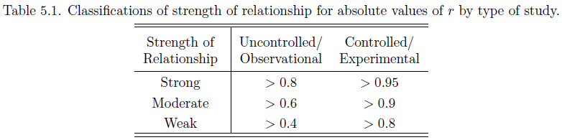
Correlation Coefficient
A measure of association and strength
Examine corrSim() from NCStats

Slide 7
Correlation Coefficient
A measure of association and strength of a linear relationship with no outliers
Moral … PLOT YOUR DATA!!
r = 0.817
r = 0.817
r = 0.817
r = 0.817

Slide 8
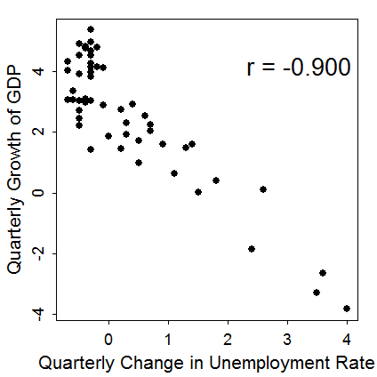
Perform a bivariate EDA from Figure 1.
The relationship between the quarterly growth of GDP and the change in unemployment rate is negative, linear, and strong with no apparent outliers. I assessed strength with the correlation coefficient because of the lack of outliers and the linear form.
Figure 1. Plot of the quarterly growth of GDP and change in unemployment rate for the U.S. from 1997-2009.

Slide 9
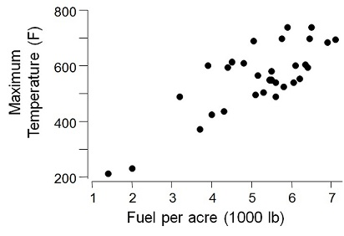
Perform a bivariate EDA from Figure 2.
The relationship between the maximum temperature and availability of fuel is positive, linear, and moderately strong with no apparent outliers. I assessed strength with the correlation coefficient because of the lack of outliers and the linear form.
r=0.798
Figure 2. Plot of the maximum temperature versus herbage yield for grassland headfires in west Texas.

Slide 10
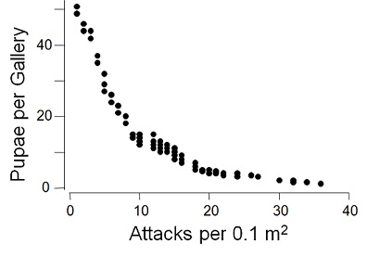
Perform a bivariate EDA from Figure 3.
The relationship between pupae per gallery and the density of attacks is negative, distinctly nonlinear, and strong with no apparent outliers. I assessed strength visually, without using the correlation coefficient, because the form is nonlinear.
r=-0.612
Figure 3. Plot of the number of pupae per gallery and the density of attacks for the beetle Ips cembrae

