Slide 1
Pie Charts
Bar chart – heights equal to category frequencies
Pie chart – pieces proportional to category frequencies
Color | Freq
Blonde | 4
Brunette | 1
Red | 3

Slide 2
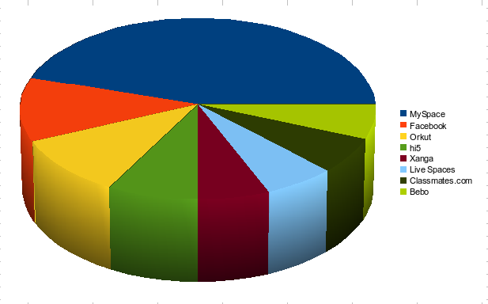
no, No, NO!!!

Slide 3

no, No, NO!!!

Slide 4

no, No, NO!!!

Slide 5

no, No, NO!!!

