Slide 1
Linear Models -- Foundation

Slide 2
Class Exercise Handout
What Type of Variables?
Before you begin … what are your choices (main categories, subcategories)?
What is the Response Variable?
Before your being … what is a response variable?

Slide 3
What Type of Variable?
Temperature (ºF)
Habitat complexity (low, medium, high)
Home range size (m²)
Brood size
Forest type (deciduous, mixed, coniferous)
Number of docks (on a lake shoreline)
Ecoregion (Northern Lakes & Forests, North Central Hardwood Forests, Driftless Area, Southeastern Wisconsin Till Plains, Central Corn Belt Plains)
Survived (yes, no)
Age (years)
Race

Slide 4
Which is the response variable?
Can length be used to predict weight?
How is weight affected by typical daily ration?
Does metabolic rate differ by sex of rabbit?
Is gas mileages significantly affected by weight of the car?
Is there a relationship between how much money a person makes and their satisfaction with deer harvest regulations?
How is the uptake of heavy metals affected by the sex and age (young, middle, old) of the individual?
Is there a relationship between how much money a person makes and how much they weigh?

Slide 5
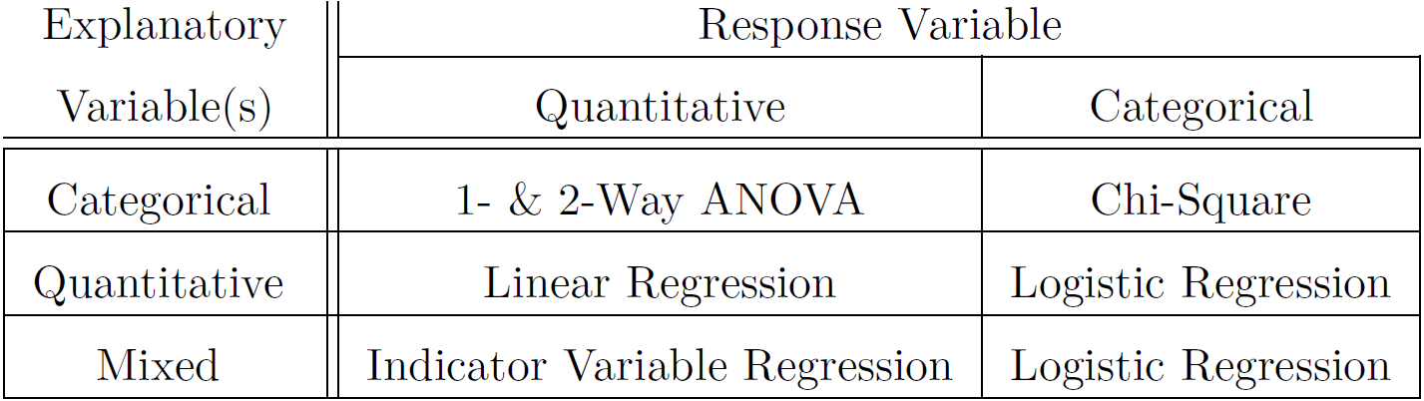
Linear Models
A categorization scheme
All use a common foundation of theory
1 Factor
2 Factors
1
2
3
4
5

Slide 6
Class Exercise Handout
Which Test? Why?
Identify response variable and explanatory variable(s)
Determine which type of variable each is.
Use table to identify method to use.

Slide 7
Which Test? Why?
Does bird species diversity (number of species) decline as you move away from the equator (increase latitude)?
Does the mean length of the anterior adductor muscle scar on a mussel species differ among five locations?
Does whether or not an otter captures a bluegill depend on the total length of the bluegill?
Is there a difference in fat reserves (thickness in mm) between wild and domestic seals, sex of the seal, or the interaction between the seal type and sex?
Does the relationship between the number of times the word gender was used in a journal volume and the year of the volume differ among three different journals?

Slide 8
Which Test? Why?
Does the relationship between resting heart rate and body weight differ among groups of subjects that had or had not ingested caffeine?
Does the mean alcohol by volume differ among five different types of beer (pale ales, IPAs, lagers, stouts, and porters)?
Does mean alcohol by volume change depending on the weight of malt extract used in the brewing process?

Slide 9
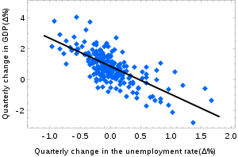
Which Test? Why?

Slide 10
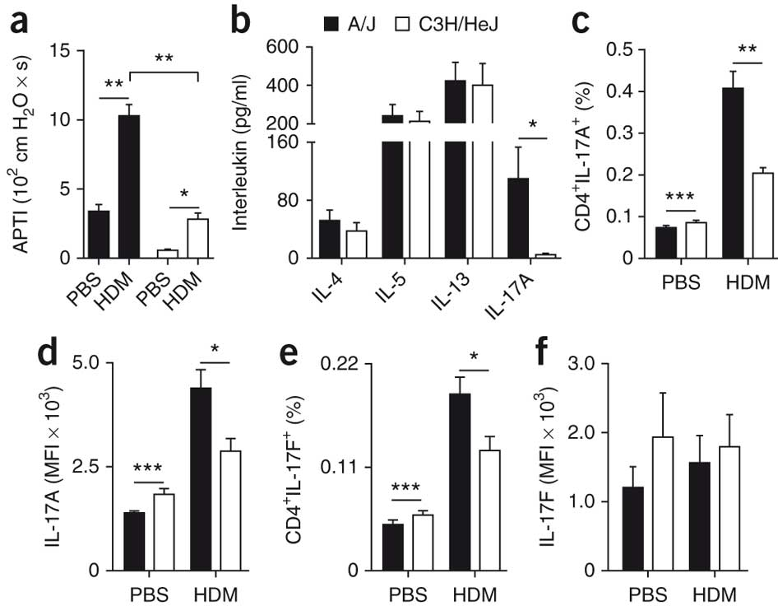
Which Test? Why?

Slide 11
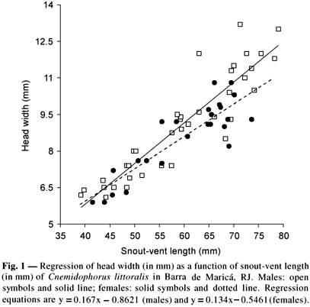
Which Test? Why?

Slide 12
Example Data – Sex & Direction
A sample of 30 males and 30 females was taken to an unfamiliar wooded park and given spatial orientation tests, including pointing to the south. The absolute pointing error, in degrees, was recorded. The results are in the SexDirection.csv file on the webpage. Is there a difference in sense of direction between men and women?
from Sholl, M.J., J.C. Acacio, R.O. Makar, and C. Leon. 2000. The relation of sex and sense of direction to spatial orientation in an unfamiliar environment. Journal of Environmental Psychology. 20:17-28.

Slide 13
Example Data – Sex & Direction
What are the hypotheses?
H_{O}: μ_{m}-μ_{f}=0 H_{A}: μ_{m}- μ_{f} ≠ 0
Use which hypothesis test?
Two Sample T-test
What is conclusion from handout?
No significant difference in mean APE between males and females

Slide 14
Competing Models
Characteristic | Full Model | Simple Model
Hypothesis
H_{A}
H₀
# Parameters
More
Less
Relative Fit
Better
Worse

Slide 15
Competing Models
Full | Simple
H_{A}
H₀
More
Less
Better
Worse

Slide 16
Competing Models – 2-sample T
H₀: μ_{i} = μ
“The mean for each group equals a single grand mean”
i.e., “No difference in group means”

Slide 17
Competing Models – 2-sample T
H_{A}: μ_{i} = μ_{i} (where μ₁≠μ₂)
“Each group mean equals a different value”
i.e., “Difference in group means”

Slide 18
Competing Models
Characteristic | Full Model | Simple Model
Hypothesis
H_{A}
H₀
# Parameters
More
Less
Is the “benefit” of a better fit worth the “cost” of added complexity?
Relative Fit
Better
Worse

Slide 19
Measuring Fit

Slide 20
Measuring Fit – Notation
Y_{ij} = Y measurement on individual j in group i
I = total number of groups
n_{i} = number of individuals in group i
n = number of individuals in all groups
‾Y_{i.} = group i sample mean (i.e., group mean)
‾Y.. = sample mean of all individuals (i.e., grand mean)

Slide 21
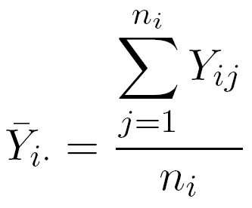
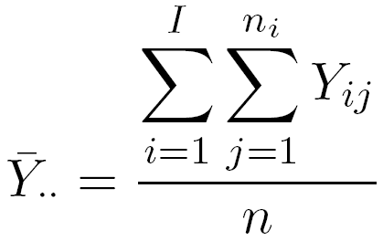
Measuring Fit – Notation Examples
i^{th} Group Sample Mean
Grand Sample Mean

Slide 22

Measuring Fit – SS
Measures lack-of-fit of a model to a set of data

Slide 23
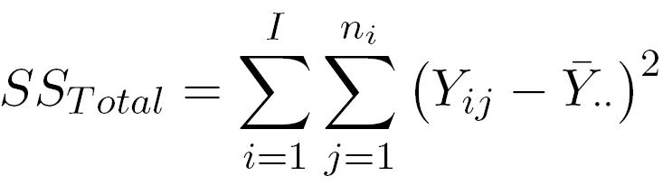
Measuring Fit – SS_{Total}
= 115465
data
model

Slide 24
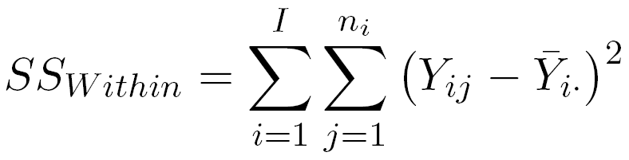
Measuring Fit – SS_{Within}
=110496
data
model

Slide 25
Measuring Fit – SS_{Within} & SS_{Total}
SS_{Total} = 115465
SS_{Within}= 110496
Full model ALWAYS fits better!

Slide 26
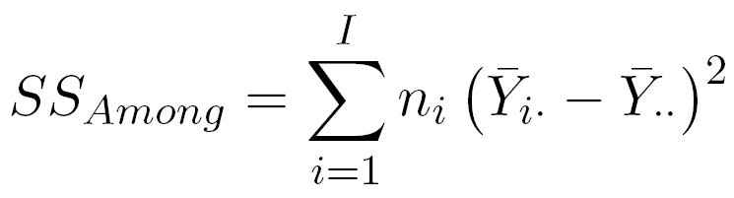
Measuring Fit – SS_{Total} Partitions
SS_{Total} = SS_{Within} + SS_{Among}
where
Difference in SS between full & simple models
Improvement in lack-of-fit when using full model (rather than simple model)
Measure of how different the group means are

Slide 27
Measuring Fit – SS_{Among}
What would make SS_{among} be “large”?
Must not forget about differences in model complexity!

Slide 28
Measuring Complexity
df = n – number of predictions
“Simple model” → df_{Total} = n-1
“Full model” → df_{Within} = n-I
df_{Total} = df_{Within} + df_{Among}
df_{Among} = I-1
Difference in number of model parameters
Added complexity of full model

Slide 29
Fit vs. Complexity
Factor out difference in number of parameters on fit calculation by dividing SS by df
Result is “mean square” (MS)
MS are sample variances
MS_{Total} = s² = total variability among individuals around grand mean
MS_{Within} = s_{p}² = pooled variability among individuals around group means
MS_{Among} = variability of group means around the grand mean

Slide 30
Fit vs. Complexity – MS
Suppose that MS_{Among} = 10
Is this “large” if MS_{Within} = 100?
Is this “large” if MS_{Within} = 1?
F=

Slide 31
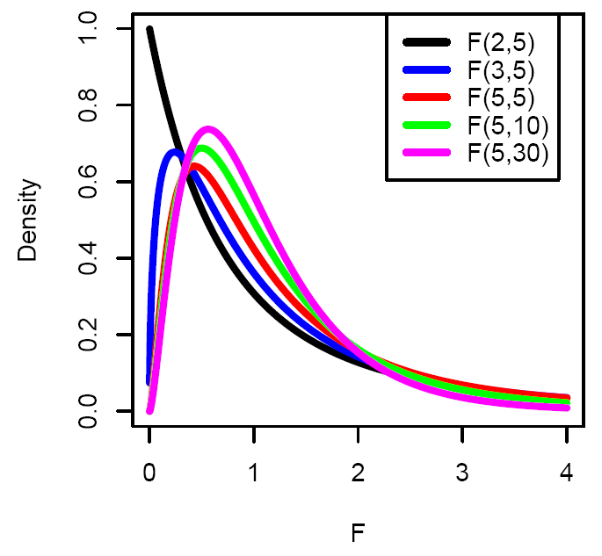
Fit vs Complexity – F Distribution
Has numerator and denominator df
numerator from df_{Among}
denominator from df_{Within}
Right-skewed, all positive numbers
P-value always upper tail

Slide 32
Fit vs. Complexity – p-value
Large p-value?
Small F
Small MS_{Among} relative to MS_{Within}
Small SS_{Among}
Full model not “better”
Group means do not differ

Slide 33
Fit vs. Complexity – p-value
Large p-value?
Small F
Small MS_{Among} relative to MS_{Within}
Small SS_{Among}
Full model not “better”
Group means do not differ
Small p-value?
Large F
Large MS_{Among} relative to MS_{Within}
Large SS_{Among}
Full model is “better”
Group means do differ

Slide 34
Linear Models in R – HO
Note use of
lm()
summary()
coef()
confint()
fitPlot()
anova()

Slide 35
Things To Remember
Always two models
Full model is separate means for each group
Simple model is a single mean for each group
The SS_{Total} partitions into two parts -- SS_{Among}+SS_{Within} = SS_{Total}
SS_{Among} is the improvement in lack-of-fit using the full model
MS are SS/df and are variances
MS_{Total} is variance of Y
MS_{Within} is the pooled common variance
df_{Among} is the increase in complexity of the full model
MS_{Among} + MS_{Within} not = MS_{Total} (because of different df)
F is the ratio MS_{Among} / MS_{Within}
If F is large then evidence for different means -- i.e., reject H₀

