Slide 1
Examples

Slide 2

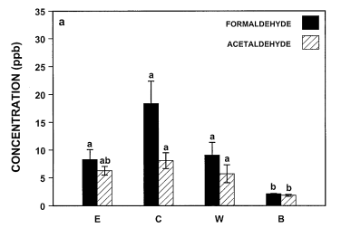

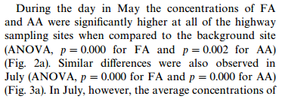

Notes:
http://gel.berkeley.edu/formaldehyde/ViskariEL_MVartiainen_etal_2000.pdf

Slide 3

