Slide 1
Linear Models
Simple Linear Regression

Slide 2
Recall from Introductory Stats
Slope
rate of change of the response for each unit increase of the explanatory
Intercept
value of the response when the explanatory =0
Best-fit line
the line of all possible lines through the two sample means that minimizes the RSS
examine the animation

Slide 3
Recall from Introductory Stats
Assumptions
Independent Observations
Homoscedasticity
Normality in the Residuals
No Outliers
Linearity
examine the animation

Slide 4
Example – Atlantic Salmon
Vladic et al. (2002) recorded (in SalmonSperm.txt)
probability of successful egg fertilization (fert.success)
the length of sperm tail end piece (step.len)
Asked “Are fertilization success and length of sperm related?”

Slide 5
Simple Linear Regression in R
From HO
Review lm() from intro class
Interpret slope
Interpret intercept
Predict @ step.len=3.5

Slide 6
Furthering – Linear Regression
If another sample was taken would we expect the exact same …
best line fit?
slope?
y-intercept?
predictions?
All are statistics
subject to sampling variability
have a standard error
summarized with CIs and hypothesis tests

Slide 7


Equation of a Line
Population Model for an Individual
where

Slide 8
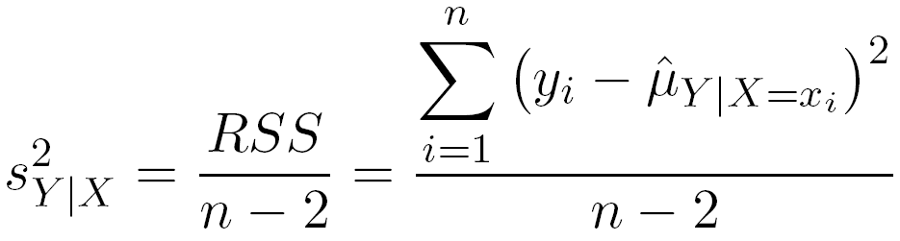
Linear Regression – Variability
Natural variability about the line
The variability in the response variable “unexplained” by the best-fit line.
residual standard error on HO

Slide 9
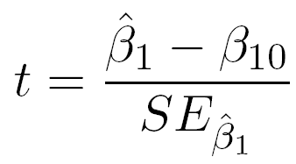
Linear Regression – SEs & Tests
Find & interpret slope & y-intercept SE on HO
Hypotheses: H_{o}: β₁=β₁₀
Test Statistic:
Default Hypotheses: H_{o}: β₁=0
Find and interpret on HO

Slide 10
Linear Regression – Tests
What does the default hypothesis test for the slope actually test? What does it tell us?
H_{A}: β₁≠0
H₀: β₁=0

Slide 11

Linear Regression – Predictions
Two types of predictions
Predict mean for all individuals with particular value of x (i.e., x₀)
Predict value for an individual with particular value of x (i.e., x₀)
Fitted Value
Predicted Value

Slide 12
Linear Regression – Predictions
Fitted Value
Predicted Value
20.93
3.5

Slide 13
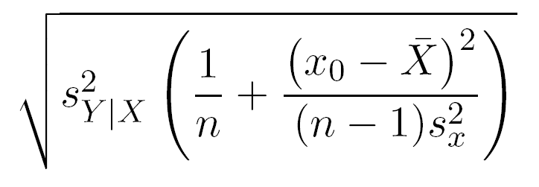
Linear Regression – Predictions
SE of fitted value
measures variability in line placement
measures variability in prediction of mean

Slide 14
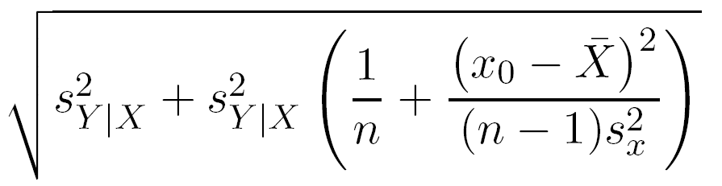
Linear Regression – Predictions
SE of predicted value
measures variability in placement of individual
measures variability in predicting individuals
Variability in
Individuals
Variability in Line Placement

Slide 15
Linear Regression – Predictions
Predict mean fert.succ for all individuals with a step.len of 3.5
fit lwr upr
20.93 17.60 24.26
Predict fert.succ for an individual with a step.len of 3.5
fit lwr upr
20.93 10.51 31.353
20.93
3.5

Slide 16
Simple Linear Regression in R
See HO
summary()
confint()
fitPlot()
predict()
predictionPlot()

Slide 17
Linear Regression – Models
Two competing models
Full Model: A non-horizontal line
H_{A}: β₁≠0
μ_{Y|X} = α + β₁X
Simple Model: A horizontal line
H_{o}: β₁=0
μ_{Y|X} = α OR μ_{Y|X} = ‾y

Slide 18
Linear Regression -- Models
Two competing models
Full Model: H_{A}: β₁≠0
Simple Model: H_{o}: β₁=0
μ_{Y|X} = α + β₁X
μ_{Y|X} = α =‾Y
μ_{Y|X}=α+β₁X
H_{A}: β₁≠0
μ_{Y|X} = α =‾y
H₀: β₁=0

Slide 19
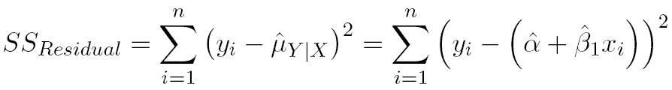

Linear Regression – Model Fits
Two competing models
Full Model: μ_{Y|X} = α + β₁X
Simple Model: μ_{Y|X} = ‾y

Slide 20
Linear Regression – Models
Two competing models
Full Model: μ_{Y|X} = α + β₁X
Simple Model: μ_{Y|X} = β₀ = ‾y

Slide 21
SS_{Regression}
SS_{Total} partitions
SS_{Residual}
exactly analogous to SS_{Within}
amount of “variability” still not explained by full model
SS_{Regression}
exactly analogous to SS_{Among}
amount of “variability” explained by full model
how much “better” the full fits than the simple model

Slide 22
Simple Linear Regression in R
See HO
anova()
Find and label the SS parts
Where do the MS come from?
Where does the F come from?
What does it test?
Compare to default t-tests in summary()

Slide 23
SLR Assumptions
Independence among individuals
Linearity
assess with fitted-line and residual plots
Homoscedasticity
assess with fitted-line and residual plots
Normality of residuals
assess with Anderson-Darling test & histogram
No outliers (or highly influential points)
assess with outlier test & residual plot

Slide 24
Influential Point
An individual with a strong effect on the fitted model
i.e., if the point is removed/included the model results are very different
130
120
110
Y
100
90
80
70
70
80
90
100
110
120
130
X

Slide 25
Simple Linear Regression in R
See HO
fitPlot()
residPlot()
leveneTest()
adTest()
outlierTest()

Slide 26
SLR Transformations
Response variable
If theory suggests (we will explore soon)
Trial-and-error using dynamic graphics
Experience
e.g., sin⁻¹(sqrt(Y)) for proportions or percentages
Explanatory variable
If theory suggests
Trial-and-error using dynamic graphics
To logs if max/min > 10 (Weisberg)

Slide 27
SLR Transformations
Response variable (cont)
Theory
Power function → Y=aX^{b}
Exponential function → Y=ae^{bX}

Slide 28

SLR Example
Croxall (1982) examined the weight loss of adult petrels during periods of egg incubation.
13 species were examined.
Some had measurements for both sexes – thus 19 measurements
These were recorded for each species …
mean initial weight (g)
mean weight lost (g g⁻¹ d⁻¹)
Data are in Petrels.txt
Croxall, J.P. 1982. Energy costs of incubation and moult in petrels and penguins. J. Anim. Ecol. 51:177-194.

