Slide 1
Linear Models
Simple Logistic Regression

Slide 2
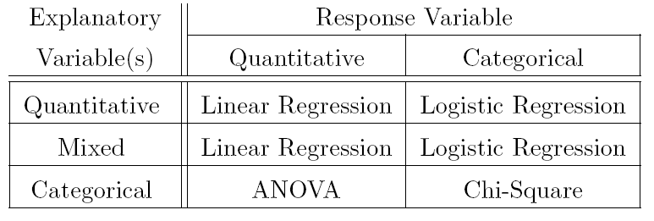
Linear Models
A categorization scheme
Logistic regression has a categorical response variable.
For simplicity we will only look at a binomial response variable.
4

Slide 3
Example -- Bats
Hawaiian bats, recorded ...
Subspecies – cinereus (0) and semotus (1)
Height of upper left canine tooth (mm)
Questions
Is subspecies type related to canine tooth height?
Can canine tooth height predict subspecies type?
Examine HO – Section 1.1

Slide 4
Probability of “Success”
Define p_{i} = μ_{Y|Xi} = PR(Y_{i}=1)
Probability of success (Y=1) for each value of X
Plot of p_{i} versus x_{i} is non-linear

Slide 5
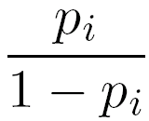
Odds Ratio
Define odds_{i} =
Ratio of PR(“success”) to PR(“failure”)
If p_{i}= 0.75 then odds_{i} = 3
Three times more likely to have a success.
If p_{i} = 0.5 then odds_{i} = 1
Equally like to have a success or a failure.
If p_{i} = 0.25 then odds_{i} = 1/3
One-third as likely to have a success.
Three times more likely to have a failure.

Slide 6
Odds Ratio
Calculate and interpret odds for:
p_{i} = 0.01, 0.1, 0.8, 0.9, 0.99
Plot of odds_{i} versus x_{i} is still non-linear

Slide 7
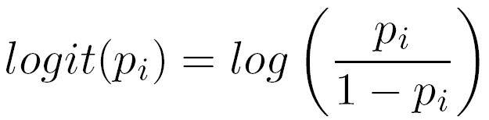
Logit Tranform (i.e., “log odds”)
Define
Plot of logit(p_{i}) versus x_{i} is generally linear.

Slide 8
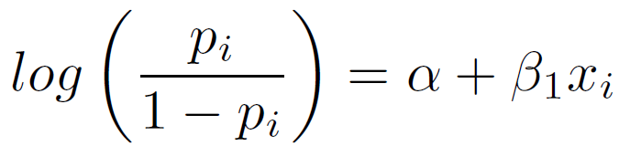
Logistic Regression Model
Transformed model then becomes …
Examine HO – section 1.2

Slide 9
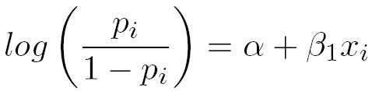
Predictions I
Log odds is predicted by plugging X into
See HO – first line of Section 1.3

Slide 10
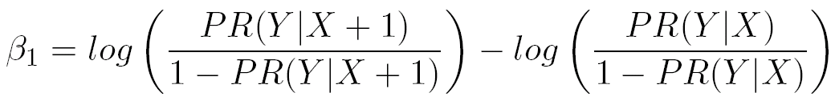
Slope Coefficient
Additive change in log(odds) for a unit change in the explanatory variable.
Examine HO – section 1.3

Slide 11
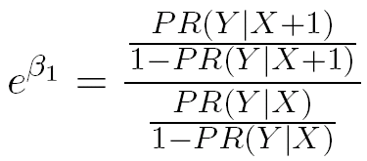
Back-Transformed Slope
Multiplicative change in odds for a unit change in the explanatory variable.
Examine HO – section 1.3

Slide 12
Default Tests for Slope
Is there a significant relationship between log(odds) and the explanatory variable?
Does the additive change in log(odds) for a unit change in explanatory variable equal 0?
OR does the multiplicative change in odds for a unit change in explanatory variable equal 1?
See HO – summary() results in Section 1.2

Slide 13

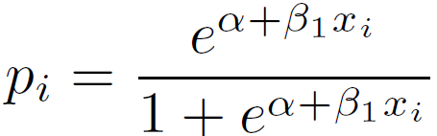
Predictions II
Log odds is predicted by plugging X into logistic regression results.
Odds is predicted by back-transforming log odds result.
Probability of success is predicted with …
See HO – Section 1.4

Slide 14
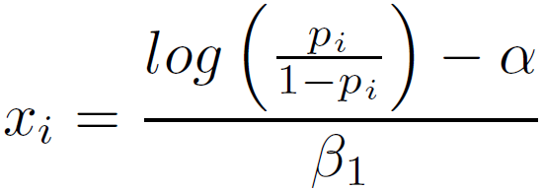
Predict X for Certain Probability
Solve the logistic regression model for x
See HO – Section 1.5

Slide 15
Confidence Intervals
Normal theory tends not to work.
Need to bootstrap.
See HO Section 2.

Slide 16
Another Example
Households were asked if they would accept an offer to put solar panels on the roof of their house if they would receive a 50% subsidy from the state.
Also recorded demographic variables for each household: income, size, monthly mortgage payment, age of head
Questions:
At what income will 25% of households accept?
What is the probability of acceptance for a household with an income of $80000.
How much does odds of acceptance change for each $1000 increase in household income?

