Slide 1
Linear Models
Binary Logistic Regression

Slide 2
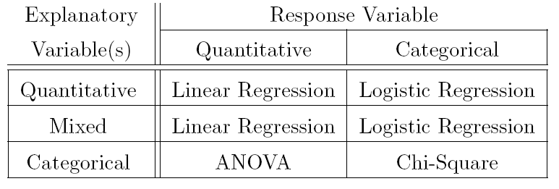
Hawaiian Bats
Examine data.frame on HO Section 1.1
Questions
Is subspecies related to canine tooth height?
Can canine tooth height predict subspecies?
4

Slide 3
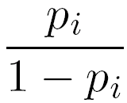
Hawaiian Bats
Examine Plots on HO – Explorations
Define p_{i} = μ_{Y|Xi} = PR(Y_{i}=1)
Probability of success (Y=1) for each X_{i}
What is the form of p_{i} vs x_{i}?
Define odds_{i} =
Put this equation into words?
Compute & interpret some odds (p_{i}=0.25,0.5,0.75)
What is the form of odds_{i} vs x_{i}?

Slide 4
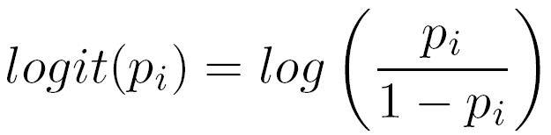
Logit Tranform (i.e., “log odds”)
Define
Plot of logit(p_{i}) versus x_{i} is generally linear.

Slide 5
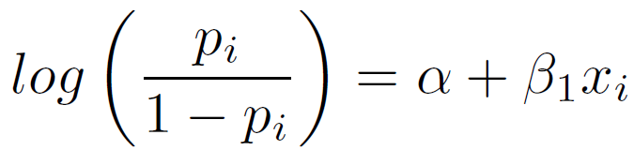
Logistic Regression Model
Transformed model then becomes …
Examine HO – Model Fitting and …
Interpret
Y-intercept
Slope
Back-transformed slope

Slide 6
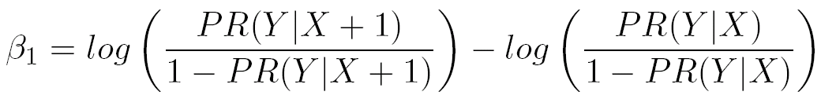
Slope Coefficient
Additive change in log(odds) for a unit change in X.
Examine HO – Interpretation of slope

Slide 7
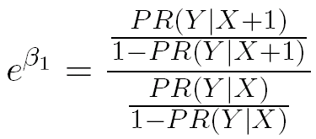
Back-Transformed Slope
Multiplicative change in odds for a unit change in the explanatory variable.
Examine HO – Interpretation of slope

Slide 8
Default Tests for Slope
Is there a significant relationship between log(odds) and the explanatory variable?
Does the additive change in log(odds) for a unit change in explanatory variable equal 0?
OR does the multiplicative change in odds for a unit change in explanatory variable equal 1?
See HO – summary() results in Model fitting and …

Slide 9
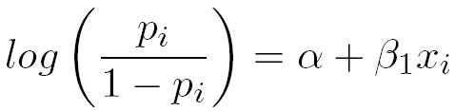

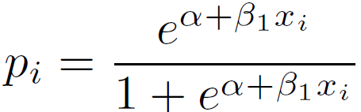
Predictions I
What is predicted by plugging x_{i} into line?
What is predicted if this is back-transformed?
Can we do more/better?
See Section Predicting Probabilities ….

Slide 10
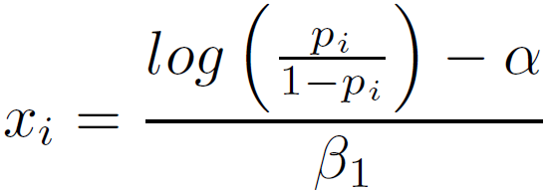
Predictions II
Solve the logistic regression model for x
What does this allow?
See HO – X for a Certain Proportion

Slide 11
Confidence Intervals
Normal theory tends not to work.
Need to bootstrap.
See HO Section Bootstrapping.

Slide 12
Another Example
Households were asked if they would accept an offer to put solar panels on the roof of their house if they would receive a 50% subsidy from the state.
Also recorded household demographic variables: income, size, monthly mortgage payment, age of head
Questions:
At what income will 25% of households accept?
What is the probability of acceptance for a household with an income of $80000? Odds of acceptance?
How much does odds of acceptance change for each $1000 increase in household income?
How much does the probability of acceptance change for $1000 increase in household income?

