Slide 1
Linear Models
One-Way ANOVA

Slide 2
A researcher is interested in the effect of irrigation on fruit production by raspberry plants. The researcher has determined that he will examine the effects of 100 ml (a maintenance amount), 200, 400, and 800 ml of water per pot. The researcher has 16 identical planting pots available and much more than that number of raspberry plant seedlings. A square table for growing the plants in a greenhouse is also available. He has enough time to let the plants mature to the point of producing fruit (i.e. berries) or not. At the end of this period, the total weight (g) of mature berries will be recorded.

Slide 3
Examine Handout
What is the response variable? Type?
What is the explanatory variable? Type?
What type of test?
What is an individual?
How should the treatments be allocated to pots?
What is the research hypothesis?
What are the statistical hypotheses?
What does the full model look like? Simple model?

Slide 4
Statistical Hypotheses
H₀: μ₁ = μ₂ = … = μ_{I}
H_{A}: “at least one pair of means is different”
One-way ANOVA is the method to test these hypotheses

Slide 5
Models in One-Way ANOVA
H₀: μ₁ = μ₂ = … = μ_{I} becomes μ_{i}=μ
i.e., a model with one mean for all groups
H_{A}: “at least one pair of means is different” becomes μ_{i}=μ_{i}
i.e., a model with different means for each group
10
Berry Weight
5
0
-100
400
900
Water Amount

Slide 6
Examine Handout
Same as described for two-sample t-test
lm()
anova()
summary()
Plotting means with CIs
use fitPlot()

Slide 7
One-Way ANOVA Assumptions
Independence between individuals within groups
No link between individuals in the same group
Independence between individuals among groups
No link between individuals in different groups
Critical Assumption

Slide 8
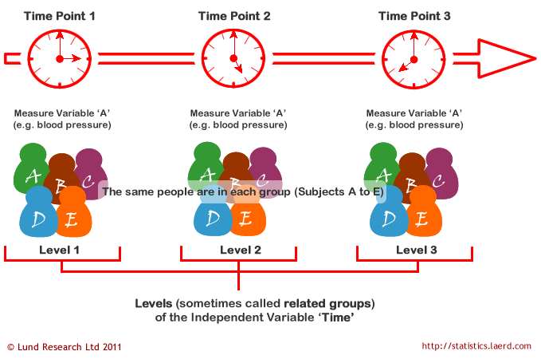
Independence?
Notes:
https://statistics.laerd.com/statistical-guides/repeated-measures-anova-statistical-guide.php

Slide 9
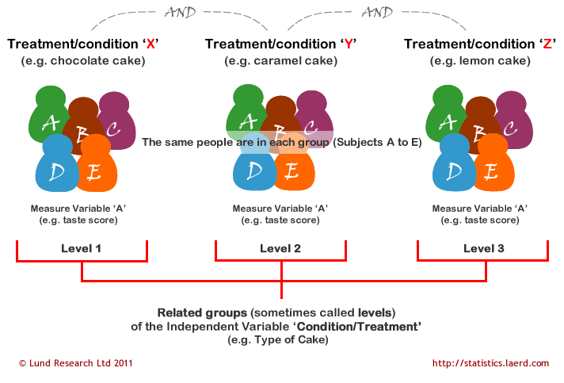
Independence?

Slide 10
One-Way ANOVA Assumptions
Equal variances among groups
MS_{Within} calculation assumes this
Two levels of assessment
Perform Levene’s homogeneity of variance test.
H₀: group variances are equal
H_{A}: group variances are NOT equal
If rejected then examine residual plot.
Does dispersion of points in each group vary dramatically?
Critical Assumption

Slide 11
One-Way ANOVA Assumptions
Normality within each group
nearly impossible to test b/c n_{i} are usually small
assess full-model residuals
Anderson-Darling Normality Test
H₀: “residuals are normally distributed”
H_{A}: “residuals are NOT normally distributed”
If rejected, visually assess a histogram of residuals
as long as the distribution is not extremely skewed and n_{i}s are not too small then the data are generally normal “enough”
Robust to Violations

Slide 12
One-Way ANOVA Assumptions
No outliers
One-way ANOVA is very sensitive to outliers
Outlier test
P-value of externally studentized residual
Obvious errors are eliminated; impact of others is assessed by comparing analyses with and without the outlier
Important Assumption

Slide 13
Examine Handout
Note use of
leveneTest()
residualPlot()
adTest()
hist()
outlierTest()

Slide 14
Following Significant ANOVA
A multiple comparison analysis is a post hoc analysis to determine which means differ
Use two-sample t-tests for all pairs?
No, experimentwise error rate gets very large

Slide 15
Error Rates
Individualwise Error Rate
Probability of rejecting a correct H₀ on a pair
equal to α
Experimentwise Error Rate
Probability of rejecting at least one correct H₀ from comparisons of all pairs

Slide 16
Experimentwise Error Rate
Probability of rejecting at least one correct H₀ from comparisons of all pairs
Experimentwise = Pr(>1 type I) = 1-(1-α)^{k}
where α is the individualwise error rate
where k is the number of comparisons
Number of Tests | Pr(reject >1 correct H₀) | Pr(reject 0 correct H₀) | Sum
1 |  |  | 1
2 |  |  | 1
3 |  |  | 1
4 |  |  | 1
α
1-α
α² + 2α(1-α)
(1-α)²
α³ + 3α²(1-α) +3α(1-α)²
(1-α)³
1-(1-α)⁴
(1-α)⁴

Slide 17

Experimentwise Error Rate
Increases dramatically with increasing (k)
α=0.05
Groups | Number of Tests (k) | use α=0.05 | use α=0.10
2 | 1 | 0.0500 | 0.1000
 | 2 | 0.0975 | 0.1900
3 | 3 | 0.1426 | 0.2710
 | 4 | 0.1855 | 0.3439
 | 5 | 0.2262 | 0.4095
4 | 6 | 0.2649 | 0.4686
5 | 10 | 0.4013 | 0.6513
6 | 15 | 0.5367 | 0.7941
Notes:
windows(4,4); par(mar=c(3.5,3.5,0.1,0.1),mgp=c(2.4,0.75,0),las=1)
g <- 2:12
g2k <- choose(g,2)
k <- 1:max(g2k)
ew <- 1-((1-0.05)^k)
plot(ew~k,type="l",lwd=3,col="red",xlab="Number of Groups",ylab="Experimentwise Error rate",xaxt="n",ylim=c(0,1))
axis(1,at=g2k,labels=g)

Slide 18
Multiple Comparisons Methods
Attempt to control e’wise error rate at α
Three of a vast array of methods
Tukey HSD – compares all pairs of groups
Dunnett’s – compares all groups to one group
Bonferroni – compares all pairs of groups when a statistical theory does not hold

Slide 19
Examine Handout
Note use of
glht()
mcp()
summary()
confint()
fitPlot()
addSigLetters()

Slide 20
One-Way ANOVA Assumptions
What to do if the assumptions are not met?
If both normality and equal variances assumptions are not met, then consider transforming (converting) the data to a scale where the assumptions are met.

Slide 21
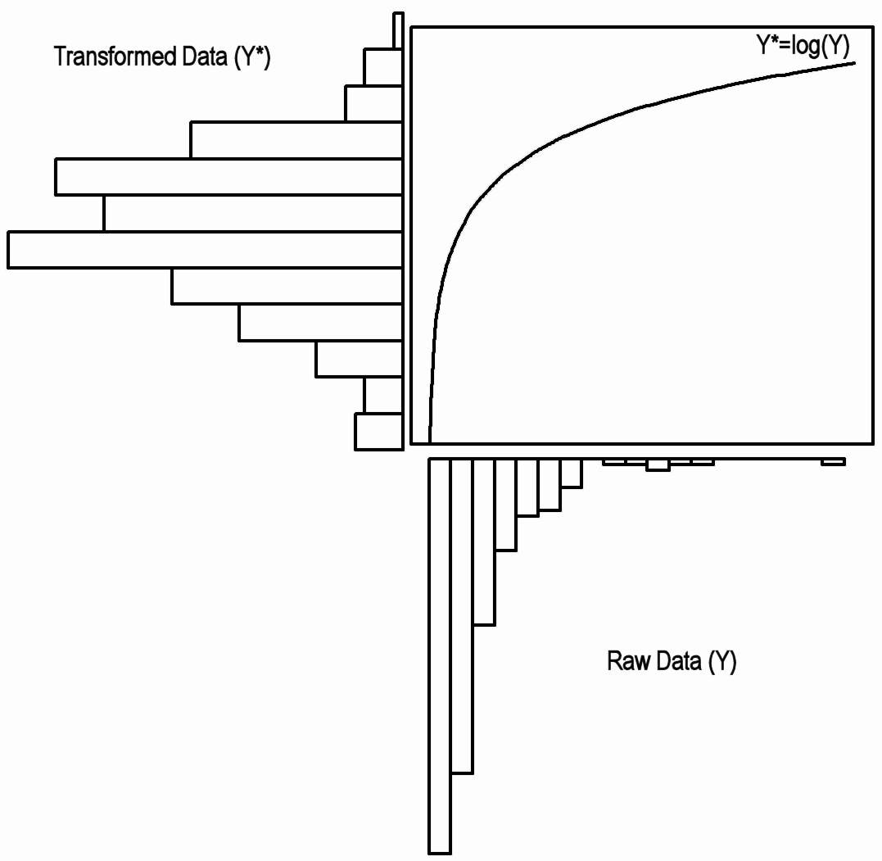
Effect of Log Transformation

Slide 22
Types of Transformations
Power Transformations
Y ➔ Y^{λ}
most common (by increasing “strength”)
λ= 0.5 → square root
λ= 0.33 → cube root
λ= 0.25 → fourth root
λ= 0 → natural log (by definition)
λ= -1 → reciprocal

Slide 23
Selecting Power Transformation
Based on experience or theory
“area” data → square root (λ=0.5)
“volume” data → cube root (λ=0.33)
“count” data → square root (λ=0.5)
Special Transformations
Usually “known” from experience in field
Proportions → arcsine square root [ Y → sin⁻¹(Y^{0.5}) ]
Trial-and-Error
Use transChooser()

Slide 24
Suggestions
Procedure – see reading
Presentation
always refer to the data as transformed
e.g., “mean square root variable-name”
Back-transform specific values related to a mean (but NOT for differences, unless logs were used).
e.g., if a square root was used then square the result
Note: back-transformed logs have special meanings

Slide 25
Example -- Background
Abundance of benthic infaunal communities between a potentially impacted location and control locations in Australia
1 potentially impacted location, 8 control locations
Impacted location is the first location (labeled as 1)
8 haphazardly-selected sublocations at each location
total abundance from a standard corer recorded
Does the potentially impacted location differ from any of the eight control locations?

Slide 26
Example – Conclusions
The mean log total abundance of benthic infauna differs between the potentially impacted site and four of the eight control sites.
The mean total abundance at control site 3 is between 1.55 (e^{0.4398}) and 2.63 (e^{0.9666}) times greater than at the potentially impacted site.
as an example

Slide 27
Fisher’s Least Significant Difference (LSD)
Computes p-value with df_{within} rather than n₁+n₂-2.
i.e., df considering all groups rather than just the two being compared
Disadvantage → provides only very moderate control of experimentwise error rate (i.e., still gets fairly large)
Use → only if primary interest is in comparisonwise error rate

Slide 28
Bonferroni Method
Computes adjusted p-value by multiplying the comparisonwise p-value by k
Advantage → Very easy
Disadvantage → too conservative / loss of power (i.e., experimentwise error rate much lower than desired)
Use → only with I<4 or software not available

Slide 29
Tukey-Kramer Honestly Significantly Different (HSD)
Computes p-value with Studentized Range distrib.
related to the range of a normal distribution divided by the standard deviation
Advantage → Controls experimentwise rate at α
Disadvantage → more complicated
Use → method of choice when comparing all pairs

Slide 30
Dunnett’s Method
Computes p-value with a “many-to-one” t distribution
ONLY compares all groups to one particular group
Does not compute for all pairs
Advantage → Controls experimentwise rate at α and has more power than Tukey-Kramer
Disadvantage → more complicated
Use → method of choice when comparing to one group

Slide 31
Externally Studentized Residuals
A residual divided by the SD of the residuals
SD is computed without the i^{th} individual.
Follow a t distribution with n-I-1 df
Thus, converted to a p-value
Individuals with small p-values are flagged as potential outliers

Slide 32
Selecting Power Transformation
CI: 0.33, 0.78
Best Guess: 0.54
Possibilities: cube root (0.33), square root (0.5)
First Try: square root

