Slide 1
Linear Models
Simple Linear Regression

Slide 2
Recall from Introductory Stats
Slope
rate of change of the response for each unit increase of the explanatory
Intercept
value of the response when the explanatory =0
Best-fit line
the line of all possible lines through the two sample means that minimizes the RSS
examine the animation

Slide 3
Recall from Introductory Stats
Assumptions
Independent Observations
Homoscedasticity
Normality in the Residuals
No Outliers
Linearity

Slide 4
Example – Oak Gall Wasps
See HO Background

Slide 5
Simple Linear Regression in R
From HO
Review lm() from intro class
Interpret slope
Interpret intercept
Predict @ damage=35

Slide 6
Furthering – Linear Regression
If another sample was taken would we expect the exact same …
best line fit?
slope?
y-intercept?
predictions?
All are statistics
subject to sampling variability
have a standard error
summarized with CIs and hypothesis tests

Slide 7


Equation of a Line
Population Model for an Individual
where

Slide 8
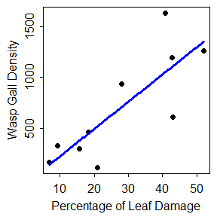
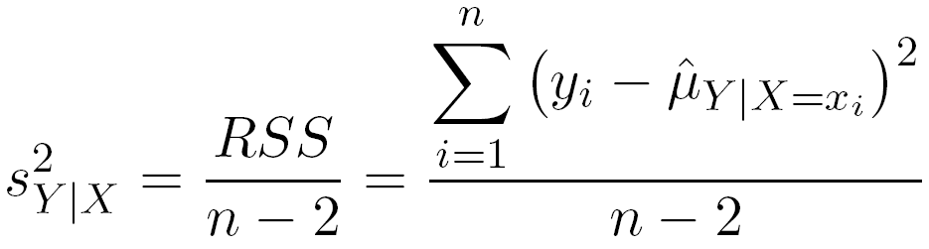
Linear Regression – Variability
Natural variability about the line
The variability in the response variable “unexplained” by the best-fit line.
residual standard error on HO

Slide 9
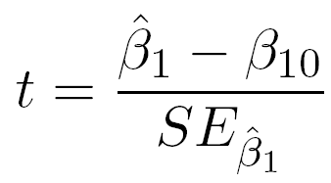
Linear Regression – SEs & Tests
Find & interpret slope & y-intercept SE on HO
Hypotheses: H_{o}: β₁=β₁₀
Test Statistic:
Default Hypotheses: H_{o}: β₁=0
Find and interpret on HO

Slide 10
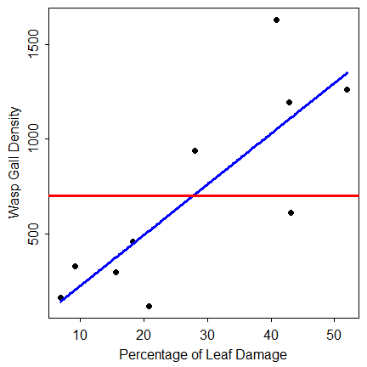
Linear Regression – Tests
What does the default hypothesis test for the slope actually test? What does it tell us?
H_{A}: β₁≠0
H₀: β₁=0

Slide 11

Linear Regression – Predictions
Two types of predictions
Predict mean for all individuals with particular value of x (i.e., x₀)
Predict value for an individual with particular value of x (i.e., x₀)
Fitted Value
Predicted Value

Slide 12
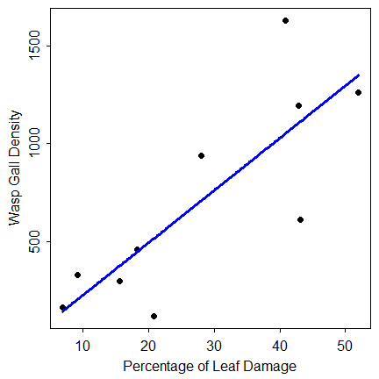
Linear Regression – Predictions
Fitted Value
Predicted Value
893
35

Slide 13
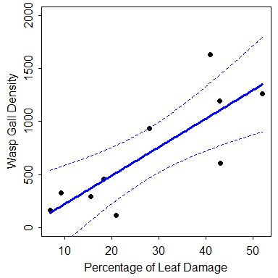
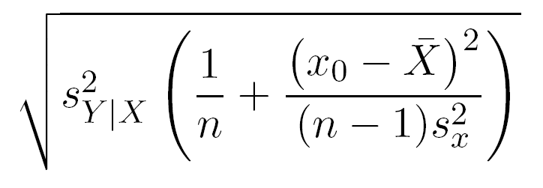
Linear Regression – Predictions
SE of fitted value
measures variability in line placement
measures variability in prediction of mean

Slide 14
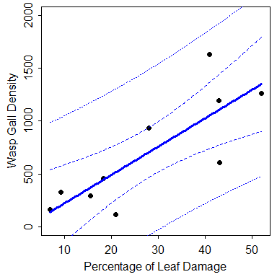
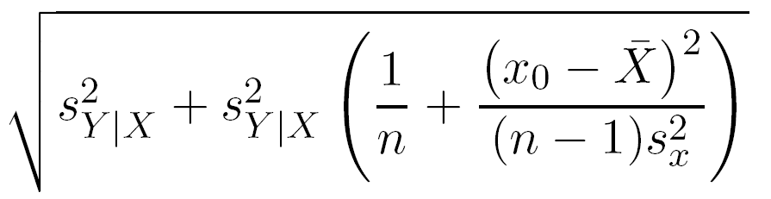
Linear Regression – Predictions
SE of predicted value
measures variability in placement of individual
measures variability in predicting individuals
Variability in
Individuals
Variability in Line Placement

Slide 15
Linear Regression – Predictions
Predict mean density for all trees with damage of 3.5%
fit lwr upr
893.05 631.60 1154.50
Predict density for a tree with a damage of 3.5%
fit lwr upr
893.05 102.42 1683.69
893
35

Slide 16
Simple Linear Regression in R
See HO
summary()
confint()
fitPlot()
predict()
predictionPlot()

Slide 17
Linear Regression – Models
Two competing models
Full Model: A non-horizontal line
H_{A}: β₁≠0
μ_{Y|X} = α + β₁X
Simple Model: A horizontal line
H_{o}: β₁=0
μ_{Y|X} = α OR μ_{Y|X} = ‾y

Slide 18
Linear Regression -- Models
Two competing models
Full Model: H_{A}: β₁≠0
Simple Model: H_{o}: β₁=0
μ_{Y|X} = α + β₁X
μ_{Y|X} = α =‾Y
μ_{Y|X}=α+β₁X
H_{A}: β₁≠0
μ_{Y|X} = α =‾y
H₀: β₁=0

Slide 19
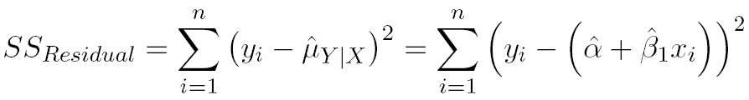

Linear Regression – Model Fits
Two competing models
Full Model: μ_{Y|X} = α + β₁X
Simple Model: μ_{Y|X} = ‾y

Slide 20
Linear Regression – Models
Two competing models
Full Model: μ_{Y|X} = α + β₁X
Simple Model: μ_{Y|X} = β₀ = ‾y

Slide 21
SS_{Regression}
SS_{Total} partitions
SS_{Residual}
exactly analogous to SS_{Within}
amount of “variability” still not explained by full model
SS_{Regression}
exactly analogous to SS_{Among}
amount of “variability” explained by full model
how much “better” the full fits than the simple model

Slide 22
Simple Linear Regression in R
See HO
anova()
Find and label the SS parts
Where do the MS come from?
Where does the F come from?
What does it test?
Compare to default t-tests in summary()

Slide 23
SLR Assumptions
Independence among individuals
Linearity
assess with fitted-line and residual plots
Homoscedasticity
assess with fitted-line and residual plots
Normality of residuals
assess with Anderson-Darling test & histogram
No outliers (or highly influential points)
assess with outlier test & residual plot

Slide 24
Influential Point
An individual with a strong effect on the fitted model
i.e., if the point is removed/included the model results are very different
130
120
110
Y
100
90
80
70
70
80
90
100
110
120
130
X

Slide 25
Simple Linear Regression in R
See HO
fitPlot()
residPlot()
leveneTest()
adTest()
outlierTest()

Slide 26
SLR Transformations
Response variable
If theory suggests (we will explore soon)
Trial-and-error using dynamic graphics
Experience
e.g., sin⁻¹(sqrt(Y)) for proportions or percentages
Explanatory variable
If theory suggests
Trial-and-error using dynamic graphics
To logs if max/min > 10 (Weisberg)

Slide 27
SLR Transformations
Response variable (cont)
Theory
Power function → Y=aX^{b}
Exponential function → Y=ae^{bX}

Slide 28

SLR Example
Croxall (1982) examined the weight loss of adult petrels during periods of egg incubation.
13 species were examined.
Some had measurements for both sexes – thus 19 measurements
These were recorded for each species …
mean initial weight (g)
mean weight lost (g g⁻¹ d⁻¹)
Data are in Petrels.txt
Croxall, J.P. 1982. Energy costs of incubation and moult in petrels and penguins. J. Anim. Ecol. 51:177-194.

