Slide 1
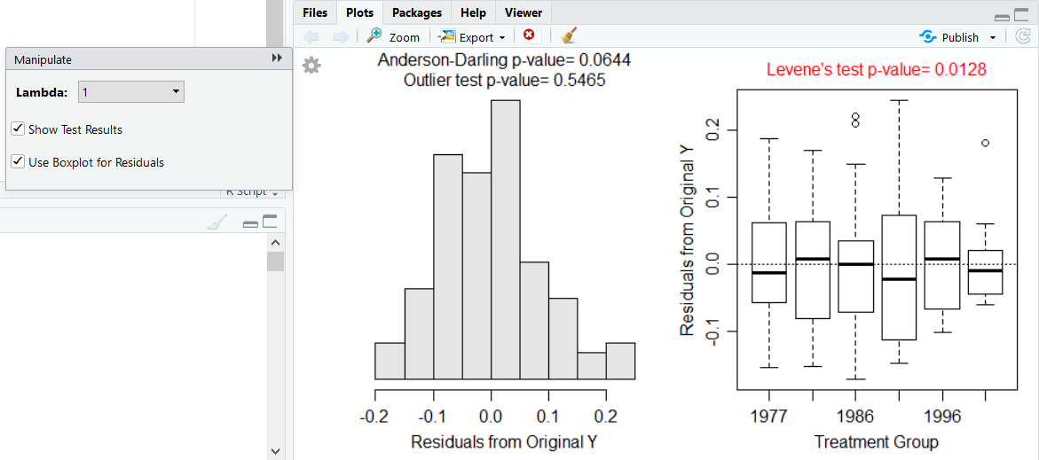
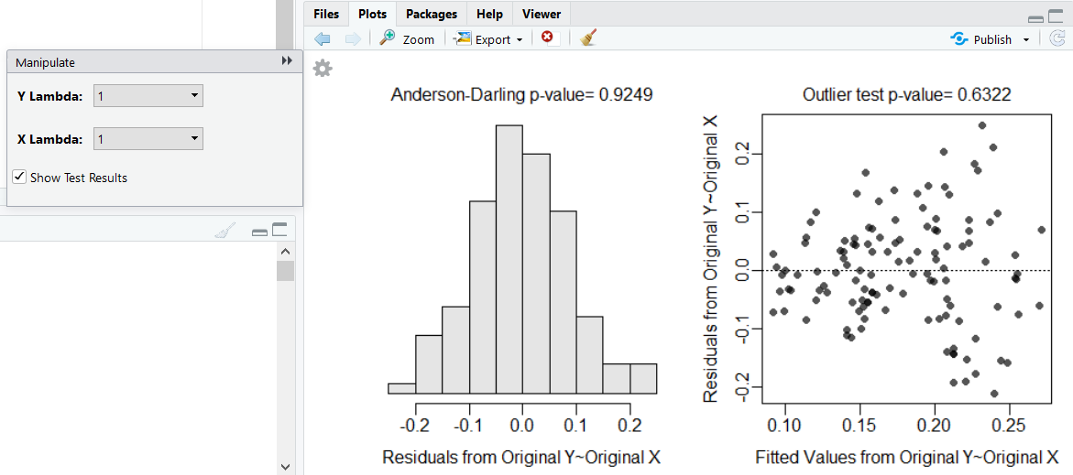
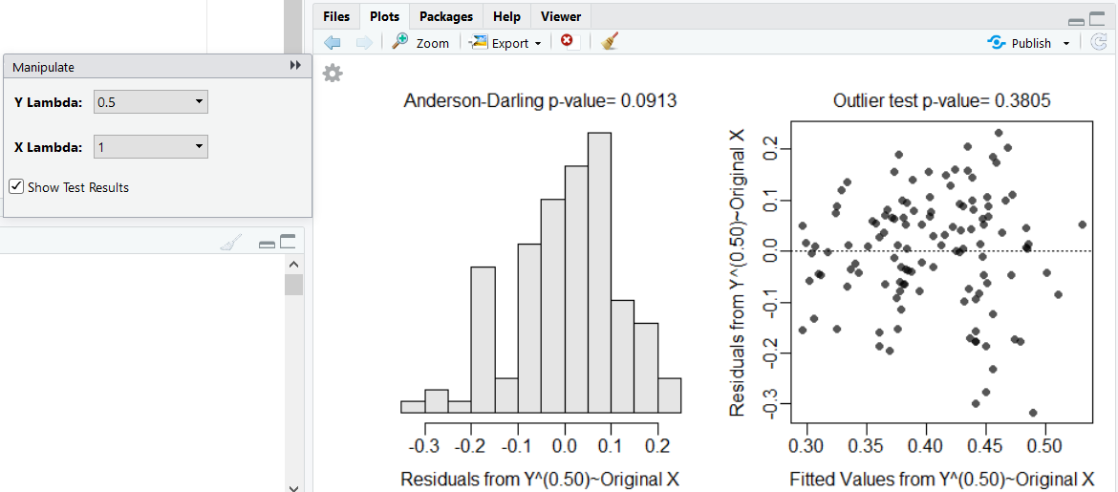
Get and Load Data
Factors (or Grouping Variables)
Checking Model Assumptions
ENTER RAW DATA:
In Excel, enter variables in columns with variable names in the first row, each individual’s data in rows below that (do not use spaces or special characters).
Save as “Comma Separated Values (*.CSV)” file in your local directory/folder.
DATA PROVIDED BY PROFESSOR:
Goto the MTH207 Resources webpage.
Save “data” link (right-click) to your local directory/folder.
LOAD THE EXTERNAL CSV FILE INTO R:
Start script and save it in the same folder with the CSV file.
Select the Session, Set Working Directory, To Source File Location menus.
Copy resulting setwd() code to your script.
Use read.csv() to load data in filename.csv into dfobj.
Observe the structure of dfobj.
Force a variable to be considered as a factor with factor()
See levels of a factor variable with levels()
Change order of levels with levels= in factor()
2
Use transChooser() for all plots and hypothesis tests required to check the assumptions of the saved lm() model object.
Select “Show Test Results” in gear box.
Select “Use Boxplot for Residuals” in gear box for one- and two-way ANOVAs.
dfobj$var <- factor(dfobj$var)
levels(dfobj$fvar)
> transChooser(oneway)
> transChooser(ivr)
dfobj$fvar <- factor(dfobj$fvar,levels=c("lev1", "lev2", "lev3")
> mdat$year <- factor(mdat$year)
> levels(mdat$species)
[1] "chinook" "coho"
> mdat$species<-factor(mdat$species,levels=c("coho","chinook"))
> levels(mdat$species)
[1] "coho" "chinook"
Add New Variables to Data.Frame
Add new variable to a data.frame with dfobj$newvar on the left side of <- and an “equation” defining the new variable (which may include variables from dfobj) to the right of <-.
Note the following:
sqrt() returns the square root.
log() returns the NATURAL log.
exp() return the exponential (anti-natural log).
^(x) raises to the power of x.
sin() returns the sine.
dfobj <- read.csv("filename.csv")
str(dfobj)
> library(NCStats)
> setwd("C:/aaaWork/Web/GitHub/NCMTH207") > mdat <- read.csv("Mirex.csv") > str(mdat)
'data.frame': 122 obs. of 4 variables:
$ year : int 1977 1977 1977 1977 1977 1977 1977 1977 ...
$ weight : num 0.41 0.45 1.04 1.09 1.24 1.25 1.3 1.34 ...
$ mirex : num 0.16 0.19 0.19 0.1 0.13 0.19 0.28 0.16 ...
$ species: Factor w/ 2 levels "chinook","coho": 1 1 1 2 ...
> headtail(mdat,n=2)
year weight mirex species
1 1977 0.41 0.16 chinook
2 1977 0.45 0.19 chinook
121 1999 11.36 0.09 chinook
122 1999 11.82 0.09 chinook
> mdat$sqrtweight <- sqrt(mdat$weight) > mdat$logweight <- log(mdat$weight)
> mdat$weight2 <- exp(mdat$logweight)
> mdat$cubrtweight <- mdat$weight^(1/3)
> mdat$sqdweight <- mdat$weight^(2)
> mdat$invweight <- mdat$weight^(-1)
> mdat$sinweight <- sin(mdat$weight)
Transforming Variables
Preferred Global Option
2
Filter Individuals
Remove “significance stars” from your results with the code below at the beginning of your script.
Use transChooser() (see above) to check which variable transformations lead to the model assumptions being met.
Change “Lambda” for one- and two-way ANOVAs.
Change “Y” first and then “X” lambda for regressions.
Transform the appropriate variables (see “Add New Variables” box) and then refit the model using the transformed variables.
Individuals may be selected from the dfobj data.frame and put in the newdf data.frame according to a condition with
where condition may be as follows
var == value # equal to
var != value # not equal to
var > value # greater than
var >= value # greater than or equal
var %in% c("val","val","val") # in the list
cond, cond # both conditions met
with var replaced by a variable name and value replaced by a number or category name (if value is not a number then it must be put in quotes).
> options(show.signif.stars=FALSE)
newdf <- filterD(dfobj,condition)
Fitting (Linear) Models
1
The five major methods from class can be fit with specific formulae in lm() or glm(). Note qvar is a quantitative variable and fvar is a factor (or grouping) variable. The response variable is to the left of ~. Save the result to an object.
> transChooser(ivr)
> mdat$tmirex <- sqrt(mdat$mirex)
> ivr2 <- lm(tmirex~weight*species,data=mdat)
oneway <- lm(qvar~fvar,data=dfobj)
twoway <- lm(qvar~fvar1*fvar2,data=dfobj)
slr <- lm(qvar~qvar,data=dfobj)
ivr <- lm(qvar~qvar*fvar,data=dfobj)
logreg <- glm(fvar~qvar,data=dfobj,family= "binomial")
> coho <- filterD(mdat,species=="coho")
> cohoALT <- filterD(mdat,species!="chinook")
> just80s <- filterD(mdat,year>=1980,year<1990)
> cohochin <- filterD(mdat,species %in% c("coho","chinook"))
> oneway <- lm(mirex~year,data=mdat)
> twoway <- lm(mirex~species*year,data=mdat)
> slr <- lm(mirex~weight,data=mdat)
> ivr <- lm(mirex~weight*species,data=mdat)
> logreg <- glm(species~weight,data=mdat,family="binomial")

Slide 2
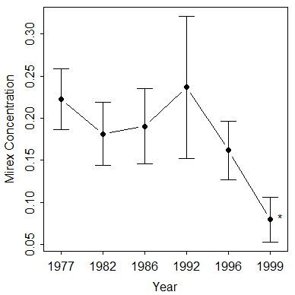
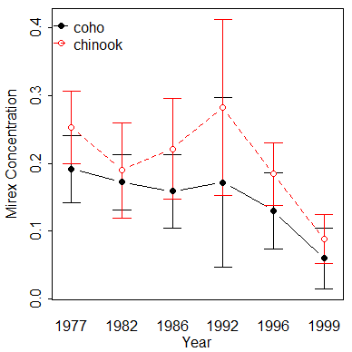
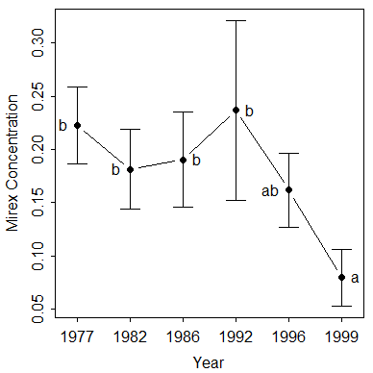
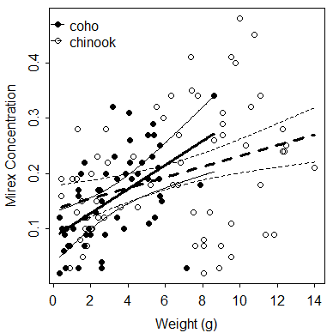
ANOVA Table
Fitted Plots (for ANOVAs)
3
Mult. Comp. (for ANOVAs) cont
6
An ANOVA table is constructed from a saved lm() or glm() object with anova(). Note that the p-value is under “Pr(>F)”.
> library(multcomp) ## MUST DO to use glht() and mcp()
> ## Dunnet’s example with one-way ANOVA
> mc1w <- glht(oneway,mcp(year="Dunnett"))
> summary(mc1w)
Linear Hypotheses:
Estimate Std. Error t value Pr(>|t|)
1982 - 1977 == 0 -0.04125 0.02610 -1.580 0.391
1986 - 1977 == 0 -0.03208 0.02610 -1.229 0.633
1992 - 1977 == 0 0.01417 0.03197 0.443 0.991
1996 - 1977 == 0 -0.06092 0.02776 -2.194 0.121
1999 - 1977 == 0 -0.14303 0.02776 -5.152 <0.001
> confint(mc1w)
Linear Hypotheses:
Estimate lwr upr
1982 - 1977 == 0 -0.04125 -0.10810 0.02560
1986 - 1977 == 0 -0.03208 -0.09893 0.03477
1992 - 1977 == 0 0.01417 -0.06771 0.09604
1996 - 1977 == 0 -0.06092 -0.13203 0.01019
1999 - 1977 == 0 -0.14303 -0.21414 -0.07192
> glhtSig(mc1w)
[1] "1999 - 1977"
> ## Tukey’s example with a two-way ANOVA (and only year var)
> mc2w <- glht(oneway,mcp(year="Tukey"))
> summary(mc2w)
Linear Hypotheses:
Estimate Std. Error t value Pr(>|t|)
1982 - 1977 == 0 -0.041250 0.026100 -1.580 0.61047
1986 - 1977 == 0 -0.032083 0.026100 -1.229 0.82002
1992 - 1977 == 0 0.014167 0.031965 0.443 0.99776
1996 - 1977 == 0 -0.060921 0.027764 -2.194 0.24655
1999 - 1977 == 0 -0.143026 0.027764 -5.152 < 0.001
1986 - 1982 == 0 0.009167 0.026100 0.351 0.99927
1992 - 1982 == 0 0.055417 0.031965 1.734 0.50991
1996 - 1982 == 0 -0.019671 0.027764 -0.709 0.98035
1999 - 1982 == 0 -0.101776 0.027764 -3.666 0.00485
1992 - 1986 == 0 0.046250 0.031965 1.447 0.69608
1996 - 1986 == 0 -0.028838 0.027764 -1.039 0.90285
1999 - 1986 == 0 -0.110943 0.027764 -3.996 0.00152
1996 - 1992 == 0 -0.075088 0.033338 -2.252 0.22055
1999 - 1992 == 0 -0.157193 0.033338 -4.715 < 0.001
1999 - 1996 == 0 -0.082105 0.029334 -2.799 0.06395
> confint(mc2w) ## CIs not shown to save space
> glhtSig(mc2w)
[1] "1999 - 1977" "1999 - 1982" "1999 - 1986" "1999 - 1992"
> cld(mc2w)
1977 1982 1986 1992 1996 1999
"b" "b" "b" "b" "ab" "a"
Use fitPlot() for a plot of group means with CIs from the saved lm() object. For two-way ANOVA use change.order=TRUE to (optionally) change which factor is on the x-axis in the interaction plot or which= for a main-effects plot.
Use addSigLetters() with the lm() object to add significance letters in lets= to the fitted plot. Use pos= to position the letters around the mean (2=“left-of” and 4=“right-of”). Must use same change.order=TRUE and which= if used in fitPlot().
> anova(twoway)
Response: mirex
Df Sum Sq Mean Sq F value Pr(>F)
species 1 0.05040 0.050395 6.5435 0.01189
year 5 0.31221 0.062442 8.1076 1.528e-06
species:year 5 0.02077 0.004154 0.5394 0.74602
Residuals 110 0.84718 0.007702
> anova(slr)
Response: mirex
Df Sum Sq Mean Sq F value Pr(>F)
weight 1 0.22298 0.222980 26.556 1.019e-06
Residuals 120 1.00758 0.008396
> anova(ivr)
Response: mirex
Df Sum Sq Mean Sq F value Pr(>F)
weight 1 0.22298 0.222980 26.8586 9.155e-07
species 1 0.00050 0.000498 0.0600 0.80690
weight:species 1 0.02744 0.027444 3.3057 0.07158
Residuals 118 0.97964 0.008302
> fitPlot(oneway,xlab="Year",ylab="Mirex Concentration")
> addSigLetters(oneway,lets=c("","","","","","*"),
pos=c(1,1,1,1,1,4)) # Dunnet’s example
> fitPlot(twoway,xlab="Year",ylab="Mirex Concentration",
change.order=TRUE,legend="topleft")
> fitPlot(twoway,xlab="Year",ylab="Mirex Concentration",
which="year") # LEFT
> addSigLetters(twoway,which="year",
lets=c("b","b","b","b","ab","a"),
pos=c(2,2,4,4,2,4)) # RIGHT … Tukey’s example
Coefficients (with CIs) Table
4
Model coefficients (estimated parameters) and confidence intervals are extracted from a saved lm() or glm() object with coef() and confint(), respectively. Column-bind (with cbind()) these results together and round to only useful digits (with round()) for a concise table of results.
> round(cbind(Ests=coef(oneway),confint(oneway)),3)
Ests 2.5 % 97.5 %
(Intercept) 0.223 0.186 0.259
year1982 -0.041 -0.093 0.010
year1986 -0.032 -0.084 0.020
year1992 0.014 -0.049 0.077
year1996 -0.061 -0.116 -0.006
year1999 -0.143 -0.198 -0.088
> round(cbind(Ests=coef(ivr),confint(ivr)),3)
Ests 2.5 % 97.5 %
(Intercept) 0.085 0.039 0.130
weight 0.022 0.010 0.034
specieschinook 0.051 -0.011 0.113
weight:specieschinook -0.012 -0.025 0.001
Fitted Plots (for Regressions)
Mult. Comp. (for ANOVAs)
6
5
Use fitPlot() to plot the best-fit line (SLR) or lines (IVR). Add CIs or PIs with interval=“confidence” or interval=“prediction”.
Tukey’s or Dunnett’s multiple comparison results are extracted from the saved lm() object with glht() and mcp() from the multComp package. The second argument to glht() is the mcp() function with the factor variable in the model set equal to "Tukey" or “Dunnett" depending on which procedure is being used. Save the result of glht() to an object.
Use summary() and confint() on the saved glht() object to see p-values and confidence intervals for paired differences in means. Use glhtSig() and cld() to find the significantly different groups and significance letters (Tukey’s only).
Make sure to attach the multComp package first with library().
Mult. Comp. (for IVR)
5
Multiple comparisons for slopes are extracted from the saved lm() object with compSlopes(). If slopes are not different, then multiple comparisons for intercepts are extracted from the saved lm() object with compIntercepts().
> fitPlot(ivr,xlab="Weight (g)",ylab="Mirex Concentration",
interval="confidence",legend="topleft")
> compSlopes(ivr)
Multiple Slope Comparisons (using the 'holm' adjustment)
comparison diff 95% LCI 95% UCI p.unadj p.adj
1 chinook-coho -0.01211 -0.0253 0.00108 0.07158 0.07158
Slope Information (using the 'holm' adjustment)
level slopes 95% LCI 95% UCI p.unadj p.adj
2 chinook 0.00961 0.00389 0.01533 0.00118 0.00118
1 coho 0.02172 0.00983 0.03360 0.00044 0.00088
Warning message: Not needed with fewer than three levels.
Prepared by Dr. Derek H. Ogle for MTH207
Revised Dec-18

