Slide 1
Linear Models
Two-Way ANOVA

Slide 2
Example -- Background
Bacteria -- effect of temperature (10ºC & 15ºC) and relative humidity (20%, 40%, 60%, 80%) on growth rate (cells/d).
120 petri dishes with a growth medium available
Growth chambers where all environmental variables can be controlled.
What is the response variable, factor(s), level(s), treatment(s), replicates per treatment?

Slide 3
Factorial or Crossed Design
Each treatment is a combination of both factors.
 |  | Relative Humidity
 |  | 20% | 40% | 60% | 80%
Temp | 10ºC
 | 15ºC

Slide 4
Factorial or Crossed Design
Advantages (over two OFAT experiments)
Efficiency – each individual “gives information” about each level of BOTH factors.
Temp |  |  | Relative Humidity
10ºC | 15ºC |  | 20% | 40% | 60% | 80%
20 | 20 |  | 20 | 20 | 20 | 20
OFAT
 |  | Relative Humidity
 |  | 20% | 40% | 60% | 80%
Temp | 10ºC | 15 | 15 | 15 | 15
 | 15ºC | 15 | 15 | 15 | 15

Slide 5
Factorial or Crossed Design
Advantages (over two OFAT experiments)
Efficiency – each individual “gives information” about each level of BOTH factors.
Power – increased due to increased effective n.
Effect Size – detect smaller differences
Interaction effect – can be detected.

Slide 6
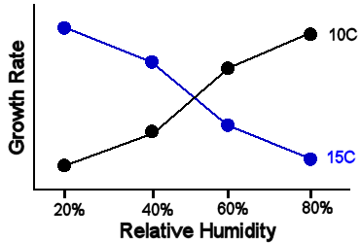
Interaction Effect
Effect of one factor on the response variable differs depending on level of the other factor.
 |  | Relative Humidity
 |  | 20% | 40% | 60% | 80%
Temp | 10ºC | 7 | 10 | 13 | 15
 | 15ºC | 14 | 12 | 11 | 8

Slide 7
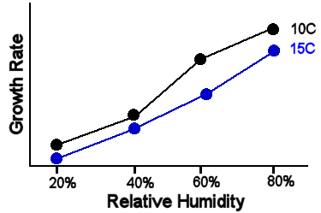
No Interaction Effect
 |  | Relative Humidity
 |  | 20% | 40% | 60% | 80%
Temp | 10ºC | 7 | 10 | 13 | 15
 | 15ºC | 6 | 9 | 12 | 14

Slide 8
Main Effects
Differences in “level” means for a factor
“Strong” relative humidity main effect
“Weak” temperature main effect.
 |  | Relative Humidity
 |  | 20% | 40% | 60% | 80%
Temp | 10ºC | 7 | 10 | 13 | 15
 | 15ºC | 6 | 9 | 12 | 14
11.25
10.25
6.5
9.5
12.5
14.5

Slide 9
Main Effects
“Strong” relative humidity main effect
“Weak” temperature main effect.

Slide 10
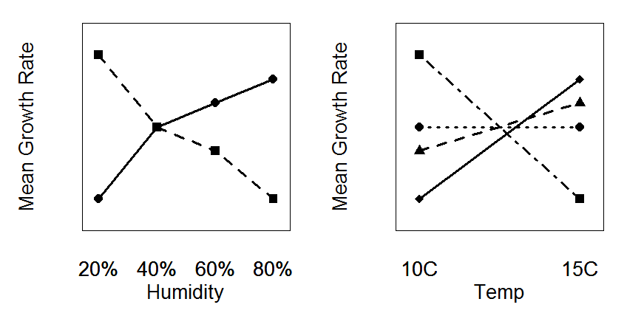
Interaction Effect
Notes:
r <- c(70,55,50,40,40,55,60,65)
interaction.plot(rf,cf,r,yaxt="n",legend=FALSE,ylab="Mean Growth Rate",xlab="Humidity",ylim=c(35,75),lwd=3)
interaction.plot(rf,cf,r,yaxt="n",type="p",pch=15:18,legend=FALSE,add=TRUE)
interaction.plot(cf,rf,r,yaxt="n",legend=FALSE,ylab="Mean Growth Rate",xlab="Temp",ylim=c(35,75),lwd=3)
interaction.plot(cf,rf,r,yaxt="n",type="p",pch=15:18,legend=FALSE,add=TRUE)

Slide 11
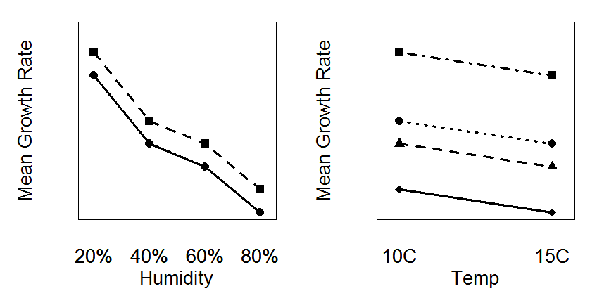
Humidity and Temperature Effects
Notes:
r <- c(70,55,50,40,65,50,45,35)
interaction.plot(rf,cf,r,yaxt="n",legend=FALSE,ylab="Mean Growth Rate",xlab="Humidity",ylim=c(35,75),lwd=3)
interaction.plot(rf,cf,r,yaxt="n",type="p",pch=15:18,legend=FALSE,add=TRUE)
interaction.plot(cf,rf,r,yaxt="n",legend=FALSE,ylab="Mean Growth Rate",xlab="Temp",ylim=c(35,75),lwd=3)
interaction.plot(cf,rf,r,yaxt="n",type="p",pch=15:18,legend=FALSE,add=TRUE)

Slide 12
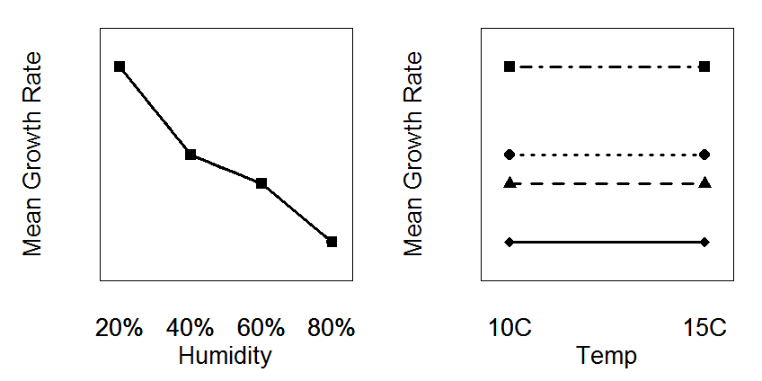
Humidity Effect Only
Notes:
r <- c(70,55,50,40, 70,55,50,40)
interaction.plot(rf,cf,r,yaxt="n",legend=FALSE,ylab="Mean Growth Rate",xlab="Humidity",ylim=c(35,75),lwd=3)
interaction.plot(rf,cf,r,yaxt="n",type="p",pch=15:18,legend=FALSE,add=TRUE)
interaction.plot(cf,rf,r,yaxt="n",legend=FALSE,ylab="Mean Growth Rate",xlab="Temp",ylim=c(35,75),lwd=3)
interaction.plot(cf,rf,r,yaxt="n",type="p",pch=15:18,legend=FALSE,add=TRUE)

Slide 13
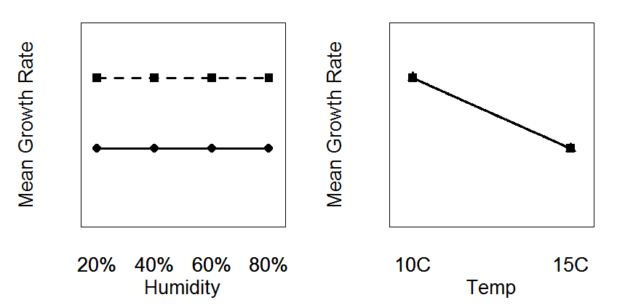
Temperature Effect Only
Notes:
r <- c(65,65,65,65,50,50,50,50)
interaction.plot(rf,cf,r,yaxt="n",legend=FALSE,ylab="Mean Growth Rate",xlab="Humidity",ylim=c(35,75),lwd=3)
interaction.plot(rf,cf,r,yaxt="n",type="p",pch=15:18,legend=FALSE,add=TRUE)
interaction.plot(cf,rf,r,yaxt="n",legend=FALSE,ylab="Mean Growth Rate",xlab="Temp",ylim=c(35,75),lwd=3)
interaction.plot(cf,rf,r,yaxt="n",type="p",pch=15:18,legend=FALSE,add=TRUE)

Slide 14
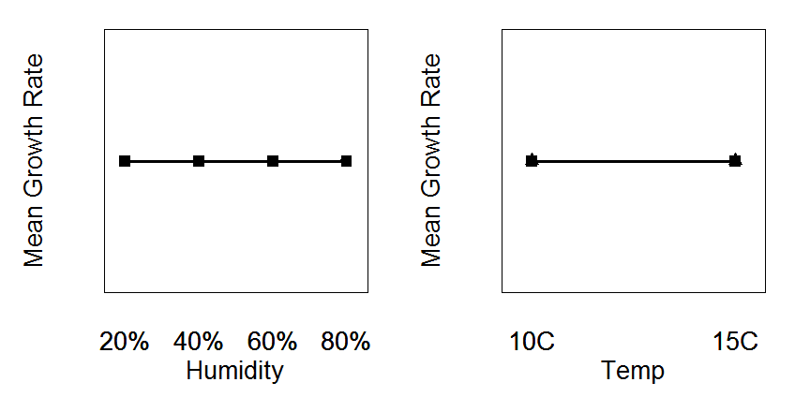
No Effects
Notes:
windows(8,4)
par(mar=c(3.5,3.5,1,1), mgp=c(2,0.25,0),mfrow=c(1,2),cex=1.5)
rf <- rep(c("20%","40%","60%","80%"),times=2)
cf <- rep(c("10C","15C"),each=4)
r <- c(55,55,55,55,55,55,55,55)
interaction.plot(rf,cf,r,yaxt="n",legend=FALSE,ylab="Mean Growth Rate",xlab="Humidity",ylim=c(35,75),lwd=3)
interaction.plot(rf,cf,r,yaxt="n",type="p",pch=15:18,legend=FALSE,add=TRUE)
interaction.plot(cf,rf,r,yaxt="n",legend=FALSE,ylab="Mean Growth Rate",xlab="Temp",ylim=c(35,75),lwd=3)
interaction.plot(cf,rf,r,yaxt="n",type="p",pch=15:18,legend=FALSE,add=TRUE)

Slide 15
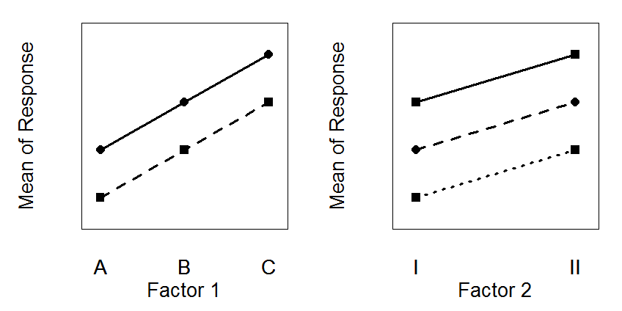
Example #1
×
Interaction Effect
Factor 1 Main Effect
Factor 2 Main Effect
√
√
Notes:
windows(8,4)
par(mar=c(3.5,3.5,1,1), mgp=c(2,0.25,0),mfrow=c(1,2),cex=1.5)
rf <- rep(c("A","B","C"),times=2)
cf <- rep(c("I","II"),each=3)
r <- c(40,50,60,50,60,70)
interaction.plot(rf,cf,r,yaxt="n",legend=FALSE,ylab="Mean of Response",xlab="Factor 1",ylim=c(35,75),lwd=3)
interaction.plot(rf,cf,r,yaxt="n",type="p",pch=15:17,legend=FALSE,add=TRUE)
interaction.plot(cf,rf,r,yaxt="n",legend=FALSE,ylab="Mean of Response",xlab="Factor 2",ylim=c(35,75),lwd=3)
interaction.plot(cf,rf,r,yaxt="n",type="p",pch=15:16,legend=FALSE,add=TRUE)

Slide 16
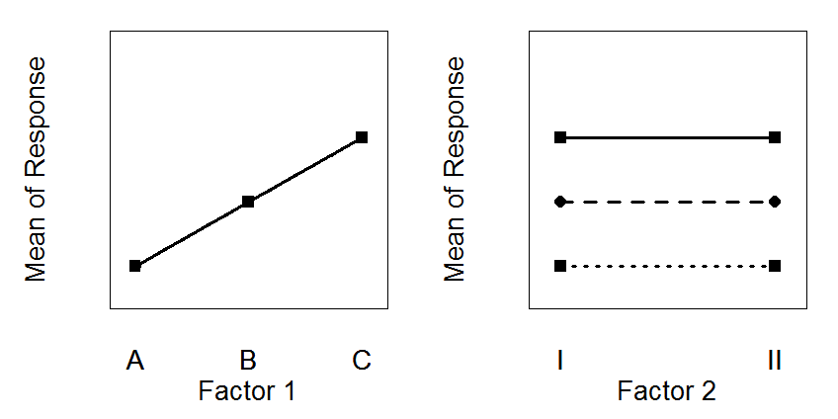
Example #2
×
Interaction Effect
Factor 1 Main Effect
Factor 2 Main Effect
√
×
Notes:
r <- c(40,50,60,40,50,60)
interaction.plot(rf,cf,r,yaxt="n",legend=FALSE,ylab="Mean of Response",xlab="Factor 1",ylim=c(35,75),lwd=3)
interaction.plot(rf,cf,r,yaxt="n",type="p",pch=15:17,legend=FALSE,add=TRUE)
interaction.plot(cf,rf,r,yaxt="n",legend=FALSE,ylab="Mean of Response",xlab="Factor 2",ylim=c(35,75),lwd=3)
interaction.plot(cf,rf,r,yaxt="n",type="p",pch=15:16,legend=FALSE,add=TRUE)

Slide 17
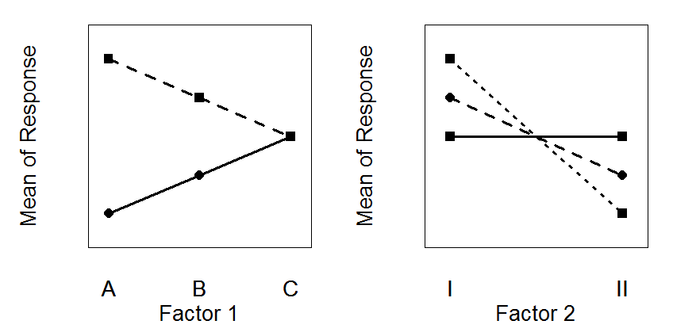
Example #3
√
Interaction Effect
Factor 1 Main Effect
Factor 2 Main Effect
Notes:
r <- c(70,62.5,55,40,47.5,55)
interaction.plot(rf,cf,r,yaxt="n",legend=FALSE,ylab="Mean of Response",xlab="Factor 1",ylim=c(35,75),lwd=3)
interaction.plot(rf,cf,r,yaxt="n",type="p",pch=15:17,legend=FALSE,add=TRUE)
interaction.plot(cf,rf,r,yaxt="n",legend=FALSE,ylab="Mean of Response",xlab="Factor 2",ylim=c(35,75),lwd=3)
interaction.plot(cf,rf,r,yaxt="n",type="p",pch=15:16,legend=FALSE,add=TRUE)

Slide 18
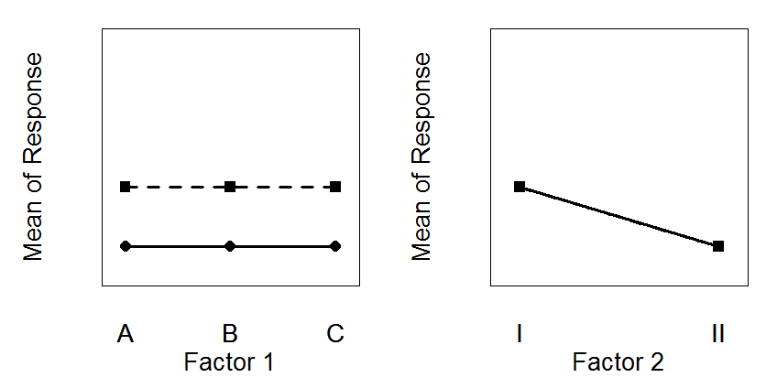
Example #4
×
Interaction Effect
Factor 1 Main Effect
Factor 2 Main Effect
×
√
Notes:
r <- c(50,50,50,40,40,40)
interaction.plot(rf,cf,r,yaxt="n",legend=FALSE,ylab="Mean of Response",xlab="Factor 1",ylim=c(35,75),lwd=3)
interaction.plot(rf,cf,r,yaxt="n",type="p",pch=15:17,legend=FALSE,add=TRUE)
interaction.plot(cf,rf,r,yaxt="n",legend=FALSE,ylab="Mean of Response",xlab="Factor 2",ylim=c(35,75),lwd=3)
interaction.plot(cf,rf,r,yaxt="n",type="p",pch=15:16,legend=FALSE,add=TRUE)

Slide 19
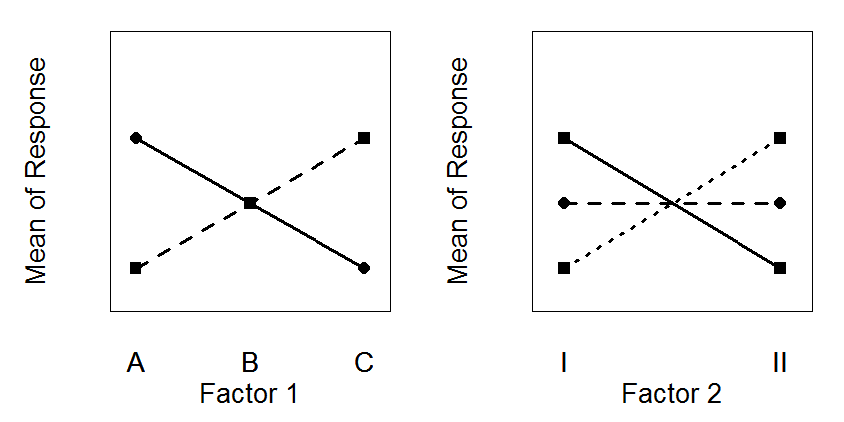
Example #5
√
Interaction Effect
Factor 1 Main Effect
Factor 2 Main Effect
Notes:
r <- c(40,50,60,60,50,40)
interaction.plot(rf,cf,r,yaxt="n",legend=FALSE,ylab="Mean of Response",xlab="Factor 1",ylim=c(35,75),lwd=3)
interaction.plot(rf,cf,r,yaxt="n",type="p",pch=15:17,legend=FALSE,add=TRUE)
interaction.plot(cf,rf,r,yaxt="n",legend=FALSE,ylab="Mean of Response",xlab="Factor 2",ylim=c(35,75),lwd=3)
interaction.plot(cf,rf,r,yaxt="n",type="p",pch=15:16,legend=FALSE,add=TRUE)

Slide 20
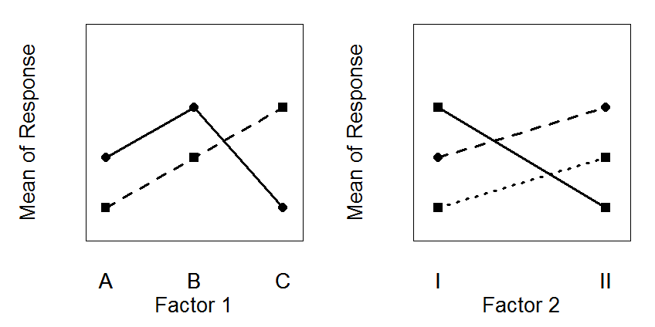
Example #6
√
Interaction Effect
Factor 1 Main Effect
Factor 2 Main Effect
Notes:
r <- c(40,50,60,50,60,40)
interaction.plot(rf,cf,r,yaxt="n",legend=FALSE,ylab="Mean of Response",xlab="Factor 1",ylim=c(35,75),lwd=3)
interaction.plot(rf,cf,r,yaxt="n",type="p",pch=15:17,legend=FALSE,add=TRUE)
interaction.plot(cf,rf,r,yaxt="n",legend=FALSE,ylab="Mean of Response",xlab="Factor 2",ylim=c(35,75),lwd=3)
interaction.plot(cf,rf,r,yaxt="n",type="p",pch=15:16,legend=FALSE,add=TRUE)

Slide 21
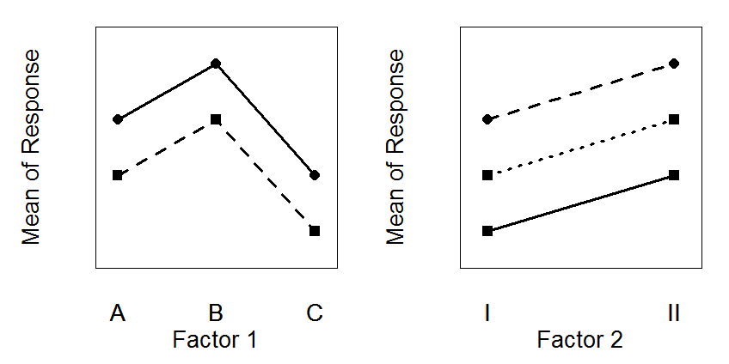
Example #7
×
Interaction Effect
Factor 1 Main Effect
Factor 2 Main Effect
√
√
Notes:
r <- c(50,60,40,60,70,50)
interaction.plot(rf,cf,r,yaxt="n",legend=FALSE,ylab="Mean of Response",xlab="Factor 1",ylim=c(35,75),lwd=3)
interaction.plot(rf,cf,r,yaxt="n",type="p",pch=15:17,legend=FALSE,add=TRUE)
interaction.plot(cf,rf,r,yaxt="n",legend=FALSE,ylab="Mean of Response",xlab="Factor 2",ylim=c(35,75),lwd=3)
interaction.plot(cf,rf,r,yaxt="n",type="p",pch=15:16,legend=FALSE,add=TRUE)

Slide 22
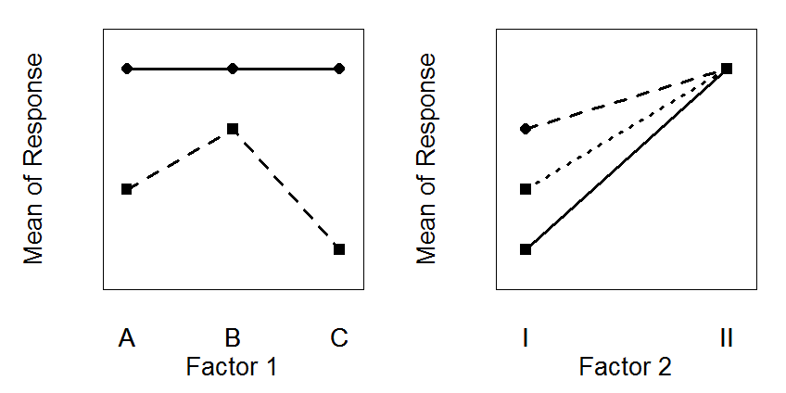
Example #8
√
Interaction Effect
Factor 1 Main Effect
Factor 2 Main Effect
Notes:
r <- c(50,60,40,70,70,70)
interaction.plot(rf,cf,r,yaxt="n",legend=FALSE,ylab="Mean of Response",xlab="Factor 1",ylim=c(35,75),lwd=3)
interaction.plot(rf,cf,r,yaxt="n",type="p",pch=15:17,legend=FALSE,add=TRUE)
interaction.plot(cf,rf,r,yaxt="n",legend=FALSE,ylab="Mean of Response",xlab="Factor 2",ylim=c(35,75),lwd=3)
interaction.plot(cf,rf,r,yaxt="n",type="p",pch=15:16,legend=FALSE,add=TRUE)

Slide 23
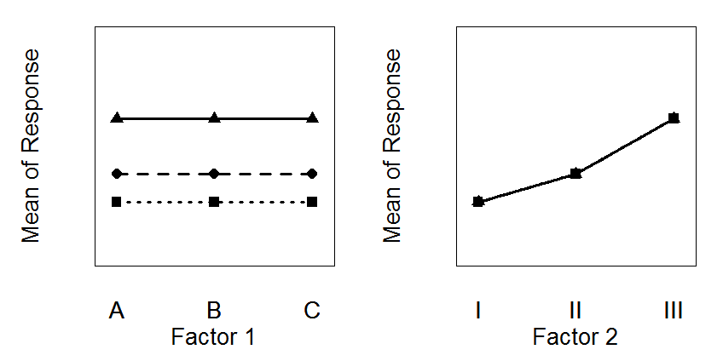
Example #9
×
Interaction Effect
Factor 1 Main Effect
Factor 2 Main Effect
×
√
Notes:
rf <- rep(c("A","B","C"),times=3)
cf <- rep(c("I","II","III"),each=3)
r <- c(45,45,45,50,50,50,60,60,60)
interaction.plot(rf,cf,r,yaxt="n",legend=FALSE,ylab="Mean of Response",xlab="Factor 1",ylim=c(35,75),lwd=3)
interaction.plot(rf,cf,r,yaxt="n",type="p",pch=15:17,legend=FALSE,add=TRUE)
interaction.plot(cf,rf,r,yaxt="n",legend=FALSE,ylab="Mean of Response",xlab="Factor 2",ylim=c(35,75),lwd=3)
interaction.plot(cf,rf,r,yaxt="n",type="p",pch=15:17,legend=FALSE,add=TRUE)

Slide 24
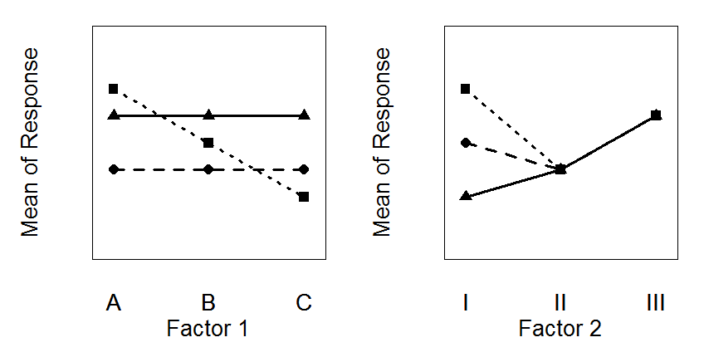
Example #10
√
Interaction Effect
Factor 1 Main Effect
Factor 2 Main Effect
Notes:
r <- c(65,55,45,50,50,50,60,60,60)
interaction.plot(rf,cf,r,yaxt="n",legend=FALSE,ylab="Mean of Response",xlab="Factor 1",ylim=c(35,75),lwd=3)
interaction.plot(rf,cf,r,yaxt="n",type="p",pch=15:17,legend=FALSE,add=TRUE)
interaction.plot(cf,rf,r,yaxt="n",legend=FALSE,ylab="Mean of Response",xlab="Factor 2",ylim=c(35,75),lwd=3)
interaction.plot(cf,rf,r,yaxt="n",type="p",pch=15:17,legend=FALSE,add=TRUE)

Slide 25
Terminology / Symbols
One factor is “row” factor
r = number of levels
Other factor is “column” factor
c = number of levels
Y_{ijk} = response variable for k^{th} individual in i^{th} level of row factor and j^{th} level of column factor
for simplicity, assume n is same for all i,j

Slide 26
Terminology / Symbols
Grand mean
Treatment means
Level means
 |  | Column Factor
 |  | 1 | 2 | … | c
Row Factor | 1 |  |  | …
 | 2 |  |  | …
 | … | … | … | … | … | …
 | r |  |  | …
 |  |  |  | …
‾Y₁₁.
‾Y₁₂.
‾Y_{1c}.
‾Y₁..
‾Y₂₁.
‾Y₂₂.
‾Y_{2c}.
‾Y₂..
‾Y_{r1}.
‾Y_{r2}.
‾Y_{rc}.
‾Y_{r}..
‾Y.₁.
‾Y.₂.
‾Y._{c}.
‾Y...

Slide 27
2-Way ANOVA Purpose
Determine significance of interaction and, if appropriate, two main effects.
Are differences in means “different enough” given sampling variability?

Slide 28
2-Way ANOVA Calculations
MS_{Within} is variability about ultimate full model
MS_{Total} is variability about ultimate simple model
if MS_{Among} is large relative to MS_{Within} then ultimate full model is warranted
i.e., some difference in treatment means
implies differences due to row factor, column factor, or interaction between the two
SS_{Among} = SS_{Row} + SS_{Col} + SS_{Interaction}
If MS_{Row} is large relative to MS_{Within} then a difference due to the row factor is indicated
Similar argument for column and interaction effects

Slide 29
2-Way ANOVA Calculations
SS_{Among} = SS_{Row} + SS_{Column} + SS_{Interaction}

Slide 30
2-Way ANOVA Calculations
r
(
)
2
c
(
)
2
∑
∑
SS_{Row} =cn
Y
−
Y
SS_{Column} =rn
Y
−
Y
..
...
. .
...
i
j
i
=
1
i
=
1
 |  | Column Factor
 |  | 1 | 2 | … | c
Row Factor | 1 |  |  | …
 | 2 |  |  | …
 | … | … | … | … | … | …
 | r |  |  | …
 |  |  |  | …
‾Y₁₁.
‾Y₁₂.
‾Y_{1c}.
‾Y₁..
‾Y₂₁.
‾Y₂₂.
‾Y_{2c}.
‾Y₂..
‾Y_{r1}.
‾Y_{r2}.
‾Y_{rc}.
‾Y_{r}..
‾Y.₁.
‾Y.₂.
‾Y._{c}.
‾Y...

Slide 31
Two-Way ANOVA Table
Source df SS MS F .
Row r-1 SS_{Row} SS_{Row}/[r-1] MS_{Row}/MS_{Within}
Column c-1 SS_{Col} SS_{Col}/[c-1] MS_{Col}/MS_{Within}
Inter (r-1)(c-1) SS_{Int} SS_{Int}/[(r-1)(c-1)] MS_{Int}/MS_{Within}
Within rc(n-1) SS_{Within} SS_{Within}/[rc(n-1)]
Total rcn-1 SS_{Total}

Slide 32
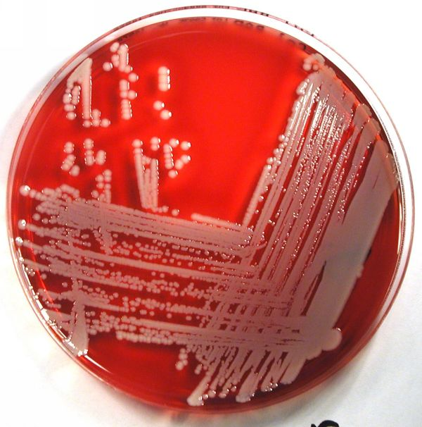
Example
What is the optimal temperature (27,35,43ºC) and concentration (0.6,0.8,1.0,1.2,1.4% by weight) of the nutrient, tryptone, for culturing the Staphylococcus aureus bacterium. Each treatment was repeated twice. The number of bacteria was recorded in millions CFU/mL (CFU=Colony Forming Units).

Slide 33
Example -- Bacteria
 |  | Concentration
 |  | 0.6 | 0.8 | 1.0 | 1.2 | 1.4
Temp | 27 | 1023 | 1056 | 160 | 267 | 131 | 153
 | 35 | 88 | 161 | 170 | 230 | 199 | 169
 | 43 | 134 | 166 | 136 | 209 | 164 | 162
 |  | 108 | 144 | 155 | 235 | 164 | 161
What kind of effects are apparent?

Slide 34
Example -- Bacteria
What kind of effects are apparent?

Slide 35
Example -- ANOVA
Analysis of Variance Table
Response: cells
Df Sum Sq Mean Sq F value Pr(>F)
ftemp 2 1313 656 0.8557 0.44473
fconc 4 51596 12899 16.8154 2.041e-05
ftemp:fconc 8 14703 1838 2.3958 0.06886
Residuals 15 11507 767
Nonsignificant temperature effect
Significant concentration effect
Weak Interaction; Nonsignificant

Slide 36
Example -- ANOVA

Slide 37
Example -- ANOVA
Linear Hypotheses:
Estimate Std. Error t value p value
0.8 - 0.6 == 0 36.00 15.99 2.251 0.2144
1 - 0.6 == 0 46.67 15.99 2.918 0.0680 .
1.2 - 0.6 == 0 126.83 15.99 7.932 <0.01 ***
1.4 - 0.6 == 0 56.17 15.99 3.512 0.0226 *
1 - 0.8 == 0 10.67 15.99 0.667 0.9611
1.2 - 0.8 == 0 90.83 15.99 5.680 <0.01 ***
1.4 - 0.8 == 0 20.17 15.99 1.261 0.7195
1.2 - 1 == 0 80.17 15.99 5.013 <0.01 **
1.4 - 1 == 0 9.50 15.99 0.594 0.9737
1.4 - 1.2 == 0 -70.67 15.99 -4.419 <0.01 **
0.6 0.8 1.0 1.4 1.2

Slide 38
Example -- ANOVA
0.6 0.8 1.0 1.4 1.2
c
a
b
ab
ab
a
a

Slide 39
Review Handout – Example 1
lm()
anova()
glht()
fitPlot()
addSigLetters()

Slide 40
Assumptions and Checking in R
Same as for the one-way ANOVA

Slide 41
Example
Measured soil phosphorous levels in plots near Sydney, Australia.
Each plot was characterized by type of soil (shale- or sandstone-derived) and “topographic” location (valley, north, south, or hillside).
Data in SoilPhosphorous.txt
Does mean soil phosphorous level differ by soil type or topographic location?
Is there an interaction effect?

