Slide 1
Management Process

Slide 2
Management Environment
Space
Sociocultural
Economic
Political
Ecological
Time

Slide 3
Management Environment
Ecological (Biotic and Physical)
Habitat, predation, forage base, genetics, etc.
Economic
Market forces, license fees, budgets, etc.
Political
Laws, treaties, etc.
Social / Cultural
Traditions, values, perceptions, philosophies, etc.
Sets bounds on productivity
Provides motivation
Sets limits on actions

Slide 4
Video Summaries
Gurnoe Decision
Tribble Brothers
Place of the Pike
Jondreau Decision
Summarize. What was focus of the story?
Environments discussed (Ecological, Economic, Political, Sociocultural)?

Slide 5
Walleye War – Mgmt Environment
Ecological
Economic
Political
Sociocultural
Notes:
Ecological
Walleye abundance, spawning behavior, etc.
Economic
Impact on recreational fishing (license sales), tourism, enforcement costs, etc.
Political
Treaties, federal vs. state, racism
Sociocultural
Native traditions, tourist expectations, racism

Slide 6
Management Environment
Space
Sociocultural
Management
Process
Economic
Political
Ecological
Time

Slide 7
Management Process
Where do we want to be?
Broad, long-term, sets direction
Goal
Objective
Specific, Measurable, Achievable, Related to Goal, Time-specific
What will prevent us?
What to do next?
Measure
Compare
Assess
Revise
Problem
Identification
Evaluation
Information
Base
Obstructions to objectives
Actions
Did we make it?
How do we get there?

Slide 8
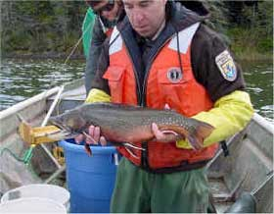
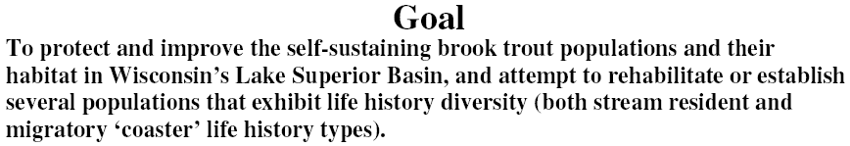
Case Study - Coaster Brook Trout
Goal
Objective

Slide 9
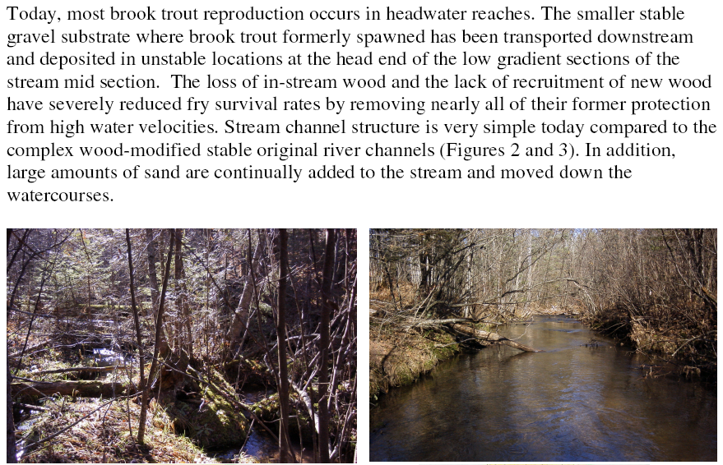
Case Study - Coaster Brook Trout
Problem Identification

Slide 10
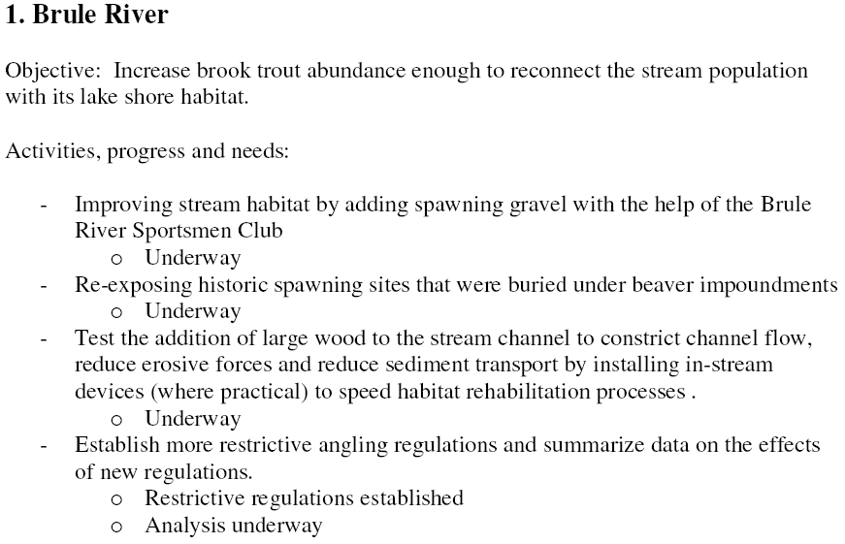
Case Study - Coaster Brook Trout
Information Base
Action
Evaluation
Action

Slide 11
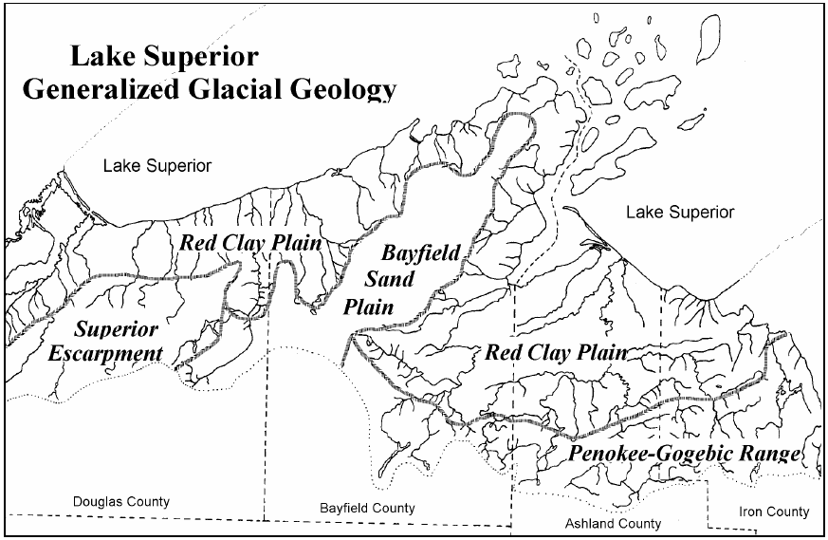
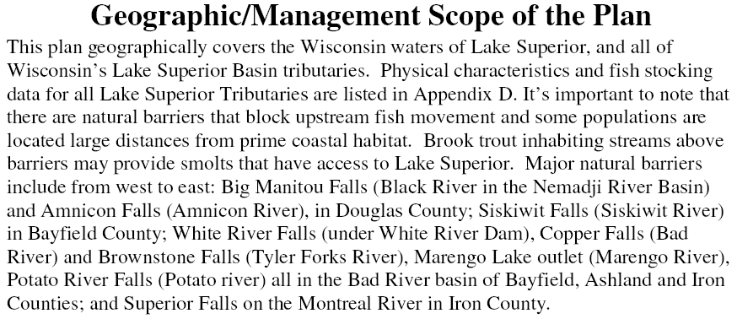
Case Study - Coaster Brook Trout

