Slide 1
Effects of an Inadvertent Introduction of Northern Pike on an Established Fish Community
Modified from Case 8 in Murphy et al. (2010)
Notes:
Image courtesy of T.J. DeBates.

Slide 2
Sandhill Region of Nebraska
N
Notes:
Figure 8.3. The Sandhill region of Nebraska, indicated by the tan shading.

Slide 3
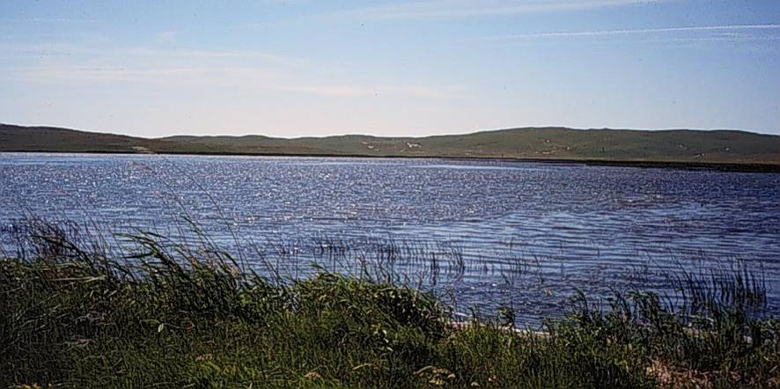
West Long Lake
25-ha natural lake
Shallow (mean D=1.2 m, max D=1.8 m)
Vegetation ~80% of surface area in mid-summer
Historically, Yellow Perch, Bluegill, Largemouth Bass, Black Bullhead
Notes:
Figure 8.1. Nebraska Sandhill lakes tend to be shallow, windblown, and productive. Lakes such as the one pictured tend to be maintained by groundwater connection. The surrounding hills are wind-deposited sand, and the terrestrial communities are sensitive to disturbance.
Image courtesy of Craig Paukert.

Slide 4
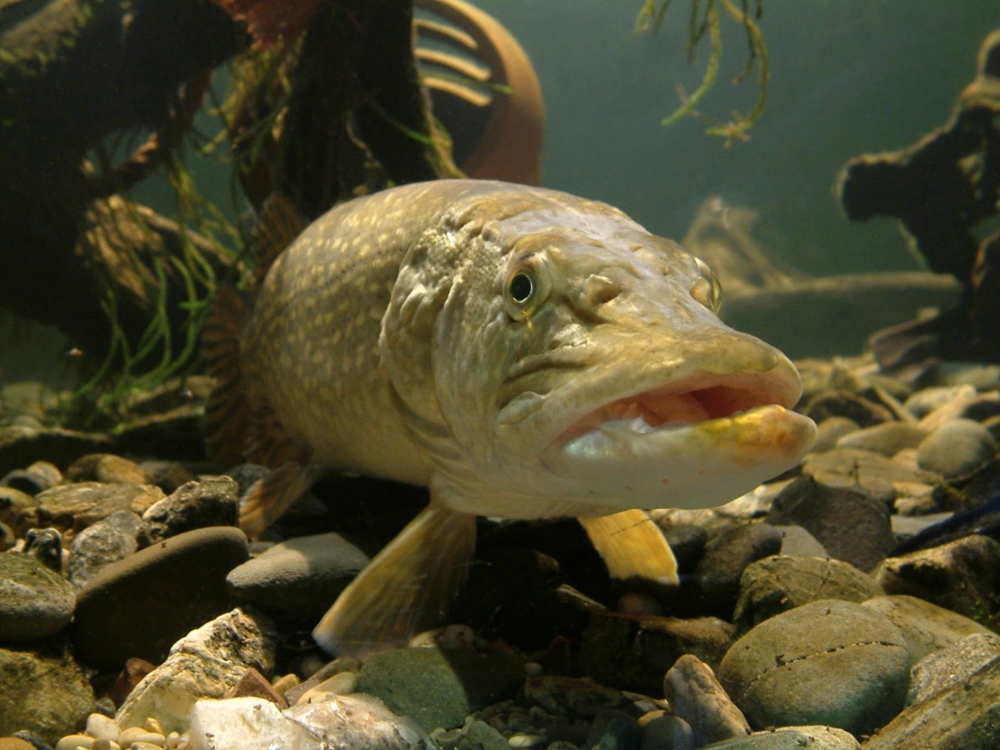
Northern Pike Invasion
Year 1 – two fish (34 & 37 cm)
Year 5 – 36 fish/ha, 22kg/ha
Typical biomasses
9.5 (L. Windermere)
11.6 (Wisconsin)
18.4 (Colorado)

Slide 5

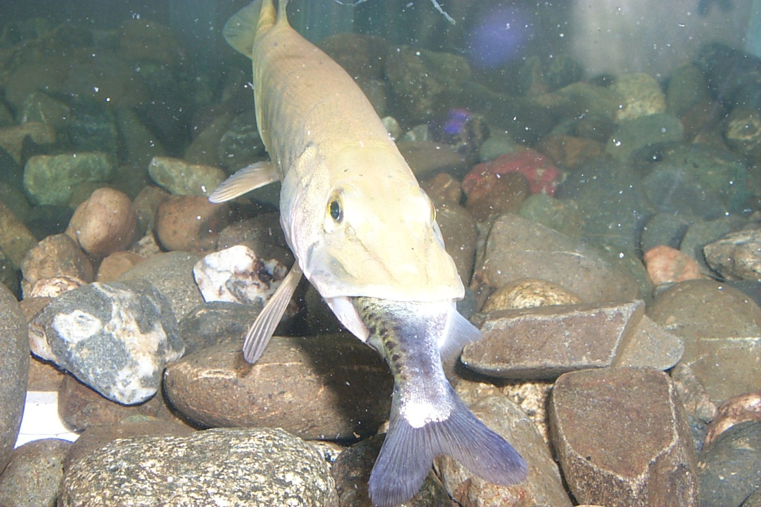
Group Think/Research
Describe the diet of NOP.
Do NOP select prey by species or size?
What impact do NOP have on prey populations?
Notes:
Bigger NOP eat bigger prey, prefer soft- to hard-rayed, prefer fusiform to compressiform, can reduce YEP, BG, and small LMB

Slide 6
Fish Community Indices
 | Year 1 | Year 5 (predict) | Year 5 (actual)
CPUE > stock (80 mm) | 28.2 (4.5)
PSD | 68 (9)
PSD-P | 40 (10)
Mean length (mm) at age 2 | 121 (3.5)
Mean length (mm) at age 3 | 157 (5.4)
Bluegill
Fyke nets
Yellow Perch
Fyke nets
Largemouth Bass
Night electrofishing
 | Year 1 | Year 5 (predict) | Year 5 (actual)
CPUE > stock (130 mm) | 14.2 (2.9)
PSD | 74 (9)
PSD-P | 62 (10)
Mean length (mm) at age 2 | 151 (3.8)
Mean length (mm) at age 3 | 181 (5.6)
 | Year 1 | Year 5 (predict) | Year 5 (actual)
CPUE > stock (200 mm) | 143.7 (32.1)
PSD | 29 (9)
PSD-P | 9 (6)
Mean length (mm) at age 3 | 227 (3.5)
Mean length (mm) at age 4 | 270 (9.3)
Mean length (mm) at age 5 | 304 (5.3)
Notes:
Print this as a handout.

Slide 7
Group Think
For each species …
Describe the population from the metrics.
Predict (with explanation) how you think each of the metrics would change in year 5 after the discovery of NOP.

Slide 8
Group Think
Instructor will provide actual Year 5 results.
For each species …
Describe the population in year 5 from the metrics.
How did the metrics change form year 1 to year 5 after the discovery of NOP?
Did anything surprise you (i.e., were your predictions upheld)?

