Slide 1
Simple Population Model
Consider a very simple population
Closed (no emigration, no immigration)
No fishing (no fishing mortality)
Only examine numbers (i.e., growth not examined)
Recruitment
Natural Mortality
Population
Numbers
Fishing Mortality
Immigration
Emigration
Growth

Slide 2
Simple Population Model
Define the following:
N_{t} = Population size (numbers) at time t
N₀ = Initial (time=0) population size
b = Per capita recruitment (birth) rate
d = Per capita mortality (death) rate
Population
Numbers
Recruitment
Natural Mortality
b
d
N_{t}

Slide 3
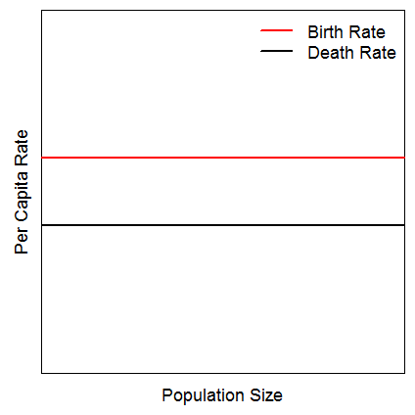
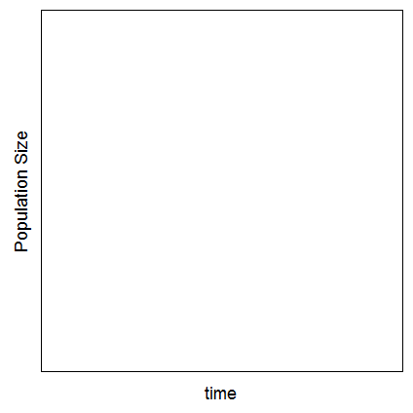
Simple Population Model
Population
Numbers
Recruitment
Natural Mortality
b
d
Consider this …
Draw this …

Slide 4
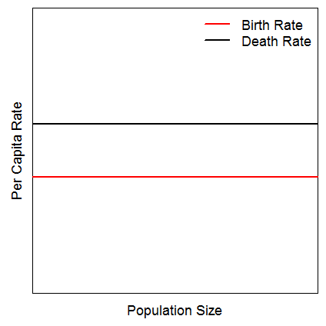
Simple Population Model
Population
Numbers
Recruitment
Natural Mortality
b
d
Now consider this …
And draw this …

Slide 5
Simple Population Model
Population
Numbers
Recruitment
Natural Mortality
b
d
N_{t}
Define the following:
bN_{t}
dN_{t}
Construct a model for estimating N_{t+1} from N_{t}
Construct a model for estimating N_{t} from N₀

Slide 6
Simple Population Model
What is r?
What are the population dynamics if …
… r = 0
… r > 0
… r < 0
Are these dynamics realistic? Why?

Slide 7
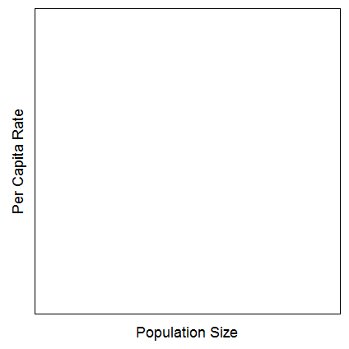
More Complex Population Model
If not realistic …
Then what is …
Notes:
What do you think happens to births as N increases? Deaths?

Slide 8
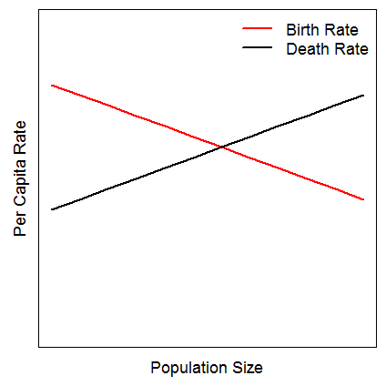
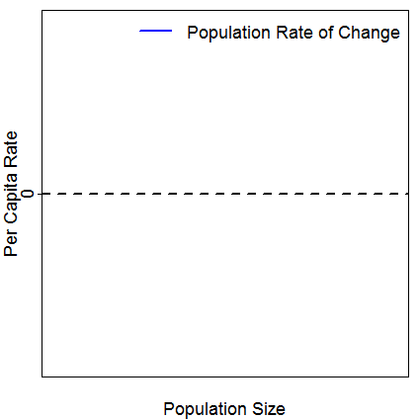
More Complex Population Model
Consider this …
Draw this …

Slide 9
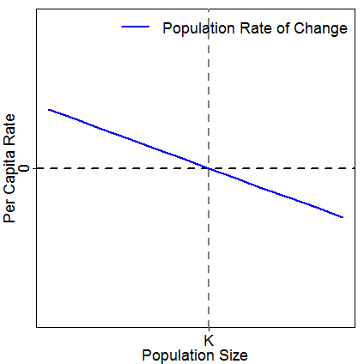
More Complex Population Model
Consider this …
Sketch this (assume low N₀) …

Slide 10
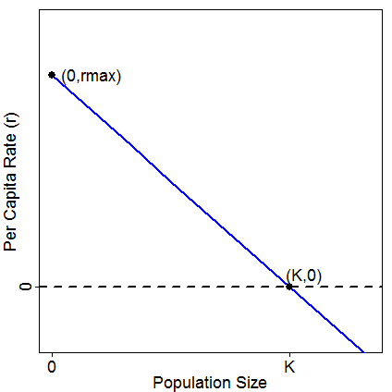
More Complex Population Model
Define equation for r
Substitute into exponential growth model and simplify
Notes:
r=rmax-(rmax/K)*Nt
Nt+1=[1+rmax(1-(Nt/K)]*Nt

Slide 11
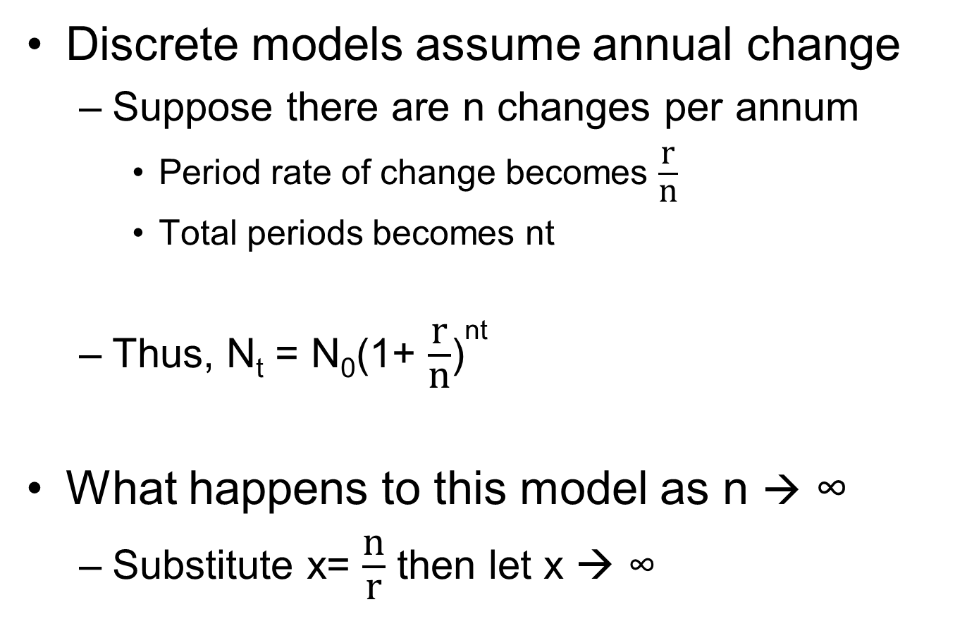
Continuous Models
Discrete models assume annual change
Suppose there are n changes per annum
Period rate of change becomes $\frac{\text{r}}{\text{n}}$
Total periods becomes nt
Thus, N_{t} = N₀(1+ $\frac{\text{r}}{\text{n}}$)^{nt}
What happens to this model as n → ∞
Substitute x= $\frac{\text{n}}{\text{r}}$ then let x → ∞
Notes:
N0(1+1/x)^(xrt)

Slide 12
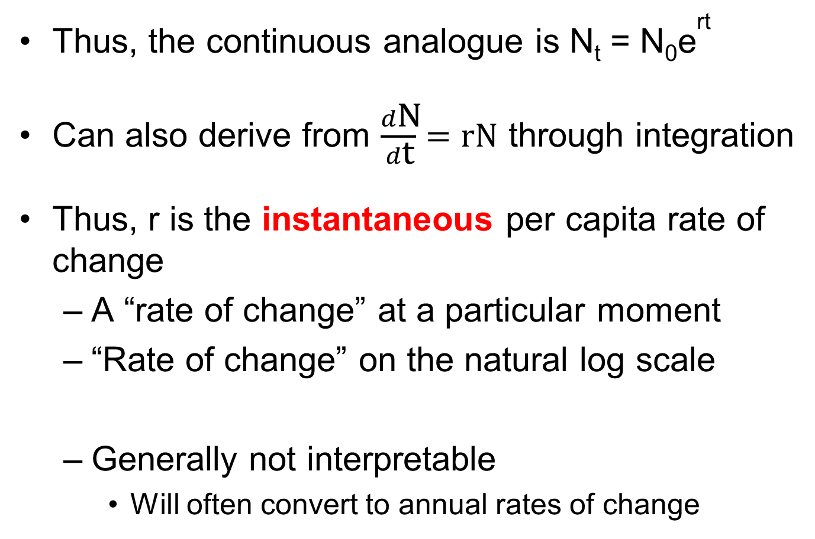
Continuous Models
Thus, the continuous analogue is N_{t} = N₀e^{rt}
Can also derive from $\frac{d\text{N}}{d\text{t}}=\text{rN}$ through integration
Thus, r is the instantaneous per capita rate of change
A “rate of change” at a particular moment
“Rate of change” on the natural log scale
Generally not interpretable
Will often convert to annual rates of change

Slide 13
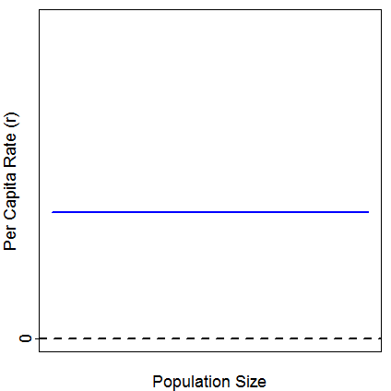
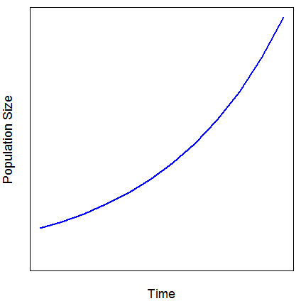
Density Independent Popn Growth
Rate of change does not depend on population size (i.e., density)

Slide 14
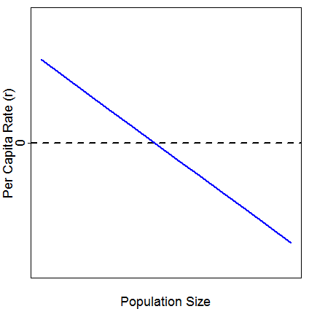
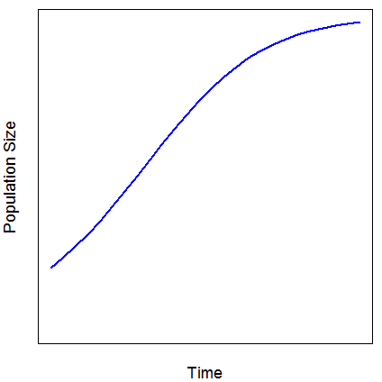
Density Dependent Popn Growth
Rate of change does depend on population size (i.e., density)

Slide 15
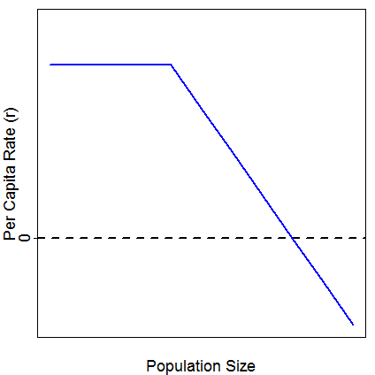
Density Dependent Popn Growth
Rate of change does depend on population size (i.e., density) …
… but not always in a linear fashion

