Slide 1
Management Regulations

Slide 2
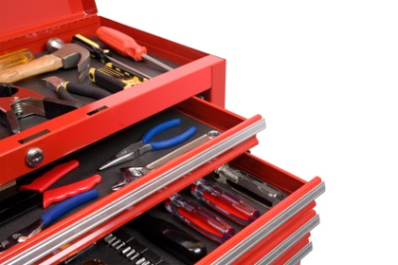
Manager’s Toolbox
What kinds of “things” can be used to …
Manipulate fish population dynamics
Manipulate angling effort
Augment limiting environmental factors

Slide 3
Bag / Creel Limits
Maximum number (sometimes weight) of fish that can be removed from a water.
Daily
maximum per day.
Possession
maximum in your possession.
Season
limited number (usually 1) per season.
Typically referred to as a quota.

Slide 4
Length Limits
Minimum – no harvest below minimum size.
Maximum – no harvest above maximum size.
Protected Slot – no harvest within slot sizes.
Harvest Slot – no harvest outside of slot sizes.
6 | 7 | 8 | 9 | 10 | 11 | 12 | 13 | 14 | 15 | 16 | 17 | 18 | 19 | 20 | 21 | 22
6 | 7 | 8 | 9 | 10 | 11 | 12 | 13 | 14 | 15 | 16 | 17 | 18 | 19 | 20 | 21 | 22
6 | 7 | 8 | 9 | 10 | 11 | 12 | 13 | 14 | 15 | 16 | 17 | 18 | 19 | 20 | 21 | 22
6 | 7 | 8 | 9 | 10 | 11 | 12 | 13 | 14 | 15 | 16 | 17 | 18 | 19 | 20 | 21 | 22

Slide 5
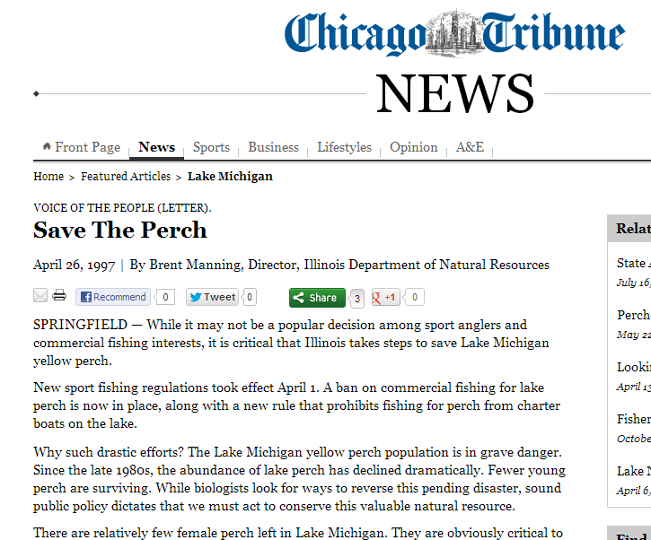
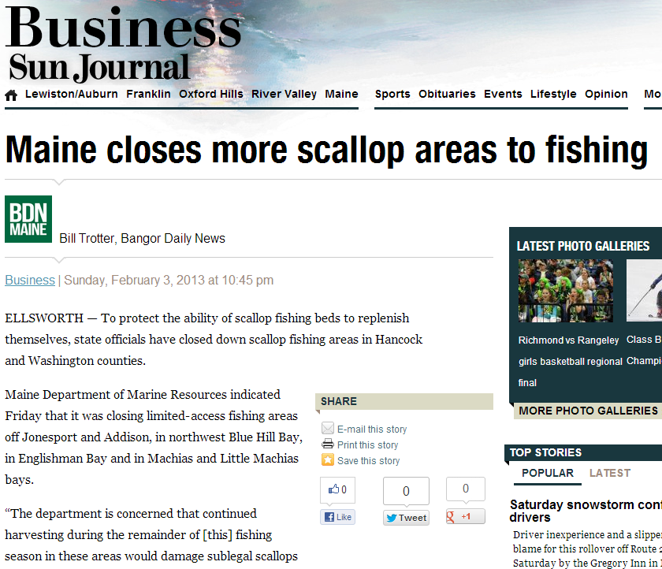
Closures
Seasons
Can fish only at certain times.
Areas
Fishing restricted in specific locations.
Fisheries
Fishing is completely prohibited.

Slide 6
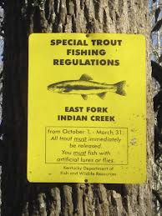
Gear Restrictions
Recreational
Anglers are restricted to certain types of gear.
Artificial lures only.
Barbless hooks.
Only three lines.
No motor trolling.

Slide 7
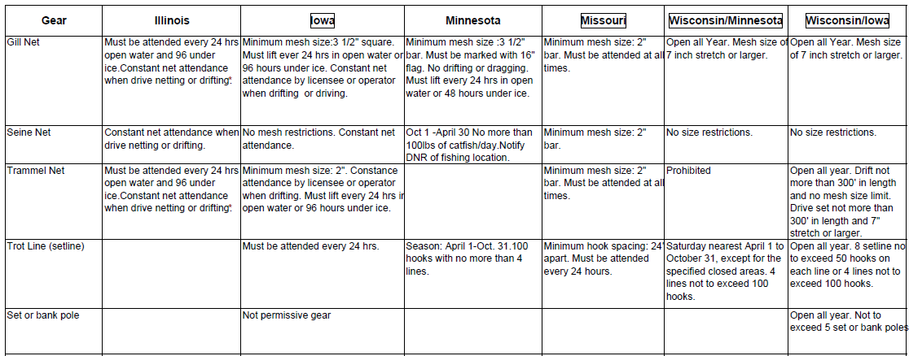
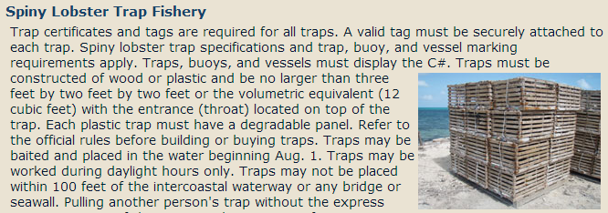
Gear Restrictions
Recreational
Anglers are restricted to certain types of gear.
Artificial lures only.
Barbless hooks.
Only three lines.
No motor trolling.
Commercial
Fishers are restricted to types/sizes of gear.

Slide 8
Quotas
The total number or weight that can be harvested during a specified time.
AKA, safe harvest level, total allowable catch
Types
“Derby” Quota
Catch-shares
Individual Transferable Quota (ITQ)

Slide 9
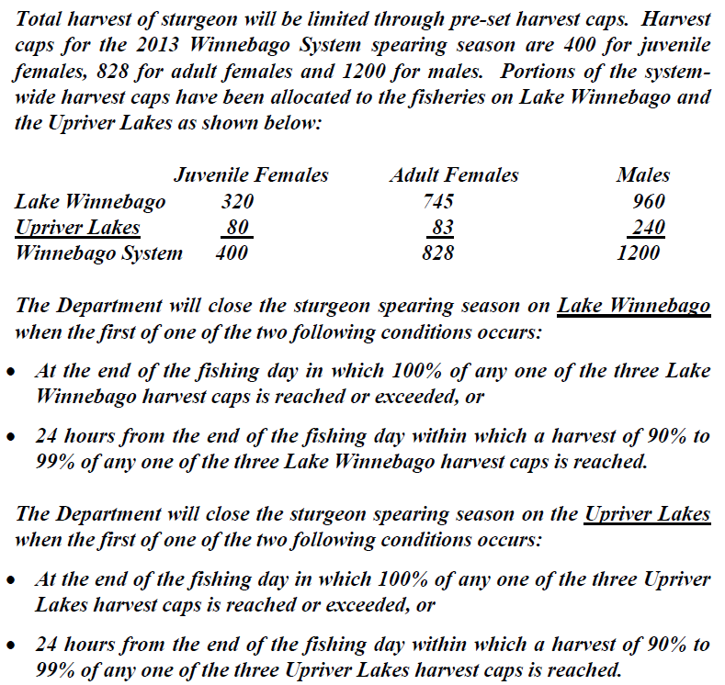
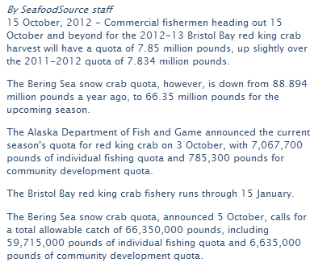
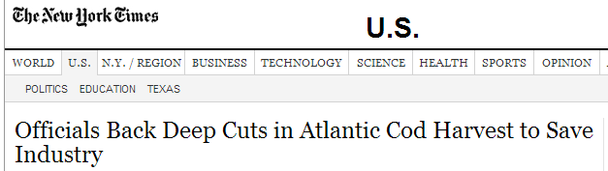

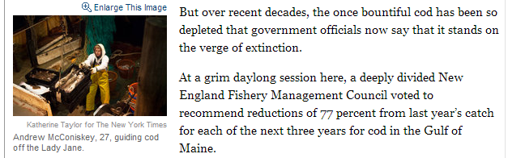
Quotas

Slide 10
Stocking

Slide 11
Habitat Manipulations

