Slide 1
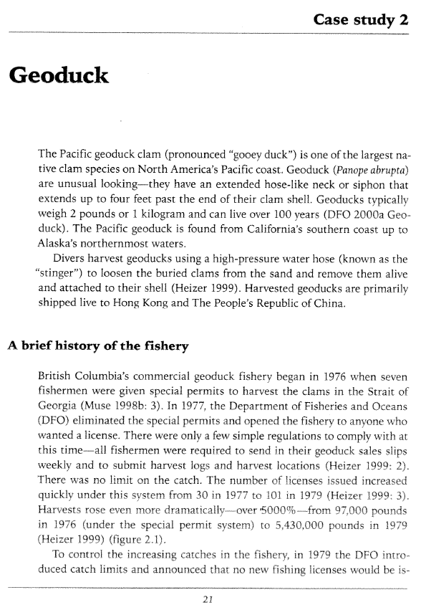
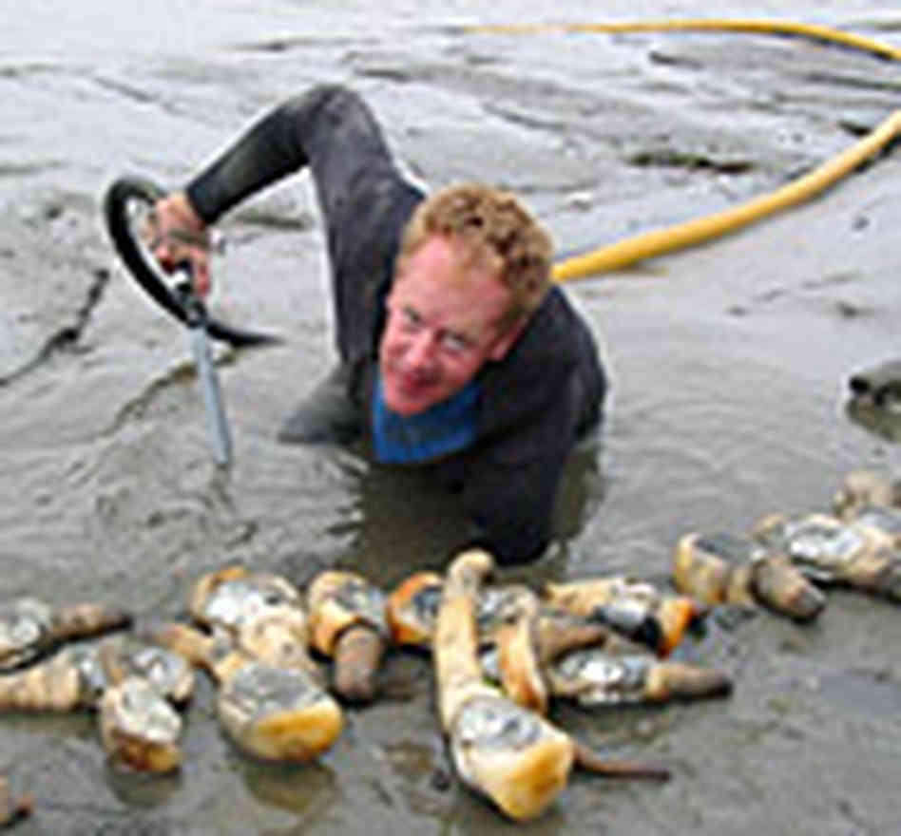
Individual Vessel Quotas British Columbia Geoduck Fishery

Slide 2
Definitions / Distinctions
Open Access
Boats work harder to maintain their harvest level
Despite increased efforts, harvest levels decline
Atlantic Cod
Even greater efforts result in even greater harvest declines
Larger harvests and profits attract more entrants
50000
40000
30000
Landings (Metric Tons)
20000
Sometimes results in the essential collapse of the fishery
10000
Newly discovered resource is open to all comers
1950
1960
1970
1980
1990
2000
2010
Year
Notes:
Data from http://www.st.nmfs.noaa.gov/st1/commercial/landings/annual_landings.html
http://youtu.be/L5wR8Iu2Q00
https://www.youtube.com/watch?v=Zni6Iy5Q-Ko

Slide 3
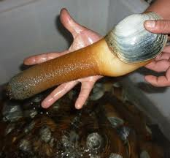
Definitions / Distinctions
Open Access
Limited Entry
IQ, IFQ, IVQ, ITQ, catch-shares
An allocated privilege of landing a specified portion of the TAC.
Geoduck

Slide 4
History of BC Geoduck Fishery
Describe specific events in the fishery
1976
Began with seven licenses
1977
Open to anyone who wanted a license
Fishery grew
1979-80
Catch limits implemented
Limited entry to 95 licenses
1983
Limited entry to 54 (soon to be 55) licenses
1984-88
TAC consistently exceeded
Reduced season to make a “shotgun” fishery
Industry asked for IQ in 1988

Slide 5
History of BC Geoduck Fishery
What were the characteristics of the fishery in 1988 that prompted industry to ask for IQs?
Harvests exceed the TAC, fear of collapse
Monitoring and enforcement was inconsistent and ineffective
Most harvest immediately after opening
Thus, most product frozen, sold at less than optimal price
“Shotgun Fishery” encouraged fishing in unsafe conditions

Slide 6
History of BC Geoduck Fishery
Describe specific events in the fishery
1989-now
IVQs were temporary in 1989-90, now permanent
TAC set at 1% of estimated biomass
TAC divided into 55 shares
Shares can be transferred, but not split
Industry pays for monitoring
Industry helps pay for management

Slide 7
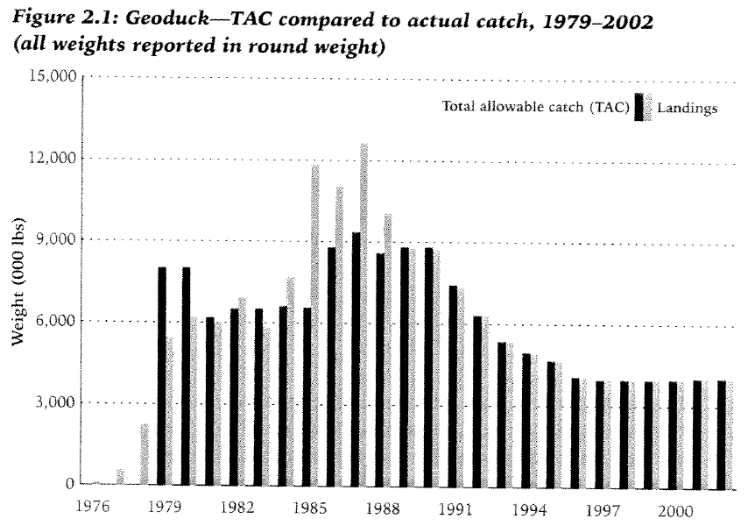
BC Geoduck Fishery – Results
Open Access
Limited Entry
IVQs

Slide 8
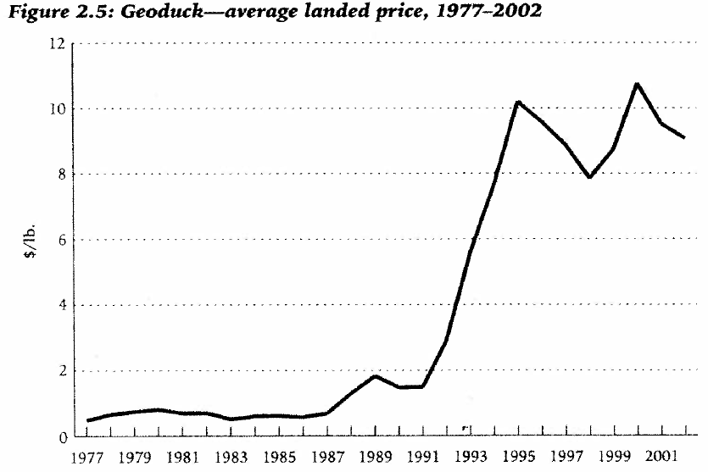
BC Geoduck Fishery – Results
Open Access
Limited Entry
IVQs

Slide 9
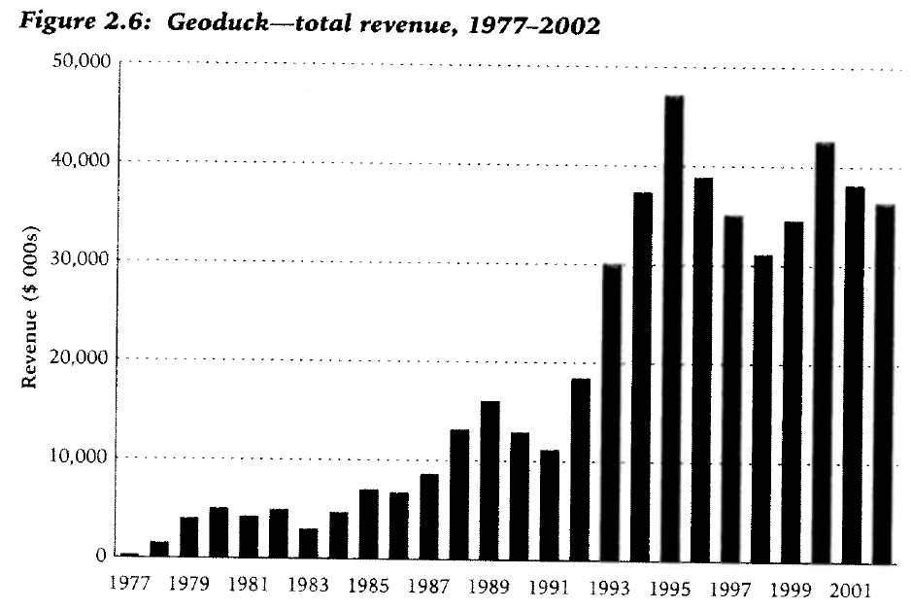
BC Geoduck Fishery – Results
Open Access
Limited Entry
IVQs

Slide 10
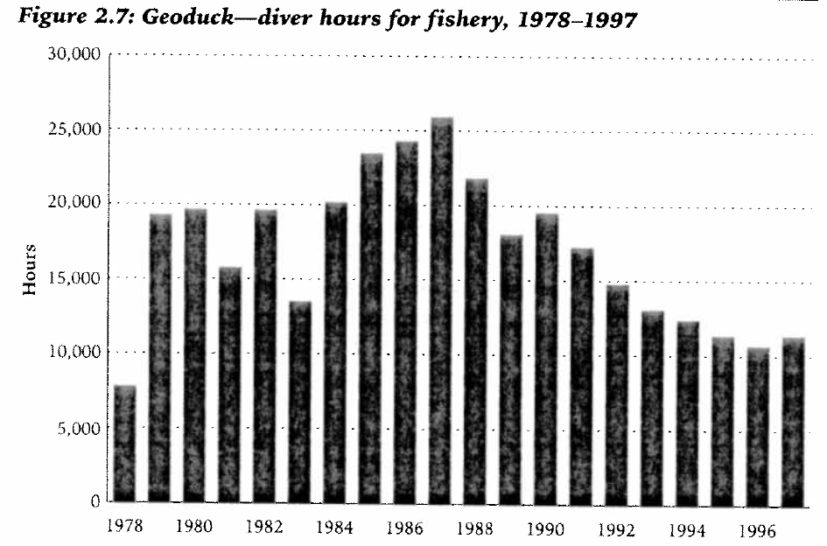
BC Geoduck Fishery – Results
Limited Entry
IVQs

Slide 11
BC Geoduck Fishery – Summary
TAC was reduced (fishing more conservatively)
TAC has not been exceeded
Meeting market demands with fresh product
$/lb increased, total revenues increased
Working conditions generally safer
Fewer workers, but jobs more stable

