Slide 1

Groups
#1 – DeRose, Lepak, Menebroeker
#2 – Fraioli, Goethlich, Lebeda
#3 – Beattie, Campbell, Hodgdon
#4 – Fiorio, JJaeckel, Moodie
#5 – Browne, MJaeckel, Valentino

Slide 2
Effects of an Inadvertent Introduction of Northern Pike on an Established Fish Community
Modified from Case 8 in Murphy et al. (2010)
Notes:
Image courtesy of T.J. DeBates.

Slide 3
Sandhill Region of Nebraska
N
Notes:
Figure 8.3. The Sandhill region of Nebraska, indicated by the tan shading.

Slide 4
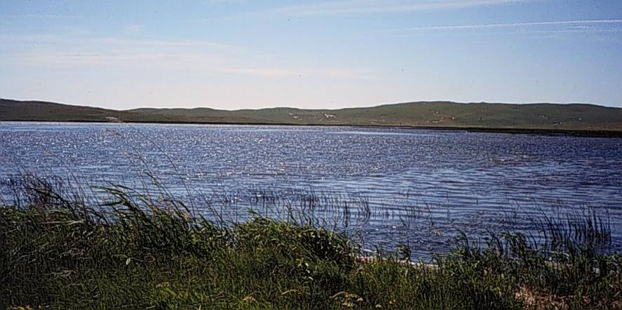
West Long Lake
25-ha natural lake
Shallow (mean D=1.2 m, max D=1.8 m)
Vegetation ~80% of surface area in mid-summer
Historically, yellow perch, bluegill, largemouth bass, black bullhead
Notes:
Figure 8.1. Nebraska Sandhill lakes tend to be shallow, windblown, and productive. Lakes such as the one pictured tend to be maintained by groundwater connection. The surrounding hills are wind-deposited sand, and the terrestrial communities are sensitive to disturbance.
Image courtesy of Craig Paukert.

Slide 5
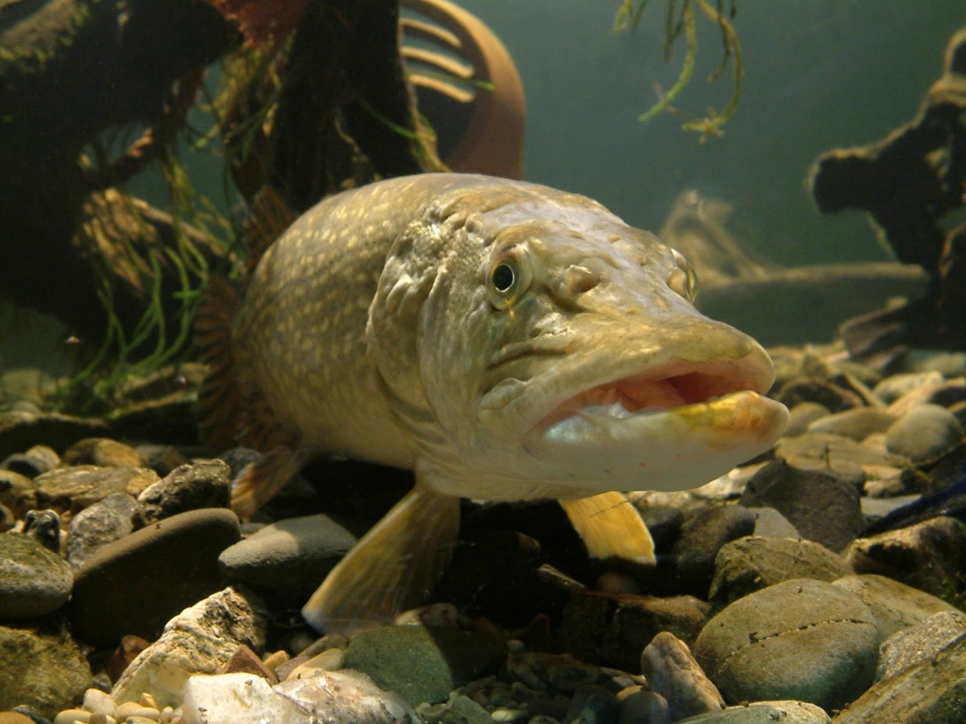
Northern Pike Invasion
Year 1 – two fish (34 & 37 cm)
Year 5 – 36 fish/ha, 22kg/ha
Typical biomasses
9.5 (L. Windermere)
11.6 (Wisconsin)
18.4 (Colorado)

Slide 6
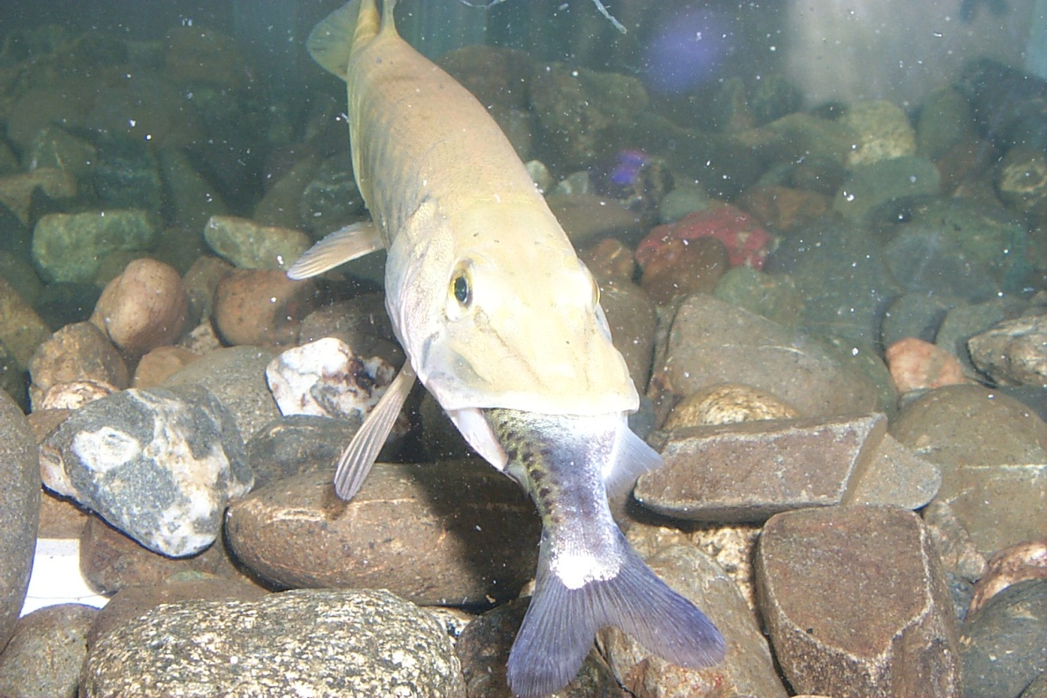
Group Think/Research
Describe the diet of NOP.
Do NOP select prey by species or size?
What impact do NOP have on prey populations?
Notes:
Bigger NOP eat bigger prey, prefer soft- to hard-rayed, prefer fusiform to compressiform, can reduce YEP, BG, and small LMB

Slide 7
Fish Community Indices
 | Year 1 | Year 5 (predict) | Year 5 (actual)
CPUE > stock (80 mm) | 28.2 (4.5)
PSD | 68 (9)
RSD-P | 40 (10)
Mean length (mm) at age 2 | 121 (3.5)
Mean length (mm) at age 3 | 157 (5.4)
Bluegill
Fyke nets
Yellow Perch
Fyke nets
Largemouth Bass
Night electrofishing
 | Year 1 | Year 5 (predict) | Year 5 (actual)
CPUE > stock (130 mm) | 14.2 (2.9)
PSD | 74 (9)
RSD-P | 62 (10)
Mean length (mm) at age 2 | 151 (3.8)
Mean length (mm) at age 3 | 181 (5.6)
 | Year 1 | Year 5 (predict) | Year 5 (actual)
CPUE > stock (200 mm) | 143.7 (32.1)
PSD | 29 (9)
RSD-P | 9 (6)
Mean length (mm) at age 3 | 227 (3.5)
Mean length (mm) at age 4 | 270 (9.3)
Mean length (mm) at age 5 | 304 (5.3)
Notes:
Print this as a handout.

Slide 8
Group Think
For each species …
Describe the population from the metrics.
Predict (with explanation) how you think each of the metrics would change in year 5 after the discovery of NOP.

Slide 9
Fish Community Indices
Bluegill
Fyke nets
Yellow Perch
Fyke nets
Largemouth Bass
Night electrofishing
 | Year 1 | Year 5 (actual)
CPUE > stock (80 mm) | 28.2 (4.5) | 3.33 (1.9)
PSD | 68 (9) | 40 (29)
RSD-P | 40 (10) | 5 (-)
Mean length (mm) at age 2 | 121 (3.5) | --
Mean length (mm) at age 3 | 157 (5.4) | 173 (2.3)
 | Year 1 | Year 5 (actual)
CPUE > stock (130 mm) | 14.2 (2.9) | 3.5 (2.6)
PSD | 74 (9) | 24 (22)
RSD-P | 62 (10) | 10 (-)
Mean length (mm) at age 2 | 151 (3.8) | --
Mean length (mm) at age 3 | 181 (5.6) | 196 (2.8)
 | Year 1 | Year 5 (actual)
CPUE > stock (200 mm) | 143.7 (32.1) | 44.0 (7.9)
PSD | 29 (9) | 91 (9)
RSD-P | 9 (6) | 21 (12)
Mean length (mm) at age 3 | 227 (3.5) | 274 (7.4)
Mean length (mm) at age 4 | 270 (9.3) | --
Mean length (mm) at age 5 | 304 (5.3) | --
Notes:
Table 8.3. Mean catch per unit effort (CPUE; number of fish > stock length per trap-net night or per hour of night electrofishing), proportional size distribution (PSD), proportional size distribution of preferred-length fish (PSD-P), and mean total length (mm) at time of capture by age group for bluegill (BLG), largemouth bass (LMB), and yellow perch (YEP) sampled from West Long Lake, Nebraska. Values in parentheses for CPUE and mean length at age are standard errors; values in parentheses for PSD and PSD-P are 95% confidence intervals. Minimum stock, quality, and preferred lengths were defined by Gabelhouse (1984). Calculations for PSD and PSD-P can be found in Gabelhouse (1984), Anderson and Neumann (1996), and Guy et al. (2007). Mean CPUE is based on trap-net samples for bluegill and yellow perch, and on night electrofishing samples for largemouth bass.

Slide 10
Group Think
For each species …
Describe the population in year 5 from the metrics.
How did the metrics change form year 1 to year 5 after the discovery of NOP?
Did anything surprise you (i.e., were your predictions upheld)?

