Slide 1
Closures

Slide 2
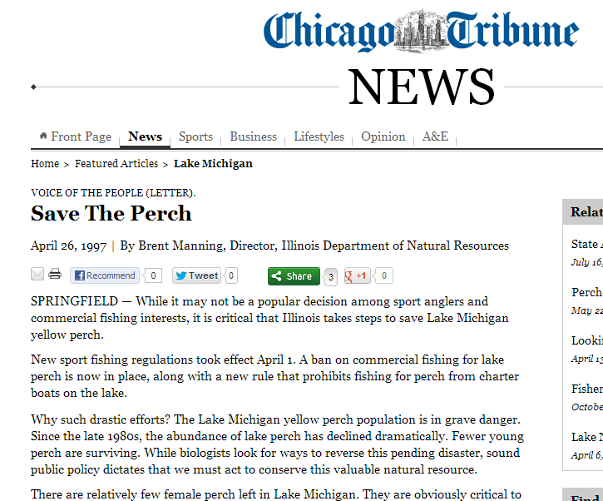
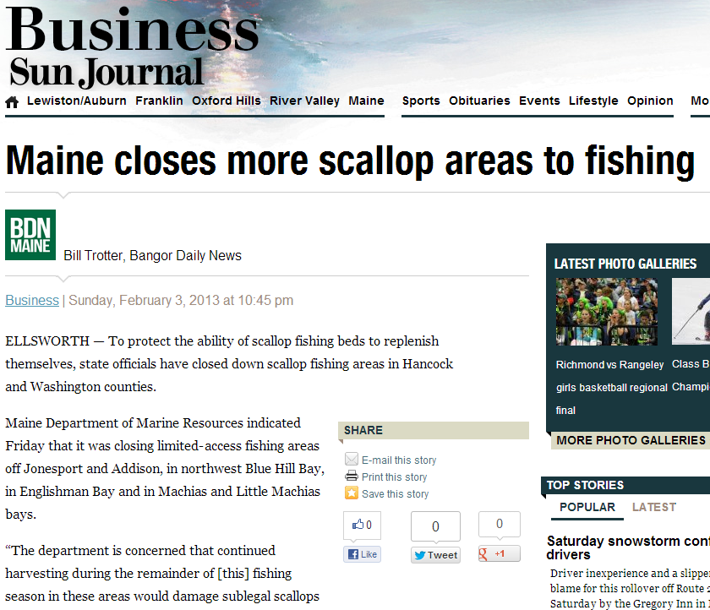
Closures
Seasons
Can fish only at certain times.
Areas
Fishing restricted in specific locations.
Fisheries
Fishing is completely prohibited.

Slide 3
Marine Protected Areas (MPAs)
“A clearly defined geographical space, recognized, dedicated and managed, through legal or other effective means, to achieve the long-term conservation of nature with associated ecosystem services and cultural values” – IUCN
Notes:
IUCN – International Union for the Conservation of Nature
Ecosystem Services
--Supporting (other services) … primary production, nutrient cycling
-- Provisioning (production) … food, water, energy
-- Regulating … carbon sequestration, purification of water/air, pest/disease control
-- Cultural … spiritual, recreational, aesthetic benefits

Slide 4
Marine Protected Areas (MPAs)
Many types
Can have ecological, cultural, or both objectives.
We will primarily discuss ecological (i.e., fishery) objectives

Slide 5
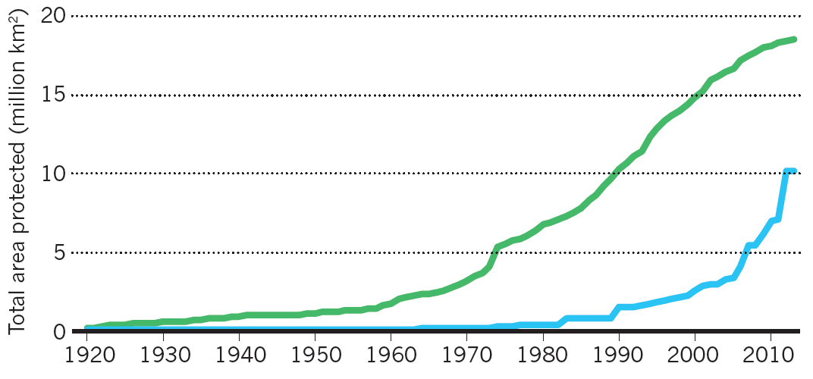
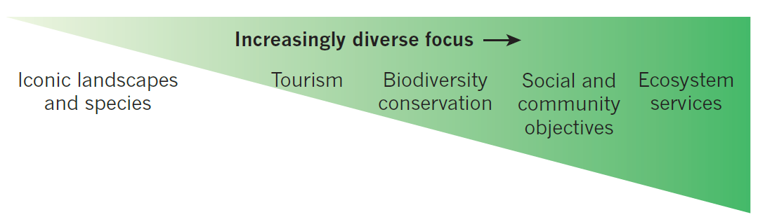
Marine Protected Areas (MPAs)
Notes:
Green – terrestrial
Blue -- aquatic

Slide 6
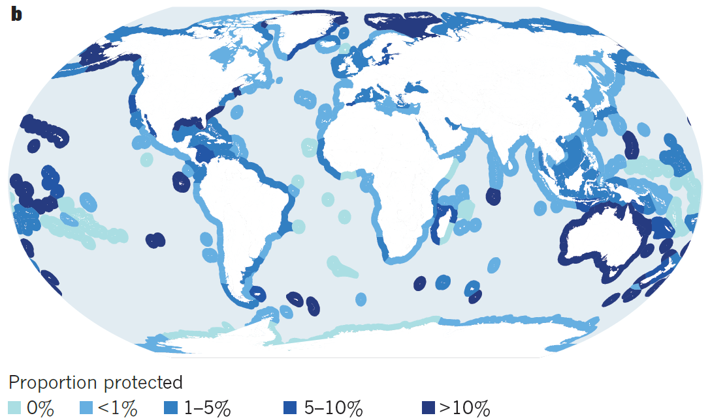
Marine Protected Areas (MPAs)
Notes:
From Watson et al. 2014. The performance and potential of protected ares. Nature 515:67-73.

Slide 7
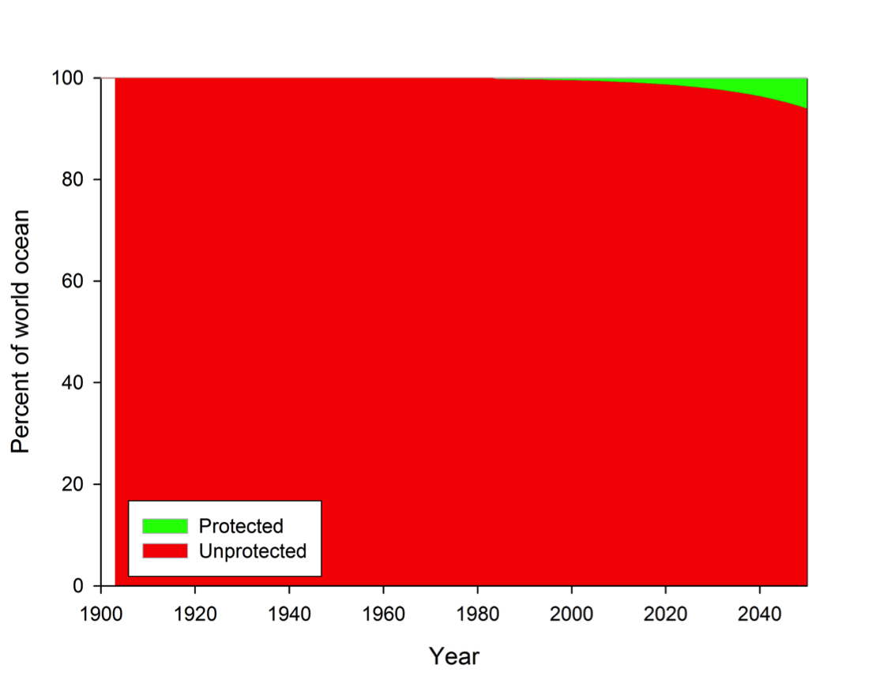
Marine Protected Areas (MPAs)
Notes:
From http://cfooduw.org/richard-branson-calls-for-more-marine-protected-areas/

Slide 8
MPAs – Objectives
“Harvest Refugia” (for exploited species)
Increase fish stocks within boundaries
Provide adult spill-over into fished areas
Provide a source of recruits to fished areas
“Conservation of Biodiversity”
Maximize numbers of species and habitats
Protect threatened species and habitats
Provide resilience to habitat degradation

Slide 9
MPAs – Case Studies
Great Barrier Reef
Papua New Guinea
Notes:
PNG – end 10:30

Slide 10
MPA – Needs for Success
“No Take” – low fishing mortality
“Strong Enforcement”
“Old Age of MPA”
“Large Size of MPA”
“Isolated Habitat” – different habitats within the MPA and immediately surrounding areas
According to Edgar et al. 2014. Global conservation outcomes depend on marine protected areas with five key features. Nature 506:216-220.

Slide 11

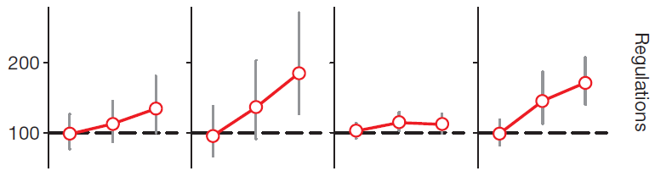
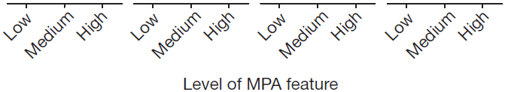
MPA – Needs for Success
Notes:
100% is same as fished area (i.e., non-MPA)

Slide 12
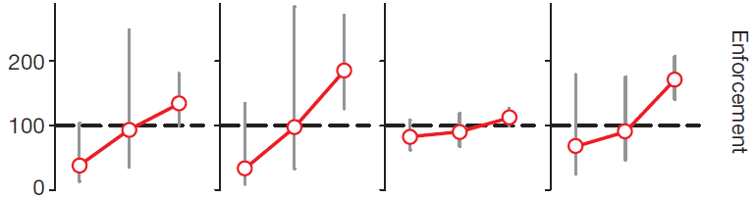
MPA – Needs for Success

Slide 13
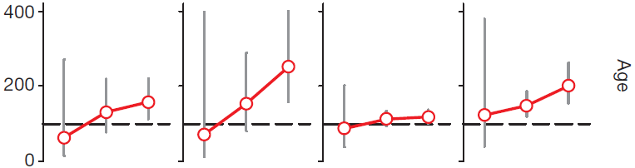
MPA – Needs for Success

Slide 14
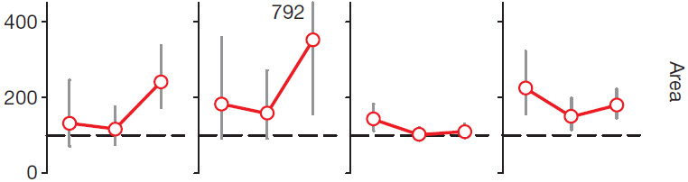
MPA – Needs for Success

Slide 15
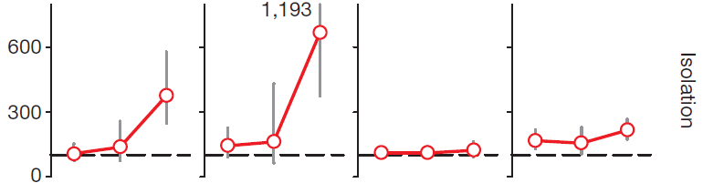
MPA – Needs for Success

Slide 16
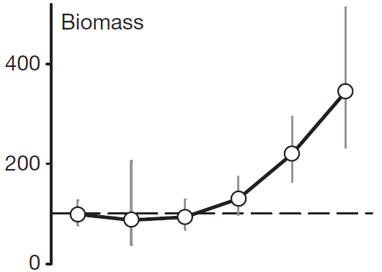



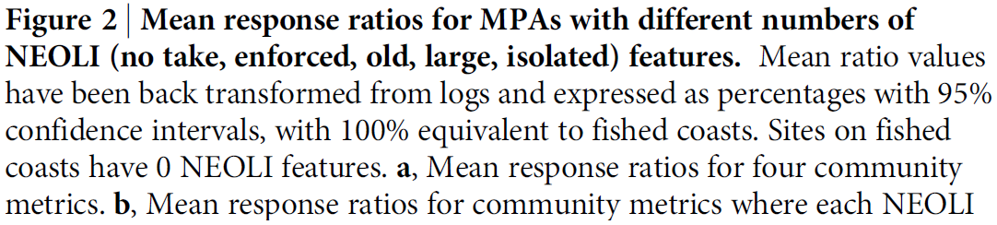
MPA – Needs for Success

Slide 17
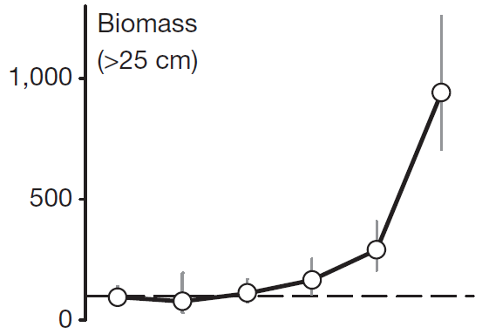
MPA – Needs for Success

Slide 18
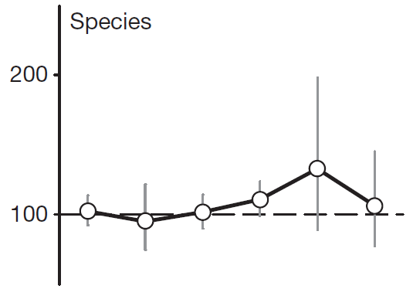
MPA – Needs for Success

Slide 19
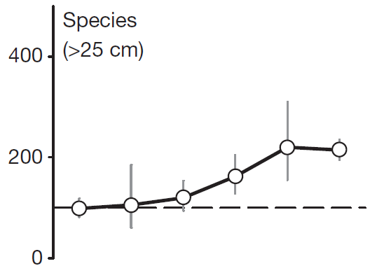
MPA – Needs for Success

Slide 20
MPA – Critiques
Displaced fishers.
Shift fishing pressure to other locations (usually poorer areas).
Attracts fishers (net increase in fishing mortality if enforcement is weak).
High costs (of maintenance and enforcement).
And see cfooduw.org

