Slide 1
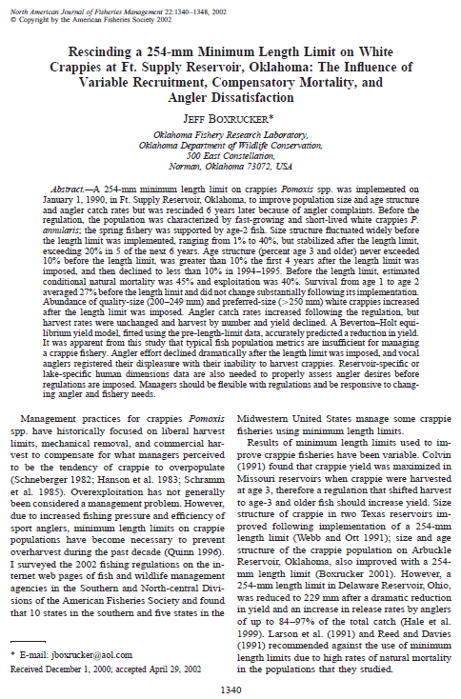
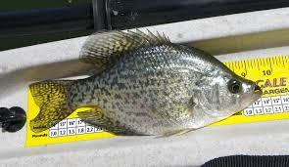
Boxrucker (2002) Crappie Length Limit Oklahoma

Slide 2

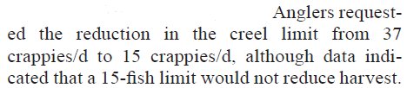

Introduction
What management “tools” were used in this study?
Who requested the bag limit reduction?
What were the objectives of the regulation change?

Slide 3
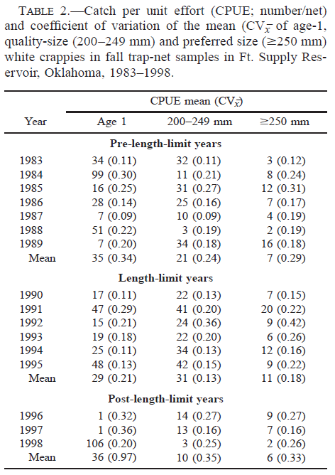
Results
Notes:
Recruitment did not differ over the years, varied widely though
CPE of larger fish increased slightly in length limit years

Slide 4
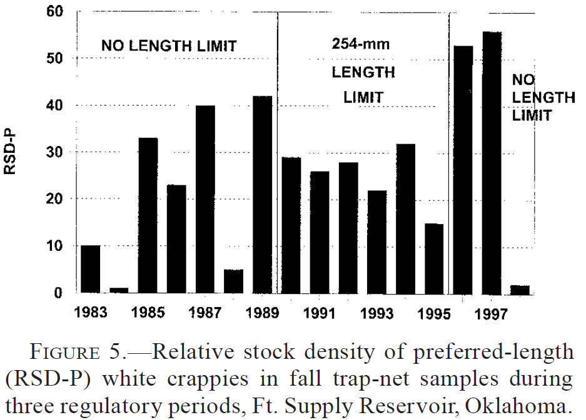
Results
Notes:
PSD-P stabilized during length limit years (>20% in 5/6 years)

Slide 5
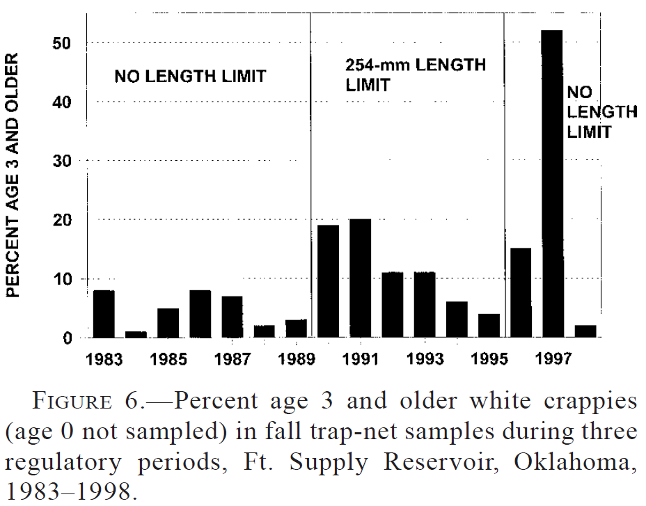
Results
Notes:
Age-strux increased during length limit years, but then increased dramatically following rescinding the limit.

Slide 6
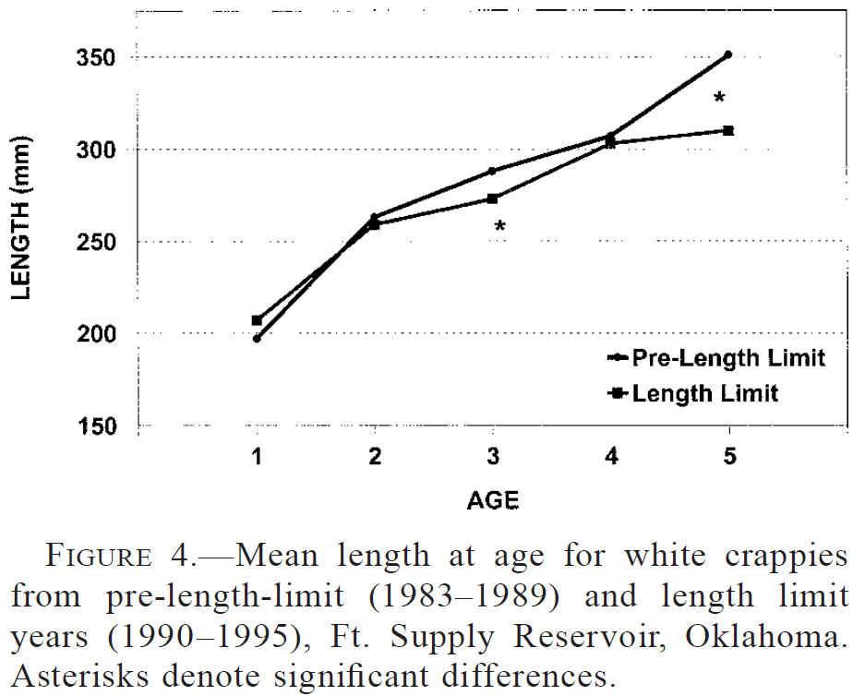
Results
Notes:
Exceptionally fast growing, growth did not change appreciably

Slide 7
Results – Crappie Population Summary
Pre-regulation
Fast-growing, short-lived crappies
Size-structure highly variable
Age-structure young (older fish harvested)
Natural mortality 45%
Exploitation 40%
After regulation
Size-structure somewhat improved, but stabilized
Age-structure older
Quality and preferred abundance increased

Slide 8
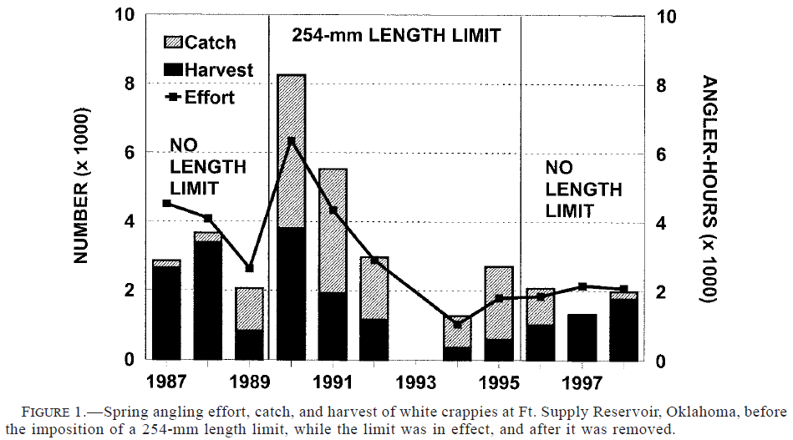
Results
Notes:
Effort declined
Catch similar, but harvest declined

Slide 9
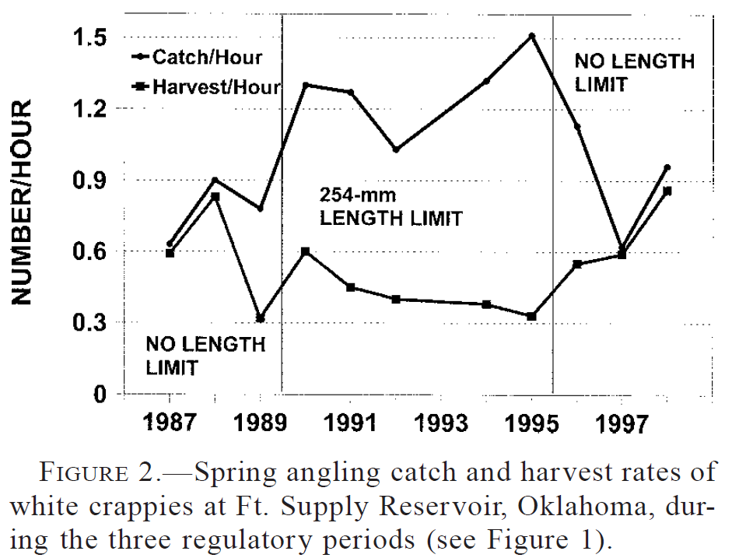
Results
Notes:
Catch rate increased, Harvest rate declined

Slide 10
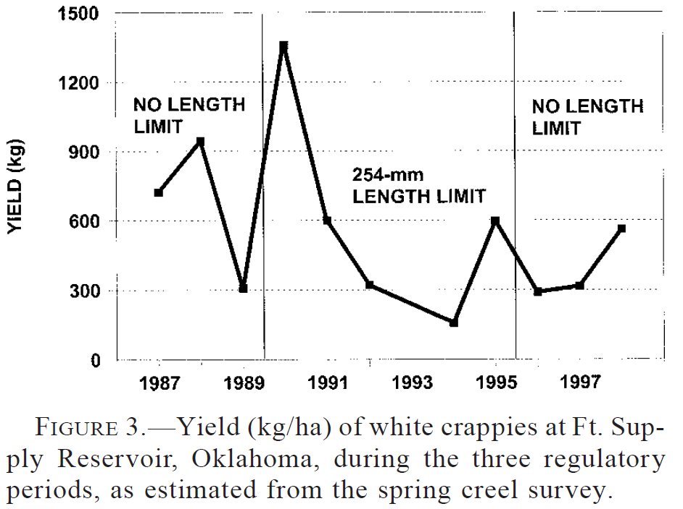
Results
Notes:
Yield dropped

Slide 11
Results – Crappie Fishery
Post-regulation
Effort decreased
Catch rate somewhat increased
Harvest rates and yields decreased
What ultimately happened to the regulation?

Slide 12
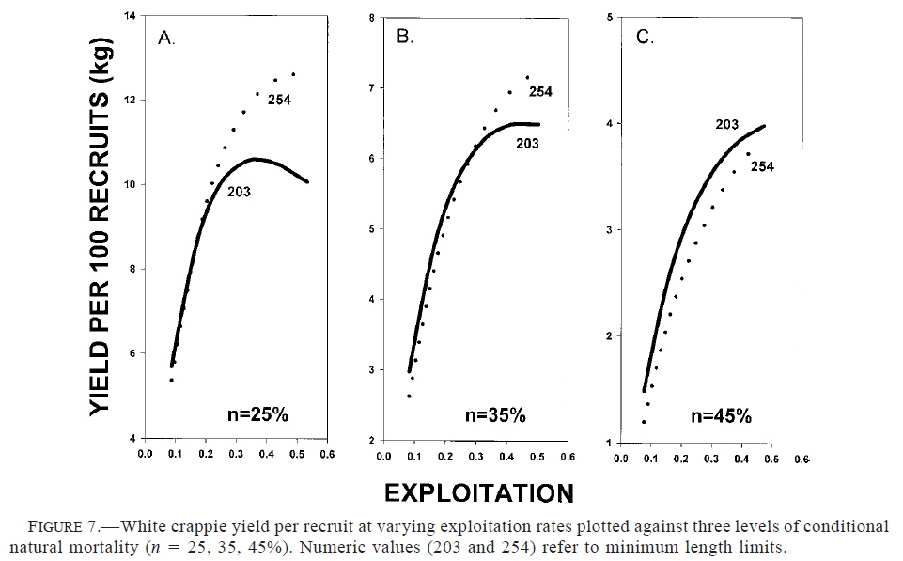
Results – Should the Reg have worked?

Slide 13
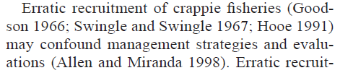
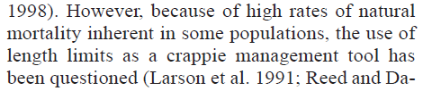
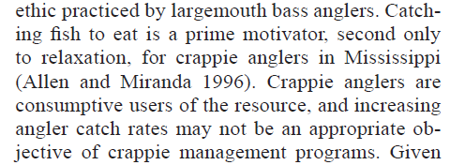
Discussion
What characteristics of crappie populations or fisheries make them difficult to manage?
High rates of natural mortality
Highly variable recruitment
Consumptive focus of the fishery
page 1345, col 2
page 1346, col 1
page 1347, col 1

Slide 14
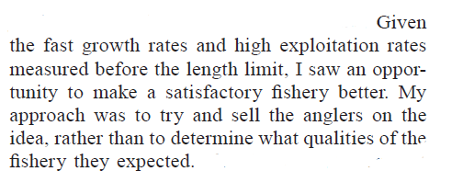
Conclusions
What are take home messages?
Even if biological objectives are met, the regulation is not useful if angler expectations are not met.

