Slide 1
Abundance Estimates
Recruitment
Natural Mortality
Population
Numbers
Fishing Mortality
Immigration
Emigration

Slide 2
Common Abundance Estimates
CPE/CPUE (relative density)
Depletion/Removal (estimate of N₀)
Mark-Recapture (estimate of N₀)

Slide 3
Overall Concept
In a closed population, population abundance can be estimated by marking animals collected in one sample, allowing them to mix back into the population, and then capturing marked and unmarked animals in a second sample.

Slide 4
Mark-Recapture Methods
Marking/Tagging
Batch
Cheaper, but has limitations

Slide 5
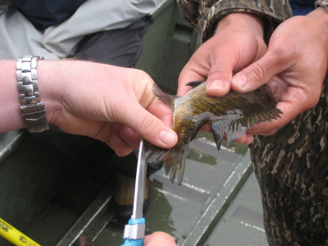
Marking Animals -- Fish

Slide 6
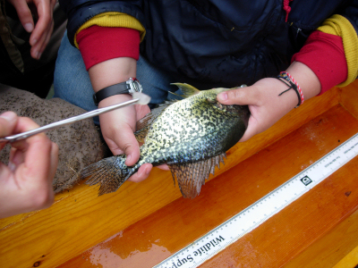
Marking Animals -- Fish

Slide 7
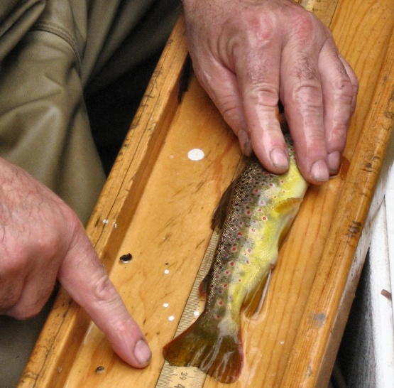
Marking Animals -- Fish

Slide 8
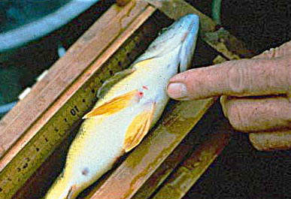
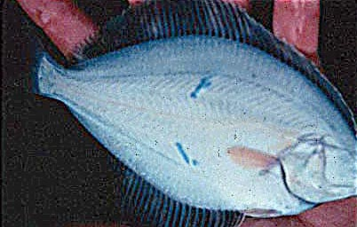
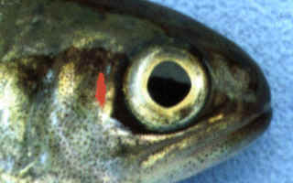

Marking Animals -- Fish

Slide 9
Mark-Recapture Methods
Marking/Tagging
Batch
Cheaper, but has limitations
Individual
Expensive, but also allows estimates of mortality / survival, recruitment, movement

Slide 10
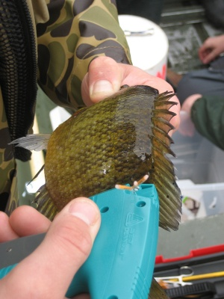
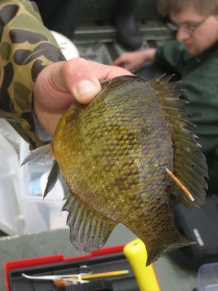
Marking Animals -- Fish

Slide 11
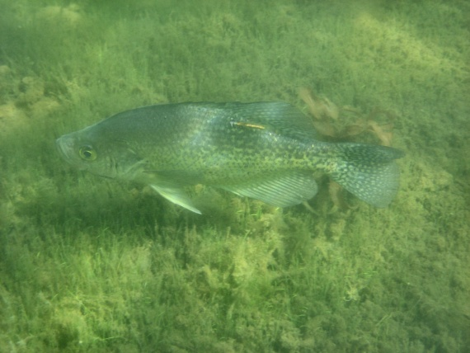
Marking Animals -- Fish

Slide 12
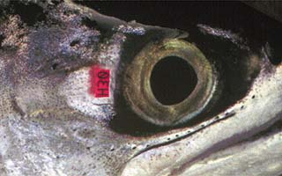
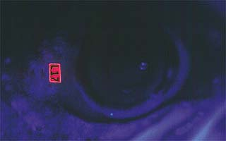
Marking Animals -- Fish

Slide 13
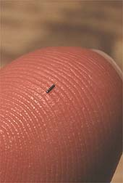
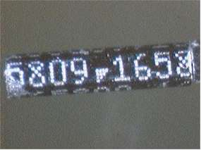
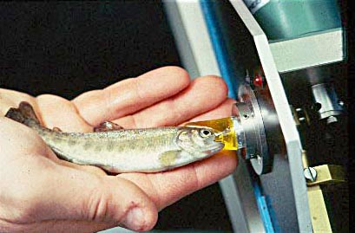
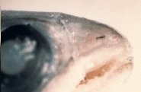
Marking Animals -- Fish

Slide 14
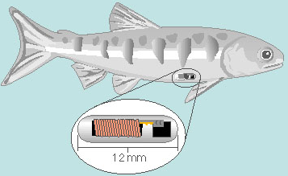

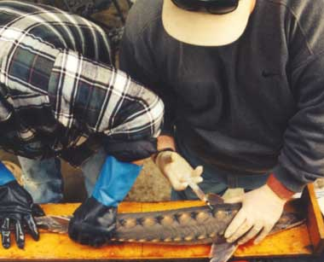
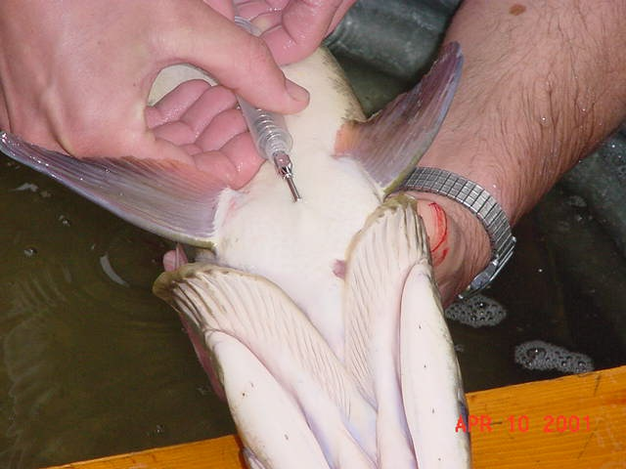
Marking Animals -- Fish

Slide 15
Mark-Recapture Methods
Marking/Tagging
Batch
Cheaper, but has limitations
Individual
Expensive, but also allows estimates of mortality / survival, recruitment, movement
Recapture information recorded in “capture history” format.

Slide 16
Capture History Format
A matrix
As many columns as capture events
As many rows as uniquely caught fish
Each cell contains a 1 if the fish was caught in that event and a 0 if it was not

Slide 17
Capture History Example #1
Suppose that a researcher captured and individually marked 75 fish on day 1. Two days later, a total of 100 fish were captured of which 25 were marked.
How many columns? Rows?
What does a row look like for a fish …
Captured in both samples
Captured in the first but not the second sample
Captured in the second but not the first sample
Captured in neither sample

Slide 18
Abundance Estimates
Recruitment
Natural Mortality
Population
Numbers
Fishing Mortality
Immigration
Emigration

Slide 19
Overall Concept
In a closed population, population abundance can be estimated by marking animals collected in one sample, allowing them to mix back into the population, and then capturing marked and unmarked animals in a second sample.

Slide 20
Overall Concept
Marking
run
Recapture
run

Slide 21
Capture Data Summary
 |  | Second | Sample
 |  | Not Captured | Captured | Total
First | Not Captured
Sample | Captured
 | Total
m
M
n
N
Definitions
M = number marked in population
n = size of recapture sample
m = number marked in recap sample
N = population size

Slide 22
Parameter / Statistics Definitions
n=19
m=7
M=16
N=50
Marking
run
N=50
Recapture
run

Slide 23
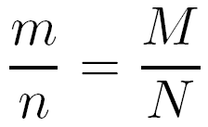
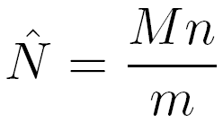
Estimation Concept
The proportion of marked fish in the recapture sample is equal to the proportion of marked fish in the population.
Which can be immediately rewritten as

Slide 24
Estimation Example
n=19
m=7
M=16
M*n/m = 16*19/7
= 43.43
N=50
Marking
run
N=50
Recapture
run

Slide 25
Method Name
Petersen
C.G.J. Petersen
Danish fisheries biologist
Publication from 1896
Lincoln
F. C. Lincoln
Worked for U. S. Fish and Wildlife Service
Publication from 1930
Thus, Lincoln-Petersen method

Slide 26
Lincoln-Petersen is Biased
Init Pop (500)
Mean Pop Est
500
1000
1500
Population Estimate

Slide 27
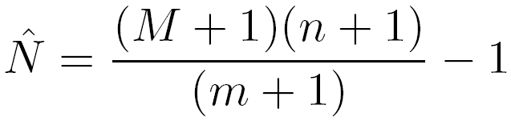
Chapman Modification
Chapman proposed a simple modification to the Petersen method
Bias is negligible if m>7

Slide 28
Chapman Modification is Unbiased
Init Pop (500)
Mean Pop Est
500
1000
1500
Population Estimate

Slide 29
Estimation Confidence Intervals
Seber (1982) suggests using …
… the binomial distribution of m/n > 0.10
… the normal approximation if m > 50
… the Poisson approximation otherwise

