Slide 1
Abundance Estimates
Recruitment
Natural Mortality
Population
Numbers
Fishing Mortality
Immigration
Emigration

Slide 2
Assumptions – Petersen Methods
The population is closed.
no losses due to emigration or mortality.
no gains due to immigration or recruitment.
All fish have the same chance of being caught.
Tagging fish does not affect their catchability.
Fish do not lose their tags.
All tagged fish are observed/reported when recaptured.

Slide 3
Assumptions – Effect of Violations
n=19
m=3
Scenario #1
M=16
m=10
Scenario #2
Which scenario would result in a larger estimate of N?
Marking
N=??
Recapture

Slide 4
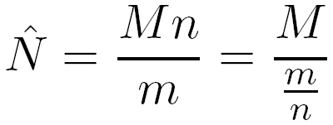
Assumptions – Effect of Violations
If M and n are constant then anything that makes m smaller will result in an increase estimate of N.
Alternatively anything that reduces the ratio of marked to unmarked fish will result in an increased estimate of N.

Slide 5
Assumptions – Effect of Violations
What happens to estimate of N if unmarked fish immigrate into the population?
There are proportionately fewer marked fish so m will be lower; thus …
N₁ OVERestimated
Marking
Recapture

Slide 6
Assumptions – Effect of Violations
What happens to estimate of N if marked fish die at a disproportionately higher rate?
There are proportionately fewer marked fish so m will be lower; thus …
N₁ OVERestimated
Marking
Recapture

Slide 7
Concept – Multiple-Census M/R
i=1
i=2
i=3

Slide 8
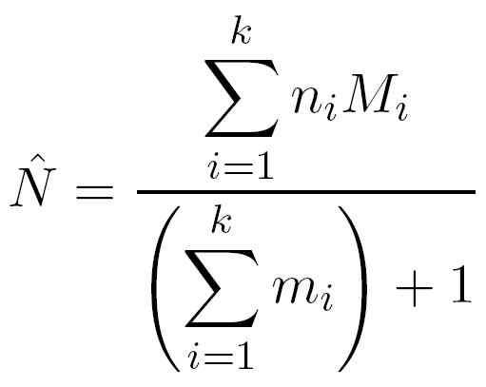
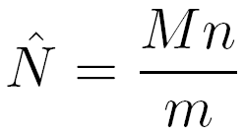
Schnabel Method (Chapman Modification)
Very similar to
Basically a weighted version of individual Petersen estimates

