Slide 1
Components of Z
Recruitment
Natural Mortality
Population
Numbers
Fishing Mortality
Immigration
Emigration
M = instantaneous natural mortality.
F = instantaneous fishing mortality.

Slide 2
Components of Z
Instantaneous components are additive
i.e., Z = F+M
Does this make sense?
Primary reason for working with instantaneous rates.
Annual components are not additive
i.e., A = m + n – mn
Where n =1-e^{-M}
m=1-e^{-F}
However, in a type-1 fishery mn=0

Slide 3
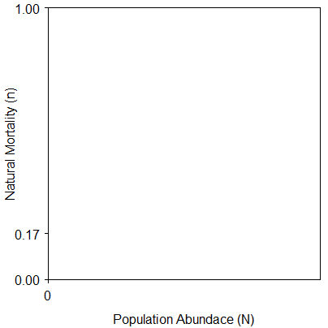
Density Independent Situation
Draw this.
Write equation.
Compute natural mortality rate if N=90.
Compute number of deaths.

Slide 4
Density Dependent Situation
Draw this.
Write equation.
Compute natural mortality rate if N=90.
Compute number of deaths.
Notes:
Assume that slope is 0.0055

Slide 5
Now, Assume m=0.33
Compute actual harvest.
For density-independent and -dependent …
Compute natural mortality rate.
Compute “natural” deaths.
Compute “total” deaths.

Slide 6
Components of Z
Components are additive – i.e., Z = F+M
As a manager, which of these do you want to know?
Controlling F is a major goal of many fisheries management strategies.
Very difficult to estimate precisely

Slide 7
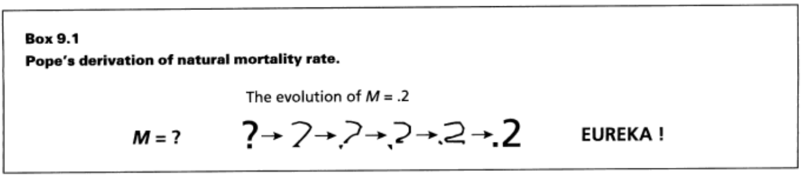
Estimating M
Assume a constant value for M
Typically use M=0.2
Is this realistic?
Notes:
Realistic? Varies by age, bathtub model

Slide 8
Estimating M
Assume a constant value for M
Relationship of M to life history traits
See page 217 in IFAR

Slide 9
Estimating M
Assume a constant value for M
Relationship of M to life history traits
From f and Z
Recall that Z = F+M and F=qf
Thus, Z = qf+M
If Z is estimated at different f, then …
M is the intercept from the Z on f regression.
Same as asking what is Z when f = 0.
Notes:
Draw the graphic

Slide 10
Controlling F
Controlling F is a major goal of many fisheries management strategies.
What happens to Z if F is decreased (i.e., more restrictive harvest regulation)?
This trade-off of mortalities is called compensatory mortality.
What happens to Z if F is increased (i.e., less restrictive harvest regulation)?
What also happens to growth, fecundity, etc.?

Slide 12



Estimating F with Marked Fish
Consider –
The number of fish caught is the proportion of dying fish due to fishing mortality
This proportion is F/Z
Therefore …
Consider --
Where the asterisks represent only marked fish

Slide 13
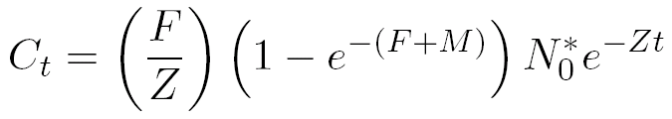
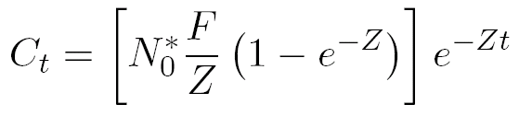
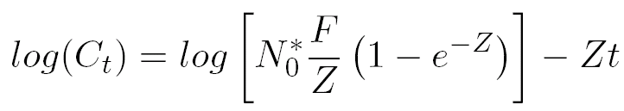
Estimating F with Marked Fish
Substitute N_{t}* equation into catch equation
and rearrange for simplicity
and take natural logs of both sides

Slide 14
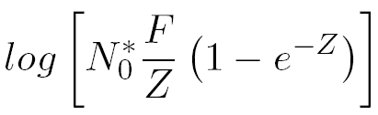
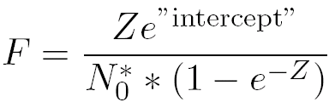
Estimating F with Marked Fish
Examine this model closely …
Slope is an estimate of –Z
Intercept is an estimate of …
Which can be solved for F

Slide 15
Example
400 fish were initially tagged
Tags were returned from the fishery over the next four years
Consider the time period to be the midpoints of the years.
Use these data to estimate Z & F (see HO).

