Slide 1
Estimation Confidence Intervals
Constructed from hypergeometric distribution
One is 95% confident that the population size is between 31 and 88 individuals.
7
31
88

Slide 2
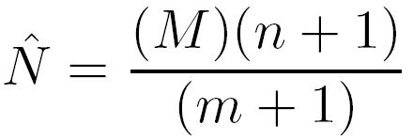
Bailey Modification
Bailey proposed a slight modification for situations where the recapture sample occurs with replacement
typically when recaptures are simply observed rather than sampled
Use type=“B” argument in mr.closed()

Slide 3
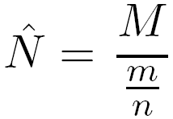
Assumptions – Effect of Violations
Recruitment
N₁<N₂, but marks stay the same
m/n would be lower, N₁ estimate biased high
Initial
+50 Recruits
i=1
i=2

Slide 4
Assumptions – Effect of Violations
Mortality (constant for marked/unmarked)
N₁>N₂, number marked decreases at same rate
m/n would be the same, N₁ estimate not biased
Initial
50% mortality
i=1
i=2

Slide 5
Assumptions – Effect of Violations
Mortality on marked fish
N₁>N₂, number of marks also decrease
m/n would be lower, N₁ estimate biased high
Initial
50% marked mortality
i=1
i=2

Slide 6
Assumptions – Effect of Violations
Tag loss
N₁=N₂, marks decrease
m/n would be lower, N₁ estimate biased high
Initial
50% Tag Loss
i=1
i=2

Slide 7
Assumptions – Effect of Violations
Increased catchability of marked fish (i.e., “trap happiness”)
N₁=N₂, marks same but appear higher
N₁ estimate biased low
Decreased catchability of marked fish (i.e., “trap shyness”)
N₁=N₂, marks same but appear lower
N₁ estimate biased high

Slide 8
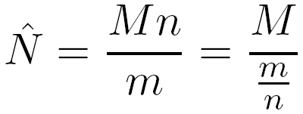
Assumptions – Effect of Violations
The Petersen estimate can be rewritten as
where the denominator can be thought of as the probability of capturing a marked fish.
Effect of assumption violations examined by
realizing that M is thought to be known
then considering how m/n is affected by violation.
If m/n < M/N then N is over-estimated
If m/n > M/N then N is under-estimated

Slide 9
Assumptions – Effect of Violations
Recruitment
N₁<N₂
m/n < M/N₁ → N₁ estimate biased high
m/n = M/N₂ → N₂ estimate unbiased
Initial
+50 Recruits
m/n: 16/100 = 0.16
M/N₁: 16/50 = 0.32
M/N₂: 16/100 = 0.16
i=1
i=2

Slide 10
Assumptions – Effect of Violations
Mortality (constant for marked/unmarked)
N₁>N₂, number marked decreases at same rate
m/n = M/N₁ → N₁ estimate unbiased
m/n < M/N₂ → N₂ estimate biased high
Initial
50% mortality
m/n: 8/25 = 0.32
M/N₁: 16/50 = 0.32
M/N₂: 16/25 = 0.64
i=1
i=2

Slide 11
Assumptions – Effect of Violations
Mortality on marked fish
N₁>N₂, number of marks also decrease
m/n < M/N₁ → N₁ estimate biased high
m/n < M/N₂ → N₂ estimate biased high
Initial
50% marked mortality
m/n: 8/42 = 0.19
M/N₁: 16/50 = 0.32
M/N₂: 16/42 = 0.38
i=1
i=2

Slide 12
Assumptions – Effect of Violations
Tag loss
N₁=N₂, marks decrease
m/n < M/N₁ → N₁ estimate biased high
m/n < M/N₂ → N₂ estimate biased high
Initial
50% Tag Loss
m/n: 8/50 = 0.16
M/N₁: 16/50 = 0.32
M/N₂: 16/50 = 0.32
i=1
i=2

Slide 13
Assumptions – Effect of Violations
Increased catchability of marked fish (i.e., “trap happiness”)
N₁=N₂, marks same but appear higher
m/n > M/N₁ → N₁ estimate biased low
m/n > M/N₂ → N₂ estimate biased low
Decreased catchability of marked fish (i.e., “trap shyness”)
N₁=N₂, marks same but appear lower
m/n < M/N₁ → N₁ estimate biased high
m/n < M/N₂ → N₂ estimate biased high

Slide 14
Summary Data Definitions
Definitions
k = number of samples in study
n_{i} = number of fish in the i^{th} sample
m_{i} = number of marked fish in i^{th} sample. m₁ = 0
R_{i} = number of marked fish returned to the population after the i^{th} sample. R_{k} = 0
M_{i} = number marked in population just prior to the i^{th} sample. M₁ = 0

Slide 15
Capture History Summary
$caphist
001 010 011 100 101 110 111
8 9 3 6 3 6 1
What is k?
What is n₁?
What is n₂?
What is n₃?
What is m₁?
What is m₂?
What is m₃?
3
6+3+6+1=16
What is R₁?
What is R₂?
What is R₃?
What is M₁?
What is M₂?
What is M₃?
n₁=16
9+3+6+1=19
n₂=19
8+3+3+1=15
0 or n₃=15
0
0
6+1=7
n₁=16
3+3+1=7
16+12=28

Slide 16
Schnabel Summary Table
Summarize previous results as such …
ni mi Ri Mi
first 16 0 16 0
second 19 7 19 16
third 16 7 0 28

Slide 17
Schnabel Assumptions
Same as for Petersen estimate
Assessed with plot of m_{i}/n_{i} versus M_{i}
If assumptions are met then will be linear
Curvature implies assumption problem

Slide 18
Schnabel Estimates in R
Examine handout
capHistSum()
mrClosed()
summary()
confint()
plot()

Slide 19
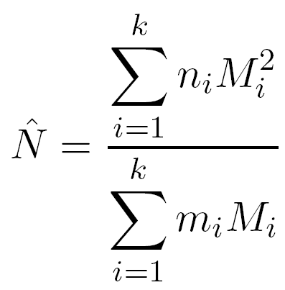
Schumacher-Eschmeyer Method
Weighted least-squares between proportion of marks in sample and proportion of marks in population.

Slide 21
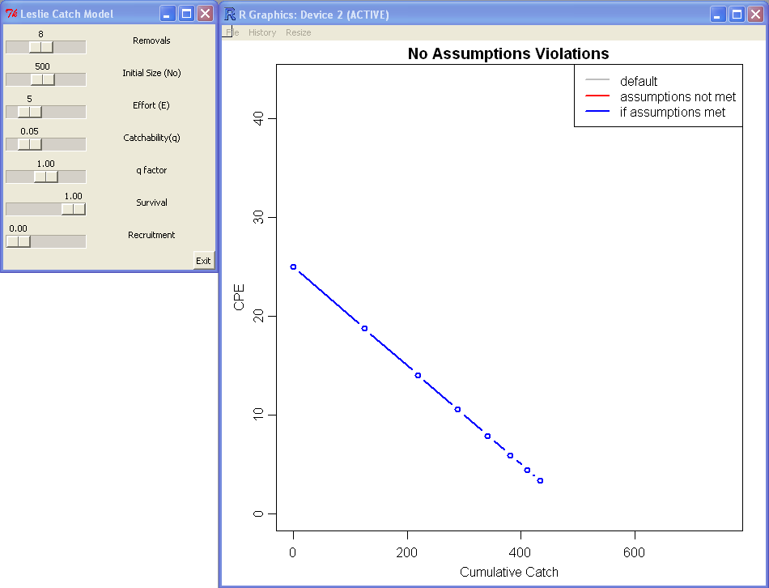
Leslie Model Assumptions
Explore with leslieSim()

Slide 22
K-pass Removal
Examine handout
Note use of
removal()
summary()
confint()

