Slide 1
Body Condition
Recruitment
Natural Mortality
Population
Biomass
Fishing Mortality
Immigration
Emigration
Growth

Slide 2
Body Condition
A measure of relative “plumpness”
How much does the fish weigh relative to some standard weight based on its length
A measure of physical health of ….
Individuals -- Energy densities, lipid content
Stocks -- Favorable habitat conditions, ample prey supply

Slide 3
Length-Weight Data
Basis of most condition metrics.
Common to weigh only a subsample of fish.
Develop a length-weight relationship model.
Nonlinear
Heteroscedastic
Power function
Multiplicative errors

Slide 4

Length-Weight Model
If b=3 then fish growth is isometric
i.e., all dimensions change similarly over time
i.e., shape of fish does not change over time

Slide 5


Length-Weight Model
if b≠3 then fish growth is allometric
if b<3 then fish gets more fusiform with time
if b>3 then fish gets more plump with time

Slide 6
Length-Weight Model
Examine natural log of
Linear
Homoscedastic

Slide 7
Length-Weight Regression in R
Examine Handout
lm()
summary()
confint()
fitPlot()
predict()

Slide 8
Condition Metrics
How much does the fish weigh relative to some standard weight based on its length?
Differ in how standard weight is computed
Cubic of observed length (L³)
Fulton’s condition factor (K)
Predicted weight from observed length using length-weight relationship for studied stock
LeCren’s relative condition factor (Kn)
Predicted 75th percentile of mean weights from many populations given observed length
Relative weight (Wr)

Slide 9
Standard Weights
Predicted 75th percentile of mean weights from many populations given observed length
4.0
Walleye Ws equation
3.5
3.0
log10(Weight (g))
2.5
2.0
1.5
1.0
2.2
2.4
2.6
2.8
3.0
log10(Length (mm))

Slide 10
Relative Weights (Wr)
Generally accepted method of computing body condition
More accepted in N.A. than in Europe
Computed with

Slide 11
Wr Interpretation
Thus, Wr=100 if fish is at 75th percentile of mean weights for many stocks
If Wr < 100 then fish is less “plump” than an average fish of the same length from 75% of stocks.
If the mean Wr < 100 then fish in stock are less plump, on average, then an average fish from 75% of stocks.
i.e., less plump then an “above average” standard.
i.e., should not be surprised to see values < 100

Slide 12
Wr Interpretation
Wr has been developed to be unrelated to fish length.
Thus, Wr is most useful for comparing body condition among
Length classes
Years
Locations
Habitats
Management conditions/scenarios

Slide 13
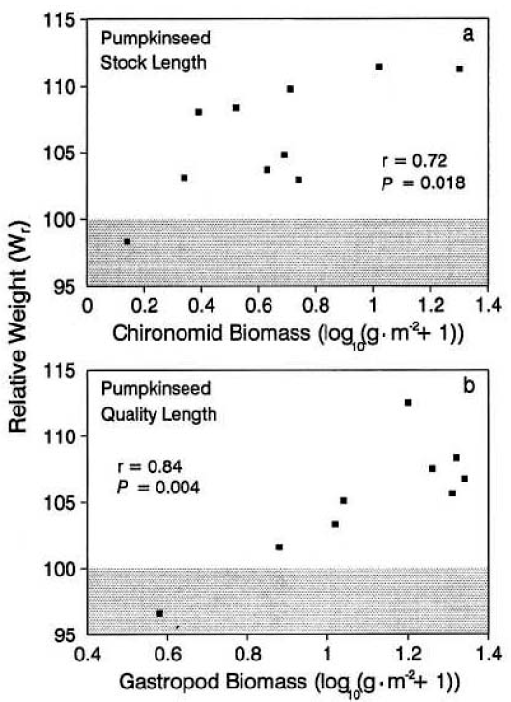
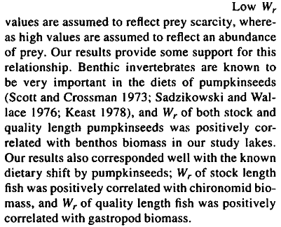
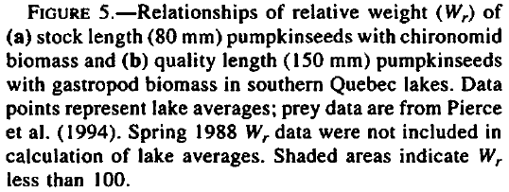
Wr Interpretation -- Example
From Liao et al. 1995. Transactions of the American Fisheries Society 124:387-400.

Slide 14
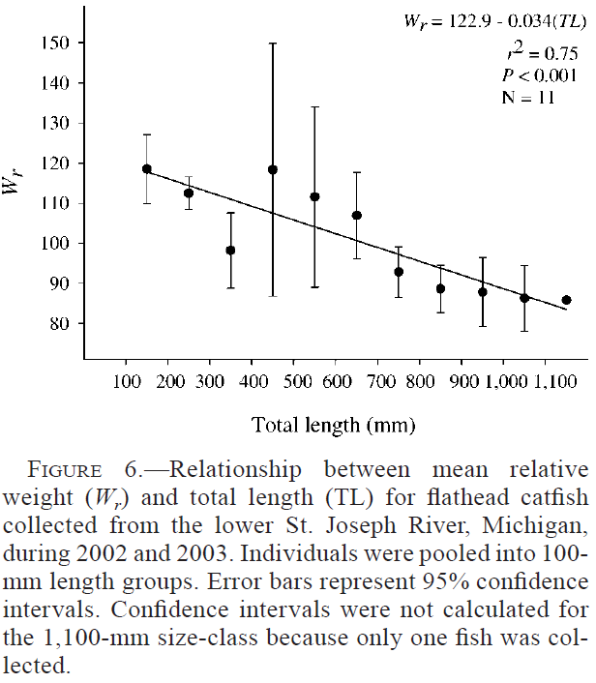
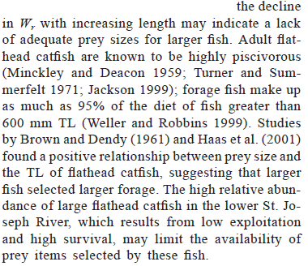
Wr Interpretation -- Example
From Daugherty and Sutton. 2005. North American Journal of Fisheries Management 25:1191–1201.

Slide 15
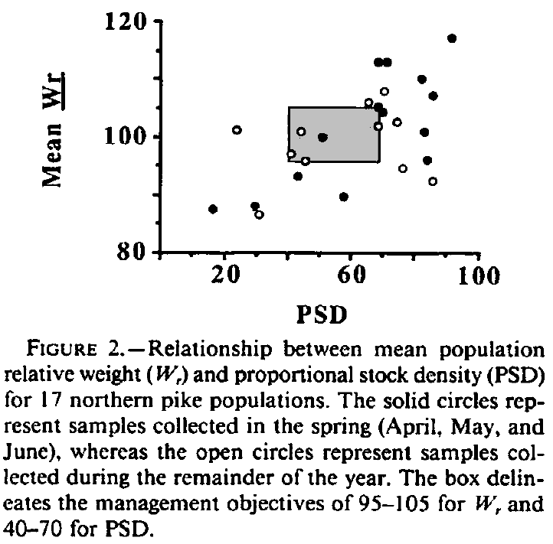
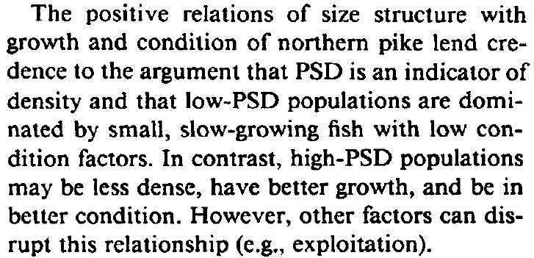
Wr Interpretation -- Example
From Willis and Scalet. 1989. North American Journal of Fisheries Management 9:488-492.

Slide 16
Wr in R
Examine Handout
lencat()
wsVal()

