Slide 1
Length-Weight Analysis

Slide 2
Length-Weight Data
Common to measure just the length of fish in the field and then later predict the weight.
Requires a length-weight relationship model developed from length and weight measurements made on fish of the same population.

Slide 3
Length-Weight Data
Examine a plot of weight versus length
Characteristics
Curved
Heteroscedastic

Slide 4
Length-Weight Model
Power function with multiplicative errors.
b ≈ 3 because fish grow in three dimensions (length, weight, depth)

Slide 5
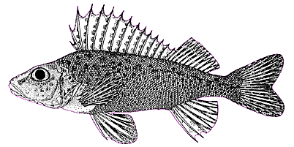
Length-Weight Model
If b=3 then fish growth is isometric
i.e., all dimensions change similarly over time
i.e., shape of fish does not change over time

Slide 6
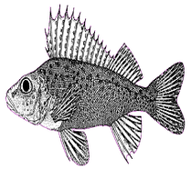
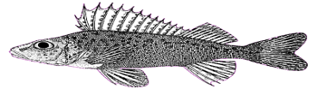
Length-Weight Model
if b≠3 then fish growth is allometric
if b<3 then fish gets more fusiform with time
if b>3 then fish gets more plump with time

Slide 7
Length-Weight Model
Natural log linearizes power function and makes errors additive
Thus, fit linear regression to log-log data
What does the slope estimate?
What does the intercept estimate?

Slide 8
Length-Weight Data
Examine a plot of log(weight) versus log(length)
Characteristics
Linear
Homoscedastic

Slide 9
Length-Weight Regression in R
Examine Handout
lm()
summary()
confint()
hoCoef()
fitPlot()
predict()
predictionPlot()

Slide 10
Length-Weight Summary
Raw data follows a power function.
Log-transformed data follows a linear function.
b is estimated by slope of regression.
log(a) is estimated by intercept of regression.
Allometry is tested with H₀:b=3 vs. H_{A}:b≠3.
Predictions are made on log scale and then back-transformed to original scale.

