Slide 1
Management Regulations

Slide 2
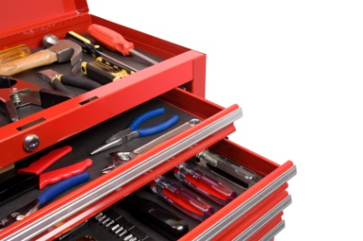
Manager’s Toolbox
What kinds of “things” can be used to …
Manipulate fish population dynamics
Manipulate angling effort
Augment limiting environmental factors

Slide 3
Bag / Creel Limits
Maximum number (sometimes weight) of fish that can be removed from a water.
Daily – maximum per day.
Possession – maximum in your possession.
Season – limited number (usually 1) per season.
Typically referred to as a quota.

Slide 4
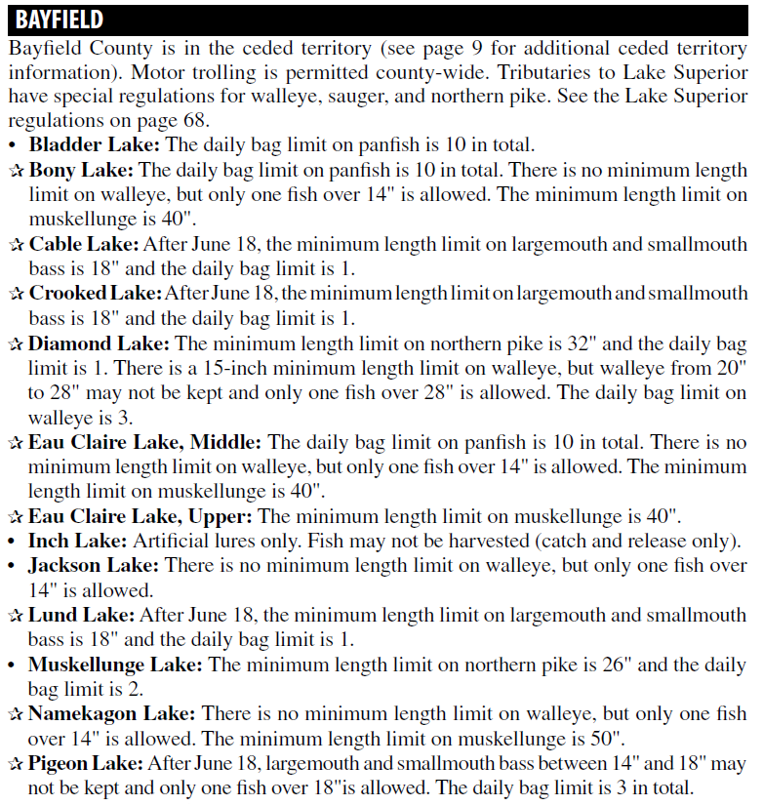
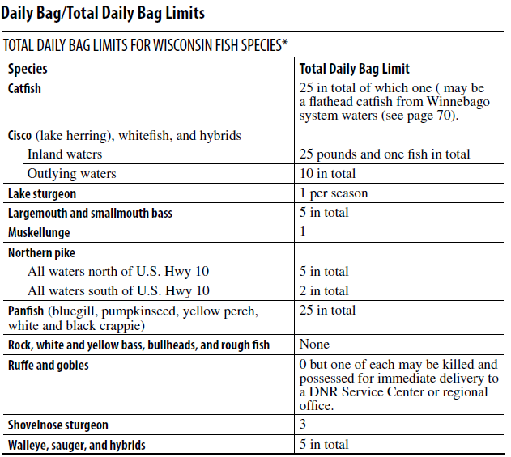
Bag / Creel Limits

Slide 5
Bag / Creel Limits
Possible reasons to use.
Prevent over-exploitation.
Equitable division of harvest.
Provide the satisfaction of reaching a goal.
Recommended when …
High rates of fishing mortality.
Check this out.
Work on “Bag Limits” case study.

Slide 6
Length Limits
Minimum – no harvest below minimum size.
Maximum – no harvest above maximum size.
Protected Slot – no harvest within slot sizes.
Harvest Slot – no harvest outside of slot sizes.
6 | 7 | 8 | 9 | 10 | 11 | 12 | 13 | 14 | 15 | 16 | 17 | 18 | 19 | 20 | 21 | 22
6 | 7 | 8 | 9 | 10 | 11 | 12 | 13 | 14 | 15 | 16 | 17 | 18 | 19 | 20 | 21 | 22
6 | 7 | 8 | 9 | 10 | 11 | 12 | 13 | 14 | 15 | 16 | 17 | 18 | 19 | 20 | 21 | 22
6 | 7 | 8 | 9 | 10 | 11 | 12 | 13 | 14 | 15 | 16 | 17 | 18 | 19 | 20 | 21 | 22

Slide 7
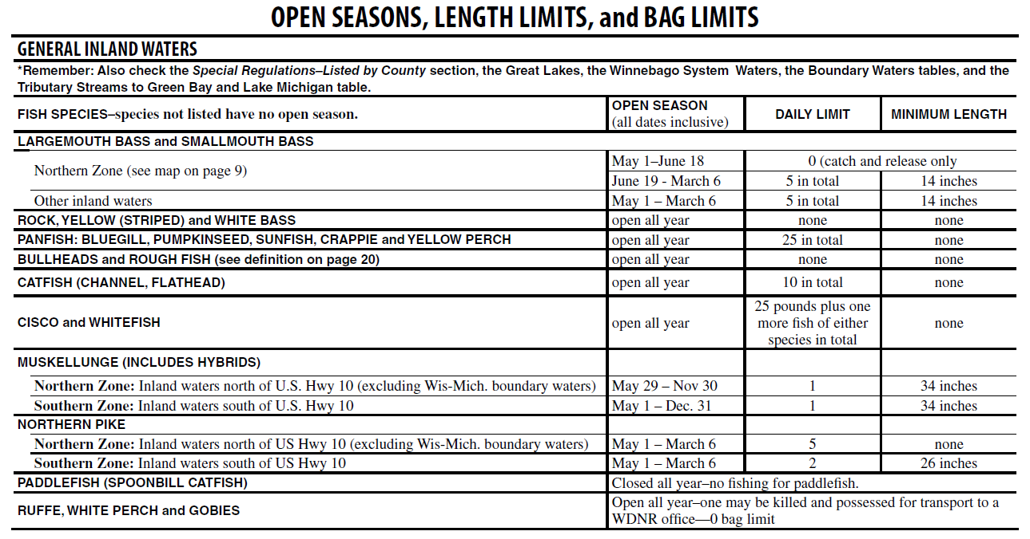
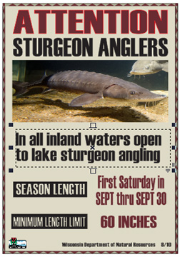
Length Limits – Minimum

Slide 8
Length Limits – Minimum
6 | 7 | 8 | 9 | 10 | 11 | 12 | 13 | 14 | 15 | 16 | 17 | 18 | 19 | 20 | 21 | 22
Possible reasons to use.
Lower mortality (fishing and total) in highly vulnerable populations.
Prevent overexploitation.
Protect reproductive potential of population.
Allow at least one spawning.
Increase catch (but not necessarily harvest) rates.
Increase abundance of quality fishes.
Promote predation on prey fishes.

Slide 9
Length Limits – Minimum
6 | 7 | 8 | 9 | 10 | 11 | 12 | 13 | 14 | 15 | 16 | 17 | 18 | 19 | 20 | 21 | 22
Recommended when …
Low rates of recruitment.
Low rates of natural mortality.
High fishing mortality.
“Good” growth rates.
“Late” maturing populations.

Slide 10
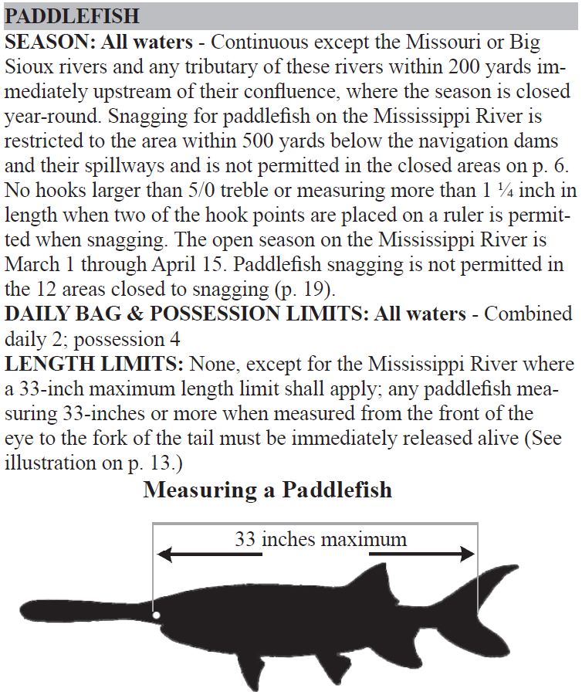
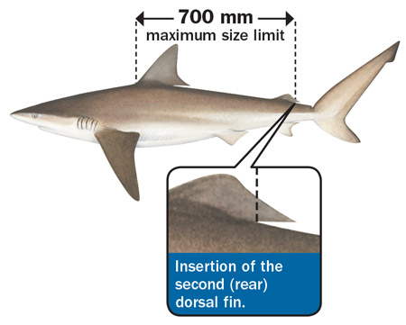
Length Limits – Maximum

Slide 11
Length Limits – Maximum
6 | 7 | 8 | 9 | 10 | 11 | 12 | 13 | 14 | 15 | 16 | 17 | 18 | 19 | 20 | 21 | 22
Possible reasons to use.
Protect relatively few sexually mature adults.
Protect important large spawners.
Reduce numbers of small fish (and potentially increase growth rates).

Slide 12
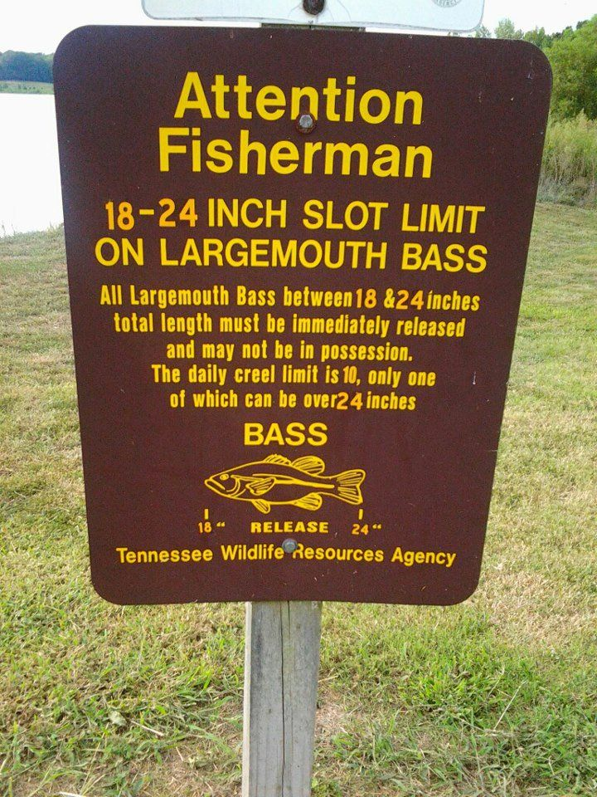
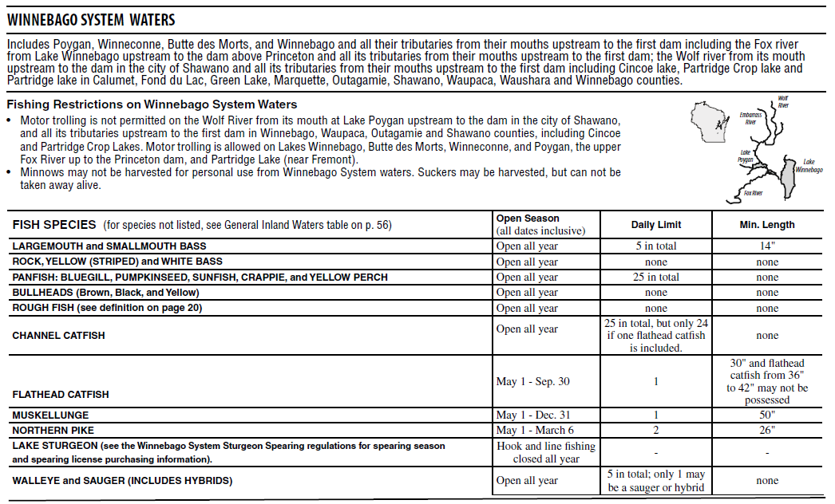
Length Limits – Protected Slot

Slide 13
Length Limits – Protected Slot
6 | 7 | 8 | 9 | 10 | 11 | 12 | 13 | 14 | 15 | 16 | 17 | 18 | 19 | 20 | 21 | 22
Possible reasons to use.
Increase abundance of protected-size fish.
Increase abundance of trophy fish.
Promote growth of smaller-size fish.
Increase catch rates.
Promote predation on prey fishes.

Slide 14
Length Limits – Protected Slot
6 | 7 | 8 | 9 | 10 | 11 | 12 | 13 | 14 | 15 | 16 | 17 | 18 | 19 | 20 | 21 | 22
Recommended when …
High rates of recruitment.
Low rates of growth.
Desire more quality fish.
Check this out! (0:45-3:30)
But also see this! (0:00-0:50)
But then this! (0:31-2:18)
Notes:
Stop video at 3:30

Slide 15
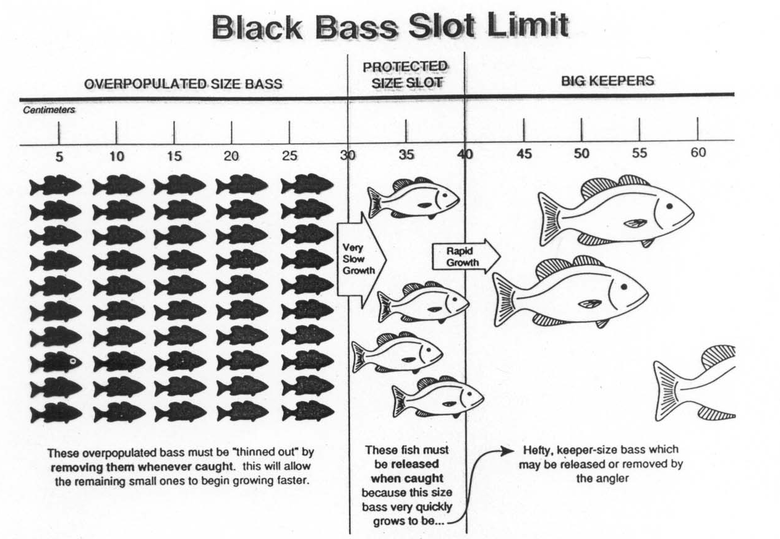
Length Limits – Protected Slot

Slide 16
Length Limits – Harvest Slot
6 | 7 | 8 | 9 | 10 | 11 | 12 | 13 | 14 | 15 | 16 | 17 | 18 | 19 | 20 | 21 | 22
Possible reasons to use.
Protect small fish for recruitment.
Protect large fish for spawning and attainment of trophy size.
Recommended when …
Low recruitment.
Good growth.

Slide 17
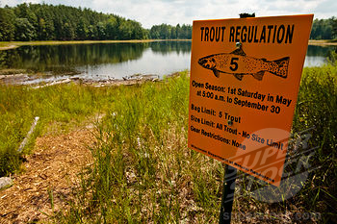
Closures – Seasons
Fish only at certain times.

Slide 18
Closures – Seasons
Possible reasons to use.
Protect fish prior to or during spawning.
Protect fish that congregate at specific times.
Promote excitement with an “opener.”
Recommended when …
High exploitation on congregated, likely spawning, fish

Slide 19
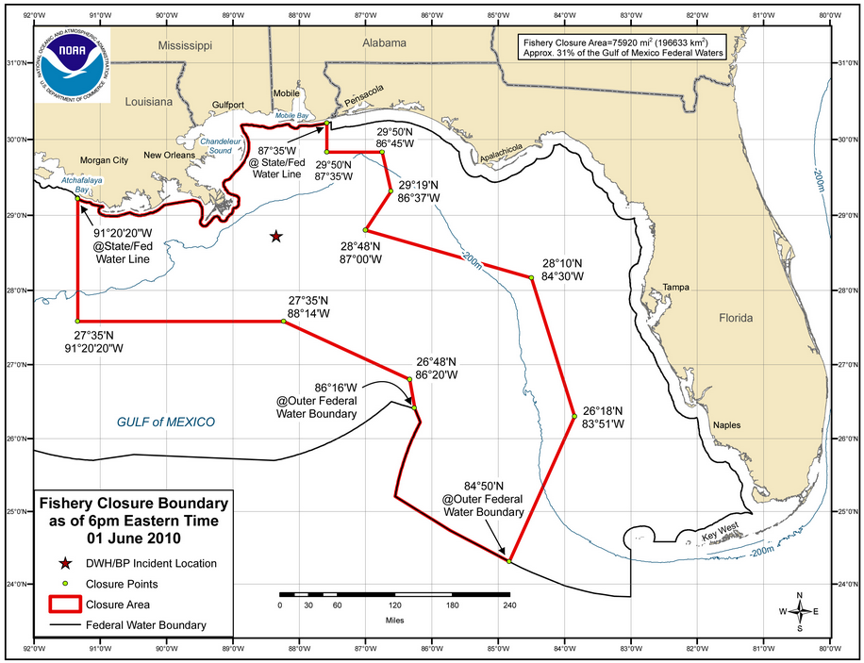
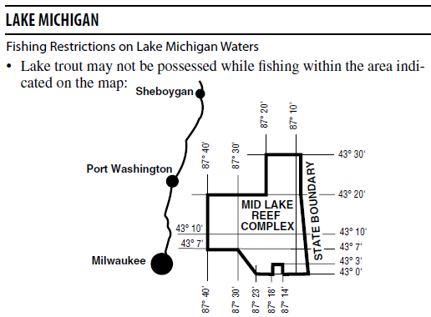
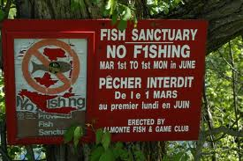
Closures – Areas
Fishing restricted in specific locations.

Slide 20
Closures – Areas
Marine Protected Areas (MPAs)
General term.
For fisheries, generally a closed area.
Some argue that these are only chance to stem overfishing.
Others argue that that is extreme.
Check this out!

Slide 21
Closures – Areas
Possible reasons to use.
Protect congregated fish, likely in spawning areas.
Protect areally-defined stocks that have collapsed.
Restrict fishing in polluted areas.
Restrict fishing in dangerous areas.
Recommended when …
High exploitation in specific areas.
Protect fishers in dangerous areas.
Restrict harvest of contaminated individuals.

Slide 22
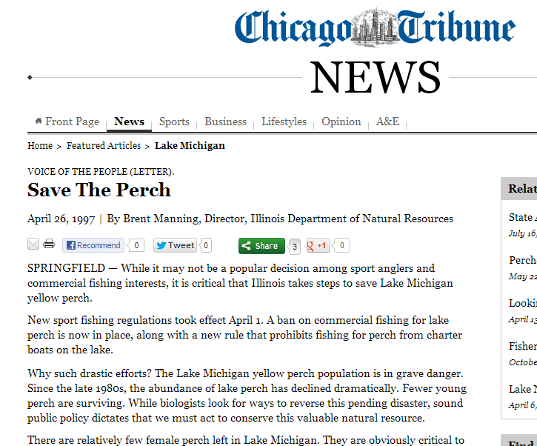
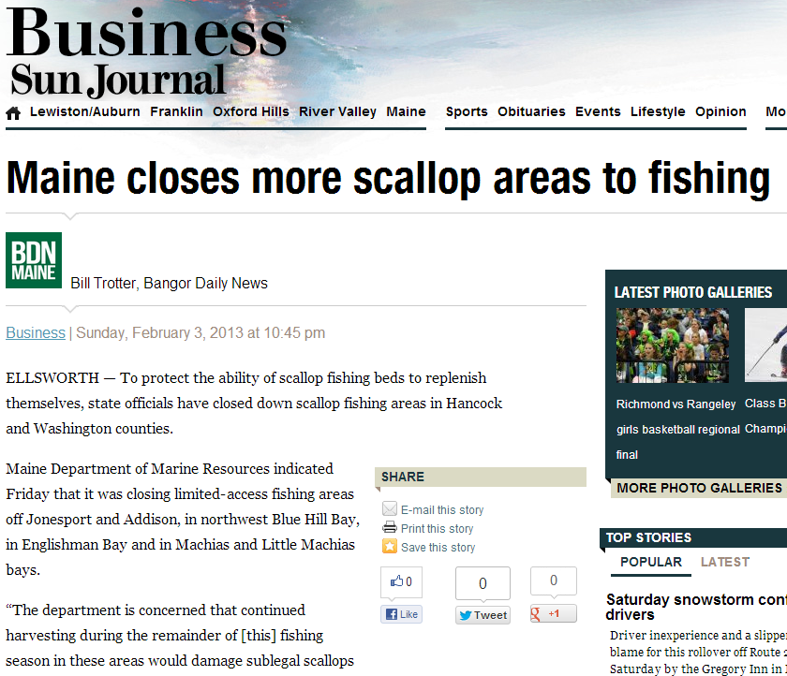
Closures – Fisheries
Fishing is completely prohibited

Slide 23
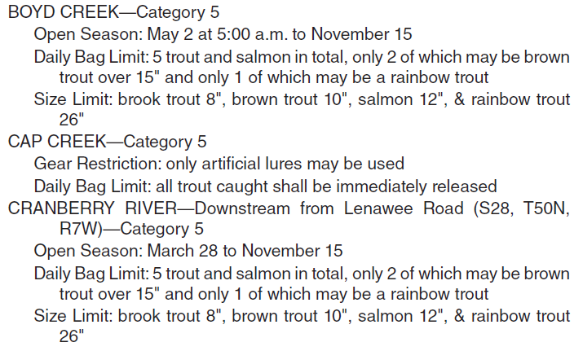
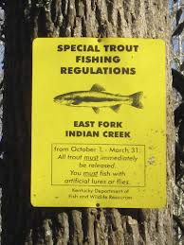
Gear Restrictions – Recreational
Anglers are restricted to certain types of gear.
Artificial lures only.
Barbless hooks.
Only three lines.
No motor trolling.

Slide 24
Gear Restrictions – Recreational
Possible reasons to use.
Reduce post-release mortality in high catch-and-release fisheries.
Social reasons
Perceptions of effectiveness of some gears
Provide unique fisheries (e.g., fly-fishing only)

Slide 25
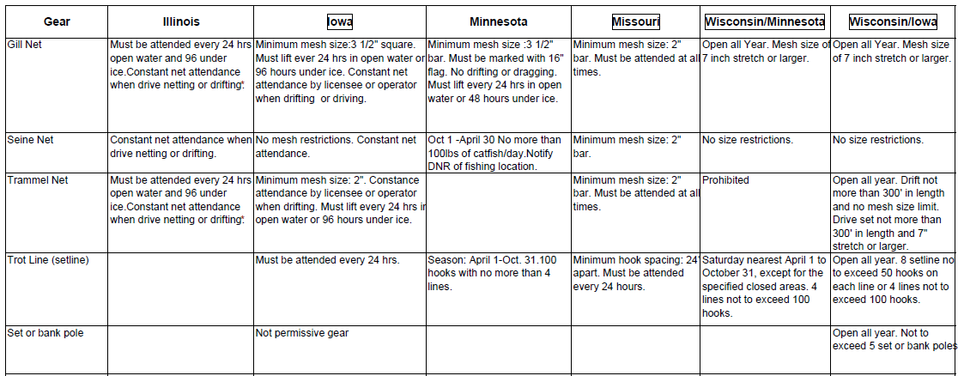
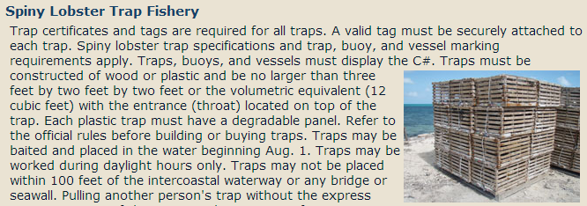
Gear Restrictions – Commercial
Fishers are restricted to types/sizes of gear.
Notes:
Upper Mississippi River rules

Slide 26
Gear Restrictions – Commercial
Possible reasons to use.
Restrict sizes of fish caught.
Restrict numbers of fish caught.
Notes:
Upper Mississippi River rules

Slide 27
Quotas
The total number or weight that can be harvest during a specified time.
AKA, safe harvest level, total allowable catch
Types
“Derby” Quota
Catch-shares
Individual Transferable Quota (ITQ)

Slide 28
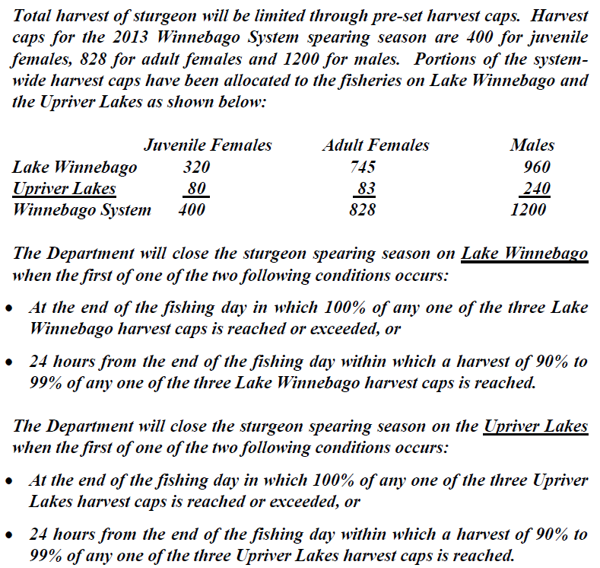
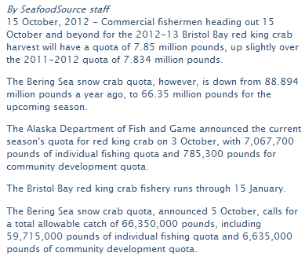
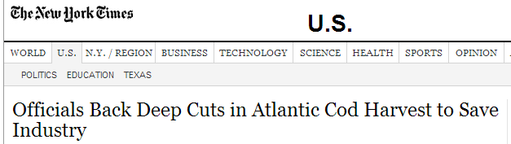

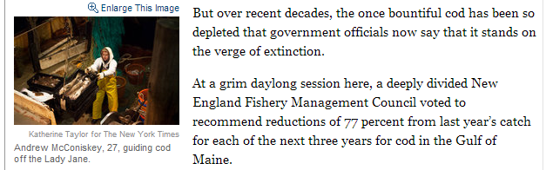
Quotas

Slide 29
Stocking

Slide 30
Habitat Manipulations

Slide 32
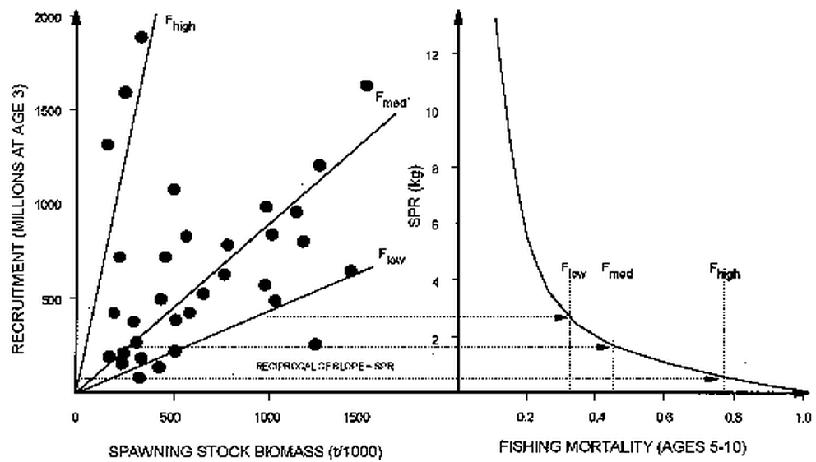
Overfishing Types
Recruitment
Recruits produced is not enough to replenish the population.
Exacerbated by the removal of large females.

Slide 33
Overfishing Types
Growth
Loss of biomass due to fishing is greater than biomass gained due to growth.
Fish are removed before reaching a size at which maximum growth and productivity would be obtained from the stock.

Slide 34
Overfishing Types
Quality
When fishing mortality exceeds the fishing mortality of optimal satisfaction yield.
The rate of fishing produces a loss in angler satisfaction.

