Slide 2
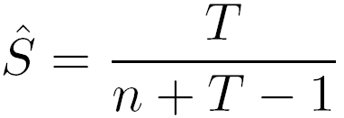
Chapman-Robson Method
Proposed a likelihood method (based on a geometric distribution) that was more precise and less biased than the catch-curve methods.
Survival estimate is
where n = number of fish on descending limb
T = total recoded age on descending limb

Slide 3
Chapman-Robson Example
age Ct
0 47
1 102
2 126
3 104
4 81
5 64
age*
--
--
0
1
2
3
Ct
--
--
126
104
81
64
Prod
--
--
0
104
162
192
Ages must be re-coded so that first age on descending limb is 0.
n is total catch on descending limb.
Multiply recoded age and catch.
T is total of these products
n=375
T=458
458
= ------------
375+458-1
= 0.550
Notes:
Ct <- c(47,102,126,104,81,64)

Slide 4
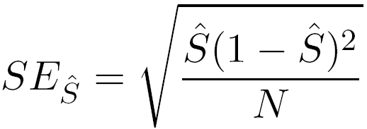
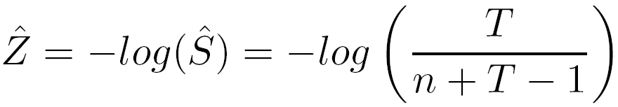
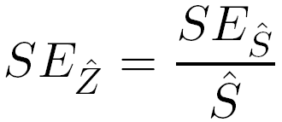
Chapman-Robson Method
The
Recall that S=e^{-Z}, thus
with
Use chapman.robson() just as catch.curve()

