Slide 1
Stock-Recruitment
Recruitment
Natural Mortality
Population
Numbers
Fishing Mortality
Immigration
Emigration

Slide 2
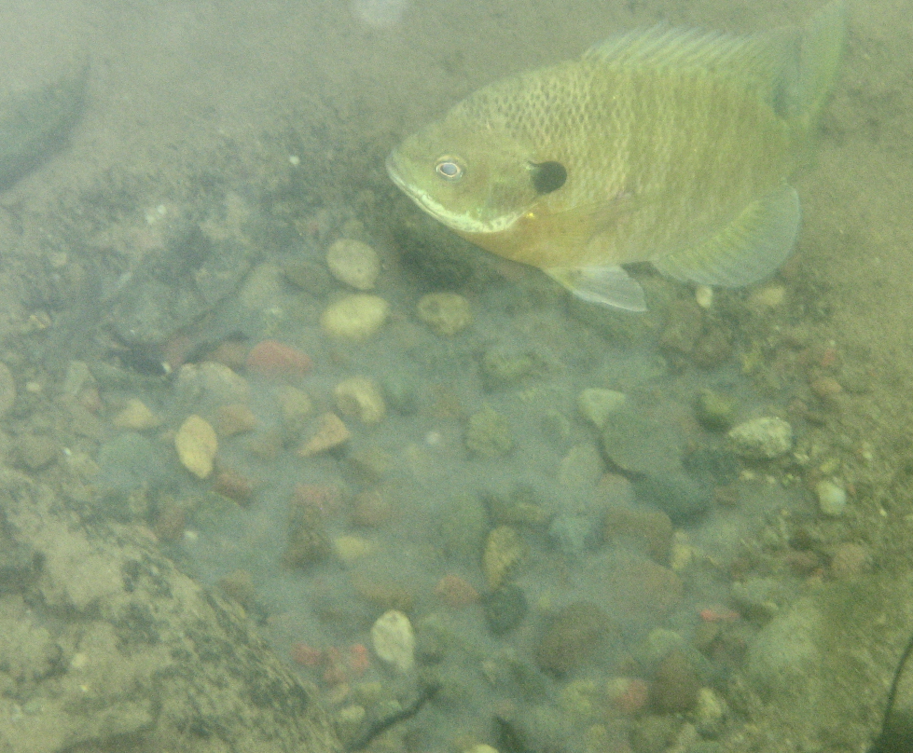
Overall Concept
How many “recruits” are produced for X number of “adults”?

Slide 3

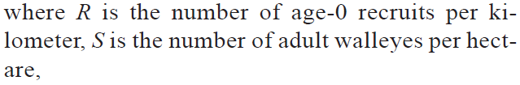
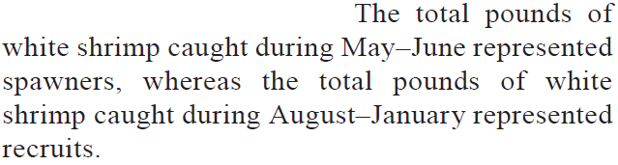
“Stock” & “Recruits” Definitions
Froese (2004) – Coho salmon, OR
Beard et al. (2003) – Walleye, WI
Belcher & Jennings (2004) – White shrimp, GA

Slide 4
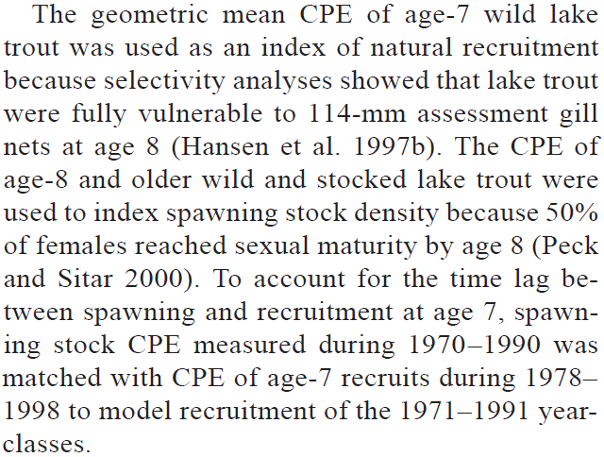
“Stock” & “Recruits” Definitions
Allen & Miranda (2001) – Black crappie, MS
Richards et al. (2004) – Lake Trout, MI

Slide 5
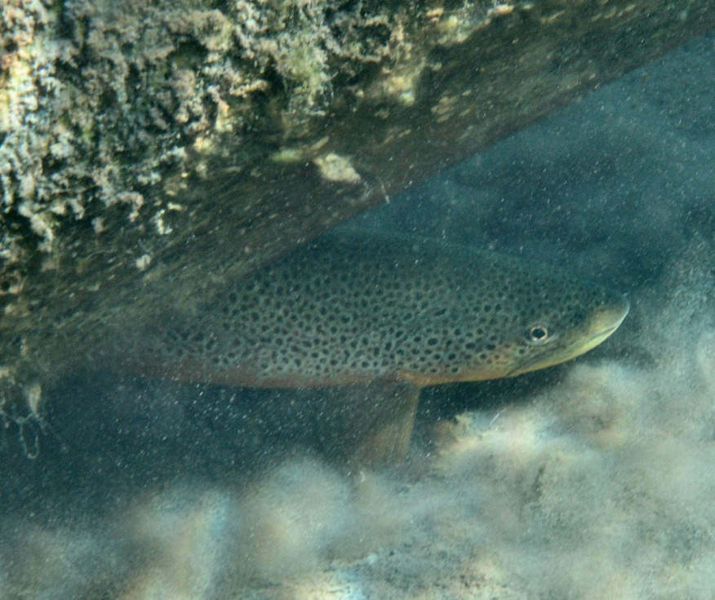
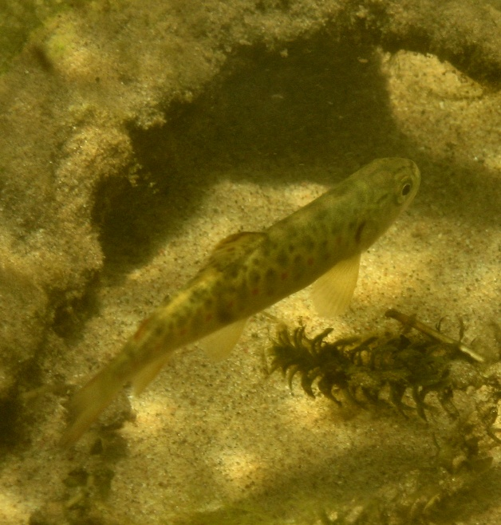

“Stock” & “Recruits” Definitions

Slide 6
Overall Concept
What do you expect this relationship to look like?
Recruits
Spawners or Stock

Slide 7
Overall Concept
What do you expect this relationship to look like?
Recruits / Spawner
Spawners or Stock

Slide 8
Density Dependence
S-R relationship is density-independent if recruits-per-spawner is constant for all numbers of spawners.
alt., number of recruits increases at a constant rate
S-R relationship is density-dependent if recruits-per-spawner decreases with increasing number of spawners.
alt., number of recruits does not increase at a constant rate

Slide 9
Density Dependence
Stock-recruit relationship is density-independent if the number of recruits-per-spawner is constant
Stock-recruit relationship is density-dependent if the number of recruits-per-spawner is decreasing
Recruits-per-Spawner
Spawning Stock
Notes:
S <- 0:1000
R.di <- 2*S
R.bh1 <- bh1(S,a=2,b=0.005)
R.r1 <- r1(S,a=2,b=0.004)
par(mar=c(3,3,1,1),mgp=c(1,0,0),cex.lab=1.5)
plot(R.di~S,type="l",lwd=4,ylim=c(0,1000),xlab="Spawning Stock",ylab="Recruits",xaxt="n",yaxt="n")
lines(R.bh1~S,type="l",lwd=4,col="red")
lines(R.r1~S,type="l",lwd=4,col="blue")

Slide 10
Density Dependence
Stock-recruit relationship is density-independent if the number of recruits increases at a constant rate with increasing number of spawners.
Stock-recruit relationship is density-dependent if the number of recruits does NOT increase at a constant rate with increasing number of spawners.
Recruits
Spawning Stock
Notes:
S <- 0:1000
R.di <- 2*S
R.bh1 <- bh1(S,a=2,b=0.005)
R.r1 <- r1(S,a=2,b=0.004)
par(mar=c(3,3,1,1),mgp=c(1,0,0),cex.lab=1.5)
plot(R.di~S,type="l",lwd=4,ylim=c(0,1000),xlab="Spawning Stock",ylab="Recruits",xaxt="n",yaxt="n")
lines(R.bh1~S,type="l",lwd=4,col="red")
lines(R.r1~S,type="l",lwd=4,col="blue")

Slide 11


Stock-Recruit Models
Density-Independent Model
Recruits
Recruits-per-Spawner
Spawning Stock
Spawning Stock

Slide 12
Stock-Recruit Models
Density-Independent Model
R/S is a constant of S
a is the “density independent” parameter
Units are “recruits per spawner”
Is this model realistic?

Slide 13

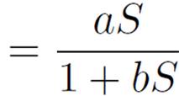
Stock-Recruit Models
Beverton-Holt Model
Recruits
Recruits-per-Spawner
Spawning Stock
Spawning Stock

Slide 14
Stock-Recruit Models
Beverton-Holt Model
a parameter has same meaning
b is “density-dependent” parameter
What happens if b=0?
Peak recruitment (R_{p}) is at asymptote
R_{p} equals a/b
What does “more density dependence” do to R_{p}?
What does “more density independence” do to R_{p}?

Slide 15
Stock-Recruit Models
Beverton-Holt Model
Model basis
juvenile competition results in a mortality rate that is linearly dependent upon the number of fish alive in the cohort at any time
predators are always present
Appropriate “if there is a maximum abundance imposed by food availability or space, or if the predator can adjust its predatory activity immediately to changes in prey abundance" (Wootton 1990, p. 264).

Slide 16


Stock-Recruit Models
Ricker Model
Recruits
Recruits-per-Spawner
Spawning Stock
Spawning Stock

Slide 17
Stock-Recruit Models
Ricker Model
a, b parameters have same meaning
What happens if b=0?
Peak recruitment (R_{p}) is a/be, occurs at S_{p}=1/b
What does “more density dependence” do to R_{p}? S_{p}?
What does “more density independence” do to R_{p}? S_{p}?

Slide 18
Stock-Recruit Models
Ricker Model
Model based on mortality rate of the eggs and juveniles is proportional to the initial cohort size.
cannibalism of the juveniles by the adults
disease transmission
damage by adults of one another’s spawning sites (e.g., redd superimposition)
density-dependent growth coupled with size-dependent predation (e.g., increase in the time it takes for the young fish to grow through a size range vulnerable to predation)
a time-lag in the response of a predator or parasite to the abundance of the fish

Slide 19
Stock-Recruit Models
Explore model parameters with srSim().
Explore dynamics with srCobWeb().
Follow examples in ?srCobWeb

Slide 20
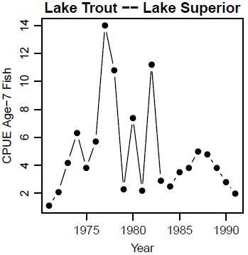
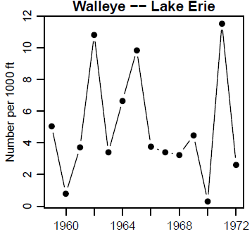
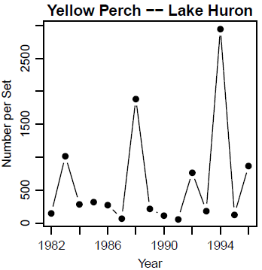
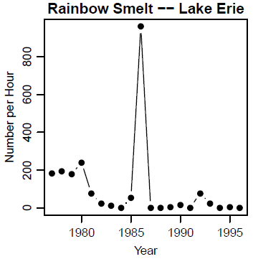
Recruitment Variability -- Annual

Slide 21
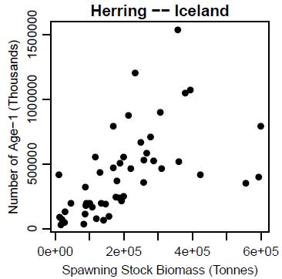
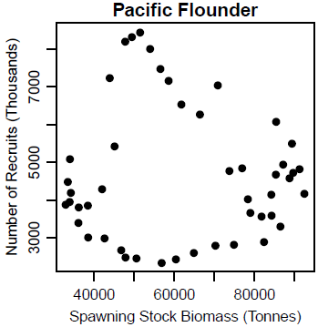
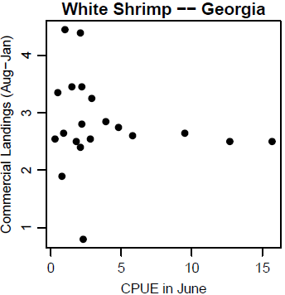
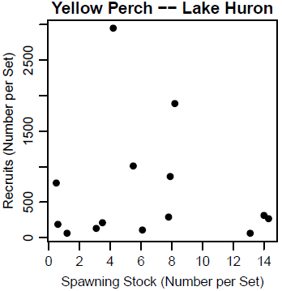
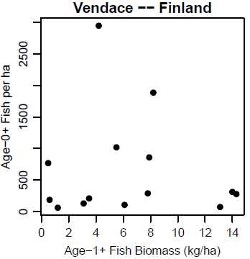
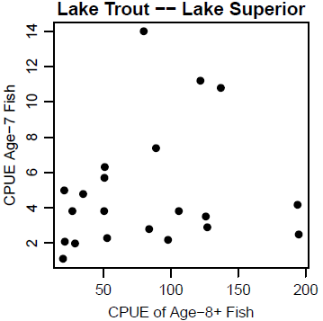
Recruitment Variability – S-R Model

Slide 22
Recruitment Variability
Empirical relationships between spawning stock and recruitment show extreme annual variability – Quinn II and Deriso (1999, p. 86)
Much ingenuity has been spent in fitting these curves to data sets and to developing the basic models. All this effort has largely foundered in the face of the variability in the relationships between stock and recruitment shown by most natural populations. The curves can be fitted, but it takes an act of faith to take the resulting curves seriously – Wootton (1990, p. 264)
Analysis of stock-recruitment data provides an enormous number of traps for the unwary – good luck – Hilborn and Waters (1992)

Slide 23
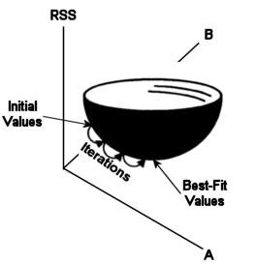
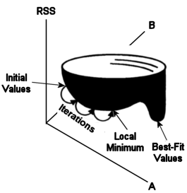
Fitting Stock-Recruit Models
The models are non-linear
can NOT be made linear
Must use non-linear regression
iterative process from starting values “downhill” to optimum solution

Slide 24
Fitting Stock-Recruit Models
CIs from normal theory are NOT reliable.
Use bootstrapping.
treat sample as if the population.
sample individuals with replacement.
compute parameter estimates.
repeat last two steps.
95% bootstrap CI are the values with 95% of parameter estimates between them.

Slide 25
Stock-Recruit Models in R
Examine handout
srModels()
srFuns()
srStarts()
nls()
overview()
nlsboot()
confint()

Slide 26
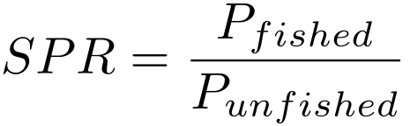
Spawning Potential Ratio (SPR)
Number of lifetime eggs produced by an average recruit when fished divided by the number of lifetime eggs produced by an average recruit when unfished.
Compares the spawning ability of a fished stock to the spawning ability of the unfished stock.

Slide 27
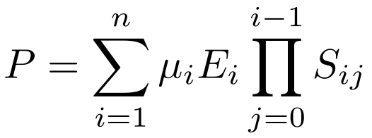
Spawning Potential Ratio (SPR)
Proportion mature
Mean fecundity
Survival to age i
Examine Excel spreadsheet

Slide 28
Spawning Potential Ratio (SPR)
Use in management
Principle: enough fish have to survive to spawn and replenish the stock.
Benchmark: not well-defined for most species
Marine pelagic -- >20% (Goodyear 1993)
Marine pelagic -- >30% (Mace & Sissenwine 1993)
Channel catfish -- >10% (Slipke et al. 2002)
Shovelnose sturgeon -- >40-50% (Quist et al. 2002)
Examine Excel Spreadsheet

