Slide 1
Size Structure Dynamics
Recruitment
Natural Mortality
Population
Biomass
Fishing Mortality
Immigration
Emigration
Growth

Slide 2
Size Structure Methods
Length frequencies
Proportional Size Distribution (PSD)
was “Proportional Stock Density”
Proportional Size Distribution (PSD-X)
was “Relative Stock Density”

Slide 3
Length Frequency
Use “common” breaks depending on fish size and sample size
2, 5, 10, or 25 mm
0.1, 0.25,0.5,or 1 in

Slide 4
Size Structure Concept
Recruitment controls … numbers in smaller length bins.
Growth controls … fish “moving” into larger length bins.
Fishing mortality controls … fish removal from larger length bins.
Natural Mortality
Natural mortality controls …
fish removal from smaller length bins
and, without compensatory mortality, larger length bins.
Natural Mortality
Thus, size structure analysis provides insight on many aspects of population dynamics!
Frequency
Recruitment
Growth
Fishing Mortality
5
10
15
20
25
Length

Slide 5
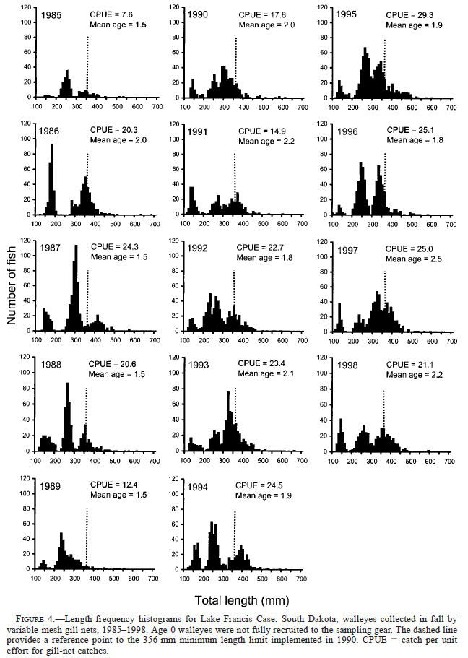
Length Frequency -- Example
From Stone and Lott. 2002. North American Journal of Fisheries Management 22:975–984

Slide 6
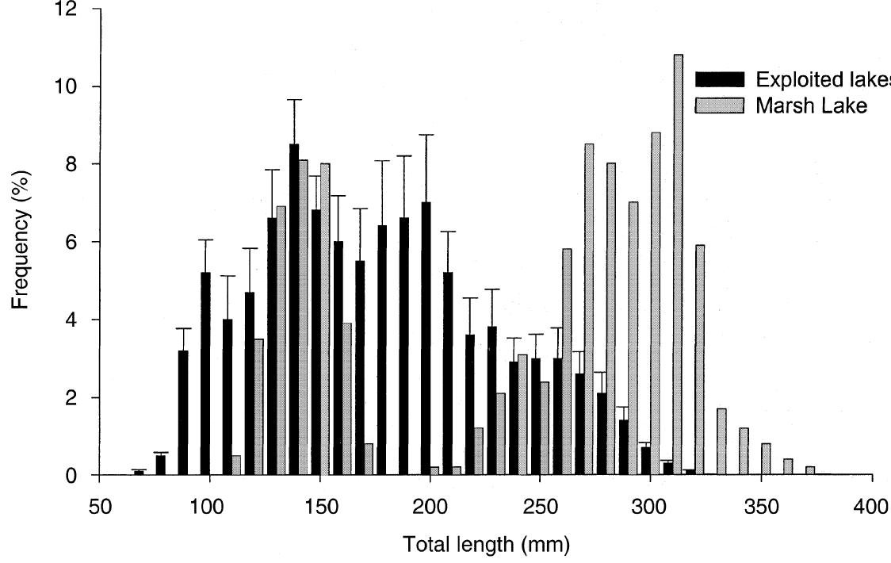
Length Frequency -- Example
From Paukert and Willis. 2001. Fisheries Management and Ecology 8:533-542

Slide 7
Length Frequency in R
Examine Handout
hist()
Summarize()
ksTest()
Whittlesey Creek Case Study

Slide 8
Why fewer 6” than 10” fish?
Size structure summaries are heavily influenced by the relative selectivity of the gear used.
Frequency
5
10
15
20
25
Length

Slide 9
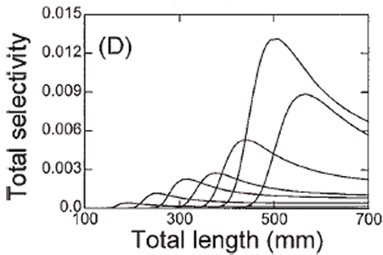
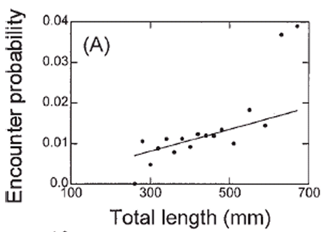
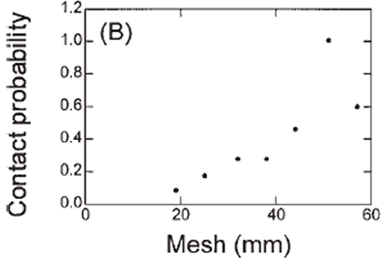
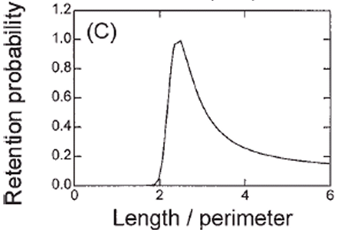
Gillnet -- Selectivity
Total selectivity is related to three parts of catch process
encounter
contact
retention
from Anderson, C.S. 1998. Partitioning total size selectivity of gill nets for walleye (Stizostedion vitreum) into encounter, contact, and retention components. Can. J. Fish. Aquat. Sci. 55: 1854–1863.

Slide 10
Case Study
Size Structure Gear Bias Case Study

Slide 11
Size Structure Methods
Length frequencies
Proportional Size Distribution (PSD)
Proportional Size Distribution (PSD-X)

Slide 12
Proportional Size Distribution (PSD)
Stock length
mature length; fully vulnerable length; or minimum size acceptable to anglers.
Quality length
minimum size anglers like to harvest.

Slide 13
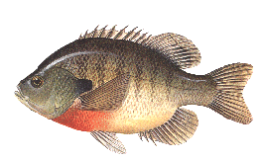
PSD
Stock
(37)
Quality
(17)
Preferred
(5)
17
PSD =
= 0.46
37
5
PSD-PQ =
= 0.29
17

Slide 14
PSD

Slide 15
PSD
Quality
253
Stock
= 0.327
100
773
80
60
Number of LMB
40
20
0
8
12
5
10
15
20
Total Length (inches)

Slide 16
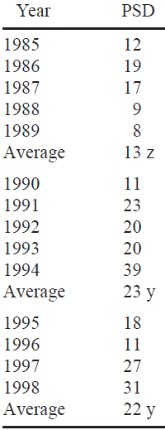
PSD -- Example
From Stone and Lott. 2002. North American Journal of Fisheries Management 22:975–984

Slide 17
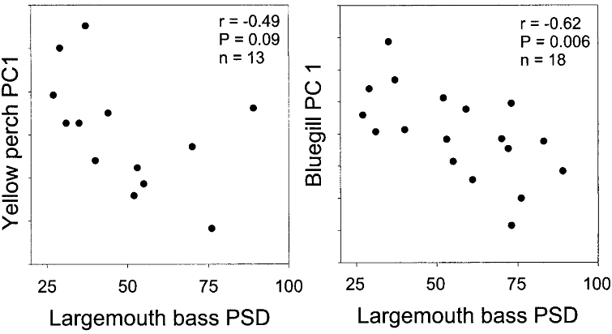

PSD -- Example
From Paukert et al. 2002. North American Journal of Fisheries Management 22:86–95.

Slide 18
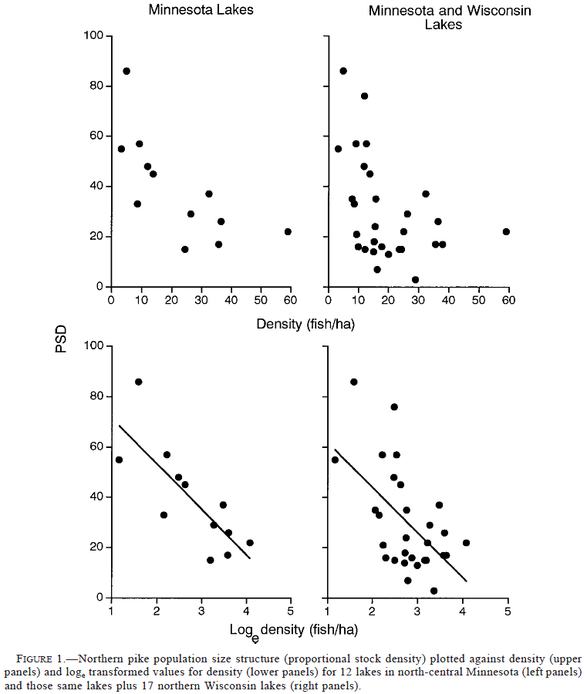
PSD -- Example
From Pierce et al. 2003. North American Journal of Fisheries Management 23:331–339.

Slide 19
PSD in R
Examine Handout
rsdVal()
lencat()
table()
rcumsum()
binCI()

Slide 20
Size Structure Methods
Length frequencies
Proportional Size Distribution (PSD)
Proportional Size Distribution (PSD-X)

Slide 21
Size Structure – Summary Measure
Proportional Size Distribution (PSD):
Examples
PSD-P → numerator is “preferred” fish.
PSD-15 → numerator is >15 fish.

Slide 22
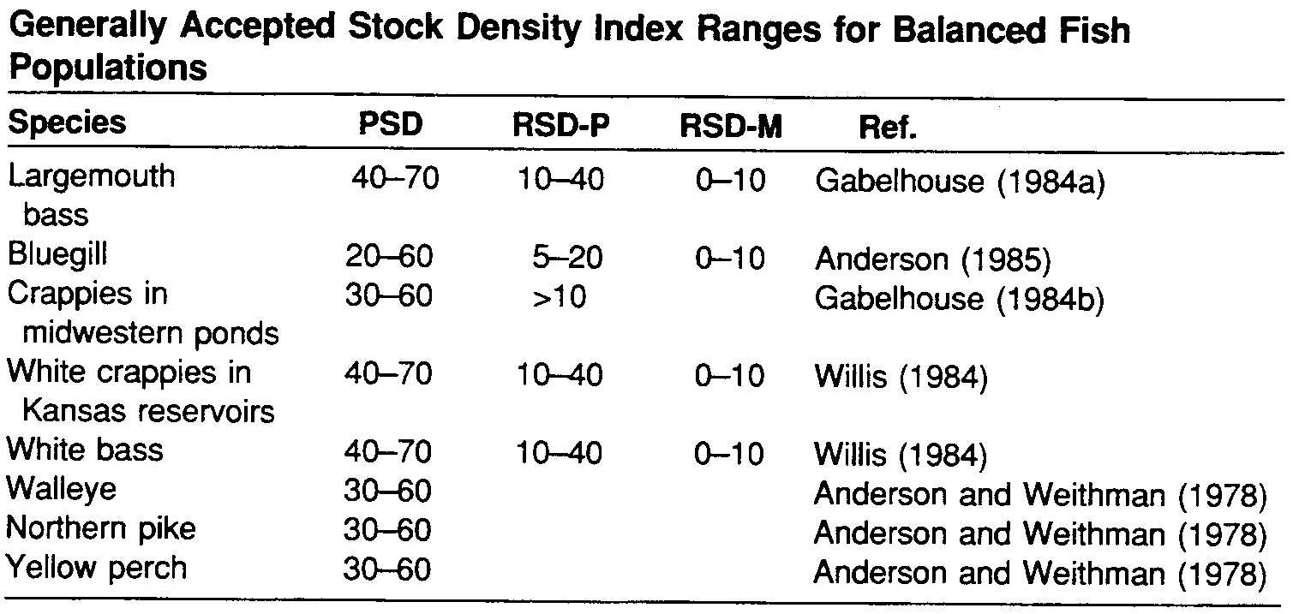
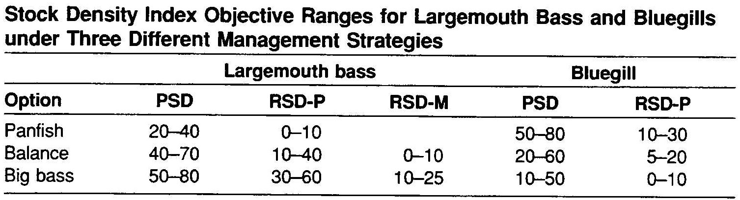
PSD – Interpretation
Many authors suggest that values of 40-60 or 30-70 represent “balanced” populations.
May depend on management goals.

Slide 23
Size Structure – Interpretation
To strengthen conclusions of PSD analysis:
Evaluate condition, growth, and mortality of target species and other species.
Determine if PSD, condition, growth, and mortality of all species are consistent with a single interpretation.
Evaluate PSD of other prey or predator species in the fish community.

Slide 24
Size Structure – Interpreting PSD
100
80
60
(lmb,bg)
Prey PSD
40
20
(wae,yep)
0
0
20
40
60
80
100
Predator PSD

Slide 25
PSD in R
Examine Handout
tictactoe()
tictactoeAdd()

