Slide 1
Body Condition
Recruitment
Natural Mortality
Population
Biomass
Fishing Mortality
Immigration
Emigration
Growth

Slide 2
Body Condition
A measure of relative “plumpness”
How much does the fish weigh relative to some standard weight based on its length
A measure of physical health of ….
Individuals -- Energy densities, lipid content
Stocks -- Favorable habitat conditions, ample prey supply

Slide 3
Condition Metrics
How much does the fish weigh relative to some standard weight based on its length?
Differ in how standard weight is computed
Cubic of observed length (L³)
Fulton’s condition factor (K)
Predicted weight from observed length using length-weight relationship for studied stock
LeCren’s relative condition factor (Kn)
Predicted 75th percentile of mean weights from many populations given observed length
Relative weight (Wr)

Slide 4
Standard Weights
Predicted 75th percentile of mean weights from many populations given observed length
4.0
Walleye Ws equation
3.5
3.0
log10(Weight (g))
2.5
2.0
1.5
1.0
2.2
2.4
2.6
2.8
3.0
log10(Length (mm))

Slide 5
Relative Weights (Wr)
Generally accepted method of computing body condition
More accepted in N.A. than in Europe
Computed with

Slide 6
Wr Interpretation
Thus, Wr=100 if fish is at 75th percentile of mean weights for many stocks
If Wr < 100 then fish is less “plump” than an average fish of the same length from 75% of stocks.
If the mean Wr < 100 then fish in stock are less plump, on average, then an average fish from 75% of stocks.
i.e., less plump then an “above average” standard.
i.e., should not be surprised to see values < 100

Slide 7
Wr Interpretation
Wr has been developed to be unrelated to fish length.
Thus, Wr is most useful for comparing body condition among
Length classes
Years
Locations
Habitats
Management conditions/scenarios

Slide 8
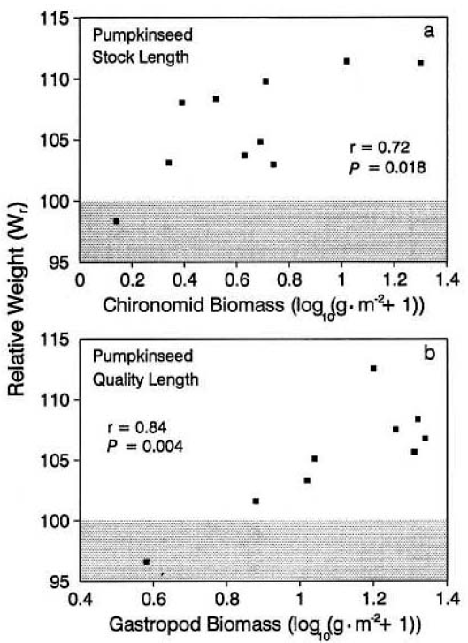
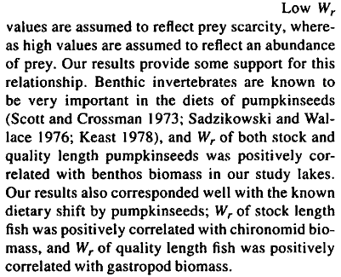
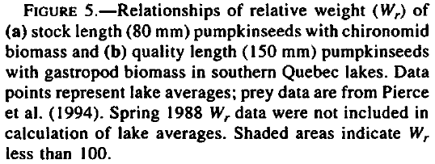
Wr Interpretation -- Example
From Liao et al. 1995. Transactions of the American Fisheries Society 124:387-400.

Slide 9
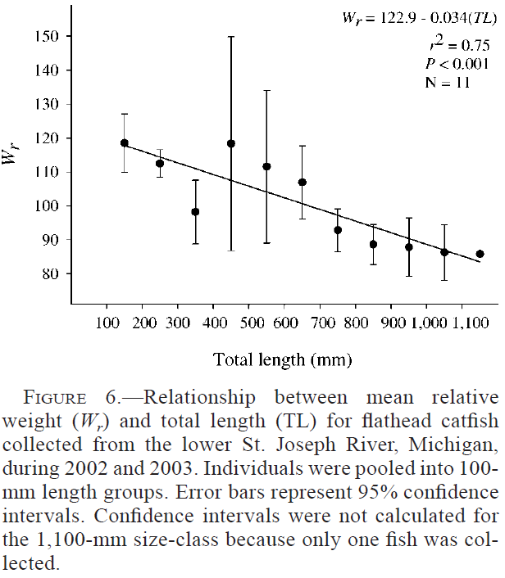
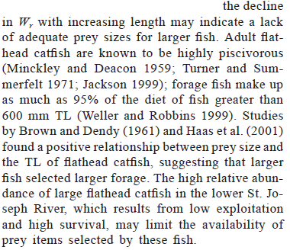
Wr Interpretation -- Example
From Daugherty and Sutton. 2005. North American Journal of Fisheries Management 25:1191–1201.

Slide 10
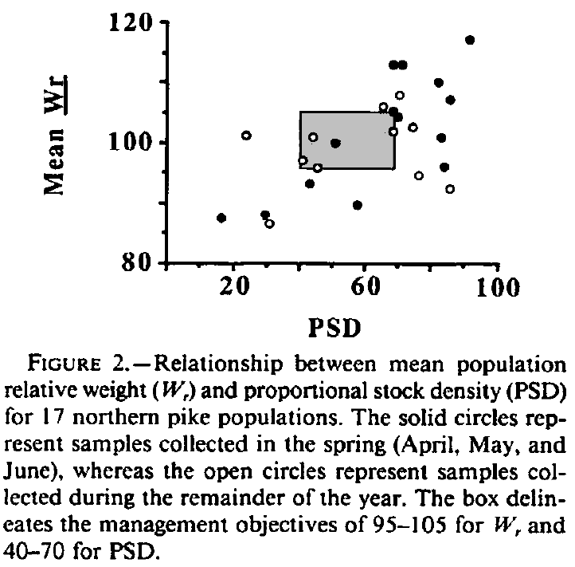
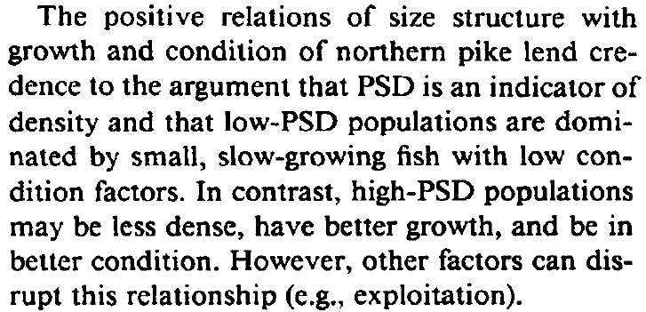
Wr Interpretation -- Example
From Willis and Scalet. 1989. North American Journal of Fisheries Management 9:488-492.

