Slide 1
Weight-Length Relationships
Recruitment
Natural Mortality
Population
Biomass
Fishing Mortality
Immigration
Emigration
Growth

Slide 2
Length-Weight Data
Basis of most condition metrics.
Common to weigh only a subsample of fish.
Develop a length-weight relationship model.
Nonlinear
Heteroscedastic
Power function
Multiplicative errors

Slide 3
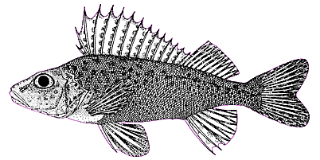
Length-Weight Model
If b=3 then fish growth is isometric
i.e., all dimensions change similarly over time
i.e., shape of fish does not change over time

Slide 4


Length-Weight Model
if b≠3 then fish growth is allometric
if b<3 then fish gets more fusiform with time
if b>3 then fish gets more plump with time

Slide 5
Length-Weight Model
Examine natural log of
Linear
Homoscedastic

