Slide 1
Abundance Estimates
Recruitment
Natural Mortality
Population
Numbers
Fishing Mortality
Immigration
Emigration

Slide 2
Common Abundance Estimates
CPE/CPUE (relative density)
Depletion/Removal (estimate of N₀)
Mark-Recapture (estimate of N₀)

Slide 3
Mark-Recapture Methods
Marking/Tagging
Batch
Cheaper, but has limitations
Individual
Expensive, but also allows estimates of mortality / survival, recruitment, movement
Recapture information recorded in “capture history” format.

Slide 4
Concept – Single-Census M/R
i=1
i=2
First sample is called the “marking run”
Second sample is called the “recapture run”

Slide 5
Parameter / Statistics Definitions
N = population size
M = number marked in popn
n = recapture sample size
m = number marked in recapture sample
m=7
n=19
M=16
N=50
i=1
N=50
i=2

Slide 6
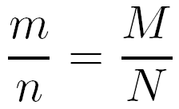
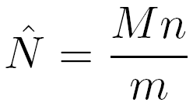
Estimation Concept
Central concept ...
… which is immediately rewritten as
Explore with mrClosed1Sim()
Use defaults, re-randomize several times

Slide 7
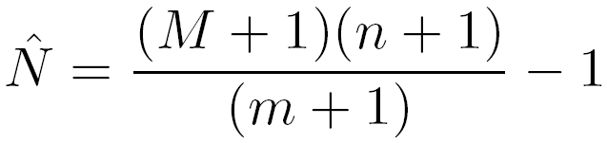
Chapman Modification
Chapman modified the Petersen method
Bias is negligible if m>7
Explore with mrClosed1Sim(type=“C”)
Use defaults, re-randomize several times

Slide 8
Estimation Example
Hand Calculation
Examine handout
mrClosed()
summary()
confint()
n=19
m=7
M=16
N=50
i=1
N=50
i=2

Slide 9
Estimation Confidence Intervals
Seber (1982) suggests using …
… the binomial distribution of m/n > 0.10
… the normal approximation if m > 50
… the Poisson approximation otherwise

Slide 10
Assumptions – Petersen Methods
The population is closed.
no losses due to emigration or mortality.
no gains due to immigration or recruitment.
All fish have the same chance of being caught.
Tagging fish does not affect their catchability.
Fish do not lose their tags.
All tagged fish are observed/reported when recaptured.

Slide 11
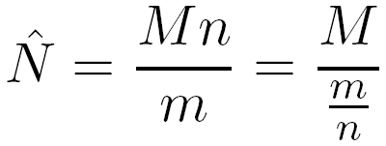
Assumptions – Effect of Violations
The Petersen estimate can be rewritten as
where the denominator can be thought of as the probability of capturing a marked fish.
If probability of capturing a marked fish is lower after the violation then N is overestimated.
If … higher … then N is underestimated.
Examine M/R Bias Simulation Case

Slide 12
Concept – Multiple-Census M/R
i=1
i=2
i=3

Slide 13
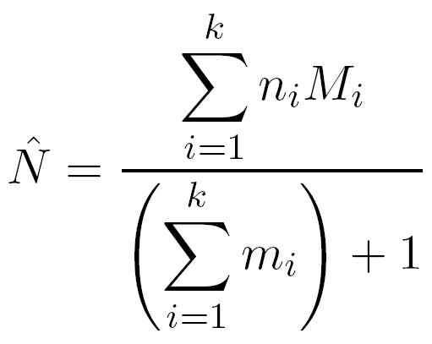
Schnabel Method (Chapman Modification)
Very similar to
Basically a weighted version of individual Petersen estimates

Slide 14
Capture History Format
A matrix
rows are individual fish
columns are capture events.
Each cell contains a …
“1” if the fish was captured
“0” if the fish was not captured (but was captured sometime)

Slide 15
Capture History – Example #1
Suppose that a researcher captured and individually marked 75 fish on day 1. Two days later, a total of 100 fish were captured of which 25 were marked.
How many columns in the capture history matrix?
How many rows in the capture history matrix?
What does a row look like for …
… a fish captured in both samples?
… a fish captured in the first but not the second?
… a fish captured in the second but not the first?
… a fish captured in neither sample?

Slide 16
Capture History – Example #2
A researcher samples a stream weekly for 8 weeks. What is the capture history row for a fish …
marked in week 2 and re-captured in weeks 7 & 8?
marked in week 3 and then not seen again?
marked in the first week, captured again in week 3, and captured again in week 5 but not again?

Slide 17
Capture History – Example #3
Suppose the following summary of capture histories.
CH 001 010 011 100 101 110 111
Fish 17 20 4 19 5 8 2
How many capture events? Captured fish?
How many fish captured in first sample and then not seen again?
How many fish captured in first sample and seen again?
How many fish were captured twice?
How many fish were never captured?

Slide 18
Capture History
Examine HO
capHistSum()
mrClosed()
summary()
confint()
plot()

