Slide 1
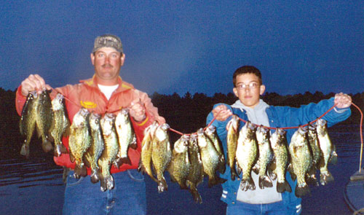
Effects of Bag Limit Reductions on Angler Harvest

Slide 2
Minnesota Lakes
Creel surveys, 1980-1996
Data
Species (WAE, NOP, LMB, YEP, sunfish, crappies)
Number harvested (daily) by individuals
Bag limits during study
WAE and LMB – 6
NOP – 3
Crappies – 15
Sunfish – 30
YEP – 100

Slide 3

Group Think
What would you expect harvest frequency to look like (suppose 10 bag limit), if …
“summer fishery” where fish are dispersed and relatively difficult to catch.
“winter fishery” where fish are more congregated and relatively easy to catch.
How much bag limit reduction would you expect would be needed to reduce harvest by 50%?
e.g., a 20% reduction in the bag limit would be from 10 to 8 or 5 to 4 fish.

Slide 4
Results
Notes:
Print this and next five as handouts (2 slides per person – WAE/YEP, LMB/BG, NOP/BKC)

Slide 5
Results

Slide 6
Results

Slide 7
Results

Slide 8
Results

Slide 9
Results

Slide 10
Group Analysis
For your two species …
Describe the harvest patterns by anglers.
What % of anglers would be affected if bag limits were reduced to …
3 for WAE & LMB, and 2 for NOP
12 for sunfish, 5 for crappies, and 50 for YEP
What % of fish would be “saved from harvest” under the same bag limit reductions?
What bag limit is required to reduce harvest by >50%?

Slide 11
Group Think
How does/will the shape of the harvest frequency plot affect your findings?
What assumptions did you make in this analysis?
Are these assumptions likely to be true?
Take-home messages about bag limits?

