Slide 1
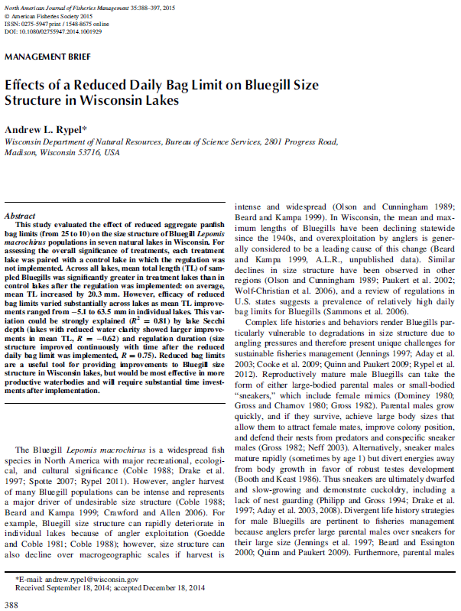
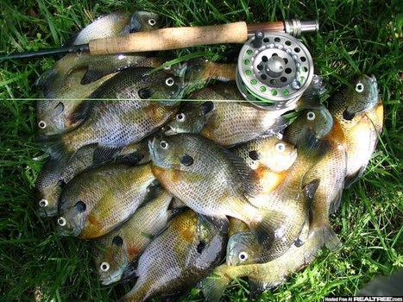
Rypel (2015) Bluegill Bag Limit Wisconsin

Slide 2
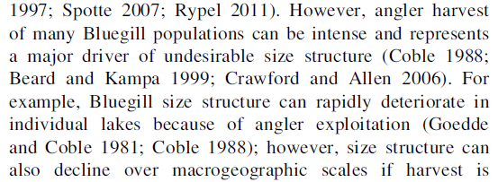
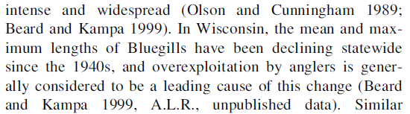
What has a major impact on BLG size structure?

Slide 3
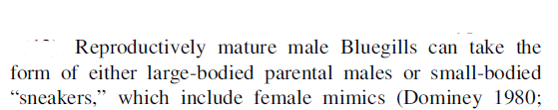
Two major life history strategies for male BLG? Impact on management?

Slide 4
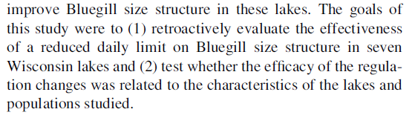
Objectives?

Slide 5
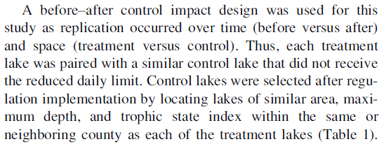
What is a BACI design?

Slide 6
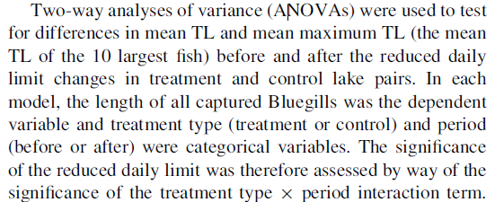
Why the focus on the interaction term in the two-way ANOVA?

Slide 7
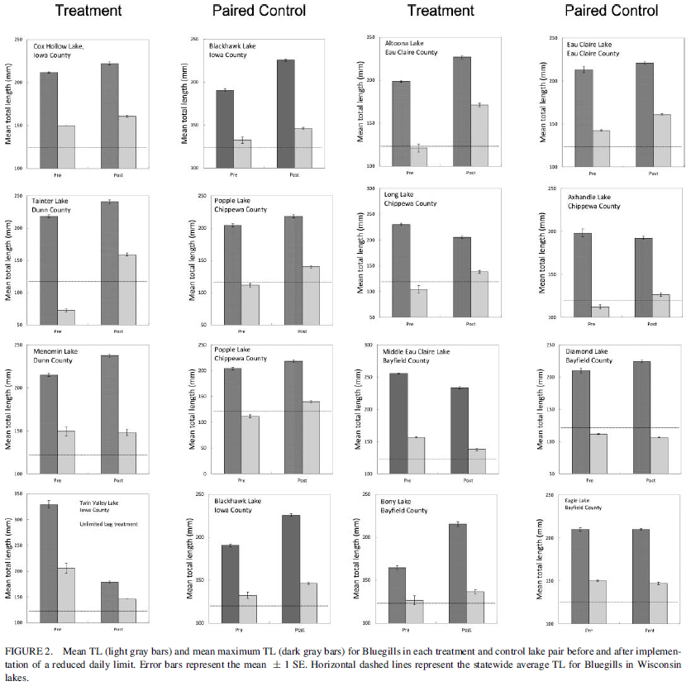
Results?

Slide 8
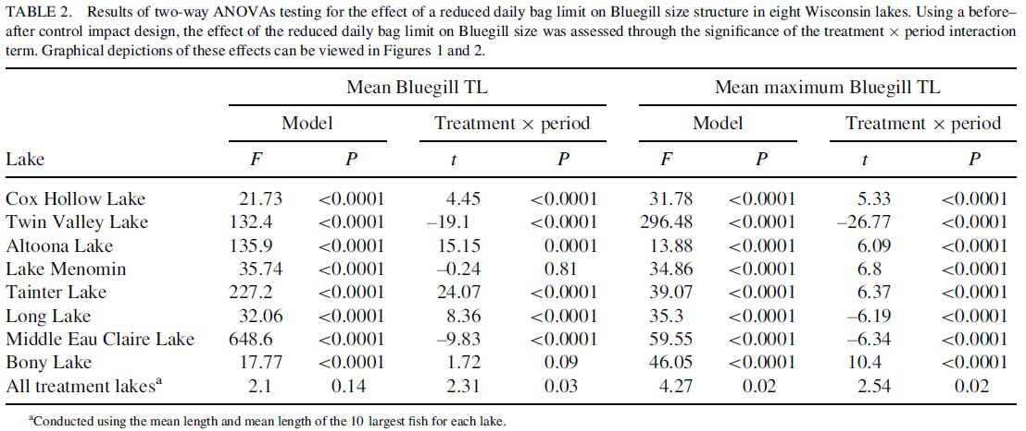
Results?

Slide 9
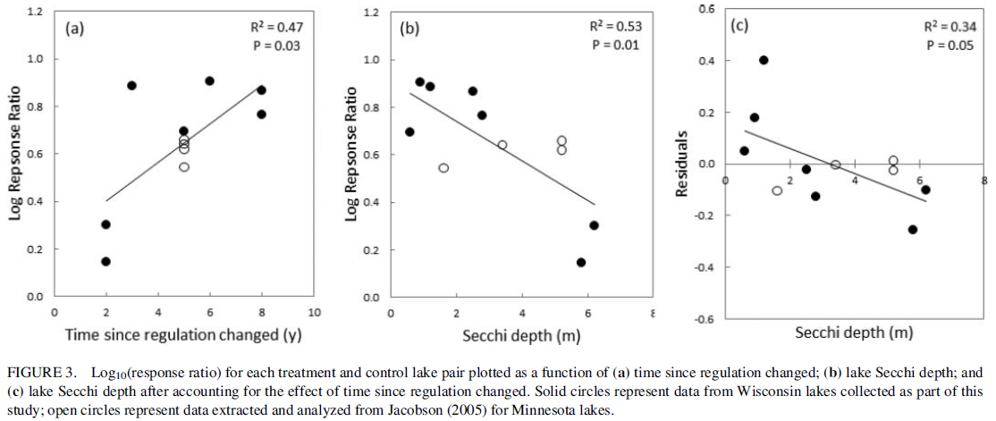
Results?

Slide 10
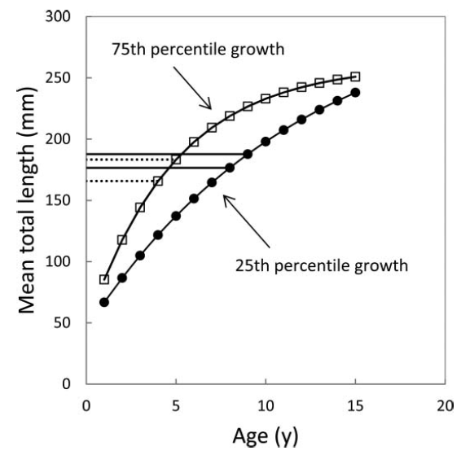
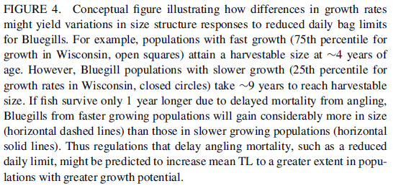
Discussion?

Slide 11
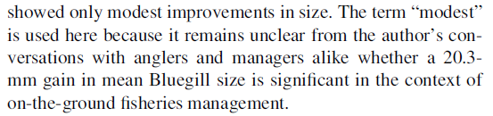
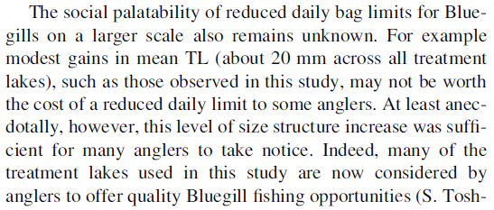
Is 20 mm increase in mean length “important”?

Slide 12
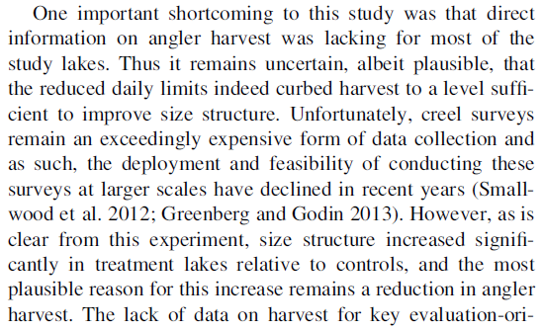
Shortcomings?

Slide 13
Conclusions
What are take home messages?
Reduced bag limit provide some improvement in BLG size structure.
More productive waters (that favor faster growth rates) will show greater improvement in size structure.
It takes time.

