Slide 1
Estimation of Mortality
Recruitment
Natural Mortality
Population
Numbers
Fishing Mortality
Immigration
Emigration

Slide 2
Catch Curve Characteristics
4.0
3.5
3.0
2.5
log(CPE)
2.0
-Z
1.5
1
1.0
-Z
0.5
Asc
Dome
Descending
1
0
2
4
6
8
10
Age / Time
Fit regression of log(CPE) on age only for ages on descending limb.

Slide 3
Catch Curve Assumptions
Population closed to immigration and emigration.
Z is constant.
q is constant
“Sample” is unbiased regarding any age-group (i.e., be careful of selective gears)
Accurate ages
Follow a cohort (if longitudinal CC used)
Recruitment on descending limb is constant (if cross-sectional CC used)

Slide 5
Components of Z
Recruitment
Natural Mortality
Population
Numbers
Fishing Mortality
Immigration
Emigration

Slide 6
Definitions
Instantaneous Models
F = instantaneous fishing mortality
M = instantaneous natural mortality
Z = F + M

Slide 7
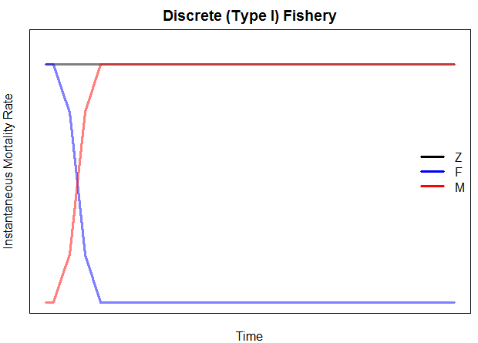
Definitions
Discrete (Type I) Fishery
F and M operate separately (different times)
Realistic for a highly seasonal fishery

Slide 8
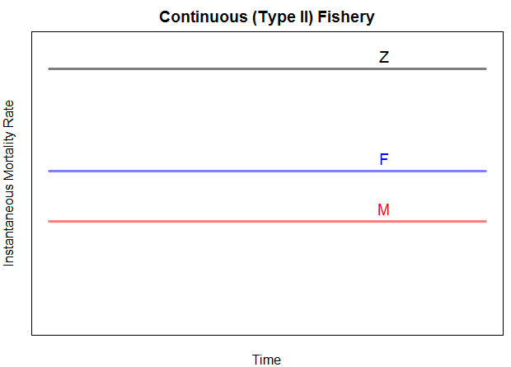
Definitions
Continuous (Type II) Fishery
F and M operate at same time
We will assume constant F & M through year

Slide 9
Definitions
Discrete (Annual) Models
u = annual exploitation rate
expectation of death due to fishing
proportion of population that dies due to fishing
v = annual natural mortality rate
m = annual conditional fishing mortality rate
expectation of death due to fishing IF no other source of mortality existed
proportion of population that dies due to fishing IF no other source of mortality existed
n = annual conditional natural mortality rate

Slide 10
Definitions
A = m + n – mn
mn is that some fish that died from one cause may have ultimately died of the other cause
Discrete (Type I) Fishery
mn=0 …. A = m + n = u + v
Continuous (Type II) Fishery
A ≠ u + v
Thus, most work on instantaneous scale

Slide 11
Mortality Components
As a manager, which of natural or fishing mortality can you control and, thus, want to know?
Controlling F, u, m is a major goal of most fisheries management strategies.
Very difficult to estimate precisely

Slide 12
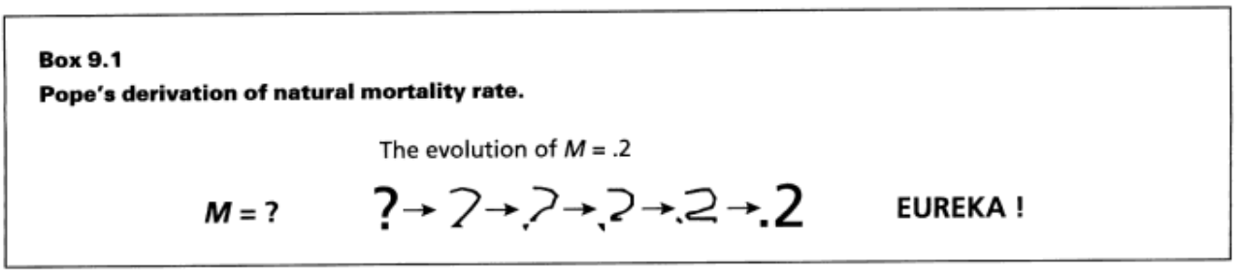
Estimating M
Assume a constant value for M
Typically use M=0.2
Is this realistic?
Notes:
Realistic? Varies by age, bathtub model

Slide 13
Estimating M
Assume a constant value for M
Relationship of M to life history traits
See page 217 in IFAR

Slide 14
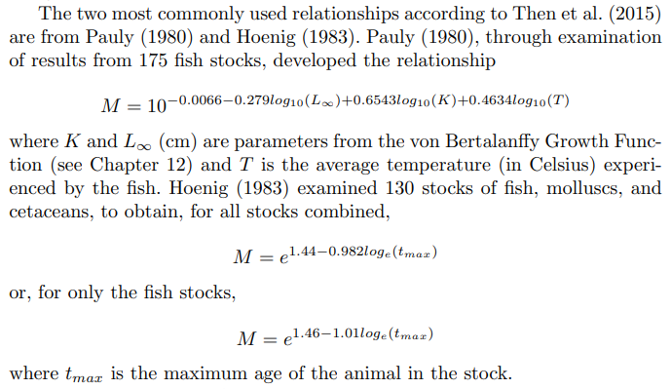
Estimating M

Slide 15
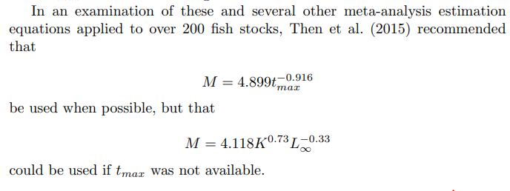
Estimating M

Slide 16
Estimating M
Assume a constant value for M
Relationship of M to life history traits
From f and Z
Recall that Z = F+M and F=qf
Thus, Z = qf+M
If Z is estimated at different f, then …
M is the intercept from the Z on f regression.
Same as asking what is Z when f = 0.
Notes:
Draw the graphic

Slide 17
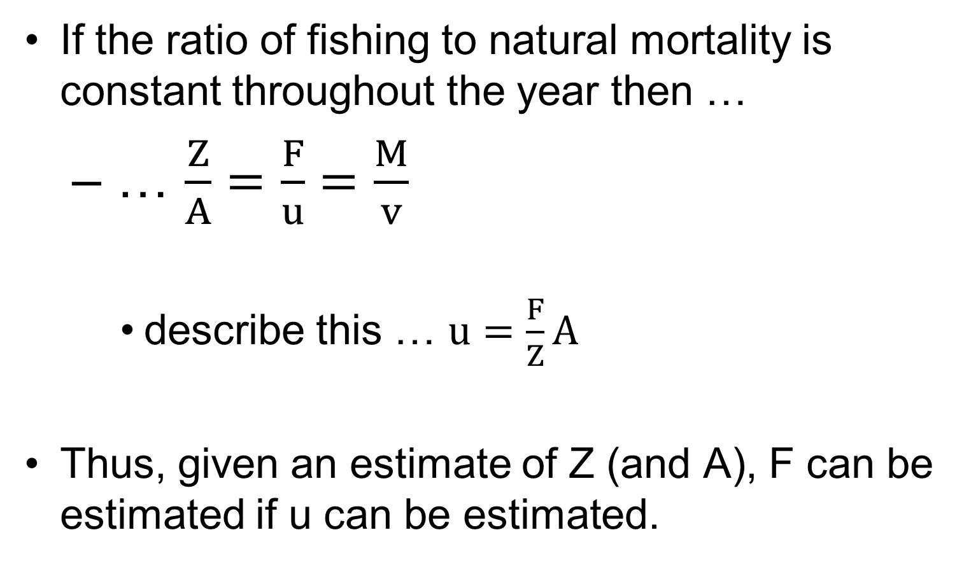
Estimating F from Expoitation Rate
If the ratio of fishing to natural mortality is constant throughout the year then …
… $\frac{Z}{A}=\frac{F}{u}=\frac{M}{v}$
describe this … $u=\frac{F}{Z}A$
Thus, given an estimate of Z (and A), F can be estimated if u can be estimated.

Slide 18
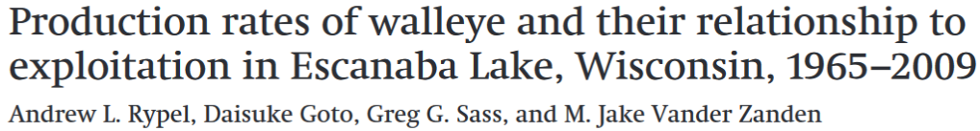
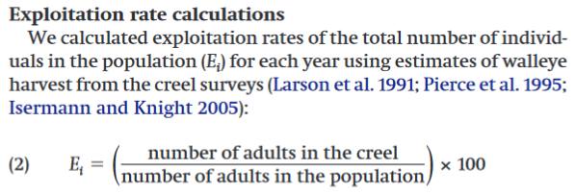
Estimating u
Divide annual harvest by estimate of N.

Slide 19
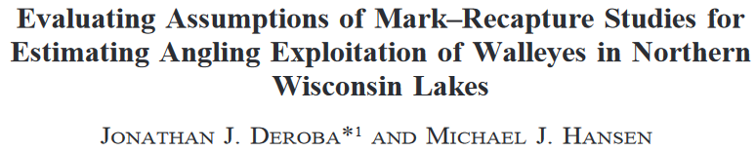
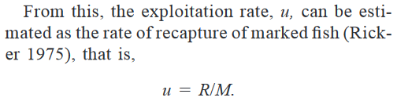
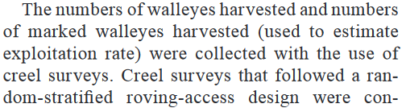
Estimating u
Divide harvested tagged fish by number of tagged fish released.

Slide 20
Estimating u
Divide annual harvest by estimate of N.
Divide harvested tagged fish by number of tagged fish released.
Recall that these estimates are only valid if ratios of fishing and natural mortality are constant throughout the year.

Slide 22



Estimating F with Marked Fish
Consider –
The number of fish caught is the proportion of dying fish due to fishing mortality
This proportion is F/Z
Therefore …
Consider --
Where the asterisks represent only marked fish

Slide 23
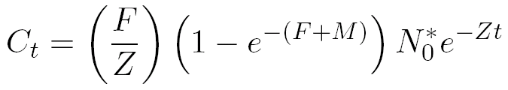
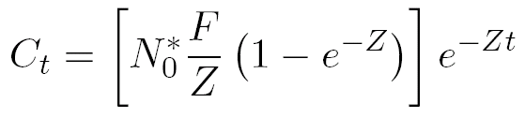
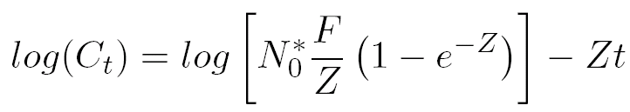
Estimating F with Marked Fish
Substitute N_{t}* equation into catch equation
and rearrange for simplicity
and take natural logs of both sides

Slide 24
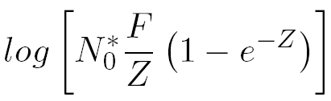
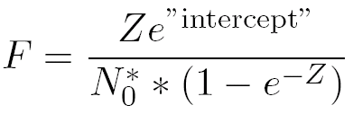
Estimating F with Marked Fish
Examine this model closely …
Slope is an estimate of –Z
Intercept is an estimate of …
Which can be solved for F

Slide 25
Example
400 fish were initially tagged
Tags were returned from the fishery over the next four years
Consider the time period to be the midpoints of the years.
Use these data to estimate Z & F (see HO).

